Slide 1
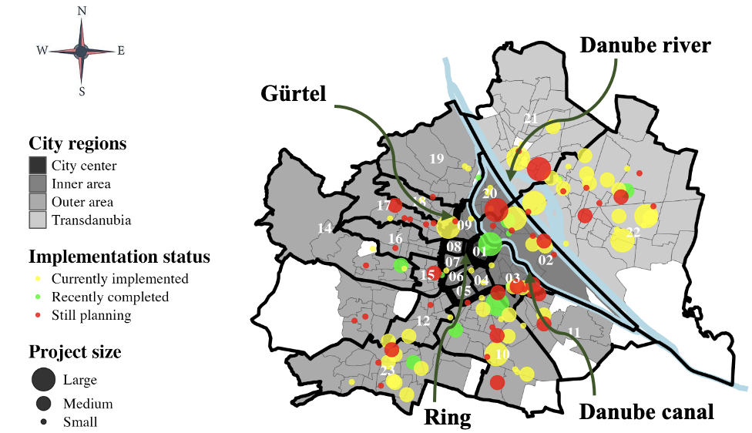

Slide 2
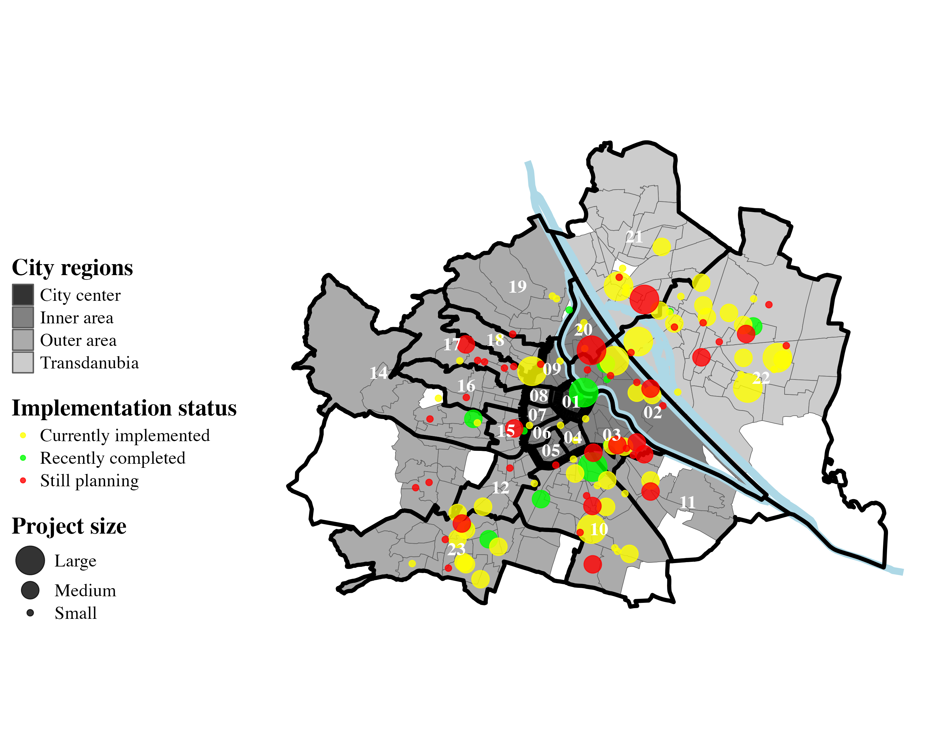
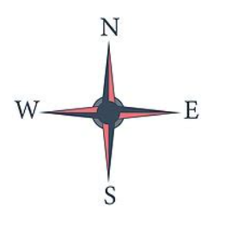
Danube river
Gürtel
Ring
Danube canal

Slide 3
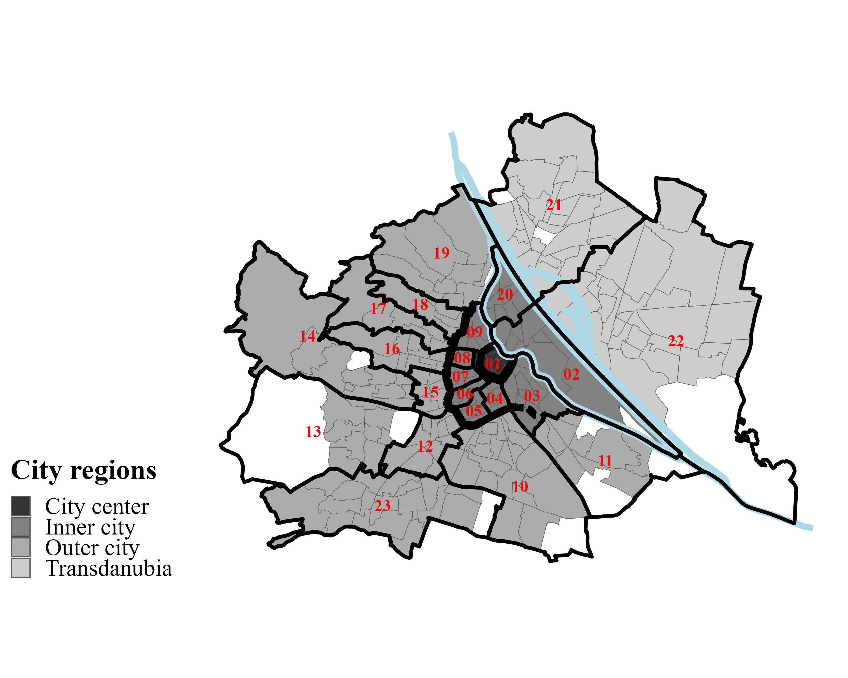
old version
Danube river
Gürtel
Danube canal
Ring

Slide 4
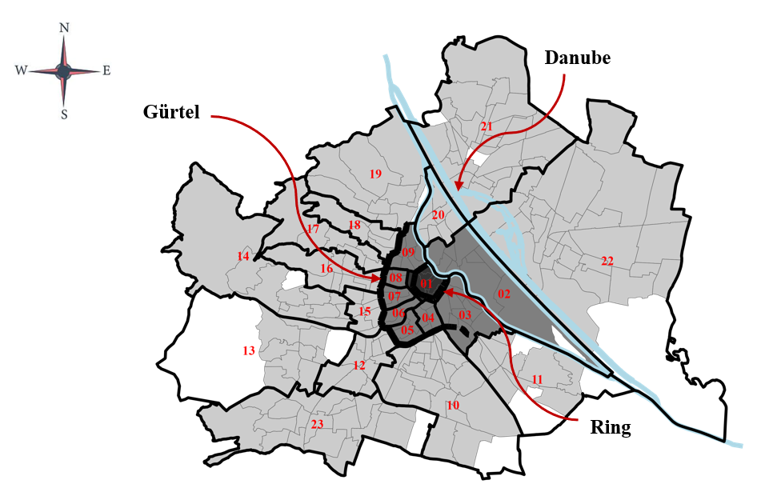
Oldest version

