Slide 1
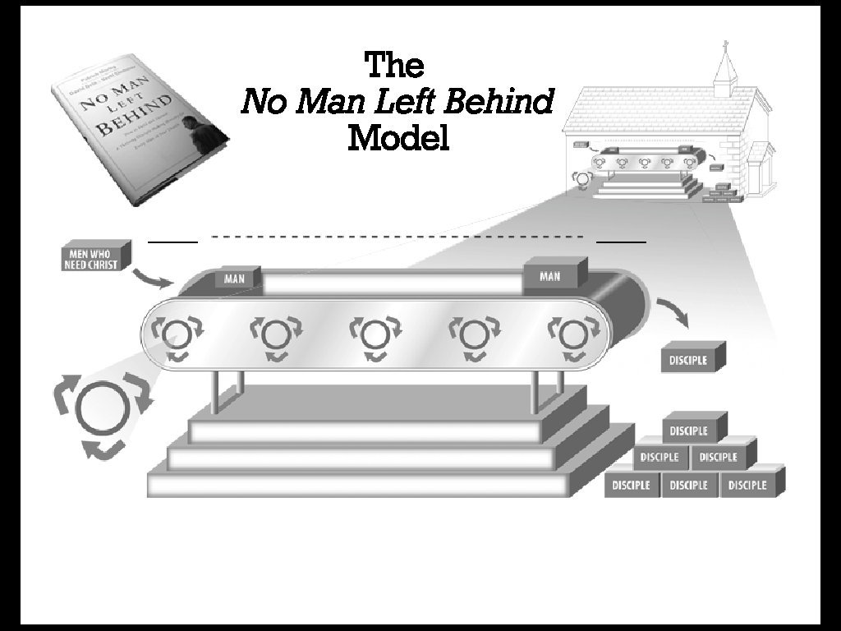
Filled all blue
© 2006 Man in the Mirror, Inc., Morley, Delk & Clemmer
Used by Permission

Slide 2
Filled all blue
← ← ← ← Hurting Men → → → →
Need Cultural Biblical Disciple
Christ Christian Christian Maker
WIDE
DEEP
3 Strands = Leadership
Man Code = Environment
Portal Priority = Discipleship
© 2006 Man in the Mirror, Inc., Morley, Delk & Clemmer
Used by Permission

Slide 3
Close Up
Create
Value
VISION
Make Disciples
Sustain
Change
Capture
Momentum
© 2006 Man in the Mirror, Inc., Morley, Delk & Clemmer
Used by Permission

Slide 4
Filled all blue
← ← ← ← Hurting Men → → → →
Need Cultural Biblical Disciple
Christ Christian Christian Maker
WIDE
DEEP
All Inclusive Ministry to Men
3 Strands = Leadership
Man Code = Environment
Portal Priority = Discipleship
© 2006 Man in the Mirror, Inc., Morley, Delk & Clemmer
Used by Permission

Slide 5


