Slide 1
Bentley Ottmann Sweep
For simple polygonal chains
- Toby Babu

Slide 2
Objective
Bentley-Ottmann sweep to DETECT if a polygonal chain C = (p1, p2, . . . , pn) is simple
Report a witness to the crossing if the chain is not simple.
Keep track of the largest size of the SLS
Programming Language Used: Python

Slide 3
Experiments
Number of Vertices | Time Taken (Sec)
20 | 0.00935
40 | 0.01608
60 | 0.01933
80 | 0.0227
120 | 0.045

Slide 4
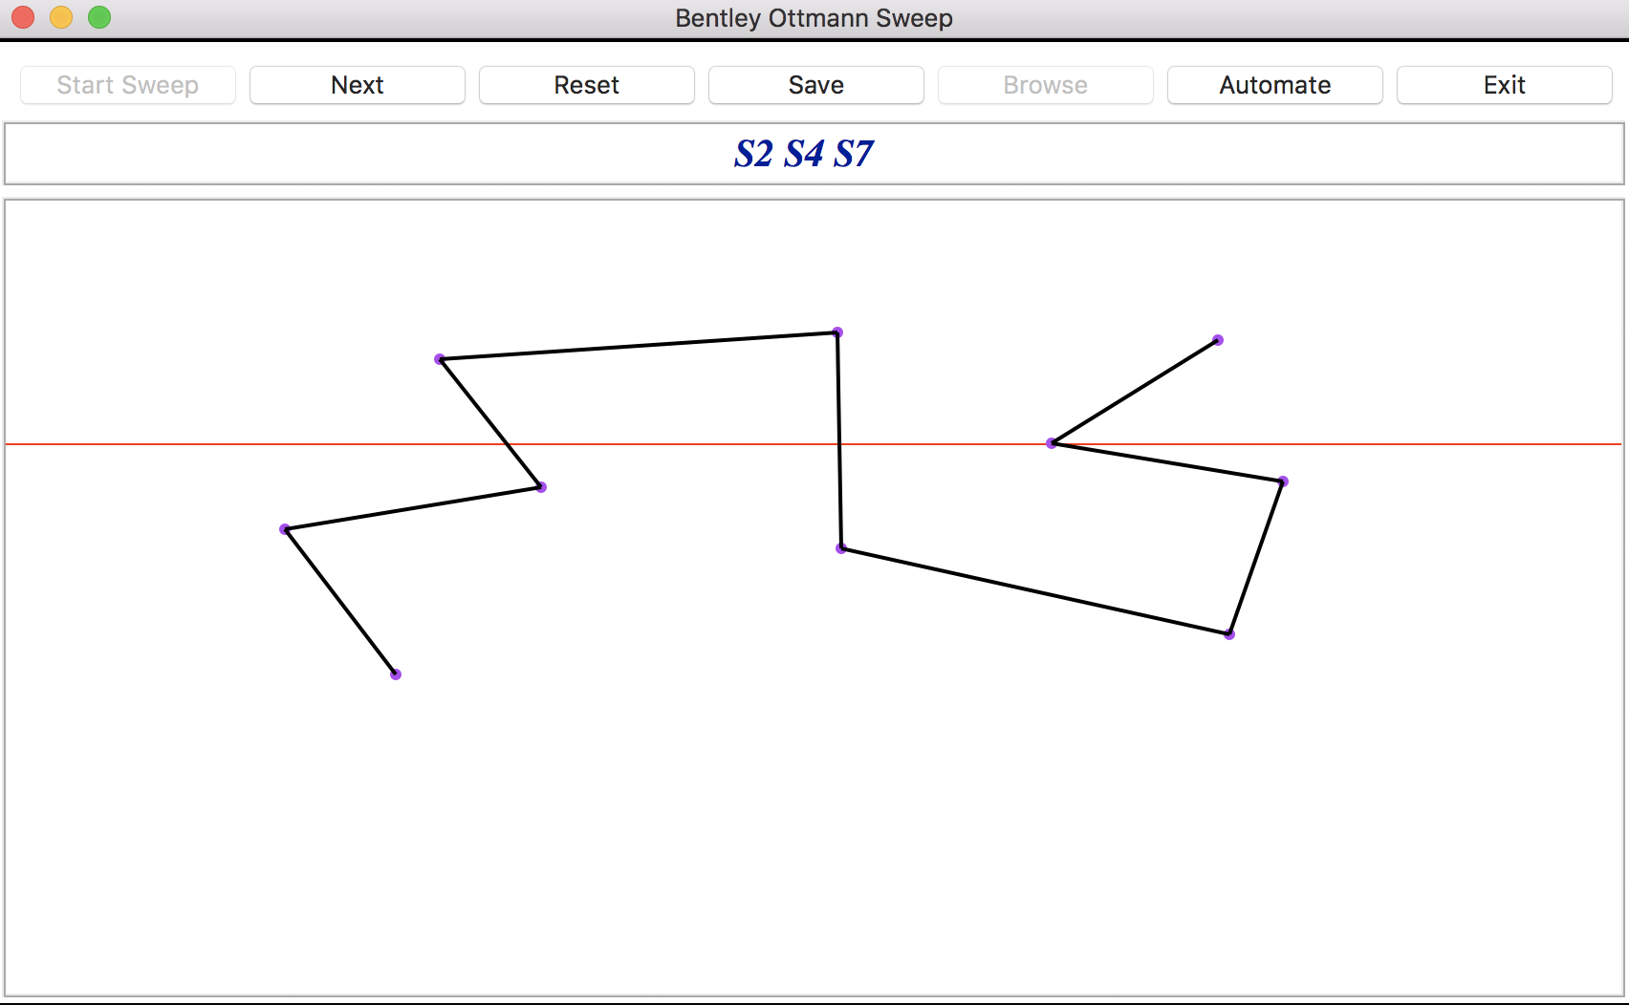

Slide 5
DEMO

