Slide 1

Wot No SQL?
An intro to non-relation databases.
(And a dodgy 80’s reference that really dates me)

Slide 2
What Is NoSQL - Long Story Short
A bunch of compromises, some of which might be of interest to us
No definite plans for NoSQL solutions here yet…

Slide 3
A Brief History Of Data
In the beginning there was the file
Well, sometime after memory offsets and tape locations other such primitive things…
Different apps would use the files in different ways
Problematic for sharing/security/maintenance…
Then there was chaos
Different types of data storage that fitted different needs & available technology
Navigational (Hierarchical/Network), Relational, Object
DBMS
Relational databases started to grow more popular
More usable than Navigational & doesn’t need OO language
Normalised data good for small disks, structure good for processing
Powerful backers & good marketing
SQL common(ish) across different implementations

Slide 4
What Is A Relational Database Anyway?
It’s all about relational mathematics
Relations (Tables) are sets of Tuples (Rows), which map attributes to atomic values {name: bob, DoB: 01/01/01} Available attributes are defined by a header tuple giving us Columns {name: string, DoB: date}
They’re not relational because tables relate to other tables via foreign keys.
Some NoSQL databases have links too.

Slide 5
Why Would We Want Something Else?
What is SQL good for?
Structured data, flexible querying
Mature technology & products
SQL Server tooling rocks; NoSQL, not so much
But then Oracle’s tooling sucks arse too.
What is it bad for?
Scale out rather than up
Huge volumes of transactions
Unstructured data
Object/Relational Impedence Mishmash

Slide 6
Hmmm, really? Go on.
SQL is packed with features that can slow things down where not needed
Ensuring integrity comes with a cost
Normalisation – it ain’t all that
Sometimes denormalised data may be more correct
No joins boosts performance at cost of storage
Enforcing data structure isn’t always possible
Performance benefits this gave are no longer relevant
Choose your own trade-offs
Performance / Durability
Ease of development
Server-side features

Slide 7





CAP Theorem
???
NO!!!
Chav scum wear burberry caps making them easy to spot and avoid!

Slide 8
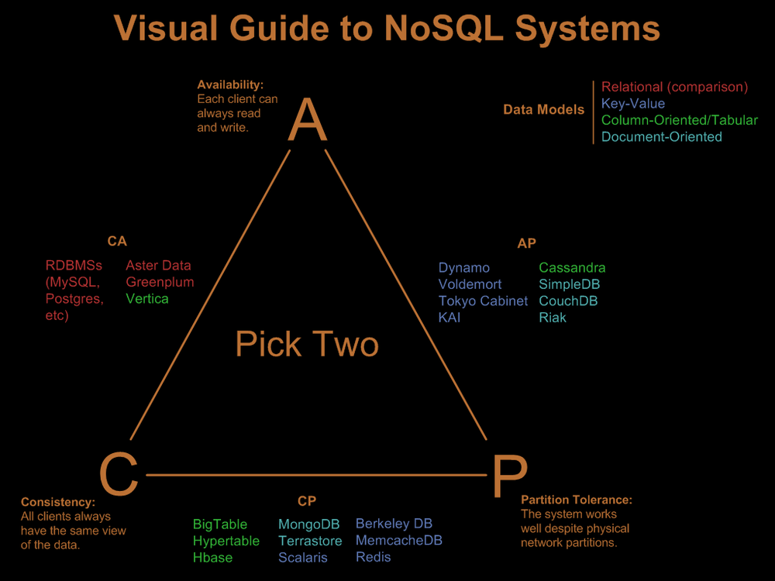
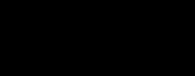
CAP Theorem

Slide 9
ACID + BASE = ?
Salt + Water – thanks GCSE Chemistry!
Atomicity. All of the operations in the transaction will complete, or none will.
Consistency. The database will be in a consistent state when the transaction begins and ends.
Isolation. The transaction will behave as if it is the only operation being performed upon the database.
Durability. Upon completion of the transaction, the operation will not be reversed.
Basically Available, Soft state, Eventually consistent
(Note, ACID consistency is different to CAP consistency)

Slide 10
Current NoSQL Datastore Types
SQL
NoSQL stands for Not Only SQL, not No SQL.
Key/Value
Memcached(b), Voldemort, Riak, Redis, Amazon Dynamo
Column / Big Table
HBase, Apache Cassandra, Google BigTable
Document
RavenDB, MongoDB, CouchDB
Graph
Neo4J, Sones, FlockDB(ish - Twitter), Trinity(MS Research)

Slide 11
NoNoSQL
RabbitMQ/AMQP
Replaces using the DB as a messaging system
Ditches polling the DB with associated performance implications
Big Data
Terabytes+
SQL, NoSQL, Hadoop
Data mining or huge throughput of simple content
NewSQL – systems prioritising scalability & performance
VCS
Search Frameworks - Solr, Lucene
Storage/Transaction/Query Services – Datomic
ORMs/Micro ORMs

Slide 12
NoNoNoSQL?
No, that’d just be silly.

Slide 13
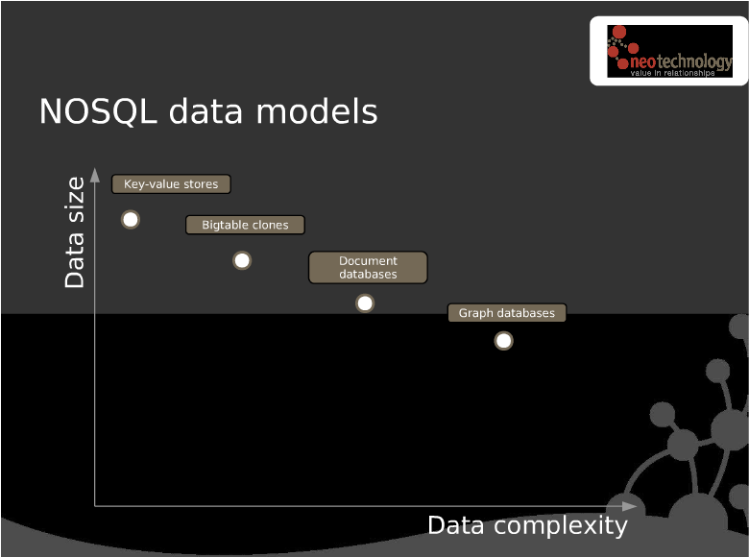
NoSQL, Data Size & Data Complexity

Slide 14
MapReduce – Queries without SQL?
Push 2 pieces of code to DB nodes, Map & Reduce
Database doesn’t need to understand data structure
Map is broadly equivalent to select <stuff> from location
Reduce runs on all mappings to produce final output
May run on each node first, then again to bring all nodes together.
Keeping Map & Reduce output structure the same helps with this
MapReduces may be chained creating complex queries
Low-level, no optimiser.
Frameworks like Hive or Pig can sit on top to provide higher level coding and have their own optimisers

Slide 15
Key/Value
Key to identify the entry. Yes, really.
Value is just a blob that the DB doesn’t understand
Really very absolutely no schema
Isn’t that a bit limiting
Entries may have metadata that the DB can understand
Links to other entries
Data about the entry
No schema to this, just more key/value pairs
Different buckets to group data
<server>/PNR/ABC123
<server>/Flight/WTF323

Slide 16
Key/Value Data Buckets
Things
Thing1
Stuff
Stuff1
Thing2
Metadata
Stuff2
Metadata
Thing3
DifferentThing
DifferentThing

Slide 17
Column / BigTable
Data stored as rows in a table, not unlike SQL
Columns are defined by each row rather than the table
Good for semi-structured data
Especially with many optional fields
Database understands the content
Indexable
Ad-hoc searchable
Column Families for fine grained performance tuning (HBase)
Tend to focus on distribution & big data

Slide 18
Column Families – tbl_recipientish
Keys
Extract
Sending
Response
extractId
timeAdded
…
notificationSent
notificationStatus
…
recipientBounce
recipientBounceId
…
recipientId : 1
extractId
timeAdded
…
notificationSent
notificationStatus
…
recipientId : 2

Slide 19
Document
Stored in a standard format understood by the database
JSON, XML
Maps very nicely for persisting OO data structures
Allows nesting of heirarchical data structures
Queryable without needing defined columns
Content may be indexed as the server can interpret data
RavenDB automatically generates indexes based on actual queries

Slide 20
Document Storage
PNR ID: ABC123
Passengers:
{
{Name: Rod, Age: Old}
{Name: Jane, Age: Old too}
{Name: Freddy, Age: Also old}
}
Flights:
{
{Num: 123, DepartureTime: Soon}
{Num: 456, DepartureTime: Later}
}
PNR ID: ABC321
Passengers:
{
{Name: George, Age: Dead?}
{Name: Zippy, Age: Another oldie}
{Name: Bungle, Age: Yup, old}
}
Flights:
{
{Num: 123, DepartureTime: Soon}
}
SSRs:
{
GimpSuit,
BallGag,
YouDontWannaKnow
}
Index

Slide 21
Graph
Objects are stored similar to Document DBs
Known format that the DB understands like JSON
Relationships are also stored as first class citizens
No set-based operations so graph traversal is constant speed
Read-performance of 1000s relationships/millisecond (Neo4J)
Maps well to OO code and how we perceive relationships
Jim hates Bob not tblPerson relates to itself on Hates to ID columns

Slide 22
Graph Layout
PNR: ABC123
-Pax1
-Pax2
…
PNR: ABC456
-Pax1
-Pax2
…
Flight: X
…
Flying On
Flying On
Flies From
Flying On
Flight: 123
From: Here
To: Infinity & Beyond
…
Airport: ACE
Location: Not a field in America
Flies To

