Slide 1
CSIEB0120 Lecture 07 Maximum Flow
Shiow-yang Wu & Wei-Che Chien
(吳秀陽 & 簡暐哲)
Department of Computer Science and Information Engineering
National Dong Hwa University

Slide 2
Objectives
What is Network Flow ?
What is flow?
Maximum Flow Problem
What is a cut?
The Ford-Fulkerson method
More on cuts
Residual Networks
Augmenting Paths
Maximum-Flow Minimum-Cut Theorem
Maximum bipartite matching

Slide 3
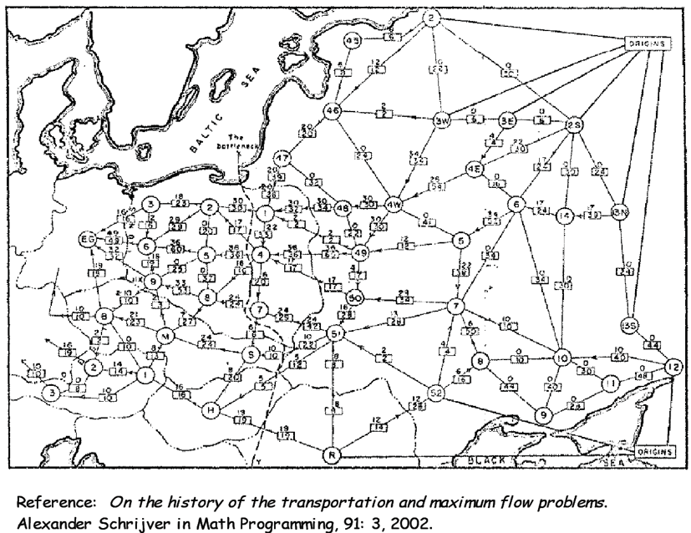
What is Network Flow ?
Soviet Rail network(1995)
Water pipes: water
Circuit network: current
Computer network: packets
Transportation network: traffic

Slide 4

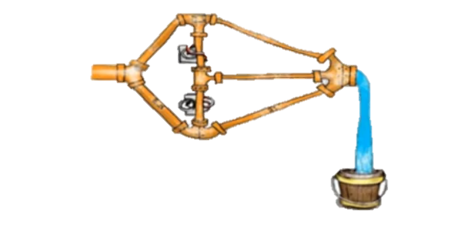
What is Network Flow ?
Source
Sink
5
3
6
Source
5
Sink
3
6
1

Slide 5
Flow networks:
A flow network G=(V,E): a directed graph, where each edge (u,v) ∈ E has a nonnegative capacity c(u,v)>=0.
If (u,v)∉E, we assume that c(u,v)=0.
two distinct vertices :a source s and a sink t.
For convenience, we assume that every vertex v lies on some path from the source to the sink.
The graph is connected
|E| ≥ |V|-1
Capacity c(u,v)=3
6
3
5
Source
5
Sink
6
5
1
Internal node

Slide 6
Pushing Flow:
1
5
5
Source
1
Sink
5
5
1
Greedy approach: push flow of value 5
Flow = 5
Can we push more?

Slide 7
Pushing Flow(Undo flow):
1
5
5
Source
1
Sink
5
5
1
Push flow of value 5
Push flow of value 1
Flow =6

Slide 8
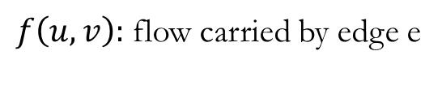

Maximum Flow Problem
1
5
5
Source
1
Sink
5
5
1
$f\left(u,v\right):$ flow carried by edge e
$$f(u,v)/ c(u,v)$$
0/1
u
5/5
5/5
Source
0/1
v
Sink
5/5
5/5
0/1

Slide 9
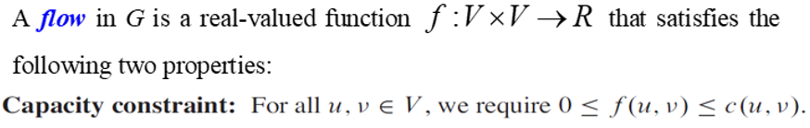
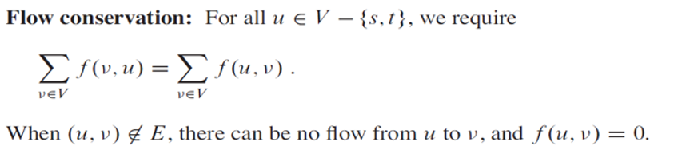
Maximum Flow Problem
Given: A flow network
Goal: Find a flow of maximum value
容量限制
流量守恆

Slide 10
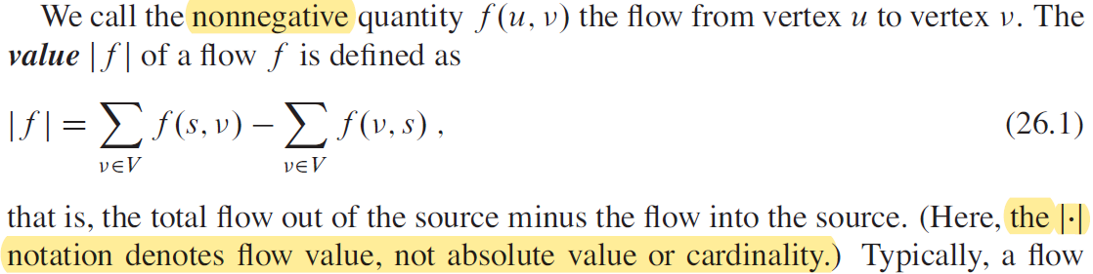
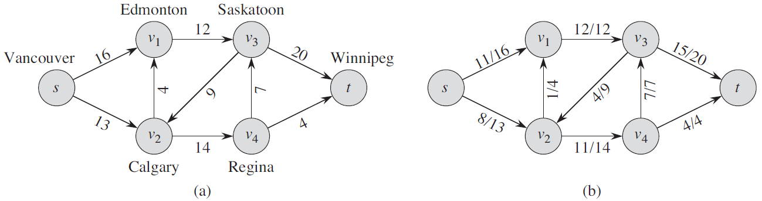
Maximum Flow Problem
In the maximum-flow problem, we are given a flow network G with source s and sink t , and we wish to find a flow of maximum value.

Slide 11
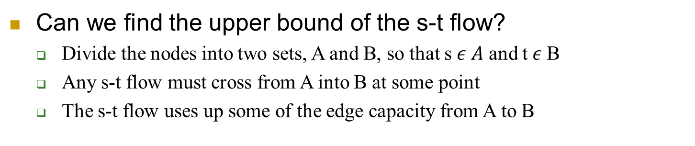
Upper Bounds of s-t flow
Can we find the upper bound of the s-t flow?
Divide the nodes into two sets, A and B, so that s $ε A$ and t$ε$B
Any s-t flow must cross from A into B at some point
The s-t flow uses up some of the edge capacity from A to B
1
5
6
Source
1
Sink
6
5
1

Slide 12
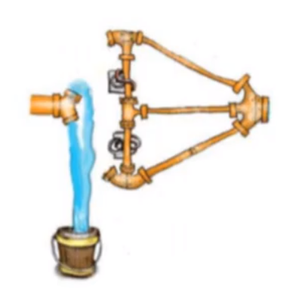
Upper Bounds of s-t flow
Source
Sink
1
5
6
Source
1
Sink
6
5
1

Slide 13
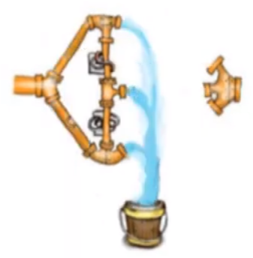
Upper Bounds of s-t flow
Source
Sink
1
5
6
Source
1
Sink
6
5
1

Slide 14
Upper Bounds of s-t flow
1
5
6
Source
1
Sink
6
5
1
Each “cut” places an upper bound on the maximum value of an s-t flow =>
Find cuts of minimum capacity =maximum flow

Slide 15
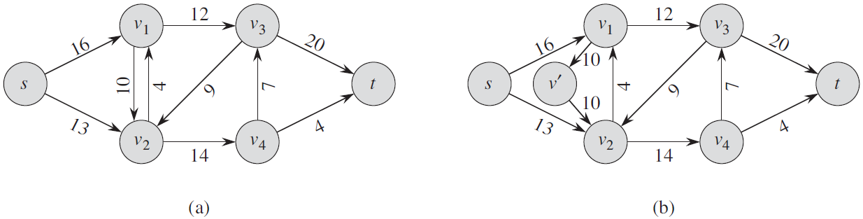
Modeling problems with antiparallel edges
Modeling problems with antiparallel edges
If (v₁,v₂) and (v₂,v₁) are both in a graph, we call the two edges (v₁,v₂) and (v₂,v₁) antiparallel.
Transform the network into an equivalent one containing no antiparallel edges:
choose one of the two antiparallel edges, say (v₁,v₂), and split it by adding a new vertex v’ and replacing edge (v₁,v₂) with the pair of edges (v₁,v’) and (v’,v₂)
Notes:
Thus, we see that a real-world flow problem might be most naturally modeled by a network with antiparallel edges. It will be convenient to disallow antiparallel edges, however, and so we have a straightforward way to convert a network containing antiparallel edges into an equivalent one with no antiparallel edges.
因此，我們看到現實世界的流動問題可能最自然地由具有反平行邊緣的網絡建模。 然而，禁止反平行邊緣將是方便的，因此我們有一種直接的方法將包含反平行邊的網絡轉換為沒有反平行邊的等效邊。

Slide 16
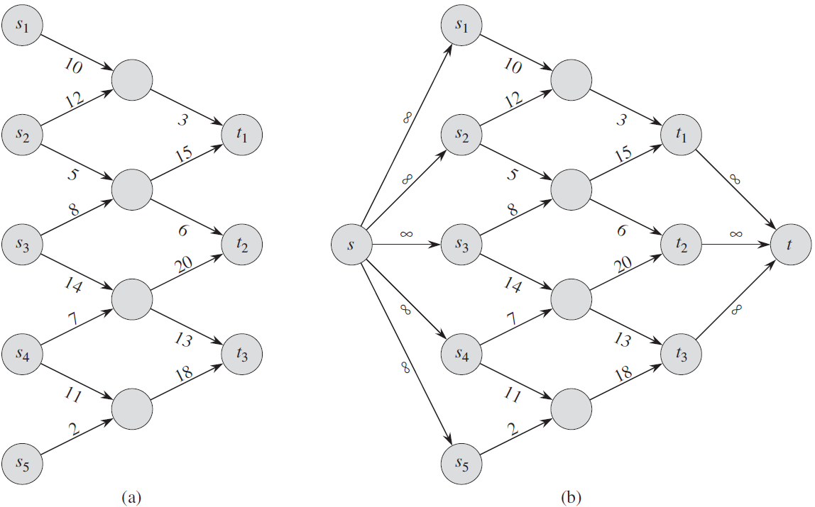
Networks with multiple sources and sinks
A maximum-flow problem may have several sources and sinks, rather than just one of each.
Fortunately, we can reduce the problem of determining a maximum flow in a network with multiple sources and multiple sinks to an ordinary maximum-flow problem.
Add
Supersource s
and
Supersink t
and …

Slide 17
Networks with multiple sources and sinks

Slide 18
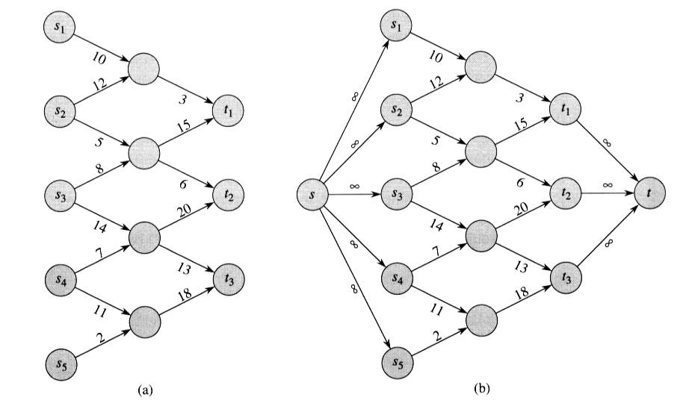
Converting a multiple-source, multiple-sink maximum-flow problem into a problem with a single source and a single sink.
Networks with multiple sources and sinks

Slide 19
The Ford-Fulkerson method
Three important ideas
Residual networks
Augmenting paths
Cuts
Max-flow min-cut theorem

Slide 20
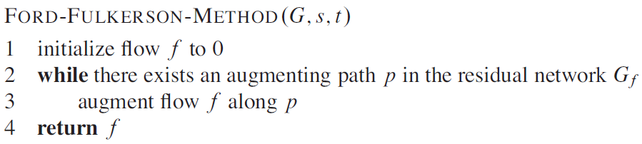
The Ford-Fulkerson method
Notes:
The Ford-Fulkerson method is iterative. We start with for all , giving an initial flow of value 0. At each iteration, we increase the flow value by finding an “augmenting path”, which we can think of simply as a path from source s along which we can push more flow, and then augmenting the flow along this path. We repeat this process until no augmenting path can be found. The max-flow min-cut theorem will show that upon termination, this process yields a maximum flow.

Slide 21
Residual networks
Intuitively, given a flow network G and a flow f , the residual network G_{f} consists of edges with capacities that represent how we can change the flow on edges of G.
An edge of the flow network can admit an amount of additional flow equal to the edge’s capacity minus the flow on that edge.
If that value is positive, we place that edge into G_{f} with a “residual capacity” of c_{f} (u,v)= c(u,v)- f(u,v).
The only edges of G that are in G_{f} are those that can admit more flow; those edges (u,v) whose flow equals their capacity have c_{f} (u,v)=0, and they are not in G_{f} .

Slide 22
Residual networks
The residual network G_{f} may also contain edges that are not in G, however.
As an algorithm manipulates the flow, with the goal of increasing the total flow, it might need to decrease the flow on a particular edge.
In order to represent a possible decrease of a positive flow f(u,v) on an edge in G, we place an edge (v,u) into G_{f} with residual capacity c_{f} (v,u)= f(u,v)—that is, an edge that can admit flow in the opposite direction to (u,v), at most canceling out the flow on (u,v).
These reverse edges in the residual network allow an algorithm to send back flow it has already sent along an edge. Sending flow back along an edge is equivalent to decreasing the flow on the edge, which is a necessary operation in many algorithms.

Slide 23
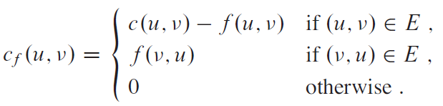
Residual capacity
More formally, suppose that we have a flow network G=(V,E) with source s and sink t. Let f be a flow in G, and consider a pair of vertices u,v ∈V. We define the residual capacity c_{f} (v,u) by
Because of our assumption that (u,v)∈E implies (v, u) ∉E, exactly one case in equation (26.2) applies to each ordered pair of vertices.
(Equation 26.2)

Slide 24

Residual networks
Given a flow network G=(V,E) and a flow f, the residual network of G induced by f is G=(V,E_{f}), where
That is, as promised above, each edge of the residual network, or residual edge, can admit a flow that is greater than 0.
(Equation 26.3)

Slide 25
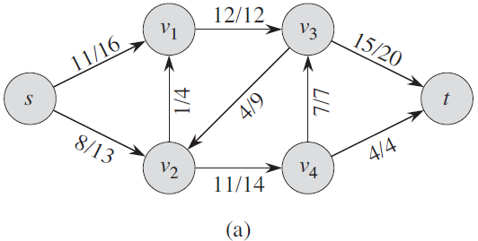
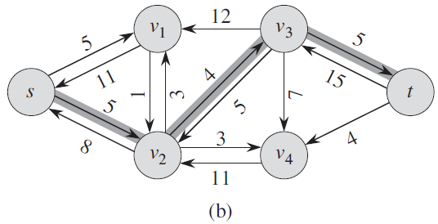
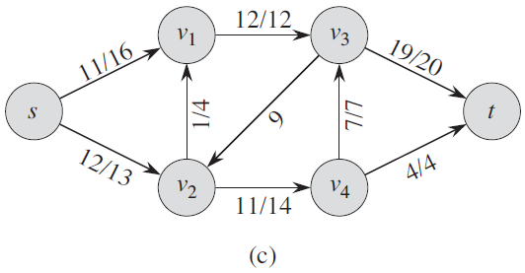
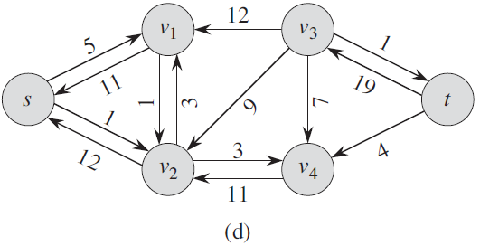
Example
The residual network G_{f} with augmenting path p shaded; its residual capacity is c_{f}(p)=c_{f}(v₂,v₃)=4.
The flow network G and flow f of Figure 26.1(b).
The flow in G that results from augmenting along path p by its residual capacity 4.
The residual network induced by the flow in (c).

Slide 26
Residual networks
Observe that the residual network G_{f} is similar to a flow network with capacities given by c_{f} .
It does not satisfy our definition of a flow network because it may contain both an edge (u, v) and its reversal (v, u).
Other than this difference, a residual network has the same properties as a flow network, and we can define a flow in the residual network as one that satisfies the definition of a flow, but with respect to capacities c_{f} in the network G_{f}.

Slide 27
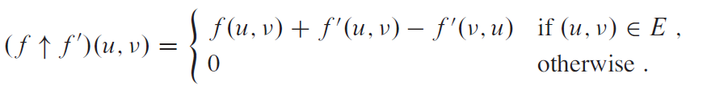
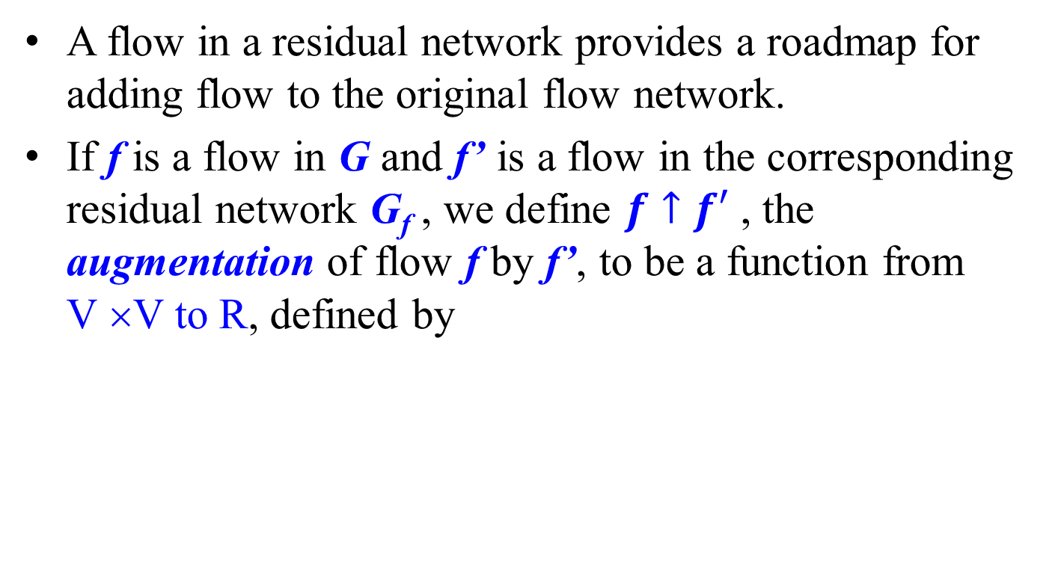
Augmentation
A flow in a residual network provides a roadmap for adding flow to the original flow network.
If f is a flow in G and f’ is a flow in the corresponding residual network G_{f} , we define $f↑f′$ , the augmentation of flow f by f’, to be a function from V ×V to R, defined by
(Equation 26.4)

Slide 28
Example
The residual network G_{f} with augmenting path p shaded; its residual capacity is c_{f}(p)=c_{f}(v₂,v₃)=4.
The flow network G and flow f of Figure 26.1(b).
The flow in G that results from augmenting along path p by its residual capacity 4.
The residual network induced by the flow in (c).

Slide 29
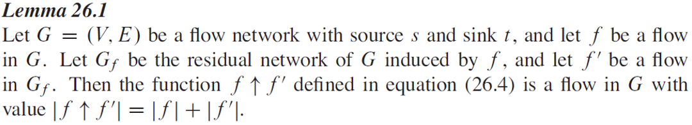
Lemma 26.1
(Equation 26.4)

Slide 30
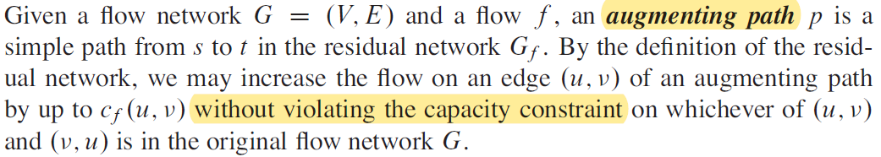
Augmenting paths
We call the maximum amount by which we can increase the flow on each edge in an augmenting path p the residual capacity of p, given by

Slide 31
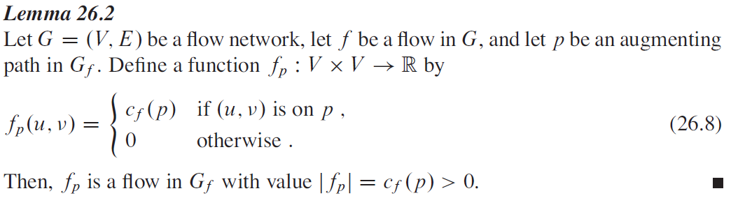
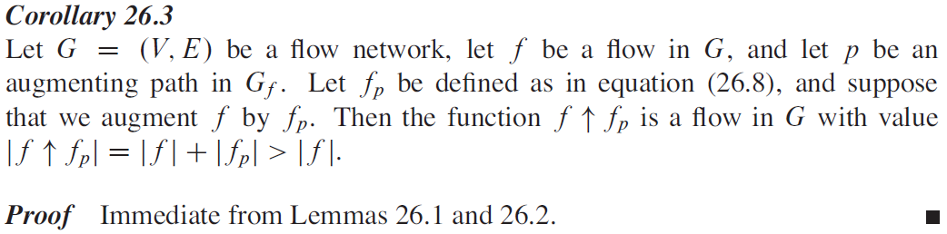
Lemma 26.2 & Corollary 26.3

Slide 32
Example
The residual network G_{f} with augmenting path p shaded; its residual capacity is c_{f}(p)=c_{f}(v2,v3)=4.
The flow network G and flow f of Figure 26.1(b).
The flow in G that results from augmenting along path p by its residual capacity 4.
The residual network induced by the flow in (c).

Slide 33
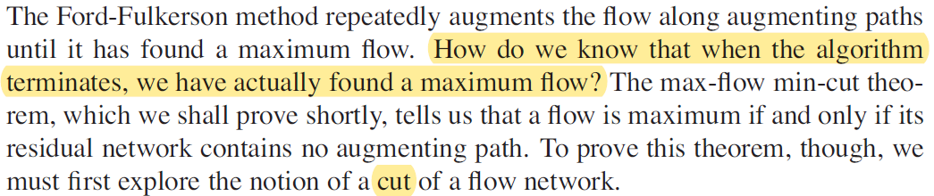
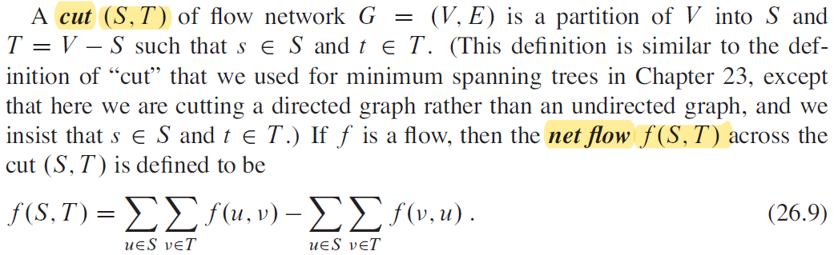
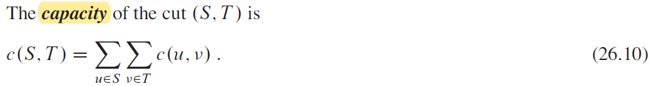
Cuts of flow networks

Slide 34
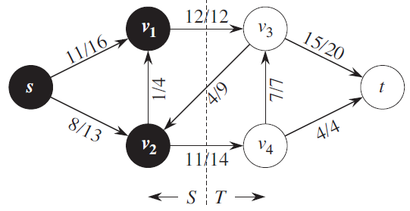




Example
The net flow across this cut is
and the capacity of this cut is
Figure 26.5 A cut (S, T) in the flow network of Figure 26.1(b), where S={s, v₁, v₂} and T={t, v₃, v₄}. The vertices in S are black, and the vertices in T are white. The net flow across (S, T) is f(S, T) =19, and the capacity is c(S, T)=26.

Slide 35
Minimum cut
A minimum cut of a network is a cut whose capacity is minimum over all cuts of the network.
The asymmetry between the definitions of flow and capacity of a cut is intentional and important.
For capacity, we count only the capacities of edges going from S to T , ignoring edges in the reverse direction.
For flow, we consider the flow going from S to T minus the flow going in the reverse direction from T to S.
The reason for this difference will become clear later in this section.
Notes:
The asymmetry between the definitions of flow and capacity of a cut is intentional and important. For capacity, we count only the capacities of edges going from S to T , ignoring edges in the reverse direction. For flow, we consider the flow going from S to T minus the flow going in the reverse direction from T to S. The reason for this difference will become clear later in this section.

Slide 36
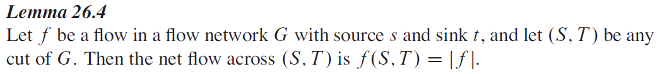
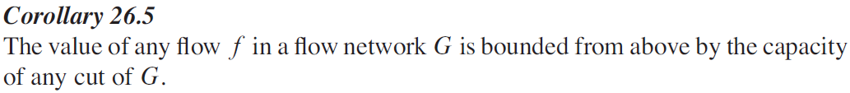


Lemma 26.4 & Corollary 26.5
(Equation 26.9)
(Equation 26.10)
Notes:
The asymmetry between the definitions of flow and capacity of a cut is intentional and important. For capacity, we count only the capacities of edges going from S to T , ignoring edges in the reverse direction. For flow, we consider the flow going from S to T minus the flow going in the reverse direction from T to S. The reason for this difference will become clear later in this section.

Slide 37
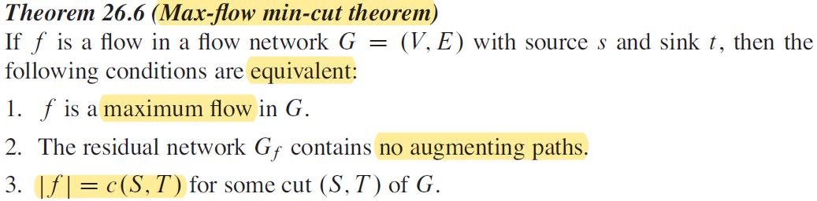
Max-flow min-cut theorem

Slide 38
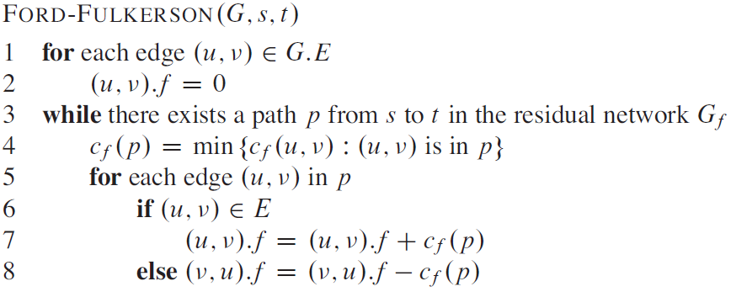

The basic Ford-Fulkerson algorithm
f* denotes a maximum flow in the transformed network
In each iteration of the Ford-Fulkerson method, we find some augmenting path p and use p to modify the flow f .
The time to find a path in a residual network is therefore O(V+E)=O(E) if we use either depth-first search or breadth-first search.
Ref to textbook for the details
Notes:
The running time of FORD-FULKERSON depends on how we find the augmenting path p in line 3. If we choose it poorly, the algorithm might not even terminate: the value of the flow will increase with successive augmentations, but it need not even converge to the maximum flow value.2 If we find the augmenting path by using a breadth-first search (which we saw in Section 22.2), however, the algorithm runs in polynomial time. Before proving this result, we obtain a simple bound for the case in which we choose the augmenting path arbitrarily and all capacities are integers.
If f* denotes a maximum flow in the transformed network, then a straightforward implementation of FORD-FULKERSON executes
the while loop of lines 3–8 at most |f*| times, since the flow value increases by at least one unit in each iteration.

Slide 39
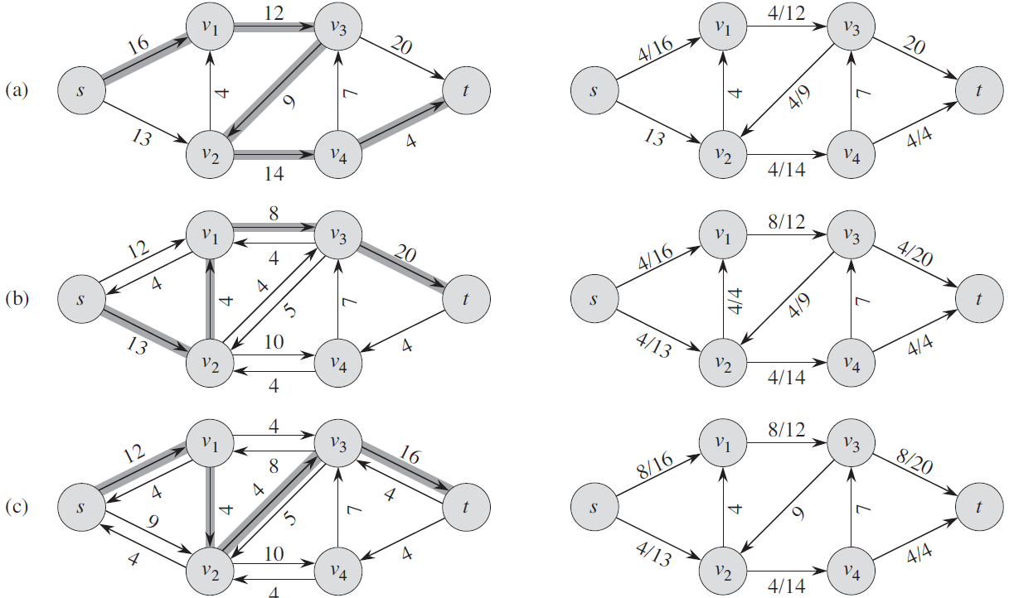
The execution of the basic Ford-Fulkerson algorithm
augmenting path p
net flow f

Slide 40
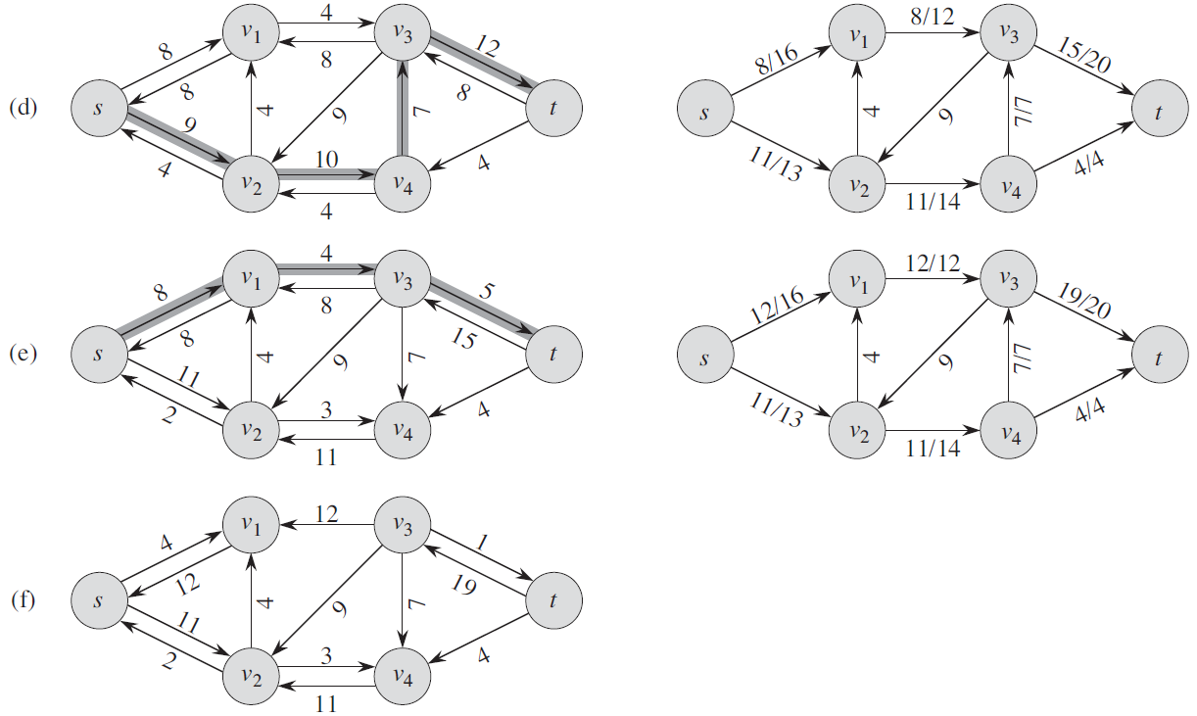
The execution of the basic Ford-Fulkerson algorithm

Slide 41
Ford-Fulkerson Algorithm
0
flow
2
4
4
capacity
G:
0
0
0
10
2
0
8
6
0
10
0
0
0
s
10
3
9
5
10
t
Flow value = 0

Slide 42
Ford-Fulkerson Algorithm
0
flow
2
4
4
capacity
G:
8
0
0
X
0
8
X
10
2
0
8
6
0
10
0
8
0
0
X
s
10
3
9
5
10
t
Flow value = 0
2
4
4
residual capacity
G_{f}:
10
2
8
6
10
s
10
3
9
5
10
t

Slide 43
Ford-Fulkerson Algorithm
0
2
4
4
G:
10
8
0
X
8
10
2
0
8
6
0
10
X
2
0
10
8
0
2
X
X
s
10
3
9
5
10
t
Flow value = 8
2
4
4
G_{f}:
8
2
2
8
6
10
s
10
3
9
5
2
t
8

Slide 44
Ford-Fulkerson Algorithm
0
2
4
4
G:
0
6
10
8
X
8
6
0
10
2
2
X
10
6
0
6
10
X
2
8
X
s
10
3
9
5
10
t
Flow value = 10
2
4
4
G_{f}:
10
2
8
6
10
s
10
3
7
5
10
t
2

Slide 45
Ford-Fulkerson Algorithm
0
2
X
2
4
4
G:
6
8
10
8
X
10
2
2
8
6
6
10
X
0
6
8
10
X
8
s
10
3
9
5
10
t
Flow value = 16
2
4
4
G_{f}:
6
10
2
8
6
4
s
4
3
1
5
10
t
6
8

Slide 46
Ford-Fulkerson Algorithm
2
3
X
2
4
4
G:
8
9
10
8
7
X
X
10
2
0
8
6
6
10
8
9
10
X
8
9
X
s
10
3
9
5
10
t
Flow value = 18
2
2
2
4
G_{f}:
8
10
2
8
6
2
s
2
3
1
5
10
t
8
8

Slide 47
Ford-Fulkerson Algorithm
3
2
4
4
G:
10
7
9
10
2
0
8
6
6
10
9
9
10
s
10
3
9
5
10
t
Flow value = 19
3
2
1
4
G_{f}:
9
1
10
2
7
6
1
s
1
3
9
5
10
t
9

Slide 48
Ford-Fulkerson Algorithm
3
2
4
4
G:
10
7
9
10
2
0
8
6
6
10
9
9
10
s
10
3
9
5
10
t
Cut capacity = 19
Flow value = 19
3
2
1
4
G_{f}:
9
1
10
2
7
6
1
s
1
3
9
5
10
t
9

Slide 49
Analysis of Ford-Fulkerson

Slide 50
Analysis of Ford-Fulkerson

Slide 51
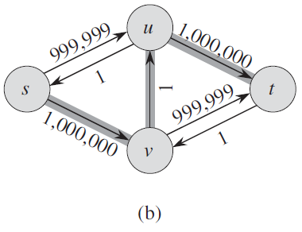
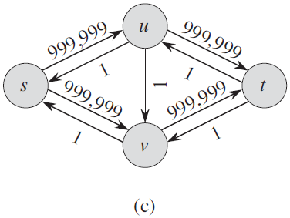
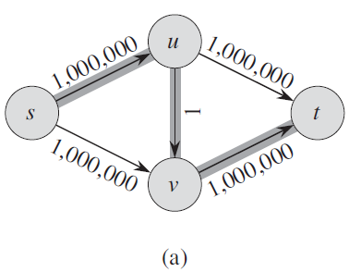
Consider |f*|
When the capacities are integral and the optimal flow value |f*| is small, the running time of the Ford-Fulkerson algorithm is good.
When |f*| is large
We would perform a total of 2,000,000 augmentations, increasing the flow value by only 1 unit in each.

Slide 52
The Edmonds-Karp algorithm
We can improve the bound on FORD-FULKERSON by finding the augmenting path p in line 3 with a breadth-first search.
That is, we choose the augmenting path as a shortest path from s to t in the residual network, where each edge has unit distance (weight).
We call the Ford-Fulkerson method so implemented the Edmonds-Karp algorithm.
the Edmonds-Karp algorithm runs in O(VE²) time.

Slide 53
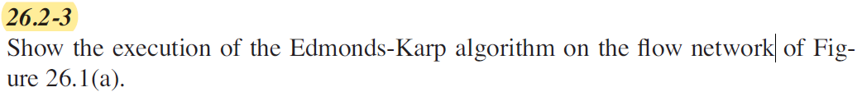
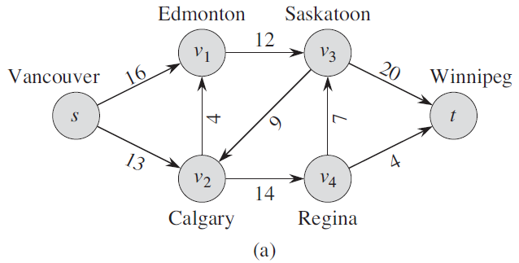
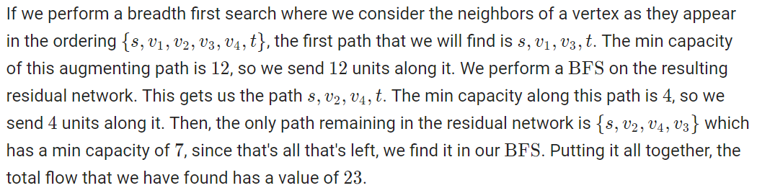
Practice

Slide 54
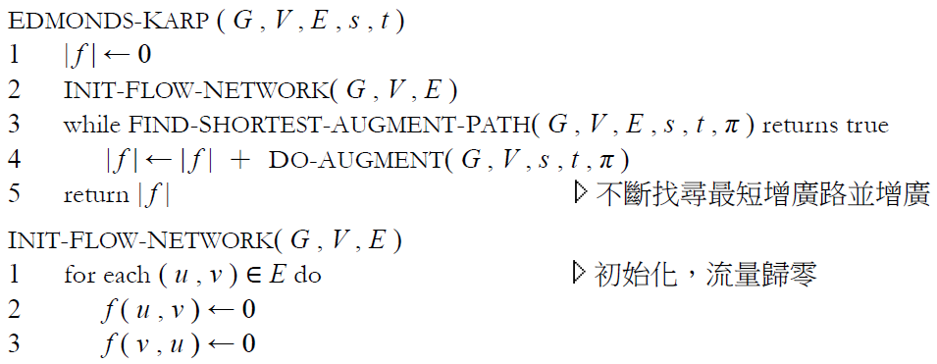
The Edmonds-Karp algorithm
http://pisces.ck.tp.edu.tw/~peng/index.php?action=showfile&file=f6cdf7ef750d7dc79c7d599b942acbaaee86a2e3e

Slide 55
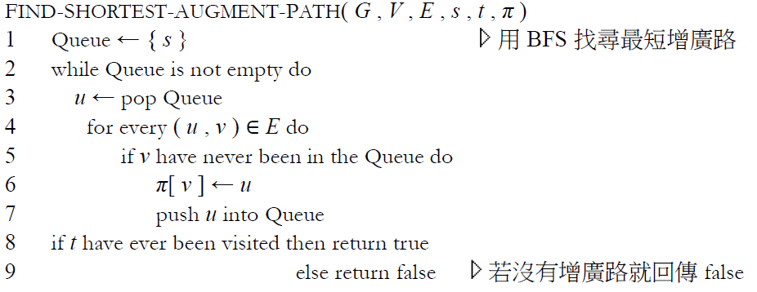
The Edmonds-Karp algorithm
http://pisces.ck.tp.edu.tw/~peng/index.php?action=showfile&file=f6cdf7ef750d7dc79c7d599b942acbaaee86a2e3e

Slide 56
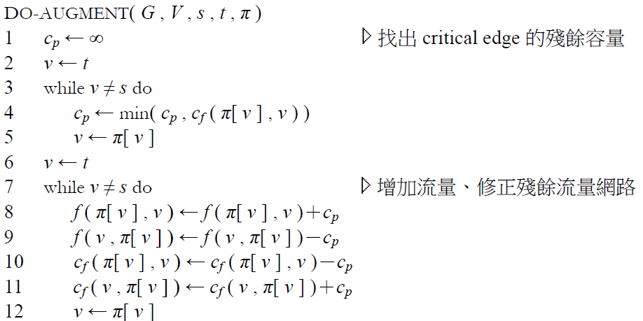
The Edmonds-Karp algorithm
http://pisces.ck.tp.edu.tw/~peng/index.php?action=showfile&file=f6cdf7ef750d7dc79c7d599b942acbaaee86a2e3e

Slide 57
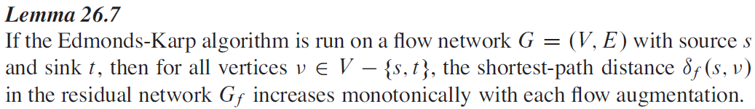
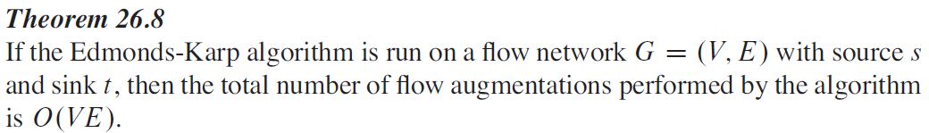
Lemma 26.7 & Theorem 26.8
Because we can implement each iteration of FORD-FULKERSON in O(VE) time
when we find the augmenting path by breadth-first search, the total running time of
the Edmonds-Karp algorithm is O(VE²).
We shall see that push-relabel algorithms can yield even better bounds. The algorithm of Section 26.4 gives a method for achieving an O(V²E) running time, which forms the basis for the O(V³)-time algorithm of Section 26.5.

Slide 58
The maximum-bipartite-matching problem

Slide 59
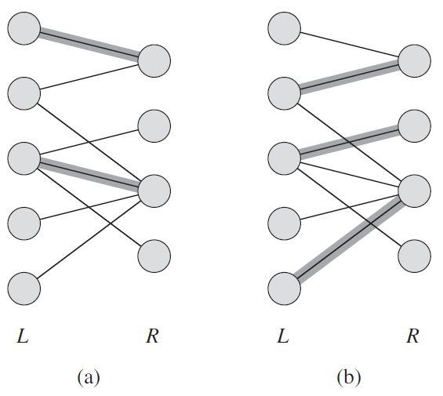
Bipartite graphs & Matching
G =(V, E) with partition V = L ∪ R
A maximum matching with cardinality 3
Cardinality 2

Slide 60
Finding a maximum bipartite matching

Slide 61
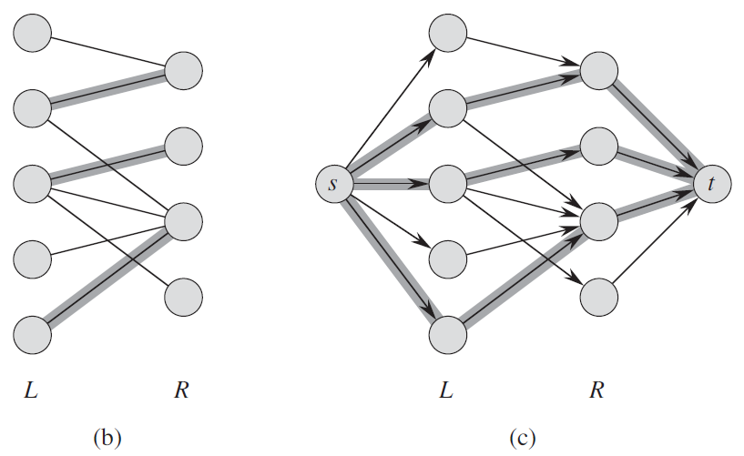
The flow network corresponding to a bipartite graph
(c)The corresponding flow network G’ with a maximum flow shown. Each edge has unit capacity. Shaded edges have a flow of 1, and all other edges carry no flow. The shaded edges from L to R correspond to those in the maximum matching from (b).

Slide 62
Maximum Flow and Minimum Cut
Max flow and min cut
Two very rich algorithmic problems.
Cornerstone problems in combinatorial optimization.
Beautiful mathematical duality
Nontrivial applications / reductions.
Network connectivity.
Bipartite matching.
Data mining.
Open-pit mining.
Airline scheduling.
Image processing.
Project selection.
Baseball elimination.
Network reliability.
Security of statistical data.
Distributed computing.
Egalitarian stable matching.
Distributed computing.
Many more . . .

Slide 63
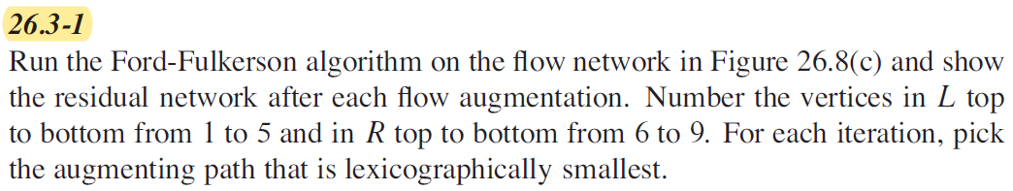
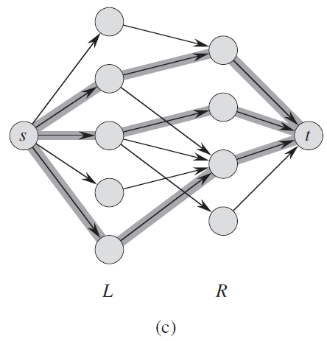
Practice

Slide 64

Practice
Run the Ford-Fulkerson algorithm on the flow network in the following figure and show the residual network after each flow augmentation.

