Slide 1

Commercial growth & Margin Optimization: Diagnosing Promotional Discounting and Regional Profit Drivers in Power BI
Author: TobyAnn Aldridge
Role: Data Analytics Intern – DataX Labs Task 3
Dataset: Cleaned Superstore Commercial Sales Records
Notes:
Core Problem Statement: While top-line revenue shows continuous expansion, operating margins suffer severe regional volatility due to unconstrained discounting.
Project Objective: Build an interactive decision-support system in Power BI and outline concrete executive interventions to recover eroded margins.

Slide 2
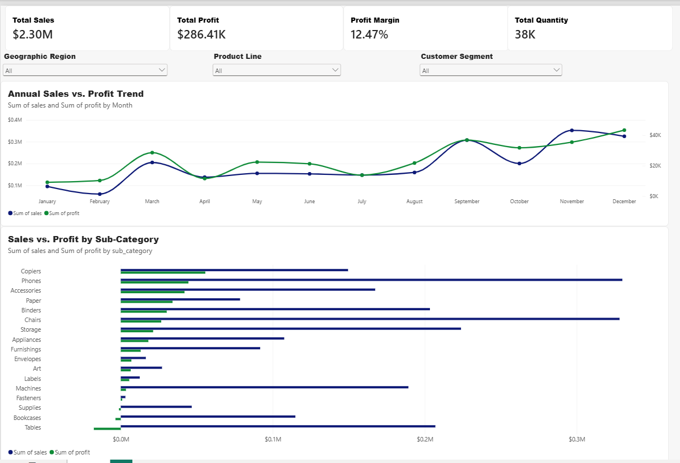
Executive Performance Cockpit (Power BI Dashboard)
Interactive Decision-Support System
Executive KPI Cards:
Total Sales: $2.30 M
Net Profit: $286.4 K
Blended Profit Margin: 12.5%
Total Units Sold: 37.8 K
Interactive Slicers: dynamic filtering across Region, Category, and Customer
Analytical Visuals: Monthly Sales vs. Profit seasonality timeline paired with a sub-category profitability ranking.
Notes:
This dashboard enables business stakeholders to evaluate top-line revenue alongside net profitability in real time. Slicing dynamically by region highlights that strong sales volume does not guarantee healthy margin contribution.

Slide 3
Key Business insights: Volume Masks destructive discounting
Seasonality Spikes, Regional Performance Gaps, and the 20% Discount Cliff
Fourth Quarter Revenue Seasonality
Over 35% of total annual sales occur between September & December
High-volume consumables order volumes surge up to 4x compared to February baselines
Strong Q4 cash flow has historically masked systemic margin leakage
Severe Margin Destruction
Transactions with discounts between 0% and 20% generate over $320K in cumulative net profit.
Any discount tier >30% consistently produces net operating losses across almost all sub-categories
Runaway discounting caused individual order losses as severe as -$6,600 on a single purchase
Central & East Disparity
South Region: Trails in overall transaction volume (~1.6k orders) but adheres to disciplined markdown policies, protecting profitability.
Central & East Regions: Epicenter of profit erosion. Texas leads total net losses at -$25.7K, followed by Ohio and Pennsylvania, driven by default discounts reaching 70%-80%

Slide 4
Strategic roadmap: margin recovery & policy governance Four Concrete Management interventions to protect operating margins
1: Enforce a Hard 20% Discount Ceiling
Eliminate unconstrained branch-level price slashing
Require senior regional manager sign-off in the ERP/sales system for any enterprise quote with discounts exceeding 20%
3: Shift Sales Incentive KPIs to Net Margin
Align sales compensation with contribution margin rather than gross top-line transaction volume
Removes incentives for sales teams to hit quarterly volume quotas by discounting products into negative margins.
2: Halt Standalone Low-Margin Clearence Slashes
Discontinue standalone markdowns on chronic loss-leaders (Tables and Bookcases).
Repackage low-margin furniture into bundles paired with high-margin technology hardware to guarantee positive basket margins.
4: Optimize Q4 Logistics & Inventory Procurement
Pre-order inventory and align warehouse staffing in August to prepare for the Sept – Dec order surge.
Prevents costly rush-shipping fees and stockouts during peak retail seasonality.

