Slide 1
Striving to Make Things
Simple and Fast
Phil Bagwell EPFL / Typesafe
I am sorry this is so long. I didn’t have time to make it shorter. Blaise Pascal

Slide 2
Striving to Make Things
Simple and Fast
Phil Bagwell EPFL / Typesafe
On Why Irish Developers are Best
Only Irish coffee provides in a single glass all four essential food groups: alcohol, caffeine, sugar, and fat. - Alex Levine

Slide 3
Learning Curve or Technology Adoption
Productivity
Perceived Payback
Perceived Risk
Perceived Investment
0%
Easier
Understand What User Does and Knows
Harder
Time

Slide 4
Parallel Collections
Automatic multi-threading of comprehensions
Comprehension is applying a function to a collection
Simple to change from sequential to parallel
val w=Vector(”the”, ”quick”, ”brown”, ”fox”, ”jumps”, ”over”, ”the”, ”lazy”, ”dog”).par
w.filter(x=>x.length > 4).map(x=>x.length)
Res> ParVector(5,5,5)

Slide 5
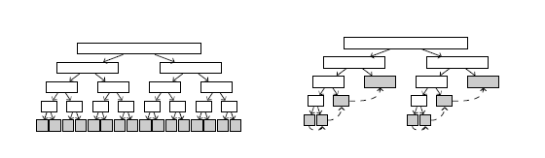
Parallel Collections
Split work by number of Processors
Each Thread has a work queue that is split exponentially. Largest on top of queue
Granularity balance against scheduling overhead
On completion threads “work steals” from top of other thread queues

Slide 6
Parallel Collections
Easy to program
Excellent speed ups in multi-core systems
Good load balancing
! Not a universal fix to all concurrency problems
Alex Prokopec, Phil Bagwell, Tiark Rompf, Martin Odersky

Slide 7
Non blocking Resizable Concurrent Hash Tries
Mutable meets Immutable
Alex Prokopec, Phil Bagwell
Caches, Dictionaries, Time varying Analytics
Scale well in Multi-core
Allow snap shot
http://skillsmatter.com/podcast/scala/parallel-algorithms-data-structures

Slide 8
Non-blocking SnapShot
val sn=cht.snap
Can take non-blocking snapshot of cht in small constant time
Changes to sn do not change cht
Changes to cht do not change sn
Mutable but makes immutable ‘copy’

Slide 9


Example
100,000 Sensor Points
Launch Fault Detection
T2
T4
T3
T5
Snapshots
T1
St0
St1
St2
St3
T6
T7
CHT
T8
T9
Mutable
Immutable

Slide 10
Vectors - Todays Problem
How about:
concat(A,B)
mid(A,30,50)
left(A,10)
right(A,50)
concat(right(concat(A,left(B,10)),5),B)
Linear Time in B!
And Parallel Comprehensions
A.filter( x => x < 5).map(x => x*5)

Slide 11
Immutable Vectors
Fast Recap
Index
0
0
0
1
1
0
0
1
m = 4
levels = 1/(lg m) * lg N
For m = 32
levels =1/5 * lg N
Pioneered by Rich Hickey

Slide 12
Vectors
Update Value Immutably
Copy all nodes on path to updated value
Update = m * 1/(lg m) * lg N
For m = 32
Update = 6.2 * lg N
Now think cache and cache lines! Index and Update ~Constant Time
X86 Cache line 64 or 128 bytes

Slide 13
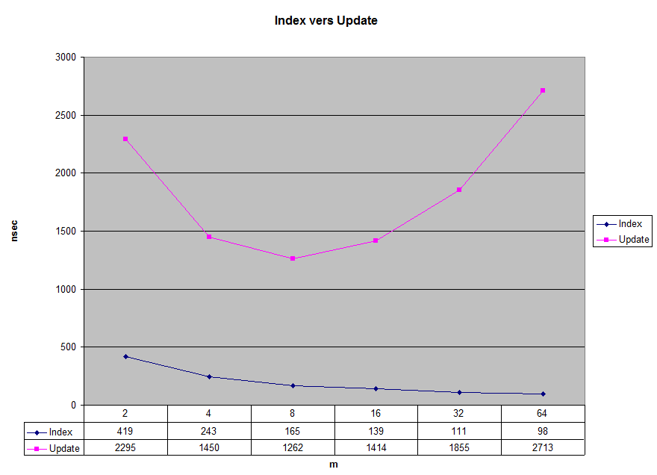

Slide 14
Vectors
For all practical purposes
Indexing constant time
Adds and Updates constant time
Iteration constant time per item
Length constant time
Reverse – Use indexing or reverse iteration, constant time

Slide 15
Vector Concatenation
Phil Bagwell & Tiark Rompf
EPFL, Switzerland
The Challenge – O(N) to O(Lg N)?
Simple Problem
Hard to Solve
Economically interesting

Slide 16

Vector Concatenation
A
B
(27)
(20)
Linear copy of B to right of A
(47)
Idea: Use Ropes by Boehm, Atkinson & Plass

Slide 17
Rope
A
B
(27)
(20)
Create a Rope Node
(47)
27
47

Slide 18
Rope
After 4 Concats
33
52
D
12
33
C
7
12
A
B

Slide 19
Rope - Split
Add Split Node
12
41
33
52
D
12
33
What happens to structure to left and right of split?
C
7
12
Memory Leak!
A
B

Slide 20
Rope
Indexing and Updates
Becomes linear in number of concats
Needs to be rebalanced
With balancing becomes lg (C+S) in number of concats and splits
Memory leak without copying sub-vectors
Linear in sub-vectors
Idea: Use B-Trees by Rudolf Bayer and Ed McCreight

Slide 21
B-Tree
Nodes sizes m to m/2
Here m = 16
Few levels like Vectors – Good!
levels = 1/(lg 2m/3) * lg N
Updates, iterations, etc all good
Concatenation cheap ~= update
Simple to balance
Longest path 1/(lg m/2) * lg N
Shortest path 1/(lg m) * lg N
(8)
(8)
(8)
But!

Slide 22
B-Tree
Index Radix search impossible!
(Expect 256 but may only have 64)
Index/256 gives wrong slot!
(Expect 16 but only have 8)
Index/16 gives wrong slot!
(8)
(8)
(8)
Idea: Add item counts at the level and use binary search

Slide 23
B-Tree
0 1 2 3 4
8
16
28
38
53
66
77
91
Binary Search
(8)
(8)
(12)
(10)
Memory Overhead only 1/m
Updates, iterations, etc all good
Concatenation cheap ~= update
Simple to balance
Index = 29

Slide 24
B-Tree
0 1 2 3 4
8
16
28
38
53
66
77
91
Binary Search
(8)
(8)
(12)
(10)
Memory Overhead only 1/m
Updates, iterations, etc all good
Concatenation cheap ~= update
Simple to balance
But Index time
~7x Standard Vectors!
Index = 29
Idea: Make all node m or m-1 in size to get near Radix Search
Exploit Cache line loads to get fast short linear Search

Slide 25
RRB-Tree Try1
Relaxed Radix Balanced Tree
m = 32
0 1 2 3 4 ……………..(31)
0 1 2 3 4 ……………..(31)
31
62
94
126
158
190
221
250
(2)
0
0
0
1
0
1
1
1
1
1
----
----
----
----
Index =95
(31)
(31)
(32)
(32)
Sub-Index = 95 – 94 = 1
Index = 0
Index = 95
Index Speed constant 60% slower than Standard Vector – Good!
Memory Overhead still only 1/m
Updates, iterations, etc all good

Slide 26
RRB-Tree Try1
Immutable Concatenation (3-4 RRB Trees)
Costly to Balance!
A
B
Follow edges
+
Copy nodes and balance the tree on way up
+
+
Start at leaves
Worst Case concatenation ~ m^2 * 1/(lg m) * lg N = K * Update

Slide 27
RRB-Tree Try1
Immutable Concatenation (3-4 RRB Trees)
A
+
Now next level
C
Done – new Vector
Exactly same principle for 31-32 RRB Trees

Slide 28
RRB-Tree Try1
Index Speed constant 40 – 50% slower than Standard Vector – Good!
Memory Overhead still only 1/m – Good!
Updates, iterations, etc all – Good!
Concatenation cost >30x Update
Idea: Constrain overall extra search steps not node size.

Slide 29
RRB-Tree
Extras allowed = 1
+
16 leaves in 6 nodes
Extras = actual nodes - ∑ items / m
E = 6 - 16/4 = 2
+
+
Reduce by 1
Principle: Look for first less than m-1 and combine with enough following to reduce node count by one

Slide 30
RRB-Tree
11 items in 4 nodes
E = 1 (no balancing)
+
+

Slide 31
RRB-Tree
Index Speed constant 60 – 70% slower than Standard Vector – Still VGood!
Memory Overhead still only 1/m – Good!
Updates, iterations, etc all – Good!
Concatenation cost 2 to 6x Update - VGood
And Vector Performance
Standard until Concat or Splits used
Negligible degradation with many splits or concats.

Slide 32
RBB – Tree Left/Right Slice
Follow Slice Path
Rewrite path with Left (or Right) removed
Only Rebalance on Concatenation

Slide 33
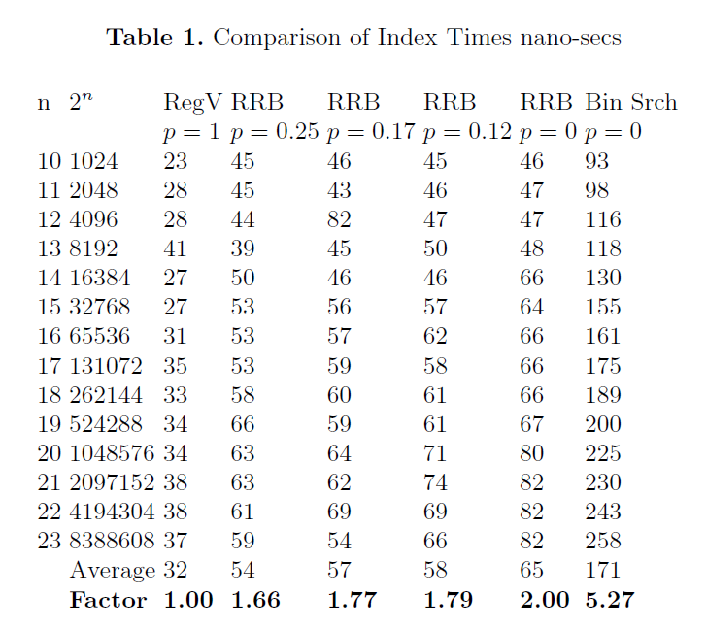

Slide 34
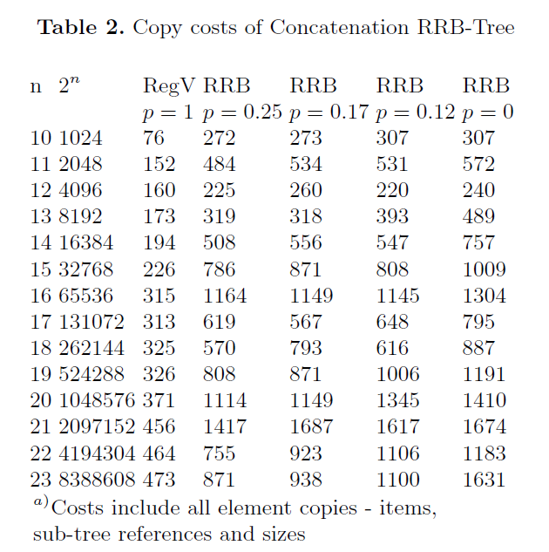

Slide 35
Implementation
RRB Node
0 1 2 3 4 ……………..(31)
31
62
94
126
158
190
221
250
0 1 2 3 4 ……………..(31)
Standard Vector Node

Slide 36
Now a Demo

Slide 37
That’s All Folks!
Thank You
http://infoscience.epfl.ch/record/169879/files/RMTrees.pdf

