Slide 1
Math 426 Objectives
Convert continuous mathematical problems into numerical algorithms to solve the problems quickly and accurately.
Implementing such numerical algorithms in Matlab.
Understanding how different numerical methods can be analyzed and evaluated. This is for both selection of methods and for evaluating implementation!
Presenting results in an attractive and succinct way.
Preparing you to solve a much wider array of problems for subsequent classes and jobs.

Slide 2
Syllabus
Contact info and tentative office hours.
Grade weighting.
6 or 7 quizzes+final.
Matlab naturally integrated in homework and projects.
Email policy: not a text or tweet.
Tentative schedule on last page.
Topics may shift a bit.
Keep up and do the work.
I’ll work hard to help you succeed.
TAs will help with office hours and in class.

Slide 3
Some Computing I Do
Modeling of the human tear film
Anything from ODEs to tear flow on eye-shaped domain using a system of PDEs
May involve fluid flow, solutes, evaporation, large systems, moving boundaries, …
Deciding what model to solve and what method to use are a critical part of what I do in research

Slide 4
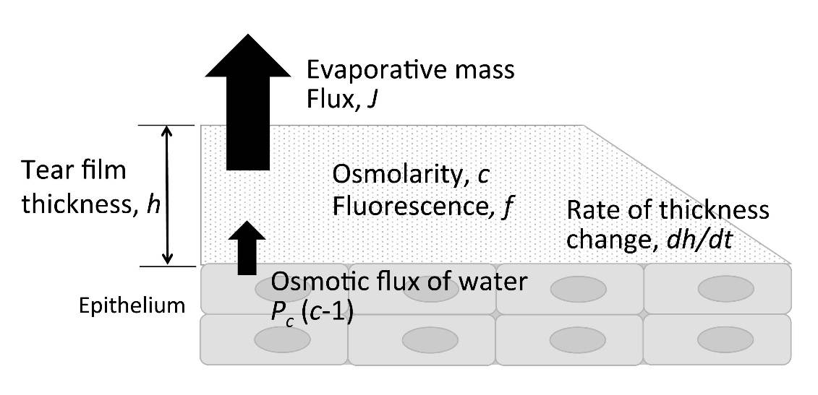
Sample
Results
Tear film thickness h(t) and concentrations c(t), f(t) from solving ODEs: conserve water and solutes
Braun et al, Invest Ophthalmol Vis Sci 2014

Slide 5
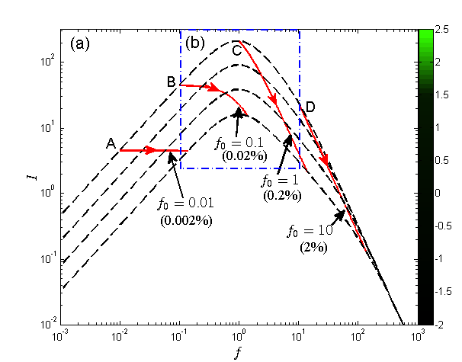
Sample
Results
Each red curve is from solving and ODE system with one IC
Dashed curves are plot of I(f,h) with h constant
Shows how tear film fluorescent intensity changes: news for eye docs
All done in Matlab

Slide 6
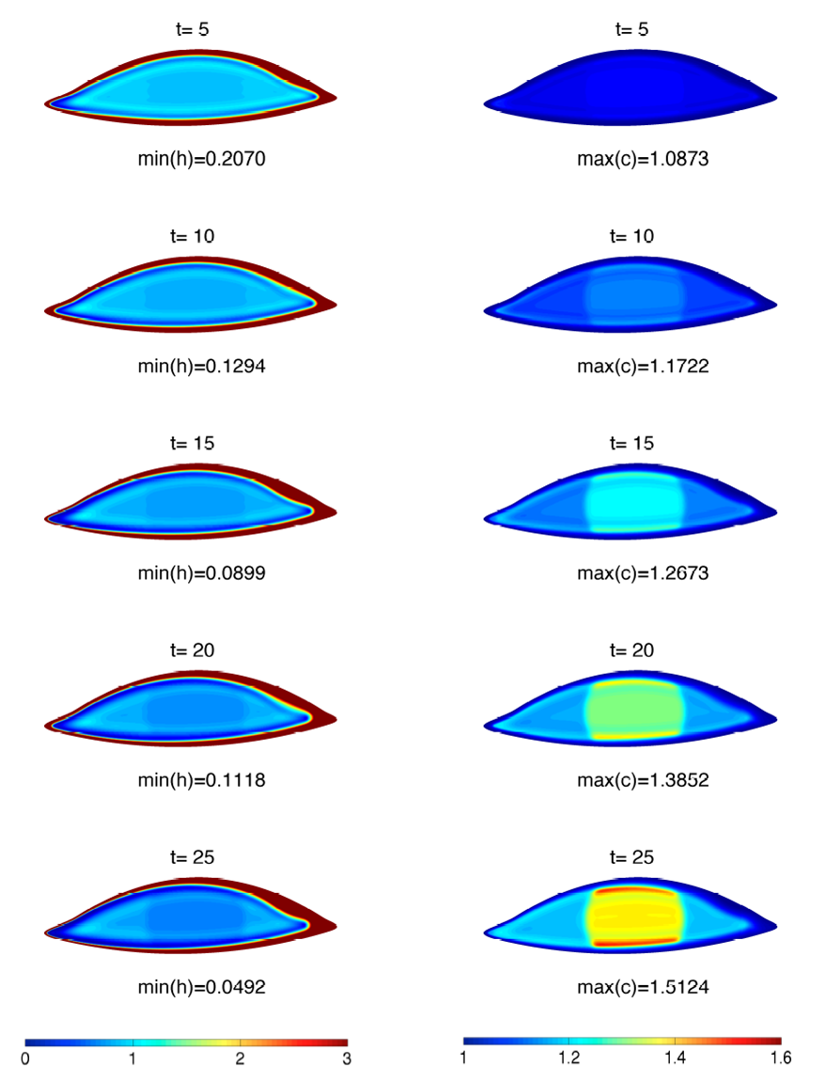
Sample
Results
Tear film thickness on left
Osmolarity (ion concentration) on right
Only estimate of this anywhere to my knowledge
Li, Braun, Driscoll et al, Math Med Biol 2015

Slide 7
Needed math
Equations for domain from pictures
Solve PDEs for thickness and osmolarity
Variable coefficeints and nonlinear PDE
Hybrid time stepping needed for efficiency

Slide 8
Numerical Methods This Term
Floating point numbers, conditioning, stability
Solving linear systems (direct)
Least squares fits (linear, nonlinear)
Root finding: solving nonlinear equations
Interplation
Numerical Calculus
ODE IVPs

