Slide 1
Biological workflows
Snakemake tutorial
EMBL 02/2016

Slide 2








-i 25
-p 5
> YB
ACGATA
CAGAG
GCGCCG
> YB
….(())...
(()).......(.
123.52
/bin/bash
.csv
YB, 12
ENO1, 24
GAPDH, 1
PKA2, 122
> EN
GACACA
GGGGGC
TACACA
>ENO
....((())))
().....(())..
243.42
2 weeks later ..
the following day
Can you just quickly add another
sequence!
Let’s change the parameter p to 4!
> AR
GGGGCC
CATAC
ACACAA

Slide 3
-i 25
-p 4
> YB
ACGATA
CAGAG
GCGCCG
> YB
….(())...
(()).......(.
123.52
/bin/bash
.csv
YB, 12
ENO1, 24
GAPDH, 1
PKA2, 122
> EN
GACACA
GGGGGC
TACACA
>ENO
....((())))
().....(())..
243.42
> AR
GGGGCC
CATAC
ACACAA
Logs
> AR
GGGGCC
CATAC
ACACAA
Management with scripts (Bash, Perl, Python, .. )

Slide 4

-i 25
-p 4
> YB
ACGATA
CAGAG
GCGCCG
> EN
GACACA
GGGGGC
TACACA
/bin/bash
.csv
> EN
GACACA
GGGGGC
TACACA
> YB
….(())...
(()).......(.
123.52
> EN
GACACA
GGGGGC
TACACA
>ENO
....((())))
().....(())..
243.42
> EN
GACACA
GGGGGC
TACACA
>ENO
....((())))
().....(())..
243.42
YB, 12
ENO1, 24
GAPDH, 1
PKA2, 122
> EN
GACACA
GGGGGC
TACACA
>ENO
....((())))
().....(())..
243.42
> EN
GACACA
GGGGGC
TACACA
>ENO
....((())))
().....(())..
243.42
> EN
GACACA
GGGGGC
TACACA
>ENO
....((())))
().....(())..
243.42
> EN
GACACA
GGGGGC
TACACA
>ENO
....((())))
().....(())..
243.42
> EN
GACACA
GGGGGC
TACACA
>ENO
....((())))
().....(())..
243.42
> EN
GACACA
GGGGGC
TACACA
>ENO
....((())))
().....(())..
243.42
> EN
GACACA
GGGGGC
TACACA
>ENO
....((())))
().....(())..
243.42
>ENO
....((())))
().....(())..
243.42
Logs
Cluster
Management with scripts
(Bash, Perl, Python, .. )

Slide 5
GNU Make
(Makefile)
rule based
file based
rule
A.txt
B.txt
2016-01-10
09:59:59
2016-01-10
10:00:00
B.txt: A.txt
cp $< $@
Disadvantages
readability
scalability
clean:
rm A.txt

Slide 6
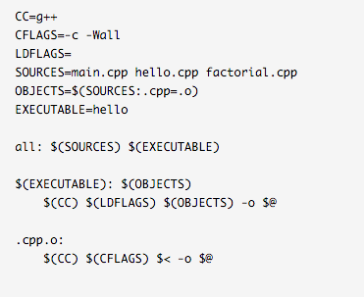
You got 30 seconds
to decrypt this tiny
script ..

Slide 7
Snakemake
rule
A.txt
B .txt
2016-01-10
09:59:59
2016-01-10
10:00:00
rule copy:
input:
“A.txt” output:
“B.txt”
shell:
“cp {input} {output}”
rule based
file based
scalable
scripting include
readable (python syntax)
no wrappers needed

Slide 8
Advanced
rule overlap:
input:
bed = “A.bed”,
bam = “B1.bam”
output:
“overlap.txt”
message:
“calculating overlaps between {input.bed} and {input.bam}”
log:
“overlap.log”
threads:
3 version:
shell(“customProgram –-version”)
resources:
gpu = 1
params:
“-s”
shell:
“customProgram {params} –t {threads} –abam {input.bam} \
–b {input.bed} > {output} 2> {log}”

Slide 9


-i 25
-p 4
> YB
….(())...
(()).......(.
123.52
> YB
ACGATA
CAGAG
GCGCCG
/bin/bash
>ENO
....((())))
().....(())..
243.42
.csv
YB, 12
ENO1, 24
GAPDH, 1
PKA2, 122
> EN
GACACA
GGGGGC
TACACA
> AR
GGGGCC
CATAC
ACACAA
> AR
GGGGCC
CATAC
ACACAA
Logs
rule create_csv
rule calculate_structure
rule create_graphics
Snakemake

Slide 10
Dependency management
> YB
ACGATA
CAGAG
GCGCCG
> YB
….(())...
(()).......(.
123.52
.csv
YB, 12
ENO1, 24
GAPDH, 1
PKA2, 122
> EN
GACACA
GGGGGC
TACACA
>ENO
....((())))
().....(())..
243.42
.csv
YB, 12
ENO1, 24
GAPDH, 1
PKA2, 122
> AR
GGGGCC
CATAC
ACACAA
> AR
GGGGCC
CATAC
ACACAA

Slide 11
Patterns
sample1_A.txt, sample1_B.txt,
sample1_C.txt, sample2_A.txt,
sample2_B.txt, sample2_C.txt
SAMPLES = “sample1 sample2”.split()
REP = “A B C”.split()
rule summarize:
input:
expand(“{samples}_{rep}.txt”, rep=REP, samples=SAMPLES)
output:
“summary.txt”
shell:
“python myscript.py {input} > {output}”

Slide 12
Wildcard rules
rule map:
input:
“{sample}.sam”
output:
“{sample}.bam”
shell:
“somecommand {input} {output}”

Slide 13
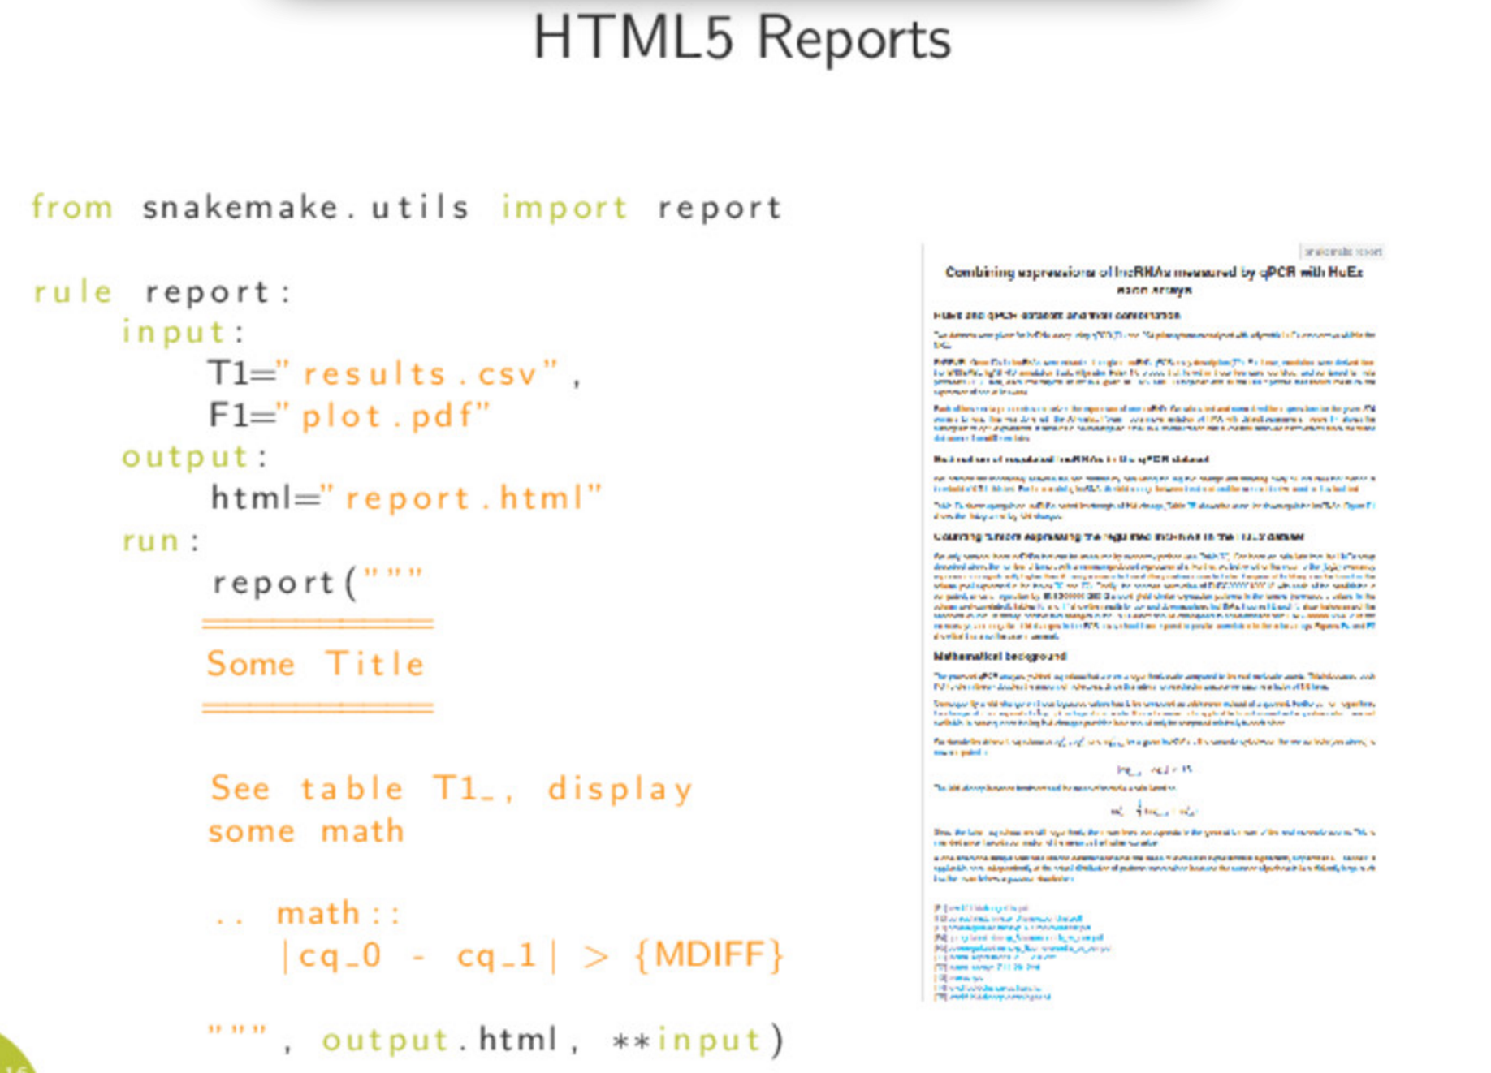
(from speakerdeck.com)

Slide 14
Usage / export to cluster
snakemake
snakemake –j 8
snakemake –j 20 –-cluster “bsub”

Slide 15
Thank you for listening. Let’s try it!

Slide 16
Get your files
> ssh schroedinger.embl.de
> sh /g/hentze/public/snakemake.sh
(or > git clone https://git.embl.de/schwarzl/snakemake-tutorial.git)
> cd snakemake-tutorial/00-start

Slide 17
First example
A.fasta
B.fasta
> A
GACACA
GGGGGC
TACACA
> B
CCCCCC
GGGGG
TTTTTT
Input files
A.fasta B.fasta
snakemake file
Snakefile
sum.txt
A 12
B 24
extract.txt
12
24

Slide 18
First rules
A.fasta
B.fasta
rule summarize:
> A
GACACA
GGGGGC
TACACA
> B
CCCCCC
GGGGG
TTTTTT
input:
“A.fasta”,
“B.fasta”
output:
“sum.txt”
sum.txt
shell:
“wc –c {input} > {output}”
20 A
66 B
rule extract:
input:
“sum.txt”
extract.txt
output:
“extract.txt”
20
66
shell:
“cut -f1 –d ‘ ‘ {input} > {output}”

Slide 19
Run the rules on its own
A.fasta
B.fasta
> A
GACACA
GGGGGC
TACACA
> B
CCCCCC
GGGGG
TTTTTT
> snakemake summarize
sum.txt
20 A
66 B
> snakemake extract
extract.txt
20
66
> rm sum.txt extract.txt

Slide 20
Add the default rule
A.fasta
B.fasta
Add the rule to the top of the Snakefile
> A
GACACA
GGGGGC
TACACA
> B
CCCCCC
GGGGG
TTTTTT
rule all:
input:
“extract.txt”
sum.txt
20 A
66 B
simply run
> snakemake
cleaning up
extract.txt
> rm sum.txt extract.txt
20
66

Slide 21
Add a clean rule
A.fasta
B.fasta
Snakefile
> A
GACACA
GGGGGC
TACACA
> B
CCCCCC
GGGGG
TTTTTT
rule clean:
shell:
“rm –f extract.txt sum.txt”
sum.txt
20 A
66 B
then run
> snakemake clean
extract.txt
20
66

Slide 22
Catchup
Folder 01-example/

Slide 23
Execute
> snakemake # executes rule ‘all’
> snakemake –n # dry run
> snakemake –p # print out the commands

Slide 24
Add a message
Snakefile
rule summarize:
input:
“A.fasta”,
“B.fasta”
output:
“extract.txt”
message:
“summarizing counts from {input} and creating {output}”
shell:
“wc –c {input} > {output}”

Slide 25
expand() – use variables for names
Snakefile
SAMPLES = “A B”.split()
rule summarize:
input:
expand(“{samples}.fasta”, samples=SAMPLES)
output:
“sum.txt”
message:
“summarizing counts from {input} and creating {output}”
shell:
“wc –c {input} > {output}”
> snakemake clean
> snakemake

Slide 26
Catchup
Folder 02-expand/

Slide 27
Add a temporary variable
A.fasta
B.fasta
> A
GACACA
GGGGGC
TACACA
> B
CCCCCC
GGGGG
TTTTTT
sum.txt
20 A
66 B
We do not really need to keep this!
extract.txt
20
66

Slide 28
Add a temporary
Snakefile
SAMPLES = “A B”.split()
rule summarize:
input:
expand(“{samples}.fasta”, samples=SAMPLES)
output:
temp(“sum.txt”)
message:
“extracting counts from {input} and creating {output}”
shell:
“wc –c {input} > {output}”
> snakemake clean
> snakemake

Slide 29
Dynamic read-in
Snakefile
SAMPLES, = glob_wildcards(“{samples}.fasta”)
rule summarize:
input:
expand(“{samples}.fasta”, samples=SAMPLES)
output:
temp(“sum.txt”)
message:
“extracting counts from {input} and creating {output}”
shell:
“wc –c {input} > {output}”
> snakemake clean
> snakemake

Slide 30
Add another file
Create a file C.fasta
> snakemake clean
> snakemake

Slide 31
Modify a file
A.fasta
B.fasta
> A
GACACA
GGGGGC
TACACA
> B
CCCCCC
GGGGG
TTTTTT
> touch B.fasta
sum.txt
20 A
66 B
> snakemake
extract.txt
20
66

Slide 32
Catchup
Folder 03-dynamic/

Slide 33
Add a log file
Snakefile
rule summarize:
input:
“{samples}.fasta”
output:
“sum.txt”
message:
“extracting counts from {input} and creating {output}”
log:
“sum.log”
shell:
“wc –c {input} > {output} 2> {log}”
> snakemake clean
> snakemake

Slide 34
Run it on the cluster
> snakemake --cluster ‘bsub –o /dev/null’

Slide 35
Local rules
Snakefile
localrules: all, extract
rule summarize:
input:
“{samples}.fasta”
output:
“extract.txt”
…

Slide 36
Catchup
Folder 04-cluster/

Slide 37
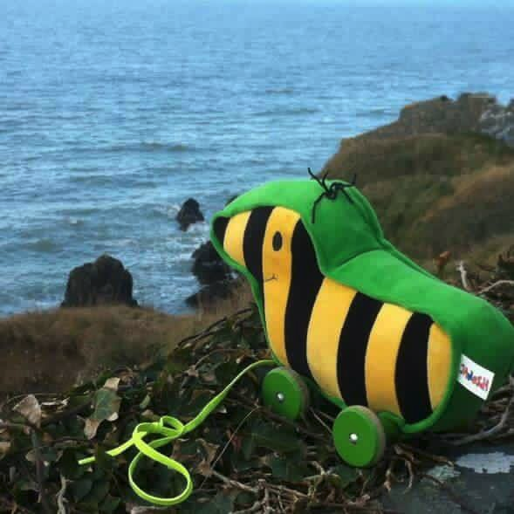
Last exercise!
Please use folder
05-foreach/

Slide 38
Understand what expand() does
Snakefile
SAMPLES = “A.fasta B.fasta”.split()
rule summarize:
input:
expand(“{samples}.fasta”, samples=SAMPLES)
output:
“sum.txt”
message:
“extracting counts from {input} and creating {output}”
shell:
“wc –c {input} > {output}”
> wc –c A.fasta B.fasta > extract.txt

Slide 39
Wildcard rules: for each
For every file do something
A.fasta
B.fasta
> A
GACACA
GGGGGC
TACACA
> B
CCCCCC
GGGGG
TTTTTT
A.sum
B.sum
20 A
20 B

Slide 40
Wildcard rules: for each
2 rules:
1) We require
A.sum B.sum
2) Wildcard rule
*fasta → *sum.txt
A.fasta
B.fasta
> A
GACACA
GGGGGC
TACACA
> B
CCCCCC
GGGGG
TTTTTT
A.sum
B.sum
20 A
20 B

Slide 41
1) We require A.sum B.sum
Snakefile
SAMPLES, = glob_wildcards(“{samples}.fasta”)
rule all:
input:
expand(“{samples}.sum”, samples = SAMPLES)

Slide 42
2) Wildcard rule
Snakefile
SAMPLES, = glob_wildcards(“{samples}.fasta”)
rule all:
input:
expand(“{samples}.sum”, samples = SAMPLES)
rule do_sum:
input:
“{sample}.fasta”
output:
“{sample}.sum”
shell:
“wc –c {input} > {output}”

Slide 43
Catchup
> snakemake
> snakemake clean
> snakemake –j 5
Folder 06-foreach-complete/

Slide 44
Outlook for next tutorial
Config files
Cluster config
Advanced Patterns
Mixing with python
Advanced reports
Visualization of execution
Sub wWorkflow sharing
orkflows etc

Slide 45
Thank you very much!
Thanks GBCS for organizing!

