Slide 1
Public repositories
Open https://pad.carpentries.org/2021-10-21_ed-dash_fair-bio-practice

Slide 2
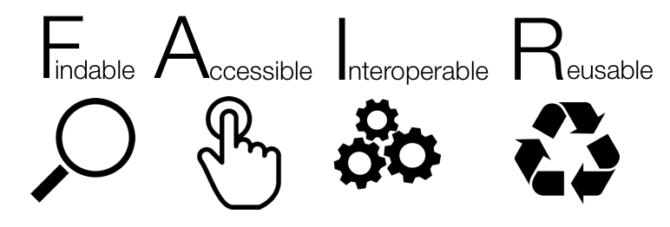

Slide 3

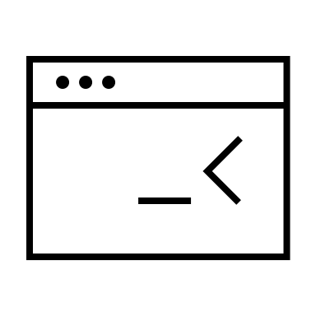

Research data repositories are online repositories that enable the preservation, curation and publication of research ‘products’:
data
code
protocols

Slide 4
Repositories are crucial for
FINDABLE and ACCESSIBLE

Slide 5

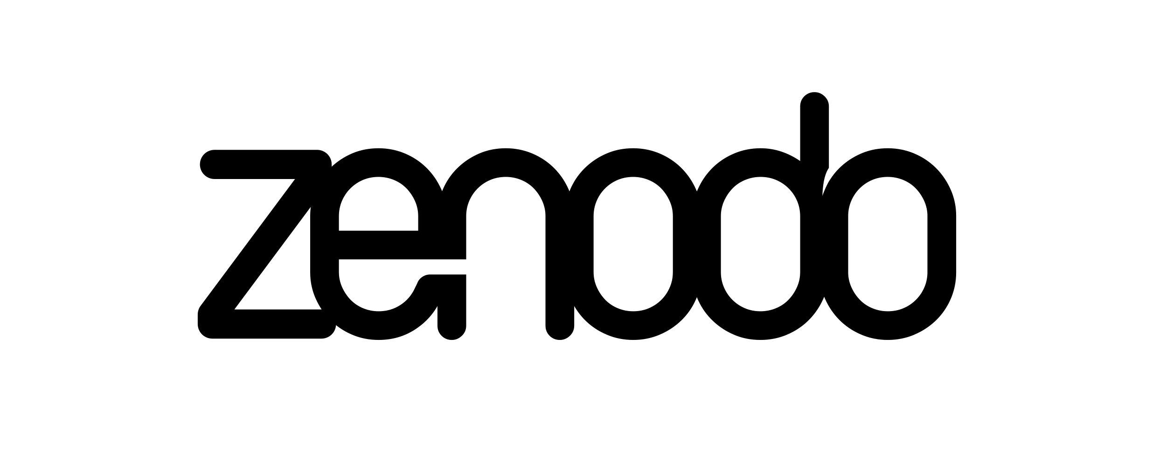

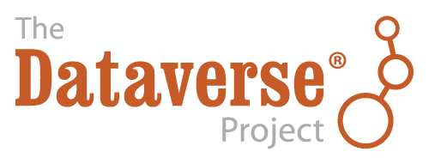

There are general “data agnostic” repositories
[Dryad](http://datadryad.org)
[Zenodo](http://zenodo.org)
[FigShare](http://figshare.com)
[Dataverse](http://dataverse.org)

Slide 6




Or “domain” (type) specific repositories
[UniProt](https://www.uniprot.org/) – protein data
[GenBank](https://www.ncbi.nlm.nih.gov/genbank/) – sequence data
[MetaboLights](https://www.ebi.ac.uk/metabolights/) – metabolomics data
[GitHub](https://github.com/) – for code

Slide 7
Public record
https://doi.org/10.5281/zenodo.5045374

Slide 8
Dataset discovery
https://doi.org/10.5281/zenodo.5045374

Slide 9
General repositories are a good place to keep your data separate from a paper.
It gives access to all files, allowing you to cite the data as well (or instead of) the paper.
But they are not great in data discovery and agreggation.

Slide 10
Minimal data set (after PLOS)
Minimal data set to consist of the data required to replicate all study findings reported in the article, as well as related metadata and methods.
The values behind the means, standard deviations and other measures reported
The values used to build graphs
The points extracted from images for analysis.
(no need for raw data if the standard in the field is to share data that have been processed)
https://journals.plos.org/plosbiology/s/data-availability

Slide 11
Domain specific repositories
Higher exposure
Data specific features (e.g. Visulization)
Enforced minimal metadata
API for data retrival / agregation /searching
Curated data
Better searching
Interlinking between data types

Slide 12
Domain specific repositories
Exercise

Slide 13
Finding repositories – use recommendations
[BioMed Central / Springer Nature] - (https://www.springernature.com/gp/authors/research-data-policy/recommended-repositories)
[eLife] - (https://submit.elifesciences.org/html/elife_author_instructions.html#policies)
[Elsevier] - (https://www.elsevier.com/about/policies/research-data)
[EMBO Press] - (https://www.embopress.org/page/journal/14602075/authorguide#datadeposition)
[F1000 Research] - (https://f1000research.com/for-authors/data-guidelines)
[GIGAscience - OUP] - (https://academic.oup.com/gigascience/pages/instructions_to_authors)
[PLoS] - (https://journals.plos.org/plosbiology/s/recommended-repositories)
[Scientific Data - Nature] - (https://www.nature.com/sdata/policies/repositories)
[Taylor and Francis] - (https://authorservices.taylorandfrancis.com/data-sharing-policies/repositories/)
[BBSRC] - (https://bbsrc.ukri.org/research/resources/)
[NERC] - (https://nerc.ukri.org/research/sites/environmental-data-service-eds/policy/)
[Royal Society] - (https://royalsociety.org/journals/ethics-policies/data-sharing-mining/)
[Wellcome Open Research] - (https://wellcomeopenresearch.org/for-authors/data-guidelines)

Slide 14
Finding repositories
FAIRSharing.org – search engine
Repositories
Data standards
Policies
(too) many options for each type

Slide 15
Finding repository
Exercise

Slide 16
Evaluating a data repository
1. Who is behind it? What is its funding?
2. Quality of interaction/interface: is the interaction for purposes of data deposit or reuse efficient,
effective and satisfactory for you?
3. Take-up and impact:
what can I put in it? is anyone else using it? will others be able to find stuff deposited in it? is the repository linked to other data repositories? can others cite the data?
4. Policy and process: does it help meeting community standards, good practices and policies? is it curated?

Slide 17
Repositories Summary
Find suitable repository(ies) as soon as you get your data
If repository permits embargo deposit data as soon as you get it (especially if analysed externally)
Deposit simultaneously to a very specialized repo and a „main stream” one (better discovery)
Cross link your repositories’ records
Add data availability section to your papers and list all the public records
List your data sets in ORCID

Slide 18
Repositories and FAIR
Why is choosing a domain specific repositoriy over zenodo more FAIR?
How can selecting a repository for your data as soon as you do an experiment (or even before!) benefit you research and help your data become FAIR?
What’s your favourite research data repository? Why?

