Slide 1

Public repositories
Open https://link

Slide 2
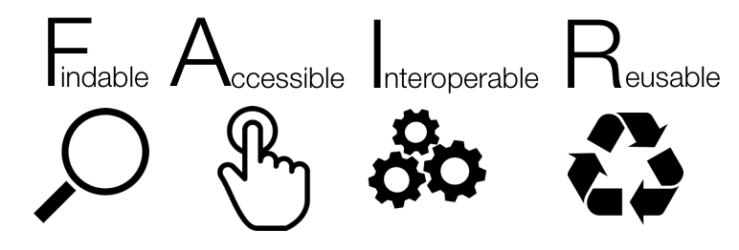

Slide 3
FAIR principles
Findable: Easy to find the data and the metadata for both humans and computers. Automatic and reliable discovery of datasets and services depends on machine-readable persistent identifiers (PIDs) and metadata.
Accessible: The (meta)data retrievable by their identifier using a standardised and open communications protocol (including authentication and authorisation). Metadata should be available even when the data are no longer available.
Interoperable: The data should be able to be combined with and used with other data or tools. The format of the data should be open and interpretable for various tools. It applies both to the data and metadata, the (meta)data should use vocabularies that follow FAIR principles.
Re-usable: FAIR aims at optimising the reuse of data. Metadata and data should be well-described so that they can be replicated and/or combined in different settings. The reuse of the (meta)data should be stated with clear and accessible license(s)

Slide 4
Research data repositories are online repositories that enable the preservation, curation and publication of research ‘products’:
data
code
protocols

Slide 5
There are general "data agnostic" repositories, for example:
[Dryad](http://datadryad.org),
[Zenodo](http://zenodo.org),
[FigShare](http://figshare.com),
[Dataverse](http://thedata.org).
Or domain specific, for example:
[UniProt](https://www.uniprot.org/) protein data,
[GenBank](https://www.ncbi.nlm.nih.gov/genbank/) sequence data,
[MetaboLights](https://www.ebi.ac.uk/metabolights/) metabolomics data
[GitHub](https://github.com/) for code.

Slide 6
Public record
https://doi.org/10.5281/zenodo.5045374

Slide 7
Dataset discovery
https://doi.org/10.5281/zenodo.5045374

Slide 8
General repositories are a good place to keep your data separate from paper.
It gives access to all files, allowing you to cite the data as well (or instead of) the paper.
But they are not great in data discovery and agreggation.

Slide 9
Minimal data set (after PLOS)
Minimal data set to consist of the data required to replicate all study findings reported in the article, as well as related metadata and methods.
The values behind the means, standard deviations and other measures reported;
The values used to build graphs;
The points extracted from images for analysis.
(no need for raw data if the standard in the field is to share data that have been processed)
https://journals.plos.org/plosbiology/s/data-availability

Slide 10
Domain specific repositories

Slide 11
Domain specific repositories
Higher exposure
Data specific features (e.g. Visulization)
Enforced minimal metadata
API for data retrival / agregation /searching
Curated data
Better searching
Interlinking between data types

Slide 12
Finding repository
Use recommendations:
- [BioMed Central / Springer Nature](https://www.springernature.com/gp/authors/research-data-policy/recommended-repositories)
- [eLife](https://submit.elifesciences.org/html/elife_author_instructions.html#policies)
- [Elsevier](https://www.elsevier.com/about/policies/research-data)
- [EMBO Press](https://www.embopress.org/page/journal/14602075/authorguide#datadeposition)
- [F1000 Research](https://f1000research.com/for-authors/data-guidelines)
- [GIGAscience - OUP](https://academic.oup.com/gigascience/pages/instructions_to_authors)
- [PLoS](https://journals.plos.org/plosbiology/s/recommended-repositories)
- [Scientific Data - Nature](https://www.nature.com/sdata/policies/repositories)
- [Taylor and Francis](https://authorservices.taylorandfrancis.com/data-sharing-policies/repositories/)
- [BBSRC](https://bbsrc.ukri.org/research/resources/)
- [NERC](https://nerc.ukri.org/research/sites/environmental-data-service-eds/policy/)
- [Royal Society](https://royalsociety.org/journals/ethics-policies/data-sharing-mining/)
- [Wellcome Open Research](https://wellcomeopenresearch.org/for-authors/data-guidelines)

Slide 13
Finding repository
FAIRSharing.org – search engine

Slide 14
Evaluating a data repository
Who is behind it? What is its funding?
Quality of interaction/interface: is the interaction for purposes of data deposit or reuse efficient, effective and satisfactory for you?
Take-up and impact:
what can I put in it? is anyone else using it? will others be able to find stuff deposited in it? is the repository linked to other data repositories? can others cite the data?
Policy and process: does it help meeting community standards, good practices and policies? is it curated

Slide 15
Repositories and FAIR
Why is choosing a domain specific repositories over zenodo more FAIR?
How can selecting a repository for your data as soon as you do an experiment (or even before!) can benefit you research and help your data become FAIR?
What’s your favourite research data repository? Why?

