Slide 1
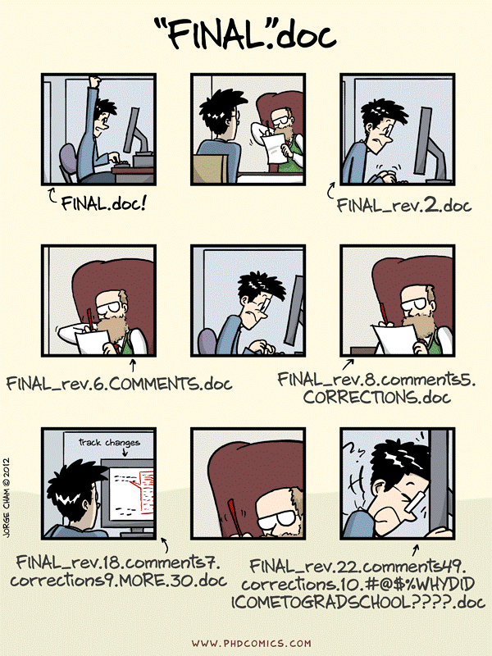

Version control
Open https://link

Slide 2
Projects are not static, and actions introduce changes.
With version control, file names do not reflect their versions. Information about versions and changes are kept separate from the files.

Slide 3
Exercise 1:
Problems with a change

Slide 4
Manual versioning
Add a file called ’CHANGELOG.txt’ to the project's subfolder, and make dated notes about changes in reverse chronological order.
Copy the entire project whenever a significant change is made, and store in a sub-folder.
Keep changes small.
Store each project in a folder that is mirrored off the researcher's working machine
Share changes frequently.

Slide 5
Exercise 2:
Manual versioning

Slide 6
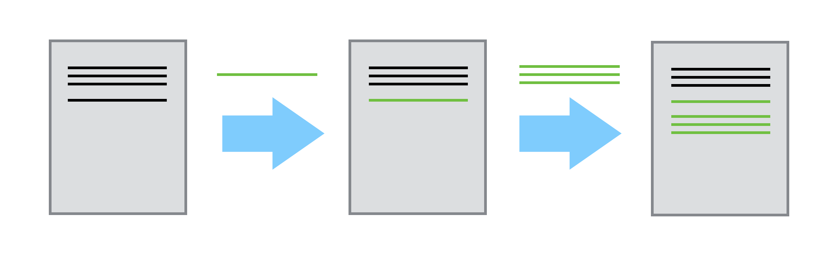
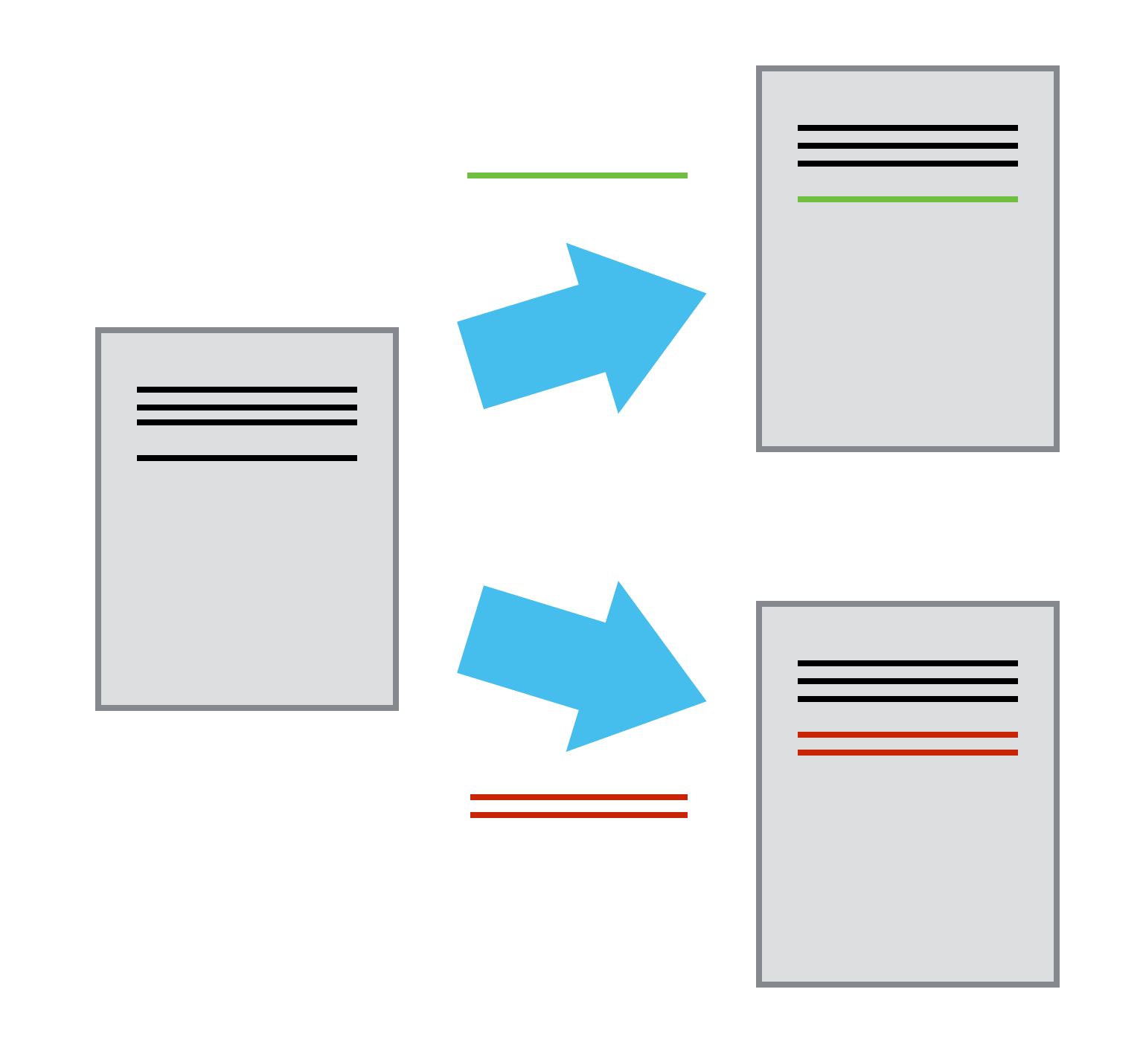
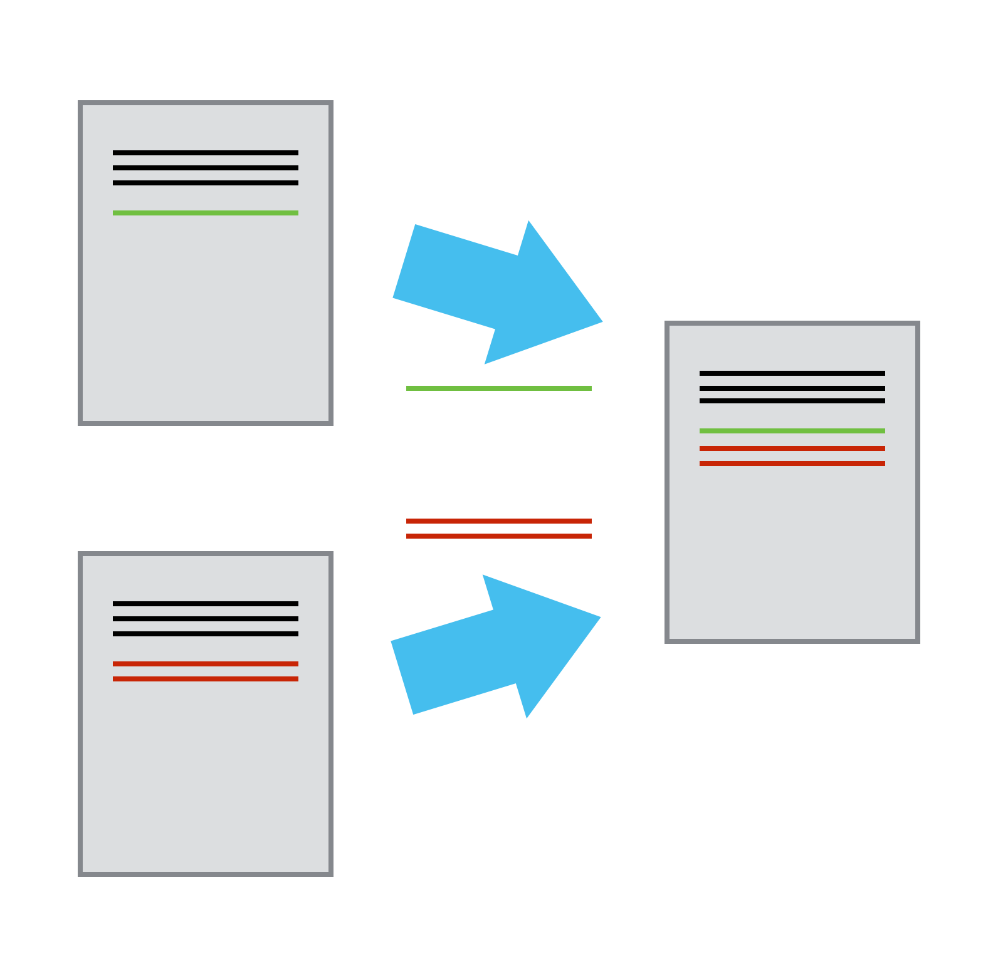
Version control systems
Tool-based version control has several benefits over manual version control

Slide 7
Exercise 3:
Changelog in action

Slide 8
Looking at the reasons to use a version control system (VCS) in research, how does using VCS help in being FAIR?
Notes:
Online respository is a Findable and Accessible resource (also Trackable).
Online repositories are also interoperable since they can be accessed from anywhere (with internet) and are not restricted to your local hard drive.
The 'telling story' and being able to travel back in time helps in reuse and reproducibility.

Slide 9
Useful (Git) resources
Software Carpentry git workshop https://swcarpentry.github.io/git-novice/
Edinburgh Carpentries runs courses: https://edcarp.github.io/
https://ourcodingclub.github.io/tutorials/git/
Crash course on youtube: https://youtu.be/SWYqp7iY_Tc
Learn git branching: https://learngitbranching.js.org/
Learn git-game: https://github.com/git-game/git-game

Slide 10
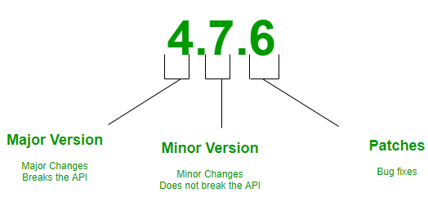
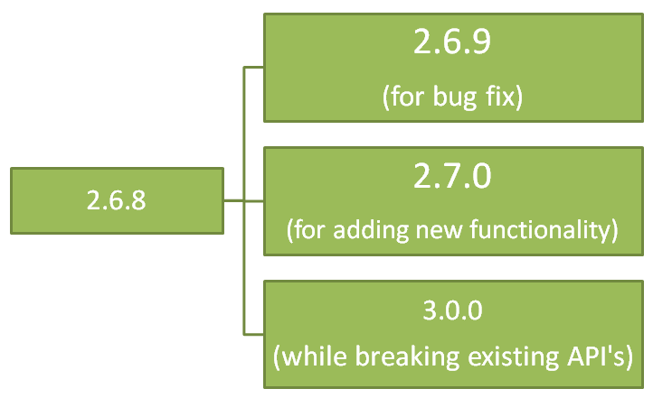
Semantic versioning

