Slide 1


(Meta)data in Excel
Open https://link to pad

Slide 2
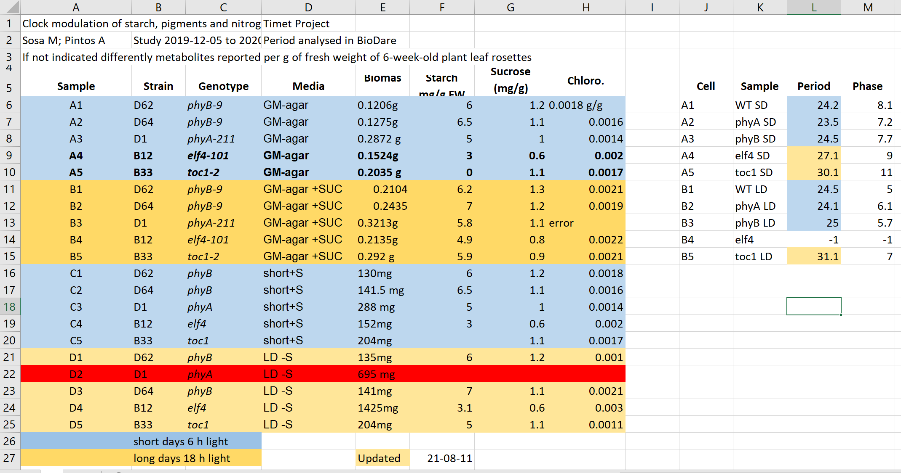
Exercise 1:
What can go wrong with data in Excel

Slide 3
Common spreadsheet errors
Using multiple tables
Confuses both humans and computers.
Using multiple tabs
Harder to do programmatic analysis and can be missed, but can be a good place to put secondary data. Use with caution.
Not filling in zeros
Zero can mean no data recorded, but a computer will treat the value as zero. Therefore, record zeros as zeros and missing data as nulls.
Using problematic null values
Best to record nulls as blanks in data fields, and keep a neighbouring column to comment that it’s null.
Using formatting to convey information organising data
Computers can’t interpret formatting easily. Better to keep a column/ field to record that data. Don’t merge cells.

Slide 4
Common spreadsheet errors
Placing comments or units in cells
Computers struggle with these
Entering 1< piece of information in a cell
Keep 1 data in each cell, and use as many cells as necessary
Inconsistency in used values
Be consistent!
Using problematic field names
Underscores not spaces. Avoid abbreviations. Include units.
Using special characters in data
Computers struggle with these
Good Name | Good Alternative | Avoid
Max_temp_C | MaxTemp | Maximum Temp (°C)
Precipitation_mm | Precipitation | precmm
Mean_year_growth | MeanYearGrowth | Mean growth/year
sex | sex | M/F
weight | weight | w.
cell_type | CellType | Cell Type
Observation_01 | first_observation | 1st Obs
Values without fields: always label values with column headers

Slide 5
Exercise 2:
Spotting problems

Slide 6
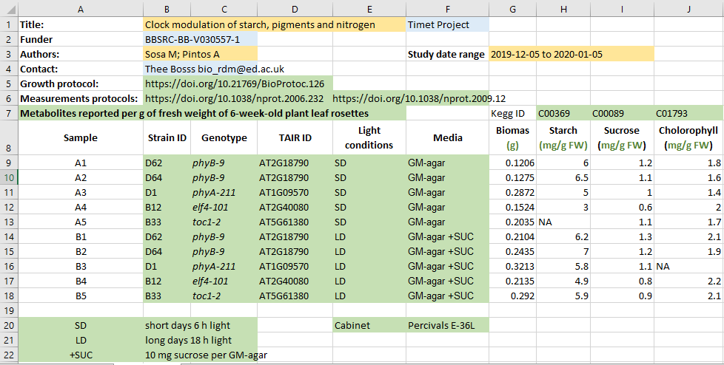
Better metadata
Do you think it would take more effort to record the data this way compared to the example before?
How long do you think it took to "clean" the original, problematic data?

Slide 7
Exercise 3:
Open excel and type following values into the cells:
Is what you see what you typed?
Can you force Excel to keep your formatting?
Do you know which year the dates represent?
A | B | C | D | E | F
Gene | SEPT2 | Sample | 0013 | Record | 12/5/4
Mar1 | 1 March | Mar-1 | 1-3 | 14/3/20 | 43904

Slide 8
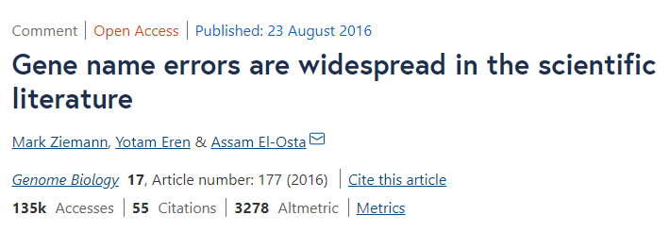
Outsmarted by Excel
Roughly 1 in 5 of 3,600 genetics papers included errors in their gene lists that were due to Excel automatically converting gene names to things like calendar dates or random numbers.
When using text files (.csv, .tsv), You should always document what format you are using to represent dates.

Slide 9

Cleaning data with Open Refine
https://openrefine.org/
A powerful tool for working with messy data: cleaning it; transforming it from one format into another; and extending it with web services and external data.
There is a carpentry course available: Data Cleaning with OpenRefine for Ecologists

