Slide 1
What do you call data that describes data?
Metadata
Open https://pad.carpentries.org/2021-10-19_ed-dash_fair-bio-practice

Slide 2
Metadata is data about the data!
Metadata is the description of data
permits understanding and interpretation of data
as important as your data
It should be continuously added to your research data
Metadata can be produced in an automated way or manually

Slide 3
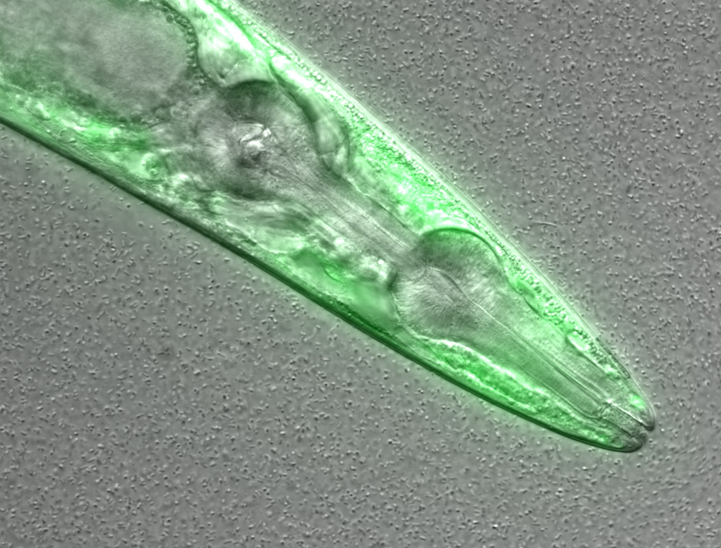
This is a confocal microscopy image of a C. elegans nematode strain used as a proteostasis model, which was deposited in a Public Omero Server.
What information can you guess without the associated description (metadata)?
Figure credits: María Eugenia Goya
Notes:
Image metadata
Name: OP50 D10Ad_06.czi Image ID: 3485 Owner: Maria Eugenia Goya ORCID: 0000-0002-5031-2470
Acquisition Date: 2018-12-12 17:53:55 Import Date: 2020-04-30 22:38:59 Dimensions (XY): 1344 x 1024 Pixels Type: uint16 Pixels Size (XYZ) (µm): 0.16 x 0.16 x 1.00 Z-sections/Timepoints: 56 x 1 Channels: TL DIC, TagYFP ROI Count: 0
Tags: time course; day 10; adults; food switching; E. coli OP50; NL5901; C. elegans
Dataset metadata
Name: Figure2_Figure2B Dataset ID: 263 Owner: Maria Eugenia Goya ORCID: 0000-0002-5031-2470
Description: The datasets contains a time course of α-syn aggregation in NL5901 C. elegans worms after a food switch at the L4 stage:
E. coli OP50 to OP50 Day 01 adults Day 03 adults Day 05 adults Day 07 adults Day 10 adults Day 13 adults
E. coli OP50 to B. subtilis PXN21 Day 01 adults Day 03 adults Day 05 adults Day 07 adults Day 10 adults Day 13 adults
Images were taken at 6 developmental timepoints (D1Ad, D3Ad, D5Ad, D7Ad, D10Ad, D13Ad)
* Some images contain more than one nematode.
Each image contains ~30 (or more) Z-sections, 1 µmeters apart. The TagYFP channel is used to follow the alpha-synuclein particles. The TL DIC channel is used to image the whole nematode head.
These images were used to construct Figure 2B of the Cell Reports paper (https://doi.org/10.1016/j.celrep.2019.12.078).
Creation date: 2020-04-30 22:16:39
Tags: protein aggregation; time course; E. coli OP50 to B. subtilis PXN21; food switching; E. coli OP50; 10.1016/j.celrep.2019.12.078; NL5901; C. elegans

Slide 4
Life example of metadata types
Figure credits: María Eugenia Goya
https://publicomero.bio.ed.ac.uk/webclient/?show=project-58
https://publicomero.bio.ed.ac.uk/webclient/?show=dataset-231
Notes:
Image metadata
Name: OP50 D10Ad_06.czi Image ID: 3485 Owner: Maria Eugenia Goya ORCID: 0000-0002-5031-2470
Acquisition Date: 2018-12-12 17:53:55 Import Date: 2020-04-30 22:38:59 Dimensions (XY): 1344 x 1024 Pixels Type: uint16 Pixels Size (XYZ) (µm): 0.16 x 0.16 x 1.00 Z-sections/Timepoints: 56 x 1 Channels: TL DIC, TagYFP ROI Count: 0
Tags: time course; day 10; adults; food switching; E. coli OP50; NL5901; C. elegans
Dataset metadata
Name: Figure2_Figure2B Dataset ID: 263 Owner: Maria Eugenia Goya ORCID: 0000-0002-5031-2470
Description: The datasets contains a time course of α-syn aggregation in NL5901 C. elegans worms after a food switch at the L4 stage:
E. coli OP50 to OP50 Day 01 adults Day 03 adults Day 05 adults Day 07 adults Day 10 adults Day 13 adults
E. coli OP50 to B. subtilis PXN21 Day 01 adults Day 03 adults Day 05 adults Day 07 adults Day 10 adults Day 13 adults
Images were taken at 6 developmental timepoints (D1Ad, D3Ad, D5Ad, D7Ad, D10Ad, D13Ad)
* Some images contain more than one nematode.
Each image contains ~30 (or more) Z-sections, 1 µmeters apart. The TagYFP channel is used to follow the alpha-synuclein particles. The TL DIC channel is used to image the whole nematode head.
These images were used to construct Figure 2B of the Cell Reports paper (https://doi.org/10.1016/j.celrep.2019.12.078).
Creation date: 2020-04-30 22:16:39
Tags: protein aggregation; time course; E. coli OP50 to B. subtilis PXN21; food switching; E. coli OP50; 10.1016/j.celrep.2019.12.078; NL5901; C. elegans

Slide 5
Types of metadata
Administrative: relevant to managing it
e.g. Experimental code, PI
Descriptive/citation: assists with discovery/identity
e.g. Authors, persistent identifier
Structural: how the data came about & is structured
e.g. Collection method, folder structures

Slide 6
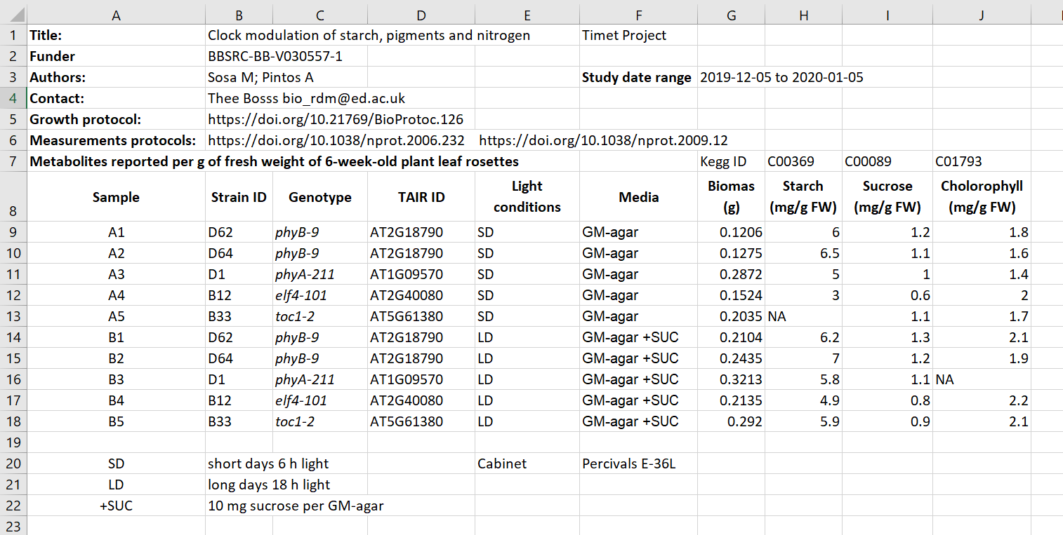
Exercise/challenge 1:
Identifying metadata types
Figure credits: Tomasz Zielinski and Andrés Romanowski
Notes:
In groups, identify different types of metadata (administrative, descriptive, structural) present in this example.

Slide 7
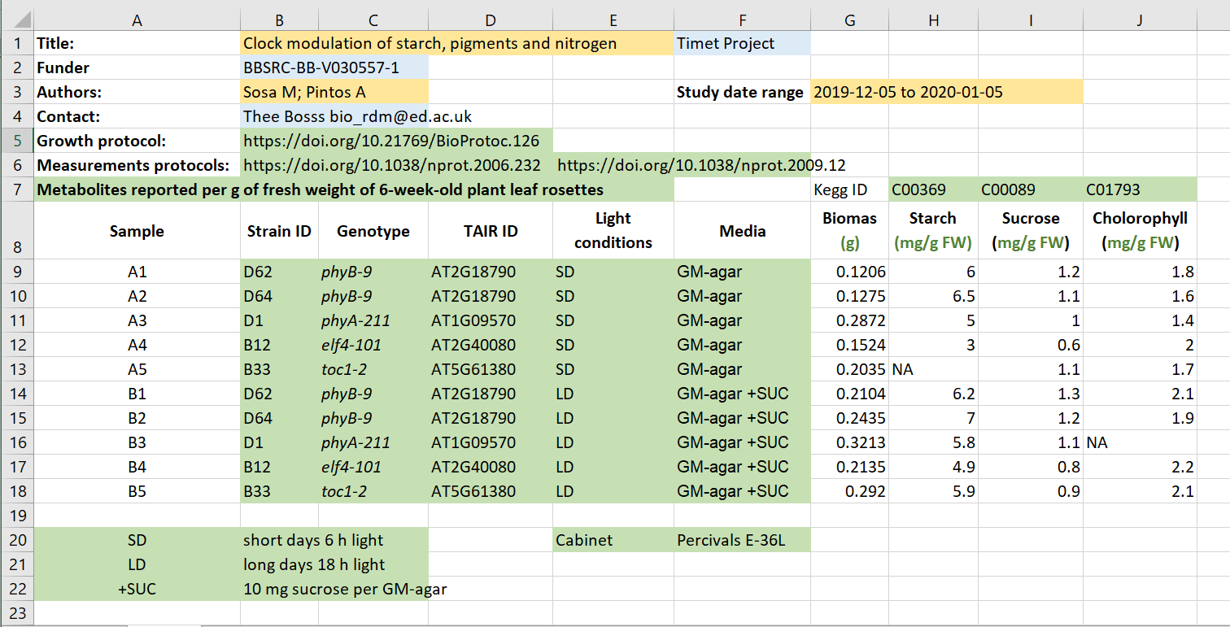
Exercise/challenge 1:
Identifying metadata types
Administrative
Descriptive
Structural
Figure credits: Tomasz Zielinski and Andrés Romanowski

Slide 8
Where does data end and metadata start?
What is "data" and what is "metadata" can be a matter of perspective:
Some researchers' metadata can be other researchers' data.
Think of an example from our „excel” table
Notes:
What can you do if there are no metadata standards defined for your data / field of research?
Think about the minimum information that someone else (from your lab or from any other lab in the world) would need to know about your dataset to be able to work with it without any further inputs from you.
Think as a consumer of your data not the producer!

Slide 9
Figure credits: Tomasz Zielinski and Andrés Romanowski
Notes:
In groups, identify different types of metadata (administrative, descriptive, structural) present in this example.

Slide 10

What to include in metadata
The minimum information standard
set of guidelines for reporting data derived by relevant methods in biosciences
ensures that the data can be easily verified, analysed and clearly interpreted by the community.
Minimum Information for Biological and Biomedical Investigations (MIBBI)
is the collection of the most known standards:
https://fairsharing.org/collection/MIBBI
Notes:
What can you do if there are no metadata standards defined for your data / field of research?
Think about the minimum information that someone else (from your lab or from any other lab in the world) would need to know about your dataset to be able to work with it without any further inputs from you.
Think as a consumer of your data not the producer!

Slide 11
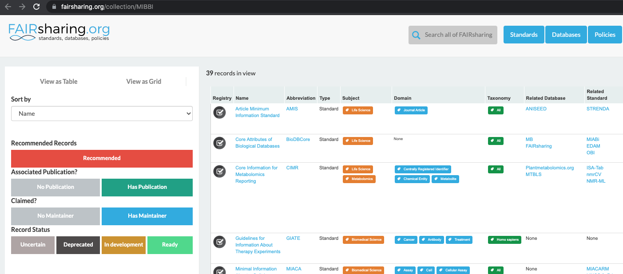
Minimum information standards
Notes:
What can you do if there are no metadata standards defined for your data / field of research?
Think about the minimum information that someone else (from your lab or from any other lab in the world) would need to know about your dataset to be able to work with it without any further inputs from you.
Think as a consumer of your data not the producer!

Slide 12

Exercise: Minimal information example
Minimum Information about a Neuroscience Investigation (MINI) Electrophysiology
https://www.nature.com/articles/npre.2008.1720.1.pdf
Notes:
What can you do if there are no metadata standards defined for your data / field of research?
Think about the minimum information that someone else (from your lab or from any other lab in the world) would need to know about your dataset to be able to work with it without any further inputs from you.
Think as a consumer of your data not the producer!

Slide 13
What can you do if there are no metadata standards defined for your data/field of research?
Think about the minimum information that someone else (from your lab or from any other lab in the world) would need to know about your dataset to be able to work with it without any further inputs from you.
Think as a consumer about your data not the producer!

Slide 14
Exercise
What to include - discussion

Slide 15
Metadata and FAIR guidelines
Metadata provides extreme valuable information for us and others to be able to interpret, process, reuse and reproduce the research data it accompanies.
Because metadata are data about data, all of the FAIR principles i.e. Findable, Accessible, Interoperable and Reusable apply to metadata.
Ideally, metadata should not only be machine-readable, but also interoperable so that they can interlink or be reasoned about by computer systems.

Slide 16


Slide 17
Quiz

