Slide 1

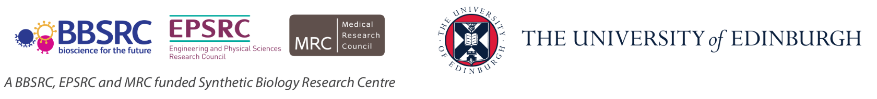
Biological Research
Data Management Team
Data Management at the University of Edinburgh
bio_rdm@ed.ac.uk

Slide 2
Your musts
According to policies (the School, the University and the funders):
You are responsible for the safety of your data (both storage and access)
You have to have DMP for your project
You have to publish with Open Access
You have to make available all the data underlying publications

Slide 3
You want to
Have as many public outputs as possible:
Datasets in public repositories
Public protocols
Code packages
Public engagement
Involvement in community groups, postdoc groups, societies, etc
for your Narrative CVs

Slide 4

Keeping safe your project files and folders
Back up (almost) everything created by a human or recorded by a machine as soon as it is created.
Always backup your files in 3 places, at least one should be off-site.
USB sticks are a failure-prone option and are not a valid solution for backup of scientific data
A robust backup cannot be achieved manually – the University gives you DataStore
Notes:
Do you know how and where to keep 3 copies of your data which are always up to date?
Secure data preservation is very difficult to achieve without institutional support and know-how. One option is cloud storage, but not all data may be put in a public cloud.
You should always check your institutional guidelines and what solutions are available in your organisation.

Slide 5
University resources - Storage
UoE DataStore
it looks like your computer disk (a network drive)
free (250GB + 250GB per staff/PGRs)
accessible from all computers
off-site backup and versioning/history of the files
easy sharing within the University
Dropbox like access vis DataSync

Slide 6
University resources - Storage
UoE DataStore
it looks like your computer disk (a network drive)
free (250GB + 250GB per student)
accessible from all computers
off-site backup and versioning/history of the files
easy sharing within the University
Dropbox like access vis DataSync
Please Use DataStore

Slide 7
University resources - Storage
UoE DataStore - using
Two areas
Group space (\\csce.datastore.ed.ac.uk\csce\biology\groups\YOUR-GROUP)
Private (\\csce.datastore.ed.ac.uk\csce\biology\users\YOUR_LOGIN)
Use group space for data!

Slide 8
University resources - Storage
UoE DataStore - using
You need VPN to connect from home
Depending on network speed, using it may be tricky for very large files
Instructions how to use:
https://www.ed.ac.uk/information-services/computing/desktop-personal/connect-uni-file-storage
BioRDM wiki (recipes for difficult use-cases)

Slide 9
University resources - Collaboration
Sharepoint / OneDrive
https://uoe-my.sharepoint.com
For documents, presentations, raports etc
Excellent for collaborative work on shared documents
Online versions of Word / Excel
Your desktop Word can directly sync with sharepoint files
DON’T bounce emails with your PI – co-edit on sharepoint!!!

Slide 10
University resources - Collaboration
UoE WIKI
https://www.wiki.ed.ac.uk
projects’ websites,
making notes, organizing files,
even a simple ELN
(can be private or public)
https://www.wiki.ed.ac.uk/display/RDMS

Slide 11

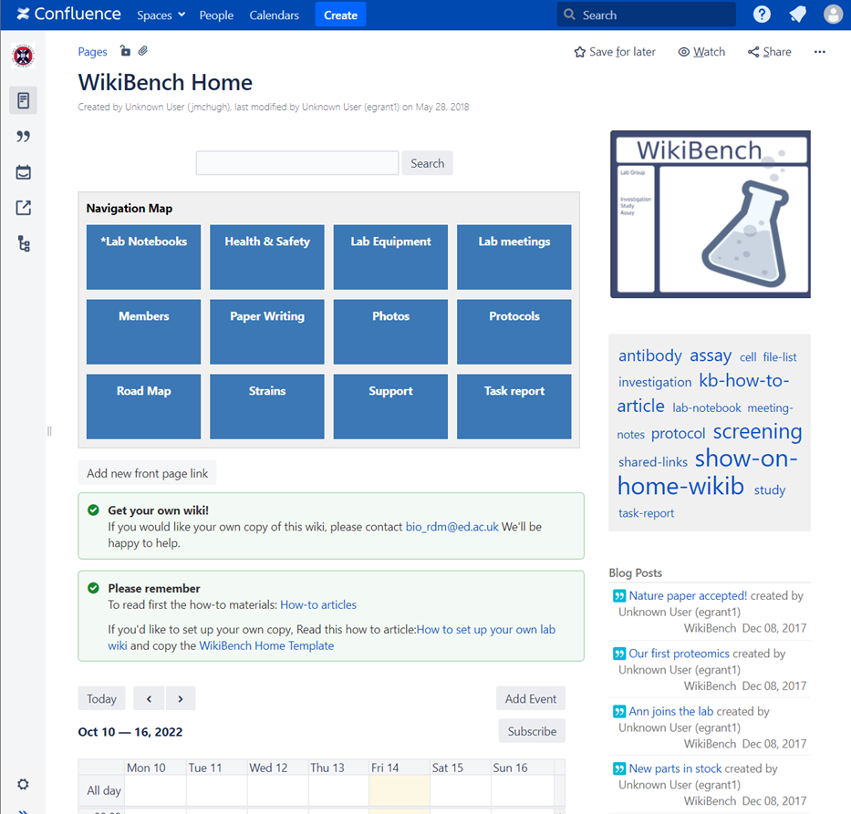



Which ELNs are used in SBS?
WikiBench (UoE Wiki)

Slide 12

University resources - protocols
Protocols.io
https://www.protocols.io/
(university pays for full version)
private and public (creates DOI)
versioning / forking
collaboration
good for group SOPs

Slide 13
University resources - DMP
DMPOnline
https://dmponline.ed.ac.uk
BioRDM wiki
https://www.wiki.ed.ac.uk/display/RDMS
ready to use paragraphs
recommended repositories

Slide 14
University resources - CODE
If you code (script) you should use GIT
(you need to learn it though)
A good start: https://swcarpentry.github.io/git-novice
Free GitHub (https://github.com)
The University one- GitLab (https://git.ecdf.ed.ac.uk)

Slide 15

University resources - repositories
UoE DataShare
https://datashare.ed.ac.uk/
for sharing public datasets (possible embargo period)
unlimited, free storage (250GB per dataset)
DOI
automatically creates records in your personal profile (UoE PURE)

Slide 16
University resources - archiving
UoE DataVault
https://datavault.ed.ac.uk/
for long term archiving (10 years)
DOI and records in PURE
can be paid upfront
retrieves files from the DataStore
works with files bundles == deposits

Slide 17
University resources - information
RDS page
https://www.ed.ac.uk/information-services/research-support/research-data-service
BioRDM wiki
https://www.wiki.ed.ac.uk/display/RDMS
(demo)

Slide 18
Learning
Practical recipes and guides:
https://faircookbook.elixir-europe.org/
https://rdmkit.elixir-europe.org/
Training
Ed-DASH https://edcarp.github.io/Ed-DaSH/index.html
UoE RDS https://www.ed.ac.uk/information-services/research-support/research-data-service

Slide 19
Research culture
Learn what you group does (does not) and why
Remember many early adopters got burnt
Do not be complicit in bad practices
Trigger change by example
Look for help (BioRDM)

Slide 20

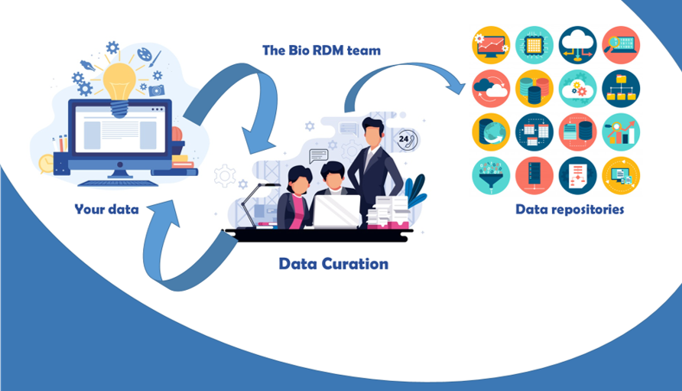
Need help? Just come talk to us!
Biological Research
Data Management Team
RDM as part of the workflow
bio_rdm@ed.ac.uk
https://www.wiki.ed.ac.uk/display/RDMS/
Notes:
Acquire description at earlier stages, split over the stages

Slide 21
Quiz and the feedback
at the end of the pad

