Slide 1
Working with files
Open https://pad.carpentries.org/2021-10-20_ed-dash_fair-bio-practice

Slide 2
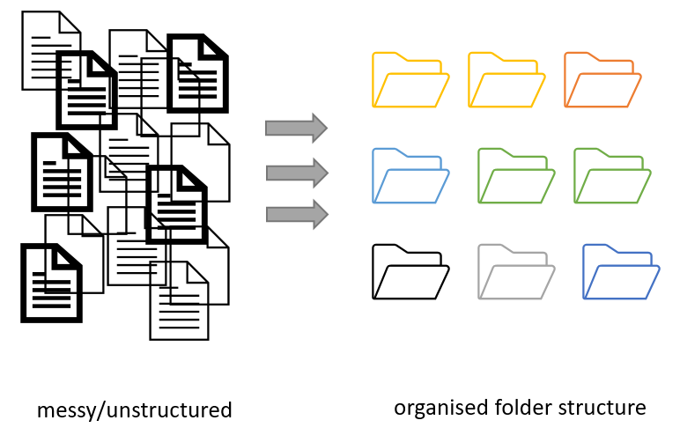
Project organization
Figure credits: Andrés Romanowski

Slide 3
Consistent naming and organization of files in folders has two main goals:
Find files quickly
Ability to tell the file content without opening it

Slide 4
It is important to develop standardized naming convention
consistent
encoding of experimental factors
meaningful to you and your collaborators
give you a sense of the content
easily identify if something is missing

Slide 5

Example
LD_phyA_off_t04_2020-08-12.norm.xlsx
could be a file that contains:
normalized data (norm),
from experiment in long day (LD)
for genotype phyA
with media without sucrose (off)
at timepoint 4 (t04)

Slide 6
Exercise 1
Naming and sorting

Slide 7
Naming Files
Do’s:
Include date in the name. Use YYYY-MM-DD or YYYMMDD format, eg. 20210920 Add date at the end of the file UNLESS you organize files chronologically
Include version number (if applicable) (ortogonal to date) Use leading zeroes (i.e.: v005 instead of v5)

Slide 8
Naming Files
Do’s:
Encode shortly biological or experimental relevant information, data catagory, etc. Example information to include:
sample, site, patient id
drug treatments, doses, names
environmntal conditions
genotypes, markers,
technique
Data operation: normalized, cleaned, detrended, clustered

Slide 9
Naming Files
Do’s:
Add leading zeros to numerical values
Add prefixes to numerical values: eg. S003, TR005

Slide 10
Naming Files
Do’s:
Make sure the file format extension is present at the end of the name (e.g. .doc, .xlsx, .mov, .tif)
Add a PROJECT_STRUCTURE (README) file in your top directory which details your naming convention, directory structure and abbreviations

Slide 11
Naming Files
Don'ts:
Avoid using spaces (use _ or - instead)
Avoid using commas and special characters (e.g. ~ ! @ # $ % < > ?[ ] { } ‘)
Avoid using language specific characters (e.g óężé)

Slide 12
Naming Files
Don'ts:
Avoid using long names (should not exceed 30 characters)
Avoid repeating information from parent elements ELN_MI_20200101.tiff in Electron_Microscopy folder
Avoid using deep paths with long names (i.e. deeply nested folders with long names)

Slide 13
Exercise 2
A good name

Slide 14
Folders vs. Files
Folders permit grouping relevant data together
Folders help to keep files names short

Slide 15
Exercise 3
Folders vs Files

Slide 16
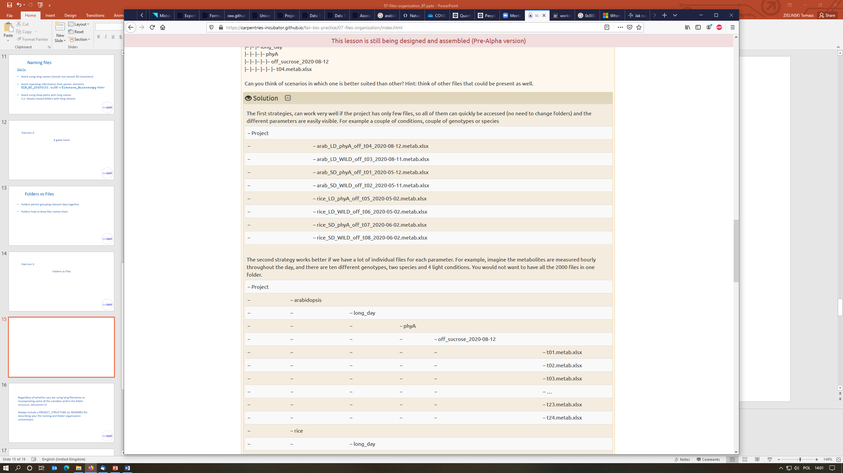

Slide 18
Regardless of whether you are using long filenames or incorporating some of the variables within the folder structure, document it!
Always include a PROJECT_STRUCTURE (or README) file describing your file naming and folder organisation conventions.

Slide 19
Use folders to group related files. A single folder will make it easy to locate them.
Name folders appropriately: use descriptive names after the areas of work to which they relate.
Structure folders hierarchically: use broader topics for your main folders and increase in specificity as you go down the hierarchy.
Be consistent: agree on a naming convention from the outset of your research project

Slide 20
Exercise 4
Organization strategies

Slide 21
Backing up your project files and folders
Back up (almost) everything created by a human or recorded by a machine as soon as it is created.
Always backup your files in 3 places, at least one should be off-site.
USB sticks are a failure-prone option and are not a valid solution for backup of scientific data
A robust backup cannot be achieved manually

Slide 22
Plan, plan, revise, update, adhere
If you change the strategy document it in PROJECT_STRUCTURE (why you made the change and when)
Update the locations and names of files which followed the old convention
Bulk renaming of files can be done with the software such as Ant Renamer, RenameIT or Rename4Mac.

Slide 23
In groups, discuss:
How can a strategy for folder organisation and naming convention help in achieving FAIR data?
Notes:
Online respository is a Findable and Accessible resource (also Trackable).
Online repositories are also interoperable since they can be accessed from anywhere (with internet) and are not restricted to your local hard drive.
The 'telling story' and being able to travel back in time helps in reuse and reproducibility.

