Slide 1
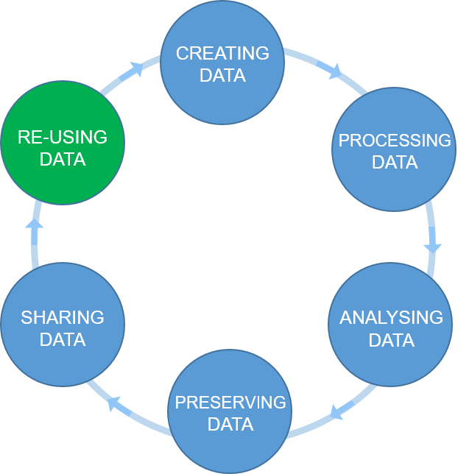

The research data life cycle
1
6
2
5
3
4
Figure credits: Tomasz Zielinski

Slide 2
Exercise/challenge 1:
Action plan challenge

Slide 3
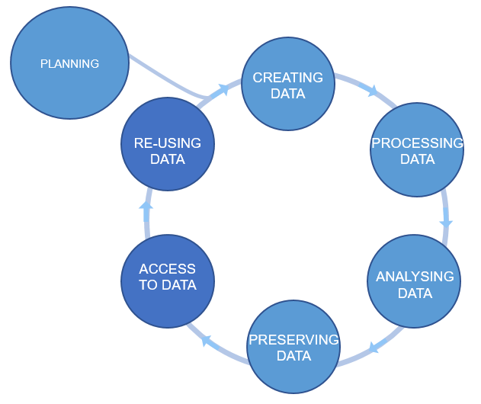
Plan ahead
data management plans
(DMPs)
Figure credits: Tomasz Zieliński and Andrés Romanowski

Slide 4
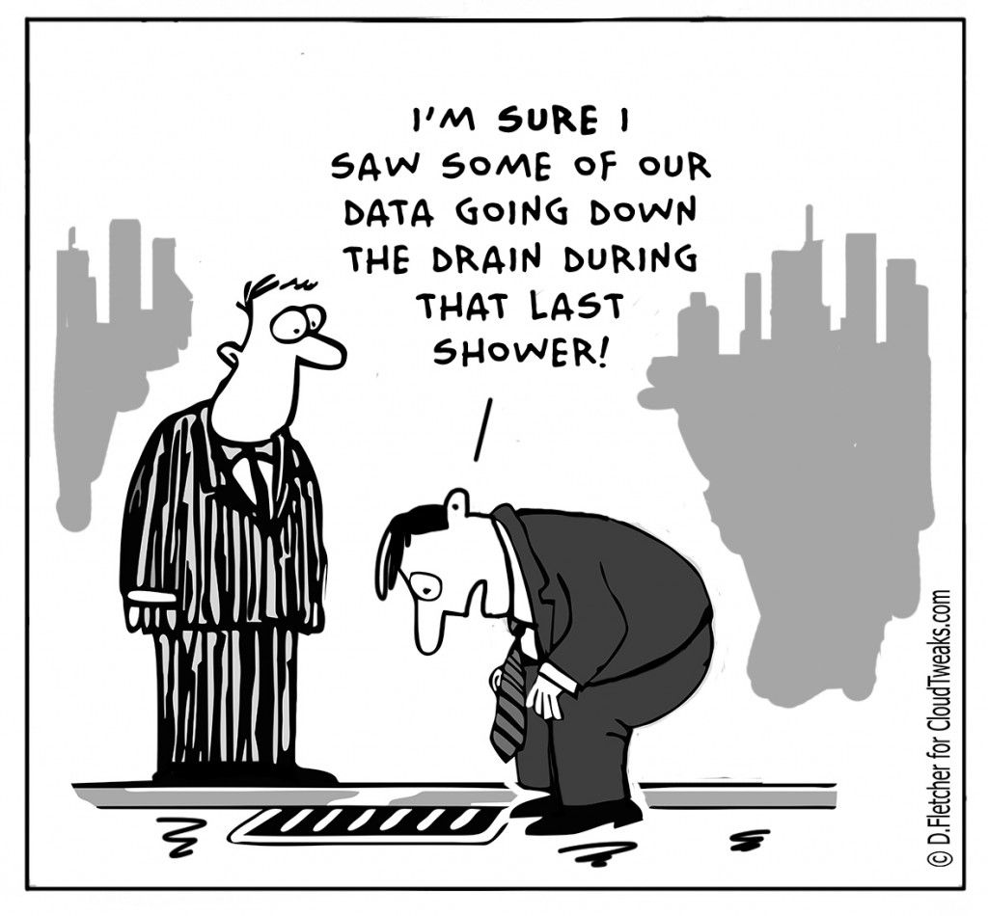
Why do we need Data Management Plans?
Your data is the basis for research papers and your PhD theses.
Data is fragile and easily lost. You need to backup your data!
Growing data management demands by funders.
It saves time and resources in the long run.
It enables reproducibility and troubleshooting and helps prevent future mistakes.
It is a protection measure against scientific fraud.
Facilitates data sharing.
A scientific paper is often written more than 1 year after the experiments were performed. What about your thesis? Will you remember everything you did? It is impossible to remember all the details! (unless you have some sort of special memory abilities)

Slide 5
What should we consider in a good DMP?
Good DMPs
Think about:
how you will store the data
how you will organize and describe your data
how you will grant access to your data
how you will share your data
how you will preserve your data
how others can use your data
how much it will all cost
Notes:
Most of the funders require that you present a DMP together with your grant applications. Some institutions ask eve their PhD students to prepare a DMP for their PhD project.
You should think how you are going to manage your data (our outputs, in general) for each of your projects (or even individual assay types). For individual project the main focus should be on: what data will be produced, how they will be stored and organized, how you are going to describe them and track them. For example what file formats will be generated, how you are going to name your files, and how you will link it to your laboratory notes.
For grant applications, DMP tend to be less technical, for example no need to discuss folder structures, but, they should emphasize the data safety (as preservation and access), data longevity, sharing, discovery and re-use.

Slide 6
Two flavours of DMP: for Grants and Internal
Grant application DMP
focus on Reuse => FAIR
safety of the data
limitation to sharing
allocation of resources
Project DMP
focus on your productivity and achieving FAIR
safety of the data
technicalities: file naming conventions, folder structures, templates for experiments, how you link to ELN ….

Slide 7

Useful resource
https://dmponline.dcc.ac.uk/
Contains DMP templates for the different funders requirements and information on how to fill each section.

Slide 8
DMP example
https://www.wiki.ed.ac.uk/x/yesNGQ

Slide 9
Exercise/challenge 2:
Working in groups, think of your last paper (or project). Write a short DMP for this joined project.
What type of data you will acquire during the research
How you will store the data
How you will share the data === target repositories, standards

Slide 10
Exercise/challenge 2B: be a reviewer
Working in groups, evaluate others DMP.
does it look as if the author(s) thought what they would do with their data or is it some ‘whatever’ copy pasted text
does it look as if the data will be stored in a secured way
does it look as if the data will be shared in a FAIR way
are there any standards that should be followed
does it look as if the data will be made accessible / findable to others for re-use
are the usage restrictions justifiable

Slide 11
Data Management Plans
Show that you are thinking about what will happen with your data during and after the project.
How your data is going to be FAIR.
Data management & admin should be done throughout the project, not at the end!

Slide 12

Data Management Plan Quiz
Notes:
1. F
2. T
3. F
4. F
5. T
6. T
7. T
8. F
9. F
10. T

Slide 13
Data Management Plan Quiz - Solutions
1. The best time to do data management is at the end of a project, when you've collected all the data you're managing. FALSE
2. Data management plans (DMPs) detail what will happen to data before collection begins. TRUE
3. The best storage method for data is multiple backups to USBs. FALSE
4. There is a single best way to manage, organise, and share data. FALSE
5. For grant applications, DMPs should mention data preservation, longevity, sharing, discover, and reuse. TRUE
6. Your metadata should be standardised and descriptive. TRUE
7. Taking the time to plan out what's needed in metadata and your DMP will save you time in the long run and make your data more FAIR. TRUE
8. DMP online is a tool which constructs DMPs for researchers. FALSE
9. Data addressed in a DMP can be freely shared regardless of confidentiality. FALSE
10. Data can be given creative commons licenses to dictate how others can and cannot use it. TRUE
Notes:
1. F
2. T
3. F
4. F
5. T
6. T
7. T
8. F
9. F
10. T

