Slide 1
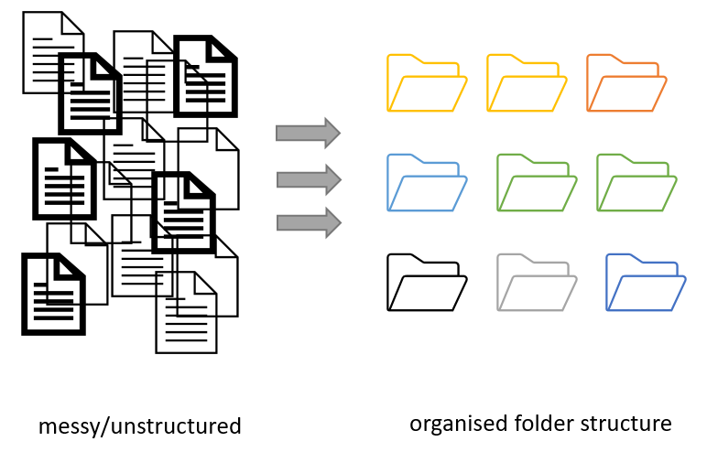

Project organization: planning file names and
folder structure
Open https://link
Figure credits: Andrés Romanowski

Slide 2
Consistent naming and organization of files in folders has two main goals:
Quick to find files
Ability to tell the file content without opening it
It is important to develop standardized, meaningful naming conventions

Slide 3
Exercise 1:
Naming and sorting

Slide 4
Naming files
Do’s:
Use YYYY-MM-DD, at the end of the file UNLESS you need to organize your files chronologically
Include version number (if applicable), use leading zeroes (i.e.: v005 instead of v5).
Make sure the 3-letter file format extension is present at the end of the name (e.g. .doc, .xls, .mov, .tif)
Add a PROJECT_STRUCTURE (README) file in your top directory which details your naming convention, directory structure and abbreviations

Slide 5
Naming files
Don'ts:
Avoid using spaces (use _ or - instead)
Avoid using dots, commas, or special characters (e.g. ~ ! @ # $ % < > ?[ ] { } ‘)
Avoid using language specific characters (e.g óężé)
Avoid using long names
Avoid repeating elements (e.g. including directory information)
Use deep paths with long names (i.e. deeply nested folders with long names) as archiving or moving between OS may fail

Slide 6
Exercise 2:
Folders vs Files

Slide 7
Regardless of whether you are using long filenames or incorporating some of the variables within the folder structure, document it!
Always include a PROJECT_STRUCTURE (or README) file describing your file naming and folder organisation conventions.

Slide 8
Exercise 3:
Organization for computing

Slide 9
Backing up your project files and folders
Back up (almost) everything created by a human or recorded by a machine as soon as it is created.
Always backup your files in 3 places, at least one should be off-site.
USB sticks are a failure-prone option and are not a valid solution for backup of scientific data
A robust backup cannot be achieved manually

Slide 10
In groups, discuss:
How can a strategy for folder organisation and naming convention help in achieving FAIR data?
Notes:
Online respository is a Findable and Accessible resource (also Trackable).
Online repositories are also interoperable since they can be accessed from anywhere (with internet) and are not restricted to your local hard drive.
The 'telling story' and being able to travel back in time helps in reuse and reproducibility.

