Slide 1
Introduction to Open Science

Slide 2
Open Science
Open science is transparent and accessible knowledge
that is shared and developed
through collaborative networks.

Slide 3
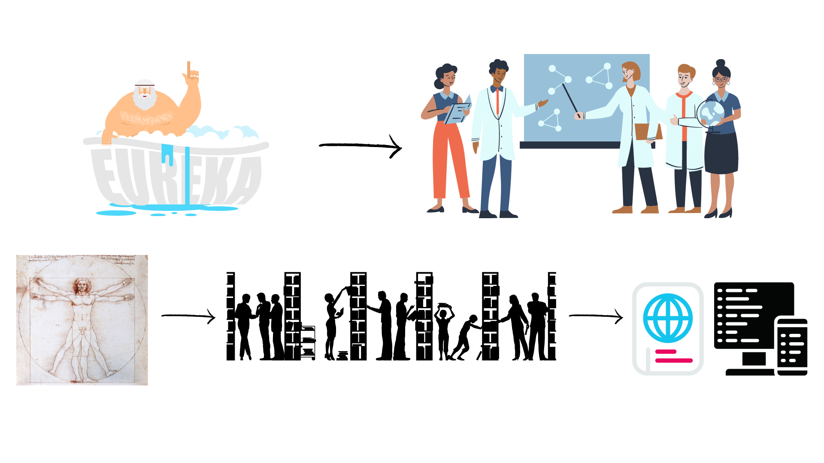
Evolution of Open Science
Level of openness in research

Slide 4
Open Science
Open science is the movement to make scientific research accessible to all levels of the society
general public
amateurs
professionals
students
teachers
publications
data
physical samples
software

Slide 5
Open Science
New approach to the scientific process based on:
digital technologies for diffusing knowledge
cooperative work and collaborative tools

Slide 6
Open Science - Charactersitics
Web-based tools to facilitate information exchange collaboration
Transparency in experimental methodology, observation, and collection of data
Public availability and reusability of scientific data, methods and communications

Slide 7
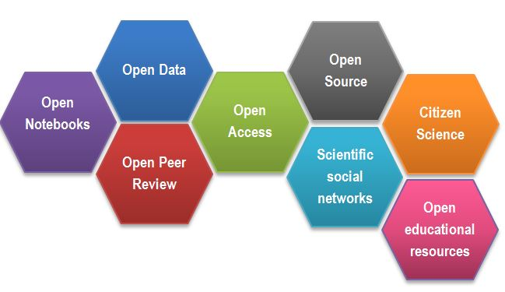
Open Science
CREDITS [1] CC BY

Slide 8
Success story – Open Access
The initiative to move to Open Access publishing is known as Plan S
Publications available immediately and under open licences, either in:
quality Open Access platforms or journals
as a copy deposited with your home institution.
Details of funding bodies requirements can be found at Plan S/cOAlition S.
cOAlition S journal checker tool to assess compliance
the Directory of Open Access Journals (DOAJ) helps finding OA journals

Slide 9
Outcomes of Openness
Open Access:
speed of work and knowledge distribution
levelling field for underfunded sites
increasing chance for collaboration, exposure & citations
new metrics of impact: views, downloads, tweets etc
access to work by lay audiences, thus increases social exposure of research

Slide 10
Outcomes of Openness
Exercise

Slide 11
Outcomes of Openness
Collaboration
Speed
Unpulished/negative results
Re-use
Learn by example
Feedback

Slide 12
Open Science motivation: Money
Scientific knowledge is a product of social collaboration and its ownership belongs to the community.
From an economic point of view, scientific outputs generated by public research are a public good that everyone should be able to use at no cost.
€10.2bn lost every year because of not accessible data (plus additional 16bn if accounting for re-use and research quality).
Source: Credits [2]

Slide 13
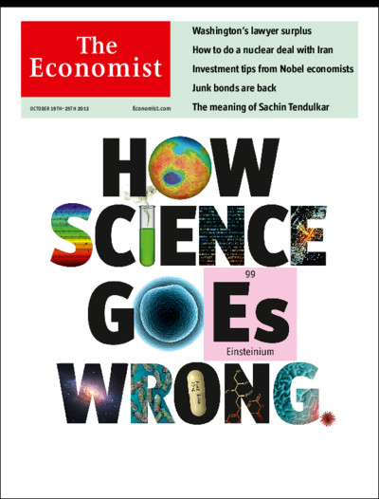
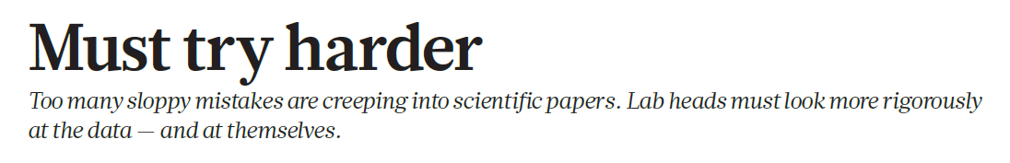
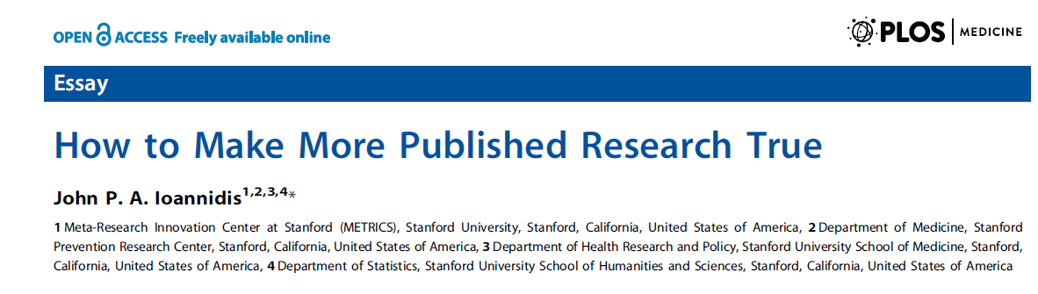
Open Science Motivation: Reproducibility

Slide 14
Motivation
“stick”
Large UK funding bodies such as The Wellcome Trust are big supporters of Open Science
“carrot”
….

Slide 15
Why we are not doing Open Science already
….

Slide 16
Why we are not doing Open Science already
sensitive data
misuse (fake news)
lack of confidence (the fear of critics)
the costs in $ and in time
IP

Slide 17
Open Science and intellectual property
Intellectual property is something that you create using your mind - for example, a story, an invention, an artistic work or a symbol

Slide 18
Open Science and intellectual property
Timeline matters for legal protection:
Patents are granted only for inventions that are novel and were not known to the public in any form.
Publishing in a journal or presenting in a conference with information related to the invention completely prevents the inventor from getting a patent later!

Slide 19
Open Science and intellectual property
(opinion) you are more likely to benefit from new collaborations, industrial partnerships, consultations which are acquired by openness, than from patent related royalties

Slide 20
Intellectual property protection
You can use a patent to protect your (technical) invention. You can control copying, making, using, selling or importing
Discoveries, mathematical methods, computer programs are not regarded as inventions. Therapeutic procedures, diagnostic methods and new plant or animal varieties are completely excluded from patentability.

Slide 21
Intellectual property protection
Patents are granted only for inventions that are novel and were not known to the public in any form.
Publishing in a journal or presenting in a conference with information related to the invention completely prevents the inventor from getting a patent later!

Slide 22
Intellectual property protection
In principle, software cannot be patented
(„no but yes” case by case, decided by court)
Software code is copyrighted. Copyright prevents people from:
copying your code
distributing copies of it, whether free of charge or for sale.
Data cannot be patented and in general, it cannot be copyrighted. It is not possible to copyright facts!

Slide 23
Open Science get involved
incentive structures are beginning to support Open Science practices:
Universities signing up to the Declaration on Research Assessment (DORA)
the Wellcome Trust funding proposals that increase Open Science or evidence of OS activities for new grant applications

Slide 24
Where to next
Challenges & benefits of OS https://doi.org/10.1371/journal.pbio.3000246
Centre for Open Science https://www.cos.io/
Ted talk supporting OS https://youtu.be/c-bemNZ-IqA

Slide 25
Open Science Quiz
…

