Slide 1
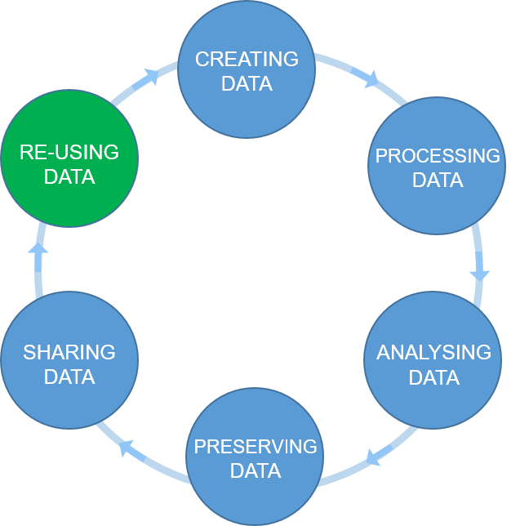

The research data life cycle
Open https://pad.carpentries.org/record-keeping_08062021
Figure credits: Tomasz Zielinski

Slide 2
Exercise/challenge 1:
Action plan challenge

Slide 3
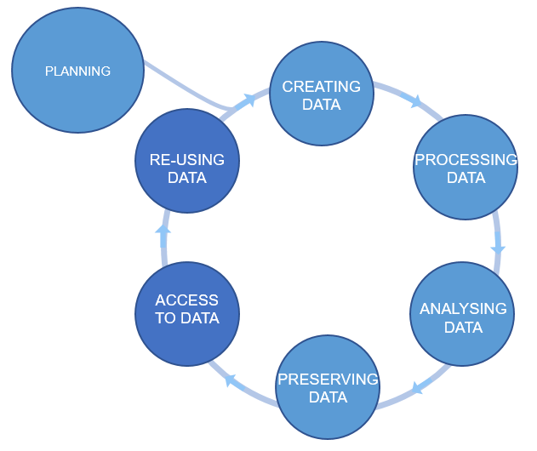
Plan ahead
data management plans
(DMPs)
Figure credits: Tomasz Zieliński and Andrés Romanowski

Slide 4
What should we consider in a good DMP?
Good DMPs
Think about:
how you will store the data
how you will organize and describe your data
how you will grant access to your data
how you will share your data
how you will preserve your data
how others can use your data
how much it will all cost
Notes:
Most of the funders require that you present a DMP together with your grant applications. Some institutions ask eve their PhD students to prepare a DMP for their PhD project.
You should think how you are going to manage your data (our outputs, in general) for each of your projects (or even individual assay types). For individual project the main focus should be on: what data will be produced, how they will be stored and organized, how you are going to describe them and track them. For example what file formats will be generated, how you are going to name your files, and how you will link it to your laboratory notes.
For grant applications, DMP tend to be less technical, for example no need to discuss folder structures, but, they should emphasize the data safety (as preservation and access), data longevity, sharing, discovery and re-use.

Slide 5

Useful resource
dmponline.dcc.ac.uk/
Contains DMP templates for the different funders requirements and information on how to fill each section.

Slide 6
DMP example
https://www.wiki.ed.ac.uk/x/yesNGQ

Slide 7
Exercise/challenge 2:
Working in pairs, think of your last paper (or project). Write a short DMP for this joined project.
Starts in this session & continues as homework.

Slide 8
Data management plans
Show that you are thinking about what will happen with your data during and after the project.
How you are going to achieve FAIR.
Data management & admin should be done throughout the project, not at the end!

