Slide 1
Object-Oriented Programming:
Why You're Doing It Wrong
Toby Inkster
Three weird tricks to make your object-oriented code
more encapsulated, more reusable, and more maintainable.

Slide 2
Object-Oriented Programming
Examples in this presentation use Moo.
Moo is a lightweight version of Moose.
  Most of these examples can be rewritten to use Moose with only minor changes.
Moo is still Perl
  You could implement any of this with just core Perl OO if you were so inclined.

Slide 3

Stop creating mutable objects
http://www.diylol.com/

Slide 4
Stop creating mutable objects
Perl Best Practices recommends creating methods called get_foo and set_foo.
my $obj = Pony->new(name => 'Pinkie Pie');
$obj->set_name('Twilight Sparkle');
say $obj->get_name();

Slide 5
Stop creating mutable objects
Perl Best Practices recommends creating methods called get_foo and set_foo.
Moose standard practice is to have a single accessor called foo that allows you to either get or set the attribute value.
my $obj = Pony->new(name => 'Pinkie Pie');
$obj->name('Twilight Sparkle');
say $obj->name();

Slide 6
Stop creating mutable objects
Perl Best Practices recommends creating methods called get_foo and set_foo.
Moose standard practice is to have a single accessor called foo that allows you to either get or set the attribute value.
These are both wrong.

Slide 7
Stop creating mutable objects
my $alice = Person->new(
name => 'Alice',
best_pony => Pony->new(name => 'Twilight Sparkle'),
);
my $bob = Person->new(
name => 'Bob',
best_pony => $alice->best_pony(), # It's what brought us together
);
$alice->best_pony->set_name('Sunset Shimmer');
say $bob->best_pony->get_name(); # Spooky action at a distance

Slide 8
Stop creating mutable objects
my $conference = Event->new( start => DateTime->new(...) );
my $keynote = Event->new( start => $conference->start );
# We need the keynote to be at the end of the conference
$keynote->start->add(seconds => 5*60*60);
# D'oh!
print $conference->start, "\n";

Slide 9
Stop creating mutable objects
Make your accessors read-only.
Don't allow an object's attribute values to be changed after it's been constructed.
Save yourself from spooky action at a distance.

Slide 10
Stop creating mutable objects
Moose and Moo:
is => 'ro'
Plain old Perl:
sub foo { $_[0]{foo} }

Slide 11
Stop creating mutable objects
Make your accessors read-only.
Don't allow an object's attribute values to be changed after it's been constructed.
Save yourself from spooky action at a distance.
Sometimes you really need to model a changing world.

Slide 12
Stop creating mutable objects
my $alice = Person->new(
name => 'Alice',
best_pony => Pony->new(name => 'Twilight Sparkle'),
);
my $bob = Person->new(
name => 'Bob',
best_pony => $alice->best_pony(),
);
$alice->best_pony->set_name('Princess Twilight Sparkle'); # SPOILER ALERT!
say $bob->best_pony->get_name();

Slide 13
Stop creating mutable objects
package Pony {
use Moo;
has name => (
is => 'ro',
writer => 'rename',
);
}
# Better than name() or set_name() because it's clear that this is
# a method. It 'does something'.
$pony->rename('Princess Twilight Sparkle');

Slide 14
Stop creating mutable objects
If you really need to model a changing world:
  Make attributes mutable only after careful consideration
  … Not by default!
  Consider naming the writer method something that doesn't sound like an attribute.

Slide 15

Stop writing 'private' methods
We can actually see you.
https://www.flickr.com/photos/a_gods_child/4553482717/

Slide 16
Stop writing 'private' methods
Methods named with a leading underscore are not really private.
Subclasses can call them.
Subclasses can override them.
Even accidentally!

Slide 17
Stop writing 'private' methods
package Employee {
use Moo;
has name => (is => 'ro');
sub _type { 'employee' }
sub output { shift; say @_ }
sub introduce_myself {
my $self = shift;
$self->output(
'My name is ', $self->name, ' and I am an ', $self->_type,
);
}
}

Slide 18
Stop writing 'private' methods
package Typist {
use Moo;
extends 'Employee';
...;
}
my $obj = Typist->new(name => 'Moneypenny');
$obj->introduce_myself();
Can't call method "press_button" on an undefined value at Typist.pm line 16

Slide 19
Stop writing 'private' methods
package Typist {
use Moo;
extends 'Employee';
has default_keyboard => (is => 'lazy', builder => sub { ... });
sub output {
my $self = shift;
my $text = join '', @_;
$self->_type($self->default_keyboard, $text);
}
sub _type {
my $self = shift;
my ($kb, $text) = @_;
for (my $i = 0; $i < length $text; $i++) {
$kb->press_button( substr($text, $i, 1) );
}
$kb->press_button('Enter');
}
}

Slide 20
Stop writing 'private' methods
How can we fix this?

Slide 21
Stop writing 'private' methods
package Employee {
use Moo;
has name => (is => 'ro');
sub _type { 'employee' }
sub output { shift; say @_ }
sub introduce_myself {
my $self = shift;
$self->output(
'My name is ', $self->name, ' and I am an ', $self->_type,
);
}
}

Slide 22
Stop writing 'private' methods
package Employee {
use Moo;
has name => (is => 'ro');
my $_type = sub { 'employee' };
sub output { shift; say @_ }
sub introduce_myself {
my $self = shift;
$self->output(
'My name is ', $self->name, ' and I am an ', $self->$_type,
);
}
}
←a lexical method is just a coderef

Slide 23
Stop writing 'private' methods
If a method is useful for end-users, then promote it to a public method.
If a method exists in your namespace, then document it.
Otherwise, use 'lexical methods' – coderefs.
For lexical accessors, see Lexical::Accessor.

Slide 24
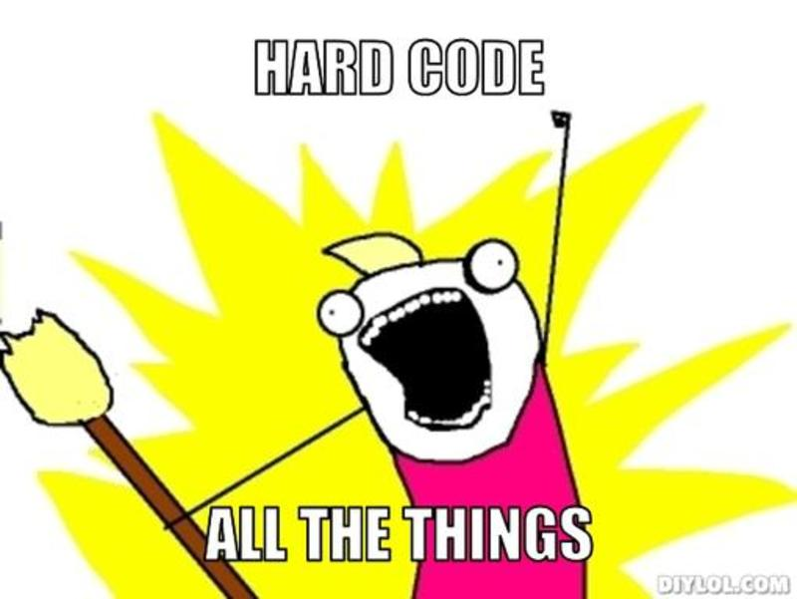
Stop hard-coding stuff
Not a great idea.
http://www.diylol.com/

Slide 25
Stop hard-coding stuff
package MyAuth;
use Moo;
sub fetch_user_list {
my $self = shift;
my $ua = LWP::UserAgent->new();
return $ua->get(
"http://example.com/users.txt",
);
}

Slide 26
Stop hard-coding stuff
package MyAuth;
use Moo;
sub fetch_user_list {
my $self = shift;
my $ua = LWP::UserAgent->new();
return $ua->get(
"http://example.com/users.txt",
);
}
URL
User-agent

Slide 27
Stop hard-coding stuff
package MyAuth;
use Moo;
sub fetch_user_list {
my $self = shift;
my $ua = LWP::UserAgent->new();
return $ua->get(
"http://example.com/users.txt",
);
}
package MyAuth;
use Moo;
has user_agent => (
is => 'lazy',
builder => sub { LWP::UserAgent->new() },
);
has user_list_url => (
is => 'lazy',
builder => sub { "http://example.com/users.txt" },
);
sub fetch_user_list {
my $self = shift;
$self->user_agent->get($self->user_list_url);
}

Slide 28
Stop hard-coding stuff
package MyAuth::Testing;
use Moo;
extends 'MyAuth';
sub _build_user_agent {
LWP::UserAgent::WithLogging->new();
}
sub _build_user_list_url {
'http://example.com/demo-users.txt';
}

Slide 29
Stop hard-coding stuff
Better for testing
Better for extensibility

Slide 30
Why you were doing it wrong
You created mutable objects
You wrote 'private' methods
You hard-coded stuff

Slide 31
How to do it right
Create immutable objects
  is => 'ro'
Avoid undocumented methods
  If they seem useful enough, document them
  Otherwise, make them coderefs so they stay private
Stop hard-coding stuff
  is => 'lazy'
  builder => sub { ... }

