Slide 1
Customer Trends in
Banking and Payments
25 years of behaviour, 10 years of forecasts
Industry partner: FIS Global · MSc Applied Data Science, University of Manchester, 2026
Notes:
[~30s] Hi, I'm presenting the final output of our FIS Global industry project. The project sets out to understand how UK customer behaviour in banking and payments has shifted over the last 25 years, and to translate those structural shifts into a 10-year forecast for FIS. Over the next 10 minutes I'll walk through: why this matters to FIS, the data and methods we used, what we found historically, where the inflection points were, where we expect things to go to 2034, and how sensitive those forecasts are to our assumptions.

Slide 2
Project aim
What FIS asked us to deliver
Assess customer trends in banking and payments over the last 25 years, and use those trends to project the next decade of behaviour.
01
02
03
Historical mapping
Driver analysis
Future modelling
Quantify the decline of physical infrastructure against the growth of digital channels.
Connect behavioural change to smartphones, regulation, COVID, and macro shocks.
Build scenario forecasts to 2034 with stated assumptions and sensitivity analysis.
FIS Global — Customer Trends in Banking and Payments
2 / 12
Notes:
[~45s] The brief from FIS was deliberately open. They wanted an evidence-based view of how UK customer behaviour has shifted, and a credible projection of where it's going. We translated that into three concrete objectives: first, map the historical change — quantify the decline of physical banking against digital growth. Second, explain the drivers — smartphones, regulation, COVID-19, macro conditions. And third, build forecasts to 2034 with transparent assumptions and sensitivity testing, which is what FIS specifically requested in their brief.

Slide 3
Why this matters to FIS
From physical-vector security to remote-vector security
70%
decline in UK bank branches since 2000
The strategic implication
UK customer behaviour has fundamentally restructured
from physical channels to digital-first ecosystems.
For FIS this means the threat surface is moving too: card-present fraud is solved, but Card-Not-Present and remote vectors are now the priority. Real-time fraud detection and digital identity infrastructure are where the strategic premium sits.
0.98
negative correlation, branches vs digital payments
91%
fall in counterfeit-card fraud as criminals shift remote
FIS Global — Customer Trends in Banking and Payments
3 / 12
Notes:
[~45s] Why does this matter to FIS specifically? Three numbers tell the story. UK bank branches have dropped 70% since 2000. The correlation between branch counts and digital payment volume is minus 0.98 — almost perfectly inverse. And card-present fraud is down 91% since chip and PIN, which sounds like good news. The strategic point is on the right: the fraud hasn't disappeared, it's relocated. Card-Not-Present, remote, and online vectors are now the priority. That's where FIS's investment in real-time detection and digital identity becomes the strategic premium.

Slide 4
Scientific and practice context
Grounding the work in existing literature
1
Branch consolidation is structural
Vives (2019) shows the post-2008 contraction of physical infrastructure is driven by cost pressure plus changing customer channel preferences — not a temporary cycle.
2
Macro rates shape savings behaviour
Disney & Gathergood (2013) find rate environments materially affect household deposit and credit composition; relevant to our ARDL specification for deposits.
3
COVID accelerated digital substitution
BIS (2021) and UK Finance (2025) document a step-change in cash-to-digital substitution in 2020 that did not revert, including contactless growth driven by limit increases.
FIS Global — Customer Trends in Banking and Payments
4 / 12
Notes:
[~45s] Before getting into our results, three brief anchors from the literature. First, Vives shows the post-2008 branch contraction is structural rather than cyclical — that frames our interpretation of the trend. Second, Disney and Gathergood support our use of an ARDL specification for deposits, since rate environments materially shape savings behaviour. And third, the BIS and UK Finance both document the COVID step-change in cash substitution that didn't revert — which is why 2020 is so important in our inflection-point analysis. These three anchors inform our methodology choices on the next slide.

Slide 5
Data and methodology
Eight authoritative datasets, interpretable models
Eight datasets, 2000–2025
Analytical pipeline
BoE — interest rates
LINK Scheme — ATM trends
Step 1
Clean & harmonise
UK Finance — payment volumes
UK Finance — card fraud losses
Step 2
EDA + correlation analysis
ONS — bank branches & banks
BoE — deposit & credit balances
Pay.UK — CASS switching
UK Finance — contactless limits
Step 3
OLS for macro relationships
Step 4
Parameter-light forecasting
Step 5
Sensitivity & Monte Carlo
Why parameter-light models? Emerging-payment data spans only 2014–2024; with n≈10 after removing the 2020 outlier, heavily-parameterised ARIMA would overfit. We use floored-exponential, Gompertz, Bass and ARDL(1,0) instead.
FIS Global — Customer Trends in Banking and Payments
5 / 12
Notes:
[~75s] On the left, the eight datasets — all from authoritative sources: Bank of England, UK Finance, ONS, Pay.UK and the LINK Scheme. Time horizons vary; the longest are infrastructure and macro variables back to 2000, while payment-method-level data only goes back to 2014. On the right, the analytical pipeline. We cleaned and harmonised everything to annual frequency, ran exploratory analysis and correlations, fitted an OLS for the macro relationships, then moved to parameter-light forecasting and sensitivity analysis. The choice at the bottom is the key methodological one: with only around 10 clean observations per emerging-payment variable after removing COVID, heavily-parameterised ARIMA models would just fit the noise. Instead we use functional forms — floored exponential, Gompertz S-curves, Bass diffusion, and ARDL — which are interpretable and constrained by scientific priors.

Slide 6
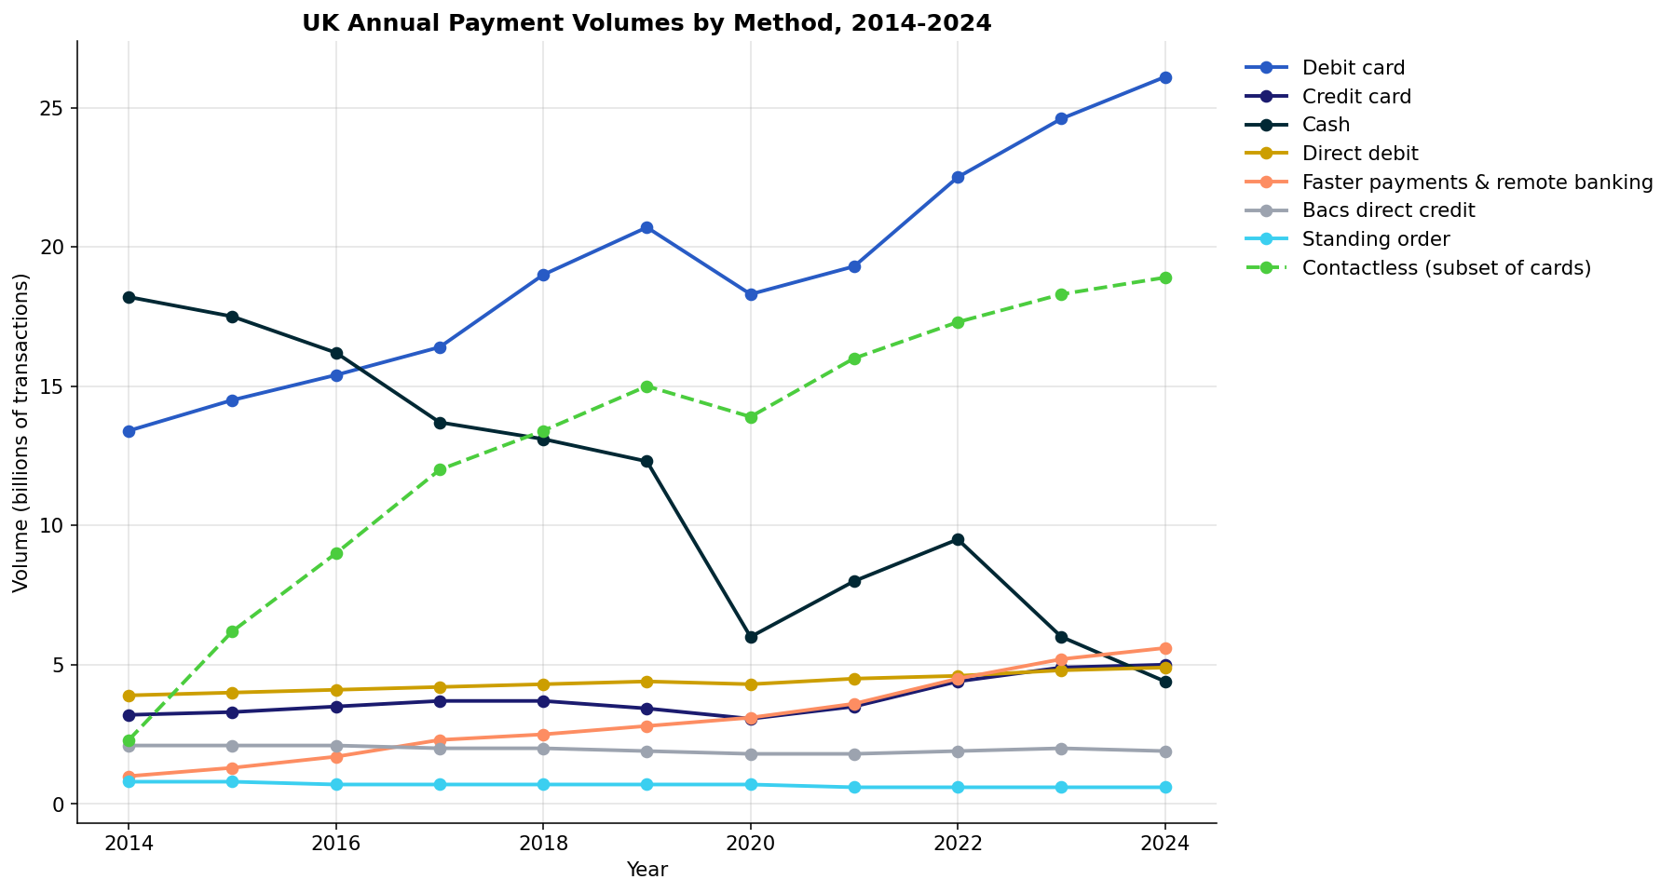
Historical findings
Cash collapsed, cards and contactless took over
What the data shows
Cash
18.2 → 4.4 bn
75.8% drop in a decade
Debit card
13.4 → 26.1 bn
now the dominant rail
Contactless
2.3 → 18.9 bn
fastest-growing method
Faster payments
1.0 → 5.6 bn
underpins digital banking
FIS Global — Customer Trends in Banking and Payments
6 / 12
Notes:
[~90s] This is the headline picture of UK payment behaviour over the past decade. The dark line at the top of the chart is cash — collapsing from 18.2 billion transactions in 2014 to 4.4 billion in 2024, a 76% drop. Debit card volumes nearly doubled. But the most dramatic line is the dashed green one — contactless — which grew eight-fold from 2.3 to 18.9 billion. Faster payments also rose substantially. The story isn't that payment activity grew overall — total transactions are roughly stable. The composition has fundamentally changed. Every transaction that used to be made in cash is now being made on a digital rail.

Slide 7
Drivers and inflection points
Where structural change accelerated
2008
2020
Financial crisis
COVID-19 step-change
Trust shock plus regulatory tightening accelerates branch consolidation.
Cash falls 51% in one year. Behavioural shift did not revert.
2000
2025
2015
2022
Contactless adoption
Rate rises
+170% YoY growth — the inflection from card-present to tap-and-go.
Deposits surge as macro policy tightens — supports the ARDL specification.
FIS Global — Customer Trends in Banking and Payments
7 / 12
Notes:
[~60s] Four inflection points define the period. 2008 — the financial crisis triggered a wave of branch consolidation that hasn't stopped. 2015 — contactless adoption inflected, growing 170% year-on-year as the £30 limit took effect. 2020 — the COVID step-change. Cash fell 51% in a single year, and crucially the behavioural shift did not revert. Even with shops fully reopened, the public didn't go back to cash. And 2022 — the rate-rise cycle that drove the deposit balance surge we saw in section 5 of our analysis. These four events are the structural turning points that any credible forecast has to account for.

Slide 8
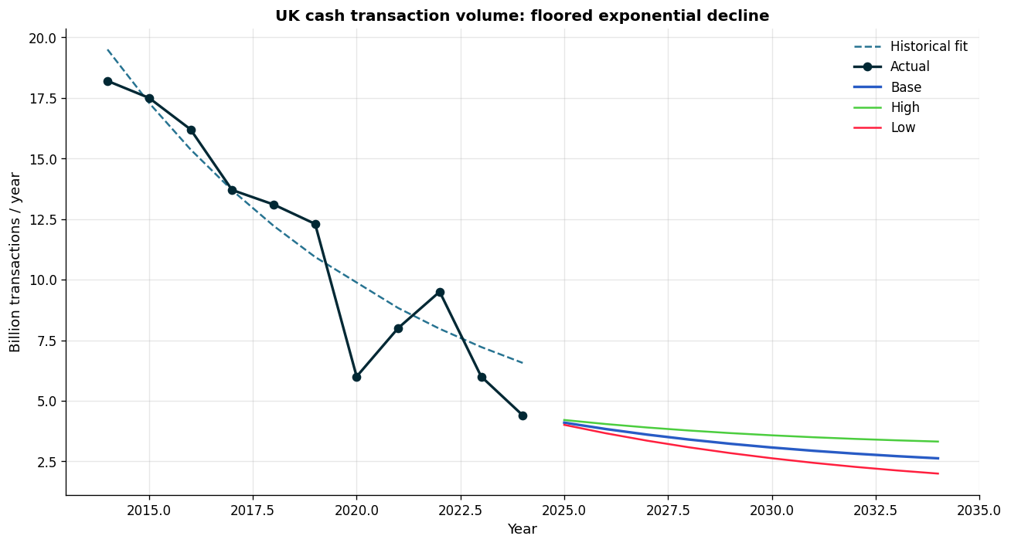
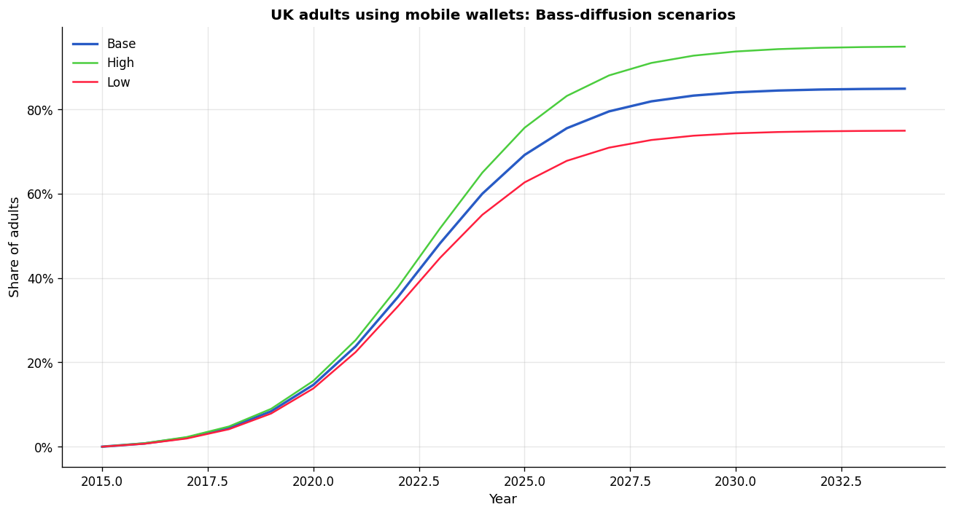
10-year forecasts to 2034
Three scenarios, calibrated by scientific priors
2.6 bn
85%
49%
Cash transactions per year, 2034 Base
Mobile-wallet penetration of UK adults
Neobank share of primary current accounts
Floored exponential decline
Bass diffusion model
Fisher-Pry substitution
FIS Global — Customer Trends in Banking and Payments
8 / 12
Notes:
[~75s] These are our three headline forecasts for 2034 in the base scenario. Cash hits a structural floor of around 2.6 billion transactions a year — not zero, because financial-inclusion regulations and cash-back use cases mean cash never fully disappears, just settles into a small minority of transactions. We model this with a floored exponential decline. Mobile wallets reach 85% of UK adults — modelled with a Bass diffusion curve calibrated to mature-market saturation parameters. And neobanks hit 49% share of primary current accounts via a Fisher-Pry substitution model. The two charts show the cash decline on the left — note the historical fit catches the trend even through COVID — and the mobile-wallet S-curve on the right, where the slope is steepest right now and we're projected to enter saturation around 2030.

Slide 9
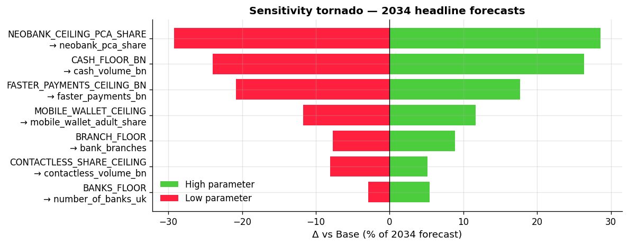
Assumptions and sensitivity
Where the forecast bites hardest
Key assumptions
Neobank ceiling
where market saturates
Cash floor
structural minimum 2030+
Faster-payments ceiling
long-run share of volume
Mobile-wallet ceiling
adult-population reach
Bottom line: the neobank ceiling and the cash floor each swing the 2034 forecast by roughly ±30%. Monte Carlo across all parameters confirms our central numbers are robust within their 80% intervals.
FIS Global — Customer Trends in Banking and Payments
9 / 12
Notes:
[~60s] The FIS brief specifically asked us to list assumptions and explain sensitivity. This tornado chart does both. Each bar is one parameter; the length shows how much the 2034 forecast moves when that parameter goes from its low to its high value. Two findings dominate. The neobank ceiling — where we assume the market saturates — swings the neobank forecast by ±29%. The cash floor — the structural minimum cash level — swings cash by ±26%. Everything else is below 20%. We also ran a Monte Carlo simulation perturbing all assumptions simultaneously, and the headline numbers stay within their 80% intervals — so the central case is robust, but FIS should be aware that those two parameters dominate the forecast uncertainty.

Slide 10
What this means for FIS
Strategic priorities for the next decade
Security
Channels
Remote-vector security is the priority
Build for digital-first, not branch-supported
Card-Not-Present fraud is the dominant remaining attack surface. Real-time fraud detection and behavioural biometrics should anchor product investment.
Account-switching, onboarding and account servicing should assume zero-branch interaction as the default journey — branches will be a long-tail channel by 2034.
Partnerships
Rails
Neobank infrastructure is half the market
Mobile wallets are the default rail
By 2034 ~49% of primary accounts will sit with neobanks. Core-banking, payment-rail and compliance products need first-class support for fintech architectures.
85% adult penetration means wallets, not cards, will be the primary point of authentication and authorisation. Tokenisation and pass-credential infrastructure follows.
FIS Global — Customer Trends in Banking and Payments
10 / 12
Notes:
[~60s] So what should FIS do with this? Four strategic implications. First, prioritise remote-vector security. CNP fraud is the dominant attack surface; real-time detection is where the strategic investment should go. Second, build for digital-first. By 2034, account journeys should assume zero branch interaction by default. Third, neobank infrastructure becomes half the market. FIS's core-banking and compliance products need first-class support for fintech architectures. And fourth, mobile wallets become the default rail at 85% adult penetration — tokenisation, pass credentials, and the wallet-as-identity story are where FIS should be positioning.

Slide 11
Delivery and evolution
How the project actually ran
1. Scope
2. Data
3. Architecture
4. Preprocessing
5. Analysis
6. Modelling
7. Submission
Feb 16–Mar 1
Mar 2–Mar 19
Mar 20–Mar 29
Mar 30–Apr 12
Apr 13–Apr 26
Apr 27–May 3
May 4–May 18
Industry engagement
Project management
Critical reflection
Feb 20: scoping with Andrew Thompson, Jeffrey Saul & Jay Desai
Mar 7: dataset findings discussion
Apr 20: mid-project modelling review
May 8: refined datasets shared with FIS
Continuous feedback channel via supervisor
Sprint structure with weekly milestones
Async work + scheduled Google Meet syncs
In-person integration workshop, Apr 28
Git-versioned codebase for reproducibility
Initial scope reduced from 10 to 8 datasets after mentor review
ARIMA dropped early — too few clean observations
Switched to interpretable functional forms
Sensitivity testing added in response to FIS brief
FIS Global — Customer Trends in Banking and Payments
11 / 12
Notes:
[~45s] Quickly on delivery. We ran the project as a seven-sprint structure across three months, shown on the timeline at the top. Three things worth noting. Engagement with FIS was continuous — we had a kickoff with Andrew Thompson, Jeffrey Saul and Jay Desai in February, a findings discussion in March, a mid-project review in April, and shared refined data in May. On project management, we used a sprint structure with async work and scheduled syncs, plus an in-person integration day in late April when the modular work needed merging. And critically — we changed direction when the data demanded it. We dropped ARIMA early because the sample sizes wouldn't support it, and we added sensitivity testing explicitly because the FIS brief required it. The scope went from 10 datasets to 8 after the first mentor review.

Slide 12
Three numbers to take away
70%
2.6 bn
49%
drop in physical branches
since 2000
cash transactions per year
by 2034 (Base)
neobank share of primary
current accounts by 2034
Code & data: github.com/tobyjl/fis_global_report (private — access on request).
Thank you.
Notes:
[~20s] To close — three numbers that capture the project. 70% — the loss of physical branches that defined the past 25 years. 2.6 billion — where cash settles by 2034 in our base scenario. 49% — neobank market share, signalling that half of UK current accounts will sit outside the traditional banks by the end of our forecast horizon. Code and the full forecast pipeline are on GitHub at the link shown. Thank you.

