Slide 1
CNN Prediction on Congressional Redistricting
Evaluating the Impact of 2021 Nationwide Redistricting on 2024 US Presidential Elections
Toby Chiu
May 2024

Slide 2
Goal: Training CNN to Evaluate Impact of 2021 Gerrymandering on 2024 Presidential Elections
Problem Statement
Gerrymandering district boundaries is proven to illegally and significantly impact voting outcomes, but it is currently very difficult to evaluate degree of gerrymandering to predict impact of redistricting on future election outcomes
Project Scope
Predicting gerrymandering outcomes by applying a convolutional neural network (CNN) on redistricted congressional district maps to evaluate the presence and partisanship of gerrymandering in 2021 congressional districts
Analytical Process
Calculate academic metrics to measure historic gerrymandering
Create standardized maps of redistricting instances as input for CNN to train/test on
Train CNN with appropriate metrics, correcting for underfitting/overfitting as necessary
Predict gerrymander outcomes of 2021 redistricting; infer outcomes on 2024 elections
Findings
Best CNN model performance could not perform better than random – likely due to a mixture of non-ideal model architecture, inefficient input map data, small input sample size, and insufficient computational resources

Slide 3
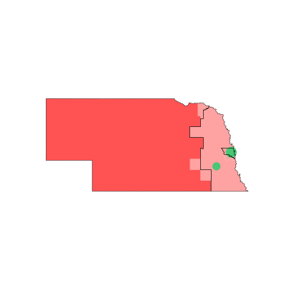
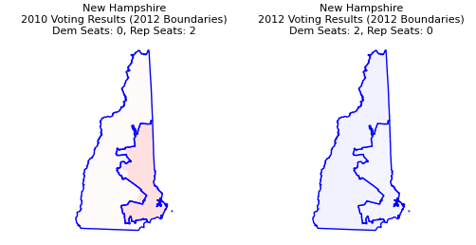
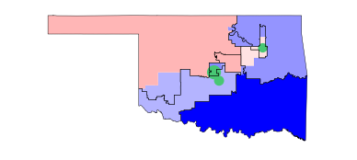
Understanding Gerrymandering
Problem
Plan
Findings
Process
1. What is “Gerrymandering”?
2. How can we measure Gerrymandering?
2002 Nebraska Redistricting
Republican Vote: 56%
Republican Seat: 3/0 (100%)
Efficiency Gap: +0.38
1974 Oklahoma Redistricting
Democrat Vote: 59%
Democrat Seat: 0/6 (100%)
Efficiency Gap: -0.33
Gerrymandering refers to redrawing state lines (redistricting) to favor voting outcomes for one political party
Gerrymandering is illegal in the US since the 1960s (on grounds of racial profiling), but both parties still rampantly gerrymander
Example: REDMAP allowed Republicans to win the 2012 House elections by 33 seats despite losing nationwide popular vote
All eligible states redistricted in 2021 – 16 states are currently in litigation to redraw boundaries over gerrymandering
Efficiency Gap is a widely-used simple metric used to measure gerrymandering in a state
Negative scores indicate Democratic gerrymandering and vice versa, magnitude of scores indicate severity
Efficiency Gap Swings (post-change – pre-change score) can be used to see landscape changes over redistricting cycle
Gerrymandering district boundaries is proven to illegally and significantly impact voting outcomes, but it is currently very difficult to evaluate degree of gerrymandering to predict impact of redistricting on future election outcomes

Slide 4
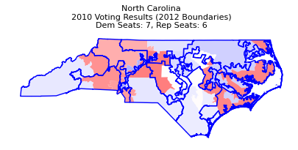

A Classic Example: Changes in North Carolina after 2011 Redistricting (Project REDMAP)
Problem
Plan
Findings
Process
1
Packing: 1st District (D+52)
Republicans packed majority-Democratic populations in Raleigh-Durham into 1 district to limit their impact, spreading Republicans majorities into surrounding districts.
1
3
2
2
Packing: 12th District (D+59)
Oddly-shaped district is stretched to pack urban centers of both Charlotte and Winston-Salem into 1 district, limiting the impact of Democratic voters
3
Cracking: 5th (R+15), 10th (R+14), 11th (R+15)
Previously heavily-conservative district is split into three to spread Republican majority, allowing them to flip District 11 and hold strong majorities in 3 districts.
1
3
2
Republicans flipped 3 seats to win the House while losing the majority vote¹ (48% Republican)
(1) Fairvote: Fairvote’s Unique Methodology Shows That 52% Of Voters Wanted a Democratic House

Slide 5
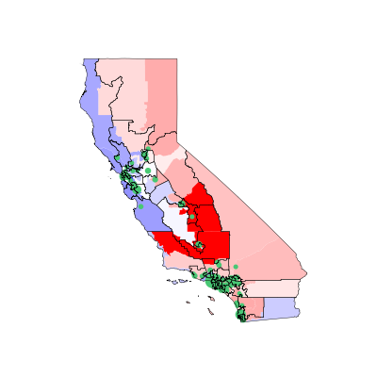
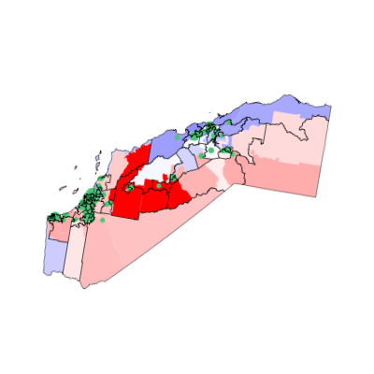
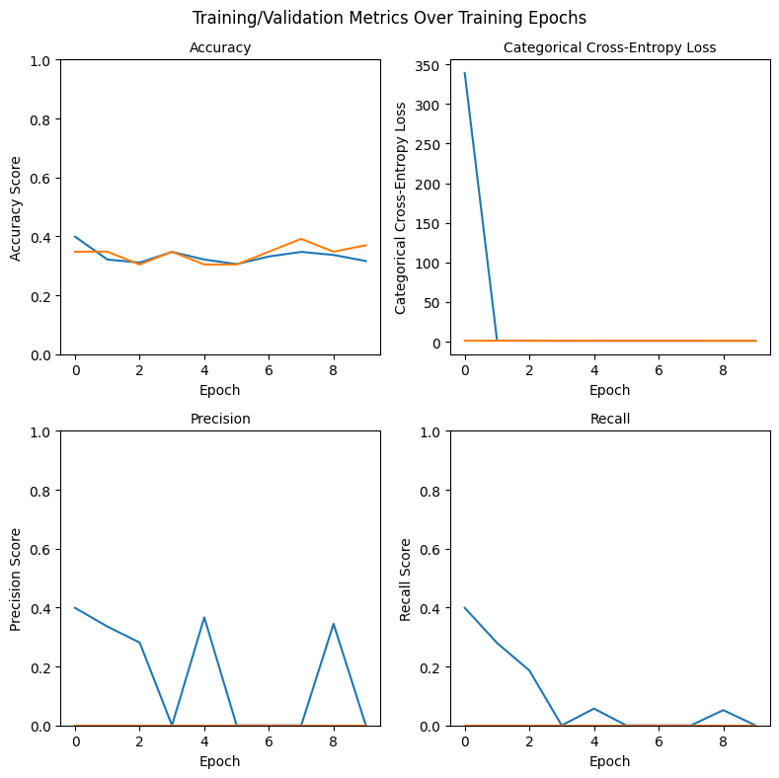
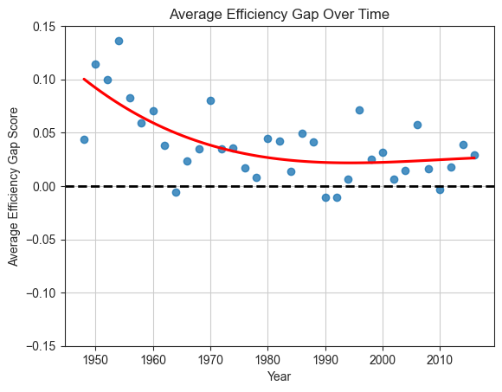
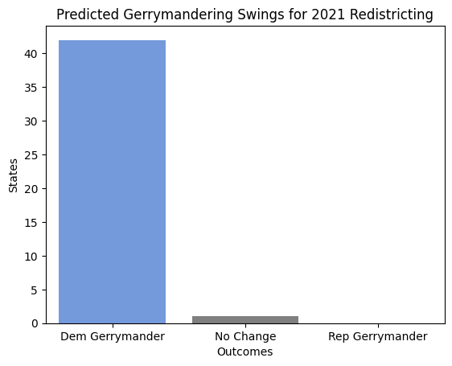
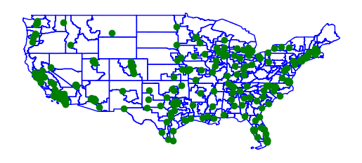
Analytical Plan
Problem
Plan
Findings
Process
Exploratory Data Analysis (EDA)
Feature/Target Engineering
CNN Training
Under/Overfit Model Tuning
Predictions
Standardization
Data Collection: Finding appropriate data for project
Efficiency Gap: primary metric for quantifying gerrymandering
Graphing Trends: understand landscape of gerrymandering over time
Partisan Lean: measuring winning margin for districts
Creating Maps: GeoPandas mapping for spatial data
Sense Check: ensure data matches reality
Standardization: creating images of standard size for CNN (400x400)
Mass Production: creating images for all 342 instances of redistricting
Image Augmentation: increasing training dataset size through augmenting data
Class Imbalance: creating images for all 342 instances of redistricting
Baseline Model: setting benchmark to improve on
Metric Tracking: Measuring metrics during training/testing to identify underfitting/overfitting
Hyperparameter Tuning: Finding best hyperparameters for training output
Prediction Maps: Recreating maps for 2021 redistricting
Making Predictions: Using best model to find outcomes
Takeaways: Learnings & Future improvements

Slide 6
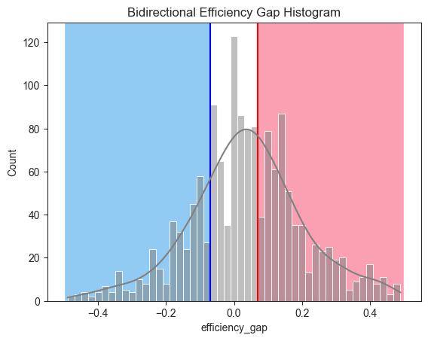
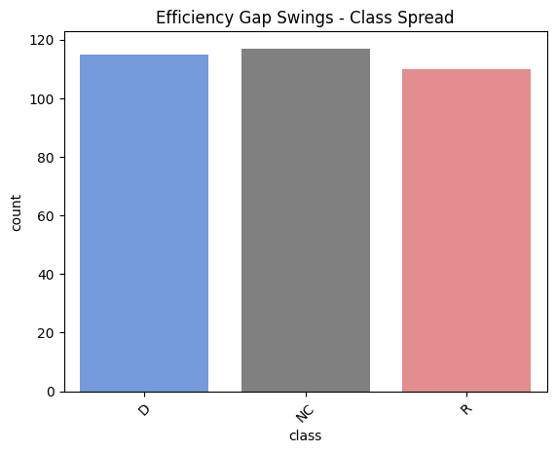
EDA process highlights vast degrees of equal gerrymandering by both parties
Problem
Plan
Findings
Process
Finding 1:
Most states are gerrymandered
62.2% of all state congressional boundaries over the last 70 years are gerrymandered; 39.4% by Republicans and 22.7% by Democrats.
Finding 2:
Democrats increasingly gerrymander since 1960s
Average efficiency gap decreases over late 20th century, indicating Democrats increasing willingness to gerrymander to same degree as Republicans.
Finding 3:
Redistricting creates equal outcomes for both parties
Redistricting statistically results in roughly equal chances for either party to significantly gerrymander in their favor, or with negligent changes in partisanship.

Slide 7
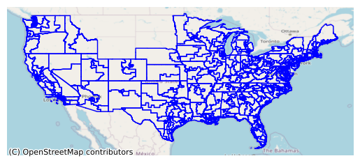
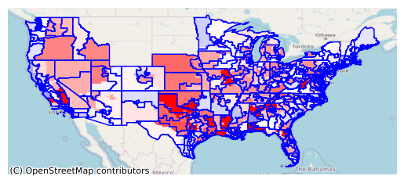
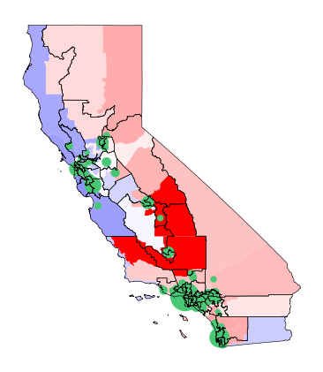
Feature Engineering – creating maps for CNNs to train on
Problem
Plan
Findings
Process
Layer 1: Map Redistricted Boundaries
Layer 2: Overlay Past Voting Results
Layer 3: Highlight Population Centers
Combine Layers into Final Map
Example: California after 2011 Redistricting
342 maps created (all instances of redistricting between 1950-2016), tagged with efficiency gap swings (swings in efficiency gap after redistricting)
Efficiency Gap Swing: +0.01 (1% in favor of Republicans)

Slide 8
Building a CNN
Problem
Plan
Findings
Process
Goal: Train a convolutional neural network (CNN) on redistricted congressional district maps to evaluate the presence and partisanship of gerrymandering in 2021 congressional districts
Model Design
Input: Standardized Maps (400x400, 200 dpi) – balance between size (complexity) and clarity
Output: Multiclass Classification – input CNN → hidden CNN → Dense layer → Softmax output
Output Classes: Pro-Dem (swing < -0.05), No Change (-0.05 < swing < 0.05), Pro-Rep (swing > 0.05)
Model Assumptions
Data Assumptions:
House elections mirror presidential elections
Gerrymandering patterns stationary over time
Model (CNN) Assumptions:
Spatial Hierarchy: Pattern granularity increases
Translation-Invariance: Consistent patterns
Model Metrics
(Primary) Accuracy: Proportion of total correct predictions
Precision: Proportion of all predictions per class that are correct
Recall: Proportion of correct predictions per class
Tuning Techniques
Class Imbalance: Oversample augmented images for minority classes, Cost-sensitive learning weights
Underfitting: Increase model kernels/introduce complex architectures to capture underlying trends
Overfitting: Random dropout on CNN/Dense layers, early stopping when test/validation metrics diverge

Slide 9
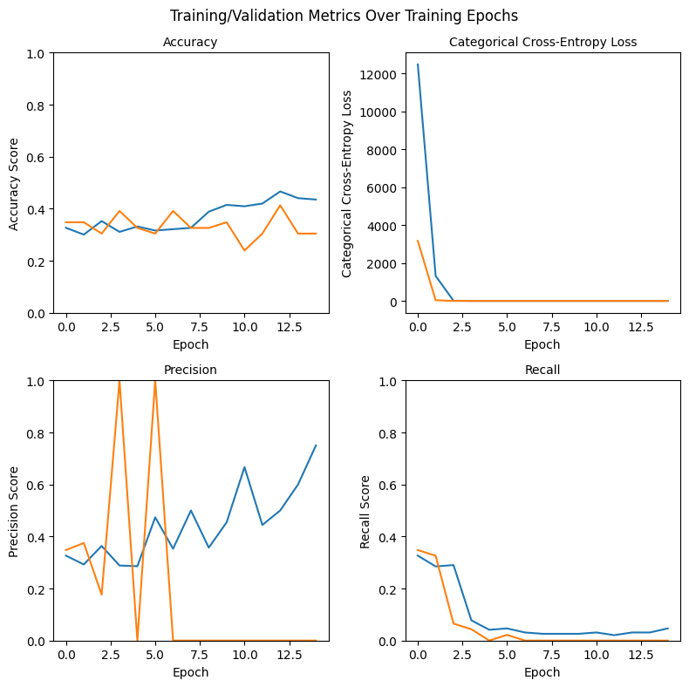
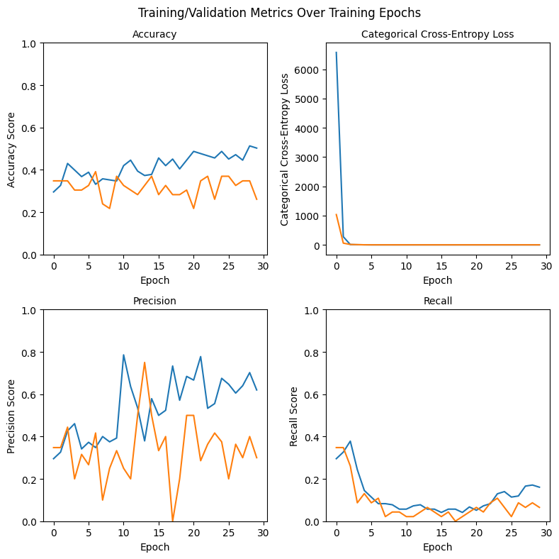
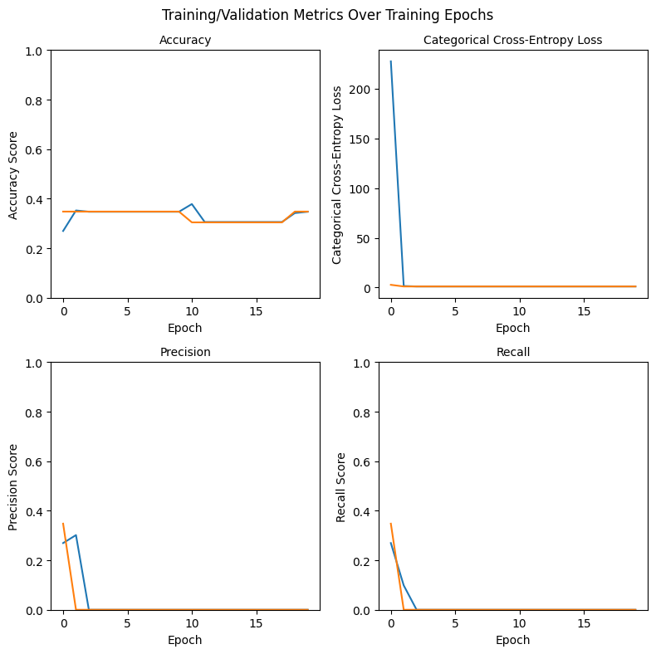
Training process was ineffective at improving model metrics
Problem
Plan
Findings
Process
1
Baseline Model
2
Hyperparameter Tuning
Goal: Set baseline metrics to improve upon
Accuracy: 34.9%
Precision: 19.4%
Recall: 40%
Model was underfit - could not differentiate from random chance
Goal: Find best set of hyperparameters to train CNN
Kernel Window: No effect
Activation Function: No effect
Batch Size: No effect
No. Epochs: No effect
Varying tested parameters had no effect on model metrics
3
Improved Complexity Model
4
Stacked CNN Layers
Goal: Increase no. of kernels to reduce underfit
Accuracy: 31.1%
Precision: 0.0%
Recall: 0.0%
Model was still underfit – precision/recall drops as model picks up bias
Goal: Stack CNN layers to better transfer relationship between layers
Accuracy: 30.1%
Precision: 0.0%
Recall: 0.0%
Worst-performing model – increased complexity not working (potential bias)

Slide 10
Results: Predictions could not produce expected outcomes
Problem
Plan
Findings
Process
Best Model: Baseline Model (34.4% Accuracy)
Improvements did not yield training improvements as expected – testing performance was bad for all models (essentially performing similar to random chance)
Model exhibited slight overfitting after 7 epochs – did not test dropout/early stop to prevent overfit since model performance was still poor
Prediction Results: 42 Dem Favor (98%), 1 No Change (2%), 0 Rep Favor (0%) – Net D+82
Actual: FiveThirtyEight¹ predicted a D+6 result, sole No Change state (TX) is under litigation for pro-Republican gerrymandering²
Model likely picked up on pro-Democratic bias, and could not capture nuance/reasoning behind gerrymander on map results
(1) FiveThirtyEight: What Redistricting Looks Like In Every State (2) All About Redistricting

Slide 11
Takeaways & Future Improvements
Problem
Plan
Findings
Process
Issue
Takeaways
Future Improvements
Ineffective Models
Utilizing Cloud Computing
Model Tuning
Limited testing of possible parameters/architectures given lack of resources on local machine led to poor training process
Using cloud computing resources can allow me to train complex models on high-quality maps with increased computational complexity
Poor Map Quality
Improving Data Availability
Low-Quality Maps
Available data on congressional voting was low-quality and inconsistent, making it difficult to create holistic maps that matched voting landscape
Increased efforts to collect and compile available demographic and voting trends over time can help make higher-quality, holistic maps
Small Map Sample
Generating “What-If” Maps
Small Sample Size
Only 342 redistricting maps were available, leading to small sample size prone to inherent bias and high noise-to-signal ratio
Writing non-partisan programs to generate hypothetical boundaries (with accurate results) can increase sample size without bias or overfitting
The dataset, with over 7 million reviews across 150,000 businesses, challenged our processing capabilities, especially for tasks like NLP feature engineering.
We addressed this by using stratified sampling of data from each city and optimizing our processing with Colab Pro for better efficiency
The dataset, with over 7 million reviews across 150,000 businesses, challenged our processing capabilities, especially for tasks like NLP feature engineering.

