Slide 1
Machine learning in Python
Toby Wise

Slide 2
Today
I will talk about:
Data, plotting, basic machine learning
I will not talk about:
Deep learning

Slide 3
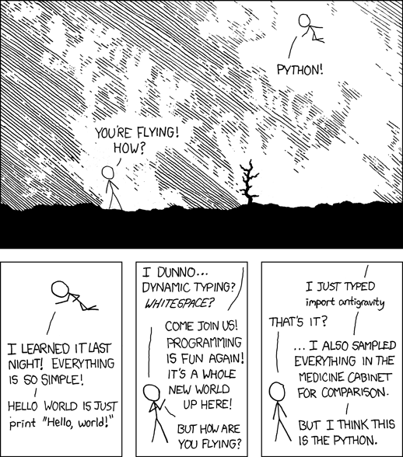
Why python?
Open source
Free
Extensive functionality
Widely used outside academia
Many tutorials etc online

Slide 4
What can Python do?
By itself, not much
With the right packages, ANYTHING

Slide 5
Making Python behave like MatLab
To provide numerical operations, handling of multidimensional data etc, we use NumPy

Slide 6
NumPy
The basic building block of NumPy code is the array
>>> np.array([1, 2, 3])
array([1, 2, 3])
>>> np.array([[1, 2], [3, 4]])
array([[1, 2],
[3, 4]])
Arrays are an n-dimensional data format that allow any kind of manipulation you could ever want

Slide 7
Pandas
Sometimes it’s nice to have labelled data
Instead of:
array([[1, 2],
[3, 4]])
Column A | Column B
1 | 2
3 | 4

Slide 8
Pandas
Pandas provides dataframes, which are basically labelled NumPy arrays
This makes everything a bit more organised
E.g. averaging
mean_value = my_array[1, :].mean()
mean_value = my_df[‘Column B’].mean()

Slide 9
Plotting
Matplotlib
Basic plotting functionality, a bit like MatLab
Seaborn
A high-level interface for Matplotlib

Slide 10

Machine learning
https://scikit-learn.org/

Slide 11
SciKit Learn
Implements most major supervised learning algorithms (linear models, SVMs, gaussian processes, random forests etc)
Same for unsupervised methods (PCA, ICA, k-means…)
Has tools for various types of cross-validation, hyperparameter estimation etc
The website has demos of all these things

Slide 12
SKLearn basics
SKlearn uses an object-oriented approach (like most Python packages)
Algorithms are instantiated as objects, which you can then do things with
from sklearn.svm import SVC # import statement
clf = SVC(kernel=‘linear’) # set up a SVM classifier

Slide 13
SKLearn basics
When creating a classifier you can specify various settings
from sklearn.svm import SVC # import statement
# SVM with C = 0.01, radial basis function kernel
clf = SVC(C=0.01, kernel=‘rbf’)

Slide 14
SKLearn basics
These objects have “methods” that do useful things
The most useful is the fit() method
This trains a classifier given X and Y data (supervised) or X data (unsupervised)
clf = SVC(kernel=‘linear’) # set up a SVM classifier
clf.fit(X, Y) # fit the classifier to our data
clf = PCA(n_components=5) # PCA object
clf.fit(X) # “train” the PCA

Slide 15
SKLearn basics
When we have a trained classifier we can use it to predict things
We do this using the predict() method
Given new X data, this predicts Y values
clf = SVC(kernel=‘linear’) # set up a SVM classifier
clf.fit(X, Y) # fit the classifier to our data
clf.predict(X_new) # predict Y values from unseen X data

Slide 16
SKLearn basics
Another useful method is the transform()
For PCA, ICA etc this applies the decomposition to your data
For simplicity, there is also a fit_transform() method that fits and transforms in one step
>>> print(X.shape)
(100, 20)
>>> clf = PCA(n_components=5) # set up PCA
>>> X = clf.fit_transform(X)
>>> print(X.shape)
(100, 5)

Slide 17
SKLearn basics
Every classifier has the same basic methods (fit etc.)
This keeps things consistent and simple
Also allows you to switch out algorithms easily
Classifiers are typically referred to as “estimators”

Slide 18
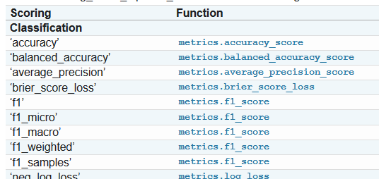
Scoring
To evaluate our classifier we need to decide how we judge its performance
For binary classification problems, we could use accuracy
For continuous targets we might use MSE or something similar
SKLearn has plenty built in

Slide 19
Cross validation
SciKit Learn has a number of tools that make CV easy
We can get cross validated accuracy metrics:
from sklearn.model_selection import cross_val_score
clf = SVC(kernel=‘linear’) # set up a SVM classifier
scores = cross_val_score(clf, X, Y, cv=5, scoring=‘accuracy’)
And cross validated predictions:
pred = cross_val_predict(clf, X, Y, cv=5)

Slide 20
Cross validation
Functions implementing CV take a parameter indicating which CV method to use
Providing an integer performs k-fold CV with the number of folds specified
SKLearn provides a number of CV types
These are objects themselves, which can then be given to any CV function
from sklearn.model_selection import LeaveOneOut
clf = SVC(kernel=‘linear’) # set up a SVM classifier
loo = LeaveOneOut() # set up a LOO CV
scores = cross_val_score(clf, X, Y, cv=loo)

Slide 21
Preprocessing
We often want to apply some sort of preprocessing to our data before feeding it into a classifier
E.g. normalising/scaling
SKLearn has functions for this
>>> from sklearn.preprocessing import scale
>>> X_train = np.array([[ 1., -1., 2.],
... [ 2., 0., 0.],
... [ 0., 1., -1.]])
>>> X_scaled = scale(X_train)
>>> X_scaled
array([[ 0. ..., -1.22..., 1.33...],
[ 1.22..., 0. ..., -0.26...],
[-1.22..., 1.22..., -1.06...]])

Slide 22
Hyperparameter optimisation
Classifiers work best with the right hyperparameter values
Various methods exist for findings optimal values
E.g. grid search, random search
SKLearn implements these, and combines them with CV
from sklearn.model_selection import GridSearchCV
tuned_parameters = {'C': np.arange(5, 0.1)}
clf = GridSearchCV(SVC(), tuned_parameters, cv=5,
scoring='accuracy')
clf.fit(X, Y)

Slide 23
Pipelines
Often we’ll have a pipeline of preprocessing / dimensionality reduction / classification steps
SKLearn has pipeline tools for this
from sklearn.pipeline import make_pipeline
from sklearn.preprocessing import StandardScaler
# pipeline = scale > PCA > SVM
pipeline = make_pipeline(StandardScaler, PCA(), SVC(kernel=‘linear’)

Slide 24
Pipelines
Pipelines can be used like a normal classifier object
This means you can do anything you would with a normal classifier
E.g. fitting, predicting, CV, hyperparameter tuning
They allow access to parameters of the component estimators
tuned_parameters = {‘SVC__c’: [1, 2, 3, 4],
‘PCA__n_components’: [5, 10, 15, 20]}
search = GridSearchCV(pipeline, tuned_parameters, cv=5)

Slide 25
Entire machine learning pipeline in 5 lines of code
pipeline = make_pipeline(StandardScaler(), PCA(), SVC(kernel='linear'))
search = GridSearchCV(pipeline, tuned_parameters, cv=5)
search.fit(X, y)
best_estimator = search.best_estimator_
best_estimator.predict(X)

Slide 26
The end
Thanks!

