Slide 1
Git
A brief introduction

Slide 2
Disclaimer
I know next to nothing about Git
I am terrible at using it
Please direct any complicated questions to Hrvoje

Slide 3
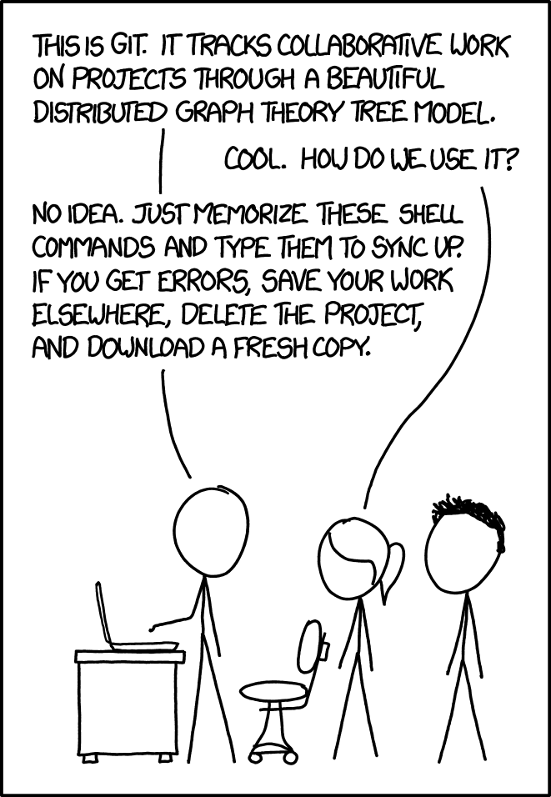
What is version control?
Version control allows you keep track of versions
Works better than
Code_v1.py
Code_v2.py
Code_final.py
Code_final_v2.py
…

Slide 4
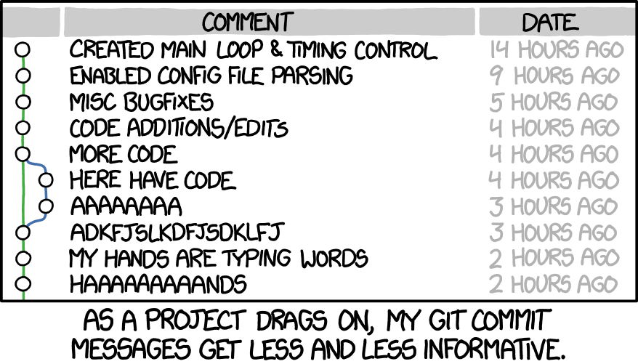
Commits
Committing things updates the versions stored in the repository
When you commit something, you should provide a commit message that explains what you’ve changed

Slide 5
Branches
Branches are a useful feature
Creating a new branch effectively clones your repository
You can then change this without affecting the main code base

Slide 6
Github
Github is an online service that hosts Git repositories
You can “push” your commits to github, and “pull” other people’s commits to your local machine
Makes collaboration easy!!

Slide 7
Tools
You can use git through the terminal
Or you can use some sort of GUI – I like SourceTree
Some IDEs/editors (e.g. Pycharm, vscode) have Git integration built in

Slide 8
The end
Thanks!

