Slide 1
Replay in aversive environments

Slide 2
Primary aims
Test whether reverse replay of state sequences occurs in response to punishing outcomes
Look for replay of paths to avoid during planning
Examine relationships between these phenomena and self-reported symptoms of worrying and rumination

Slide 3
Overview
We will use similar methods to Kurth-Nelson et al. (2016) to identify replay of state sequences
This will involve running a functional localiser in the scanner prior to the task to enable to decoding of individual states

Slide 4
Task
Subjects will navigate through a 3-step tree of 11 total states
The task will be performed non-spatially – subjects will never see a birds-eye view of the tree, and random keys will be used to transition between states
The task will be to collect as many points as possible from the terminal states

Slide 5
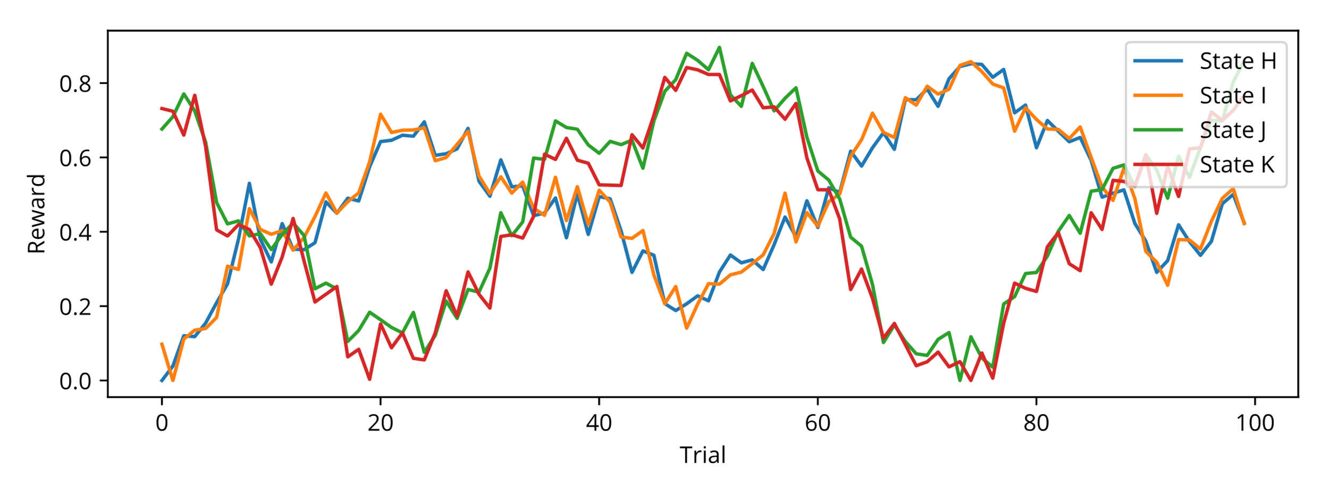
Rewards
Terminal states will be associated with rewards that follow a random walk
The two terminal states in each “branch” of the tree will have similar rewards

Slide 6
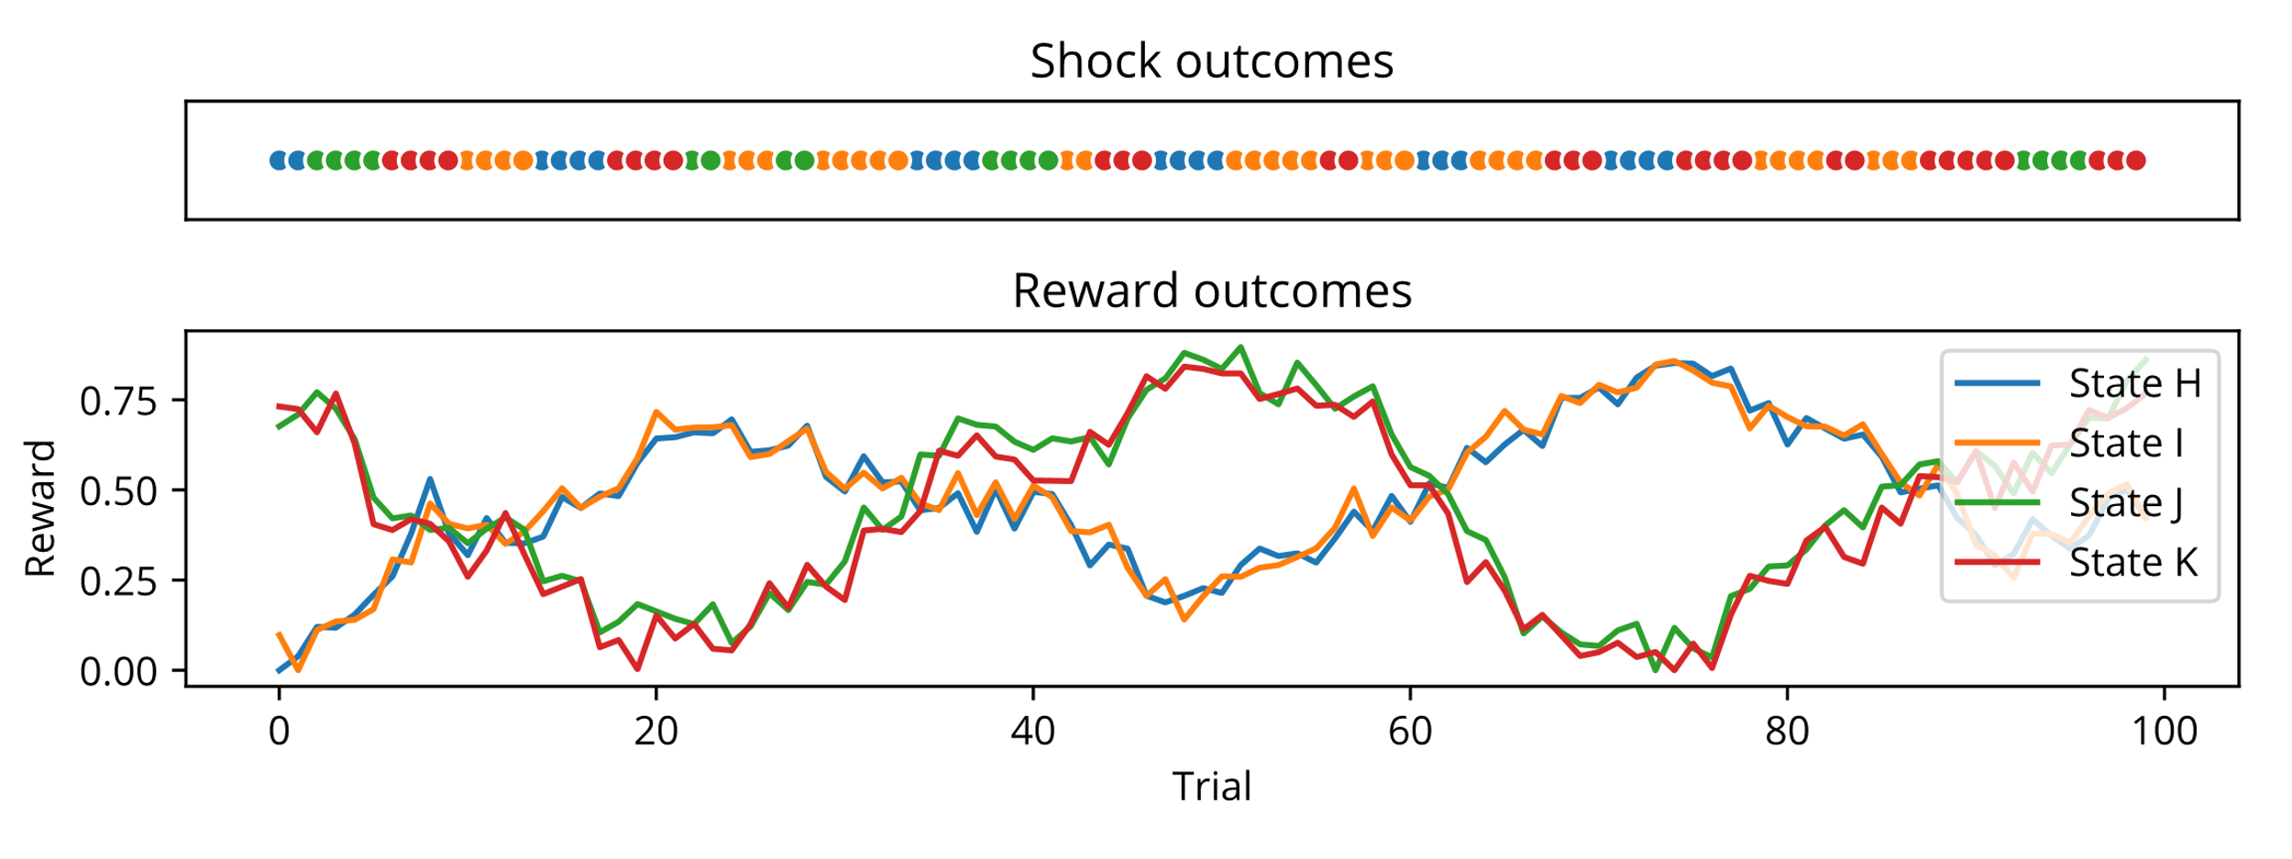
Shocks
On every trial, one terminal state will be associated with a shock
This state will remain shocked for ~2-6 trials, such that some learning of shock locations is required but it still changes frequently enough that subjects will take shocked trajectories relatively often
(for illustration – actual outcomes will be designed more carefully!)

Slide 7
Trial structure
On each trial, subjects will first plan a sequence of moves before entering them and then seeing the state sequence and terminal state outcome
Replay analyses will focus on the planning and rest periods

Slide 8
Separation of rest and planning
To separate rest from planning periods, we need to attempt to prevent subjects from planning before the trial starts
Methods we have considered include adding a large reward to a random terminal state on some trials (subjects would be informed of the highly rewarded state when starting the trial) – this would mean that plans would be dependent on the presence of this reward, which is not known until the trial begins
Another option would be to remove transitions from the tree on random trials
Alternatively, non-decision trials (following slide) may help address this problem

Slide 9
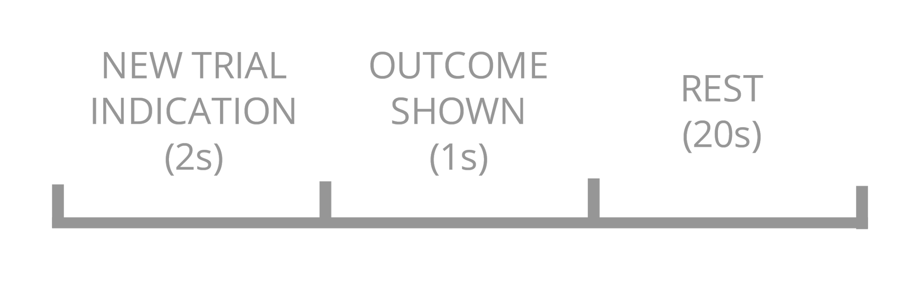
Decision-free trials
On some trials, subjects will not plan sequences but will instead be shown the outcome associated with a random terminal state without the sequences leading to it
This will allow us to avoid the exploration issue to some extent, as subjects are unlikely to explore trajectories with low rewards and would hence be unlikely to experience shocks in these states

Slide 10
Additional aims
Generalisation
The task design will allow us to test for proximity-based generalisation of aversive experiences behaviourally and neurally
As the two terminal states in each “branch” of the tree have similar reward values, if state J becomes shocked, the subject should instead go to state K. However, if the shock is generalised, subjects may instead visit state H or I
Likewise, we may see replay of states K > G > C > A if generalisation of a shock at J occurs

Slide 11
Additional aims
Policy-dependent replay
The inclusion of non-decision trials means that subjects will experience outcomes that are off-policy
This will allow us to test the proposal that replay is present when outcomes lead to a change in policy (Mattar & Daw, 2018)
Shocked state is in the optimal trajectory – replay used to update the Q value to favour the neighbouring trajectory?
Shock state is in the non-optimal trajectory – no need to change the policy so replay is not required

Slide 12
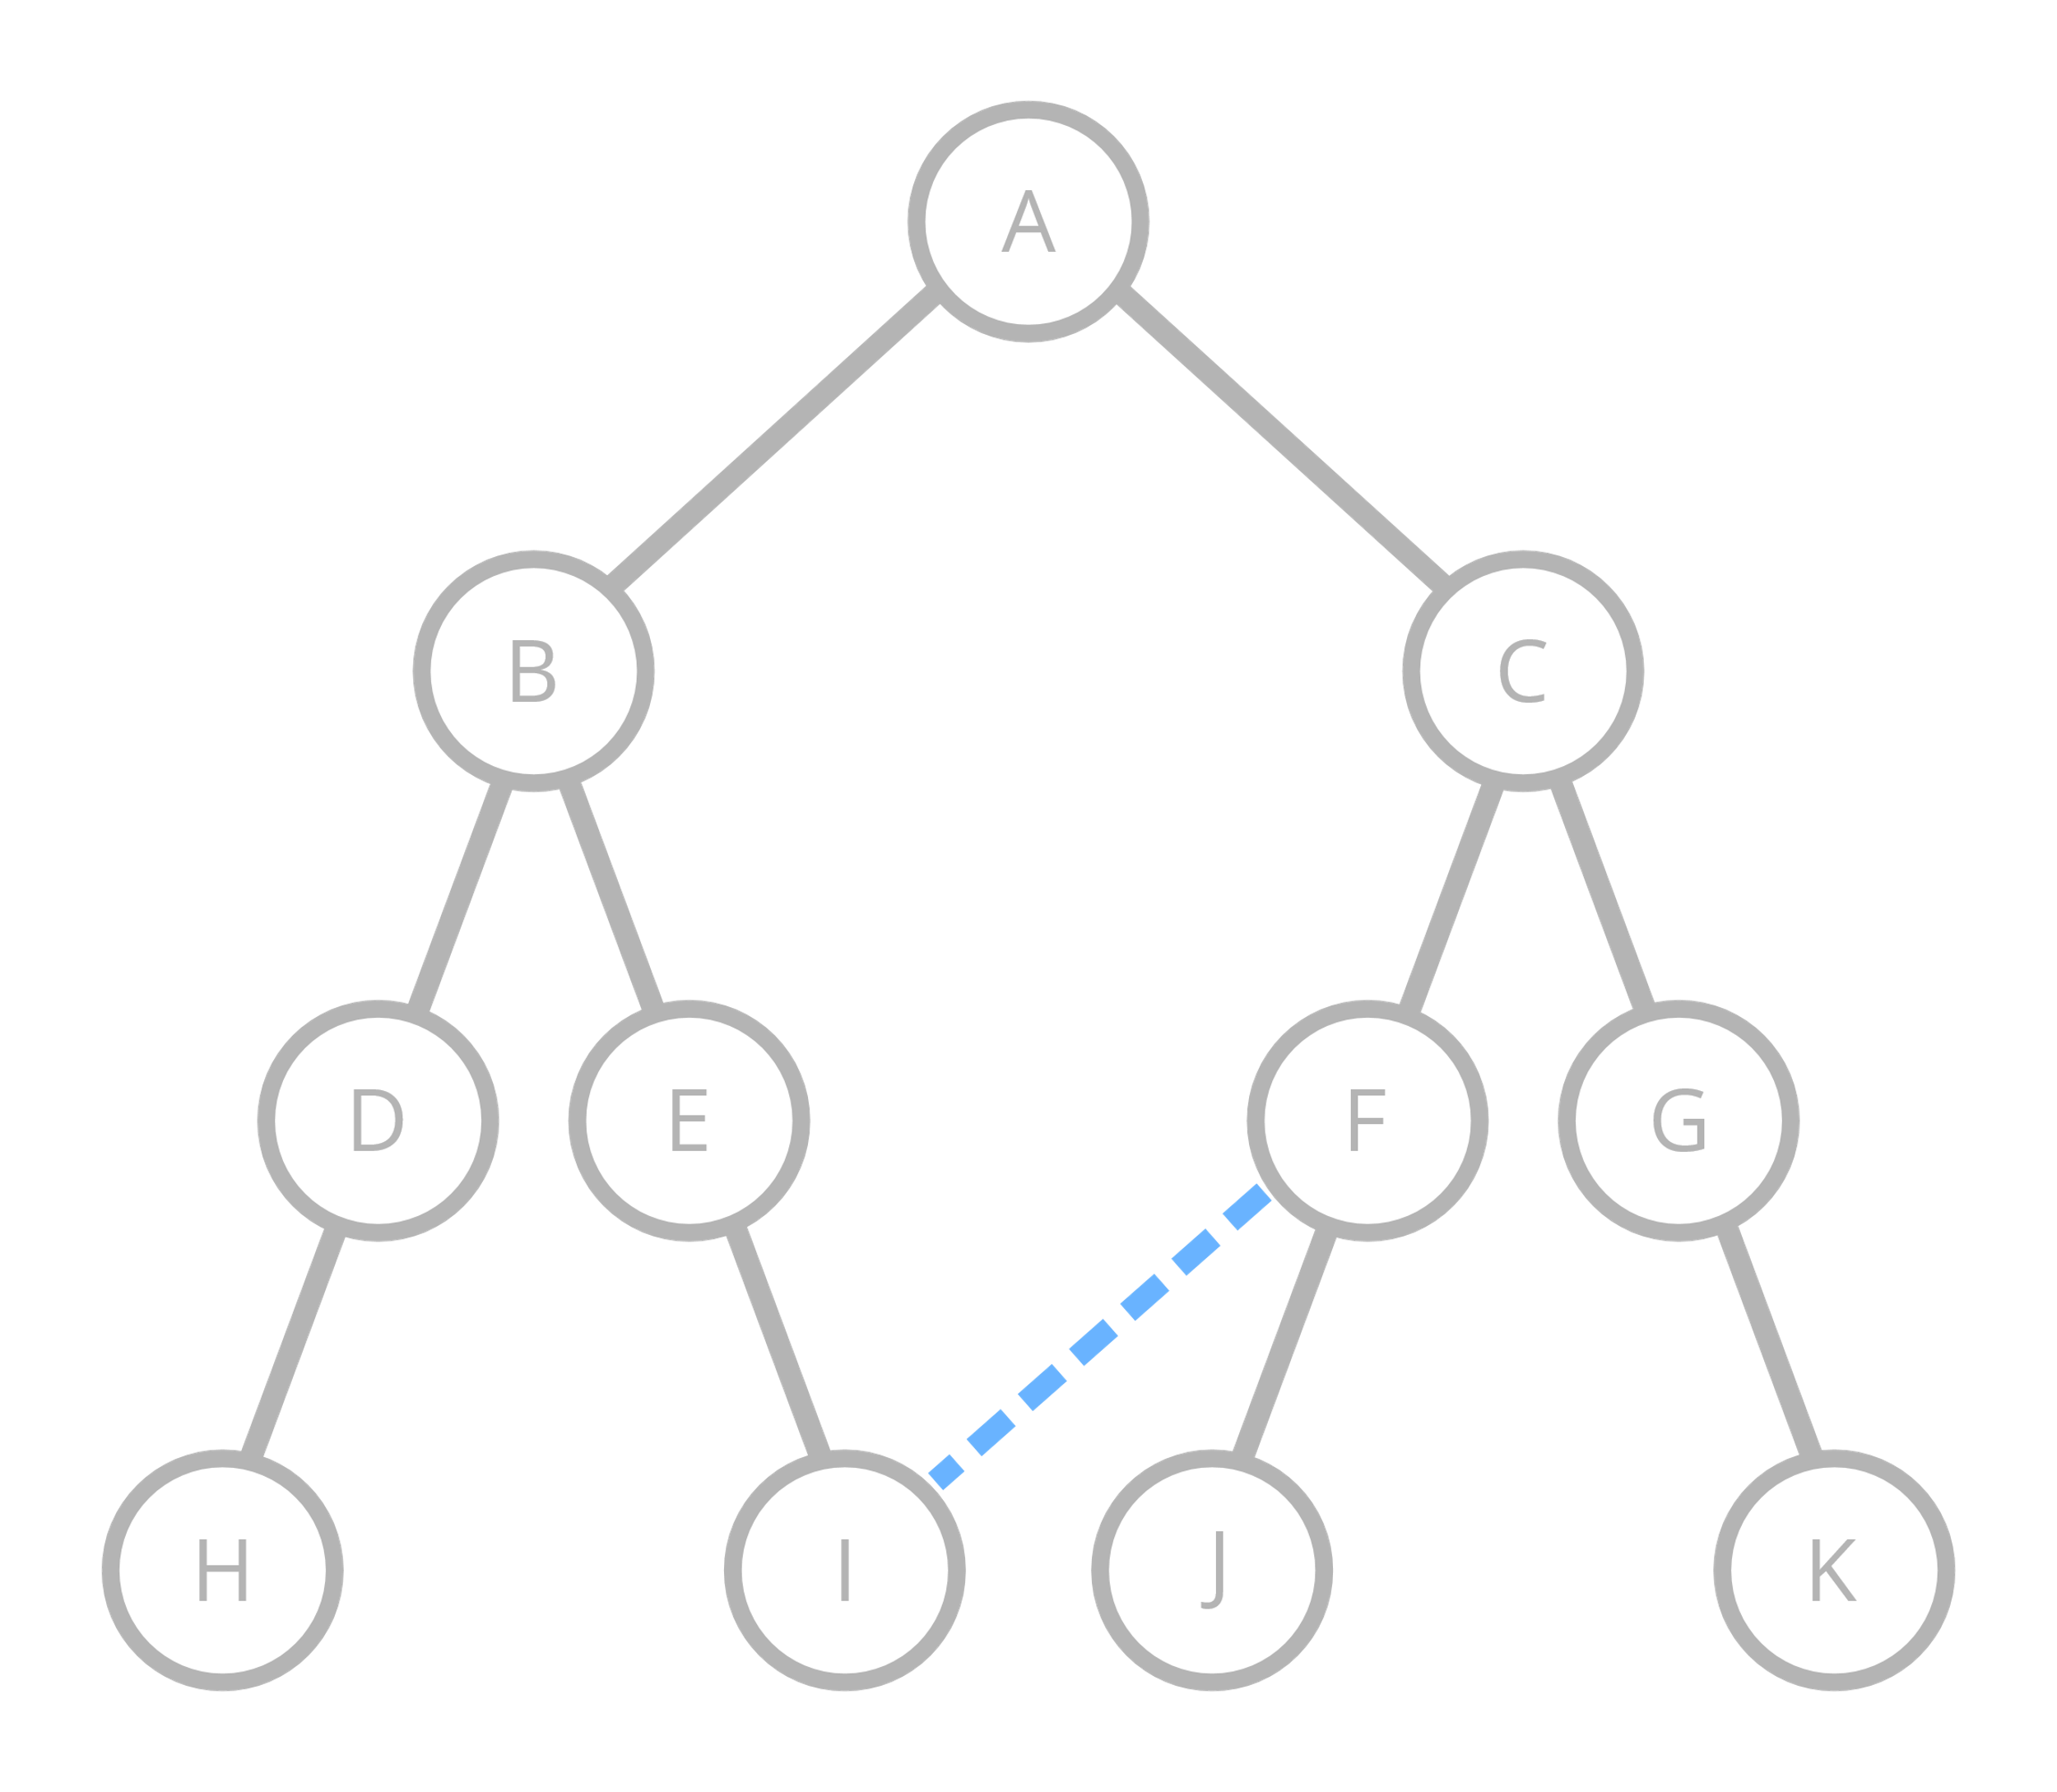
Further extension of the task
Distinguishing between model-based planning and successor representation
Telling subjects that previously-unconnected states are now connected (without experiencing this transition) would allow subjects to update their model of the task, without updating the SR
It could then be interesting to see whether replay of the new path is present, as this would be dependent on model-based planning/updating

Slide 13
Peter
Imbalance
Going too many steps ahead
Non-optimal paths
Redundant states

