Slide 1
Replay in aversive environments
Toby Wise, Yunzhe Liu, Helen Schmidt & Ray Dolan
Project presentation
23 / 3 / 18

Slide 2
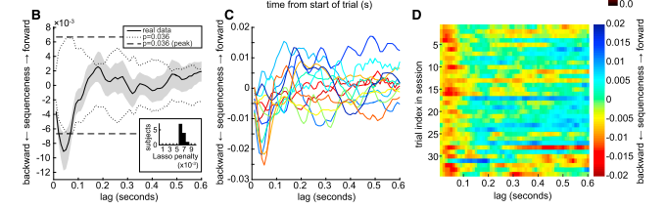
Replay
Replay of experienced state sequences has been repeatedly demonstrated in the hippocampus of rodents
Replay-like activity can be detected in humans using MEG (Kurth-Nelson et al., 2016, Neuron)

Slide 3
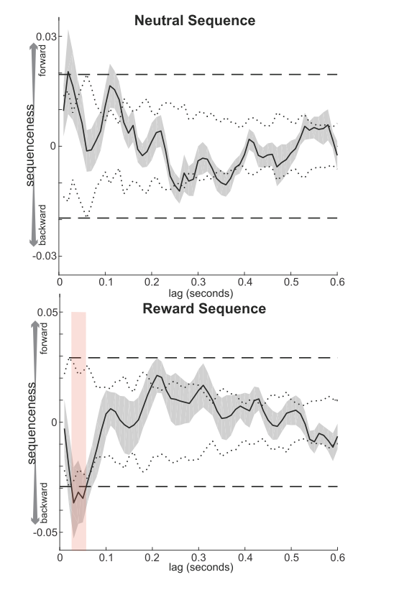
Replay
During learning, administration of reward results in reverse replay starting at the rewarded state (Foster et al., Nature, 2006)
Recent work has shown the same phenomenon in humans using MEG

Slide 4
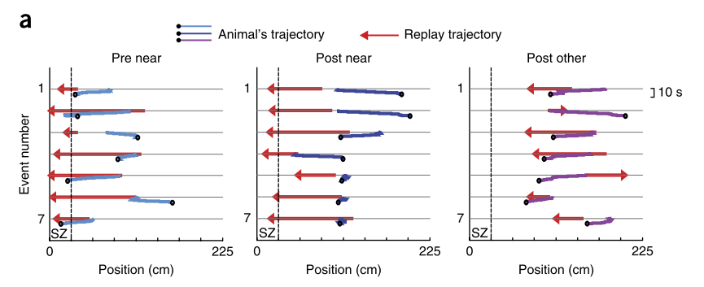
Replay in aversive environments
Some evidence that forward replay occurs when planning trajectories in aversive environments (Wu et al., 2017, Nature Neuroscience)
It is unclear whether reverse replay also occurs after punishing outcomes

Slide 5
Aims
Test whether reverse replay occurs in response to punishing outcomes
Look for forward replay of paths to avoid during planning
Examine relationships between these phenomena and self-reported symptoms of worrying and rumination

Slide 6
Task

Slide 7
Task

Slide 8
Trial structure

Slide 9
Functional localiser
Images used to represent the 9 task states will be presented sequentially in a random order for ~1 second each
Total scan time will be approximately 20 minutes

Slide 10
Training
Subjects will be trained on the task in separate sessions prior to scanning, without rewards and punishment
The task in the scanner will only require learning about rewards and punishments – not the transition matrix itself

Slide 11
Experiment timeline
Day 1
Training on the task (~45 minutes)
Questionnaires (~15 minutes)
Day 2
Re-familiarisation with the task outside the scanner (~30 minutes)
Functional localiser (~20 minutes)
Task in the scanner (~100 minutes)
Questionnaires (~5 minutes)

Slide 12
MEG analyses
Data will be analysed as in previous experiments to detect evidence of forward & reverse replay during planning and rest
This involves training a classifier on data from the functional localiser and using this to decode state reactivation
This can be used to create a state X time matrix, where we can look for replay events
Replay intensity will be correlated with self-report measures of worry and rumination

Slide 13
Scanning details
Number of subjects: 20 initially, with a potential further 20 to allow investigation of individual differences (depending on initial results)
Time per subject: 120 minutes
Total scanning time: 20 subjects x 120 minutes = 40 hours, with a potential additional 40 hours
Scanner: MEG, standard setup
Ethics: 12707/001 – allows administration of shocks in MEG tasks
Funding: Sir Henry Wellcome Fellowship
Data sharing: We will aim to share all data from the project (exact format will depend on outcome of MEG data sharing discussions)

