Slide 1
Ex 05
Characters encoding
Basic Engineering Course

Slide 2
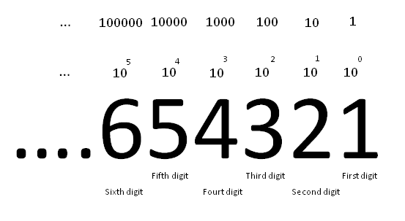
Decimal system
654321_{D}= 6×10⁵+5×10⁴+4×10³+3×10²+2×10¹+1×10⁰

Slide 3
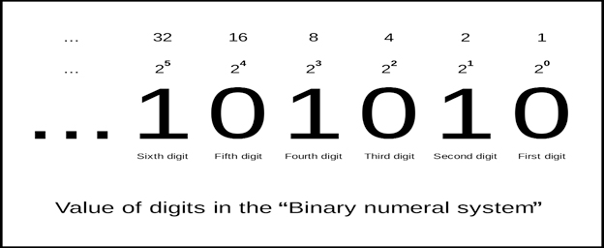
Binary system
101010_{B}= 1×2⁵+0×2⁴+1×2³+0×2²+1×2¹+0×2⁰

Slide 4
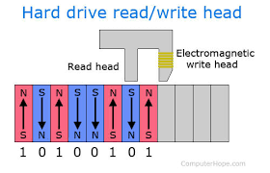
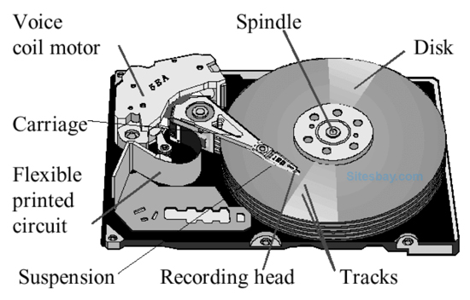
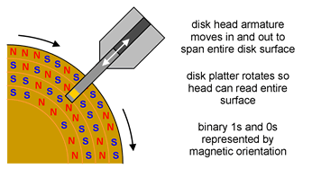
Data storage

Slide 5


Slide 6
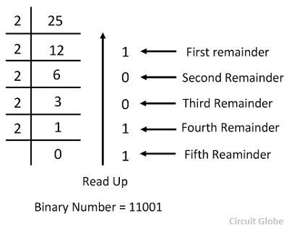
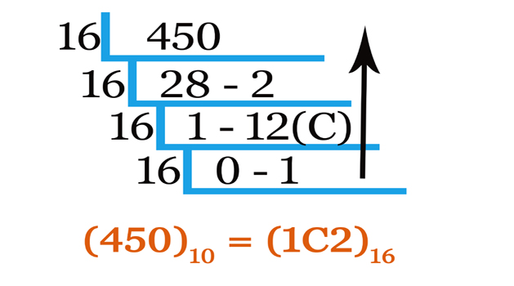
Conversion

Slide 7
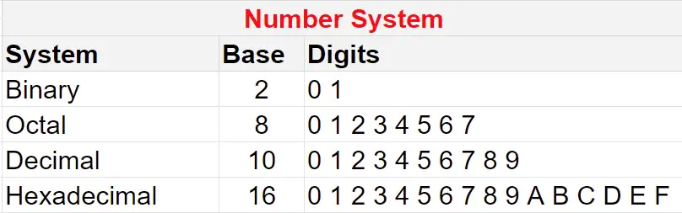
Number systems

Slide 8


Slide 9
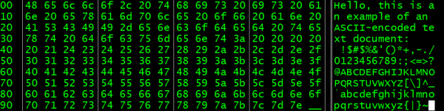
Introduction
Computers operate in binary numbers.
Q1: How are we able to store letters and words?

Slide 10
Introduction
Characters encoding is assigning numbers to characters.
Q2: Rules?

Slide 11
Simple example
Assign the numbers 1-26 to the English alphabet.
1 2 3 4 5 6 7 8 9
a b c d e f g h i
c o m p u t e r
10 11 12 13 14 15 16 17 18
j k l m n o p q r
19 20 21 22 23 24 25 26
s t u v w x y z
3 15 13 16 21 20 5 18

Slide 12
Characters encoding
To completely capture the English alphabet:
upper-case letters
lower-case letters
punctuation
Other characters:
numbers
math operators, brackets
...

Slide 13
Characters encoding
Required number of characters:
from A to Z - 26 characters
from a to z - 26 characters
from 0 to 9 - 10 characters
. : , : ‘ “ < > ? / … - ?? characters
+ - * / = - 5 characters
( ) [ ] { } - 6 characters

Slide 14
ASCII - Standard Code
Conclusion
We needed more than 26 characters.
Solution
American Standard Code for Information Interchange (ASCII) was created as one of the first character encoding standards for computers.

Slide 15
ASCII - milestones
Work on the ASCII standard began on October 6, 1960.
The 1st edition of the standard was published in 1963.
On March 11, 1968, U.S. President Lyndon B. Johnson mandated that all computers purchased by the United States Federal Government support ASCII.

Slide 16
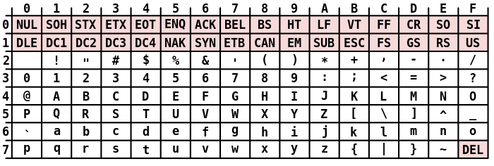
ASCII character set
There are 32 control and 95 printable characters in the ASCII encoding scheme

Slide 17
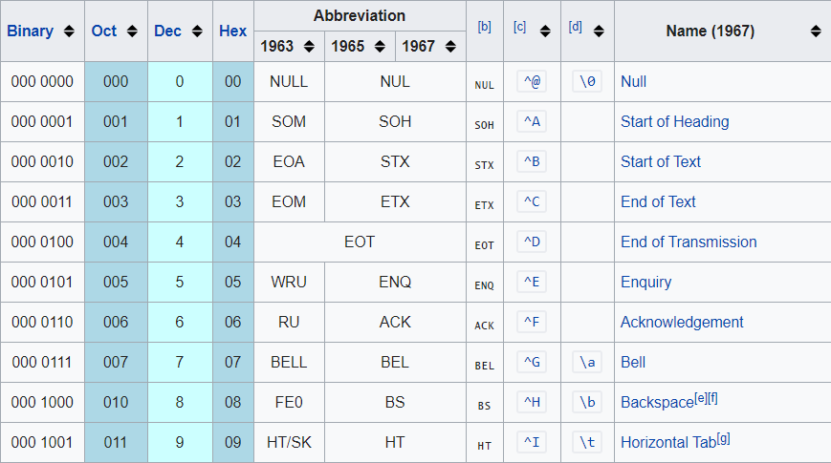
ASCII control characters

Slide 18
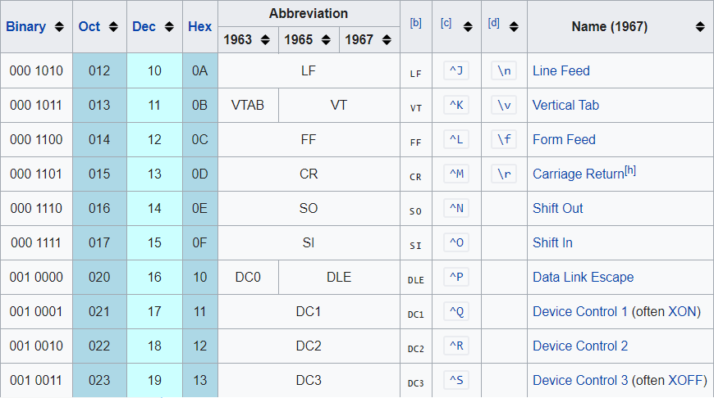
ASCII control characters

Slide 19
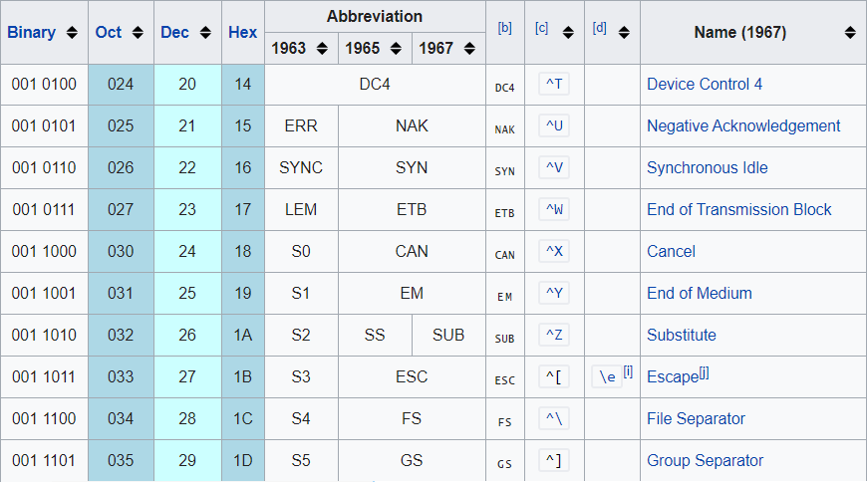
ASCII control characters

Slide 20
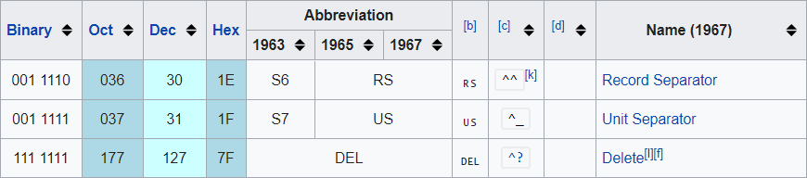
ASCII control characters
Control characters make up the first 32 characters of the ASCII table. These characters are not intended to be printed, instead they are used to send command instructions to another device, such as a printer.

Slide 21
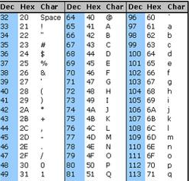
ASCII printable characters
0 - 9 → 30h - 39h
A - Z → 41h - 5Ah
a - z → 61h - 7Ah
“ “(space) → 20h

Slide 22
ASCII example
c o m p u t e r
63 6f 6d 70 75 74 65 72

Slide 23
Arduino
void loop() {
Serial.write(0x48); // H
Serial.write(0x65); // e
Serial.write(0x6C); // l
Serial.write(0x6C); // l
Serial.write(0x6F); // o
Serial.write(0x21); // !
Serial.write(0x0A); // \n
delay(500);
}
#define BAUDRATE 115200
void setup() {
Serial.begin(BAUDRATE);
}

Slide 24
Extended ASCII
Extended ASCII character encodings are 8-bit or larger encodings that include the standard ASCII(7-bit) character set + additional characters.
But 128 additional characters is still not enough to cover all purposes, all languages, etc.

