Slide 1

Starting and restarting businesses since 36 hours ago
Confidential & Proprietary; Copyright © 2016, Restart.

Slide 2
Problem
About 50% of the population prefers watching sporting events from home
“4.5 percent fewer fans are attending games in the current season than they did five years ago.”[1]
Watching sports on television is far cheaper and you get much better view/close up of the game
Live stadium events need to be more engaging for the audience leading to more revenue
What is the difference between being in the stadium and home? What can you do in a stadium that you couldn’t at home?
Confidential & Proprietary; Copyright © 2011, Restart.

Slide 3
Solution
An application that increases the engagement and excitement of audience while creating incoming revenue
General polls such as “Who was the MVP?” to keep the audience interested
Raffles through the event to raise money for a cause and/or generate revenue
Polls and quizzes where the correct answers can receive an award. (shirts, balls, etc. signed by athletes)
Confidential & Proprietary; Copyright © 2011, Restart.

Slide 4
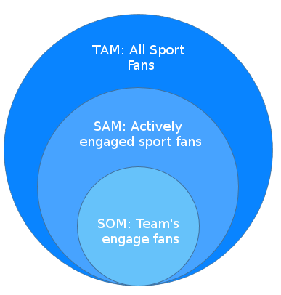
Market Size
With the cheap and accessibility of television, the TAM has been decreasing.
People who watch the game from home do not get:
The physical experience
Free stuffs!
Meeting and autographing with favorite team
Hyped! can push the benefits of going to sporting events to its limits.
Confidential & Proprietary; Copyright © 2011, Restart.

Slide 5
Business Model
Pricing: Cheap!
App requires little work and maintenance
Multi platform (iOS, Android, Windows, Web)
Engages audience, generate revenue
Low risk with a high yield
Marketing: Easy!
Can be advertised through the jumbotron
Free advertising for teams in their own stadium
Confidential & Proprietary; Copyright © 2011, Restart.

Slide 6
Closing
Most revenues come from sport fans attending events. Its critical to keep fans excited!
Hyped! is easy, cheap, and accessible
We, at are dedicate to making this prototype a reality
Contacts:
Daniel Eynis - eynis@pdx.edu
Larry Chiem - clarry@pdx.edu
Rohan Elukurthy - roh3@pdx.edu
Doanh Tran Caraballo - doanh@pdx.edu
Kiarash Torkian - torkian@pdx.edu
Confidential & Proprietary; Copyright © 2011, Restart.

Slide 7
Citation
[1]Why Rising Ticket Prices and Technology Lead NFL Fans to Stay Home
[2] Declining Attendance Trends In Collegiate

