Slide 1
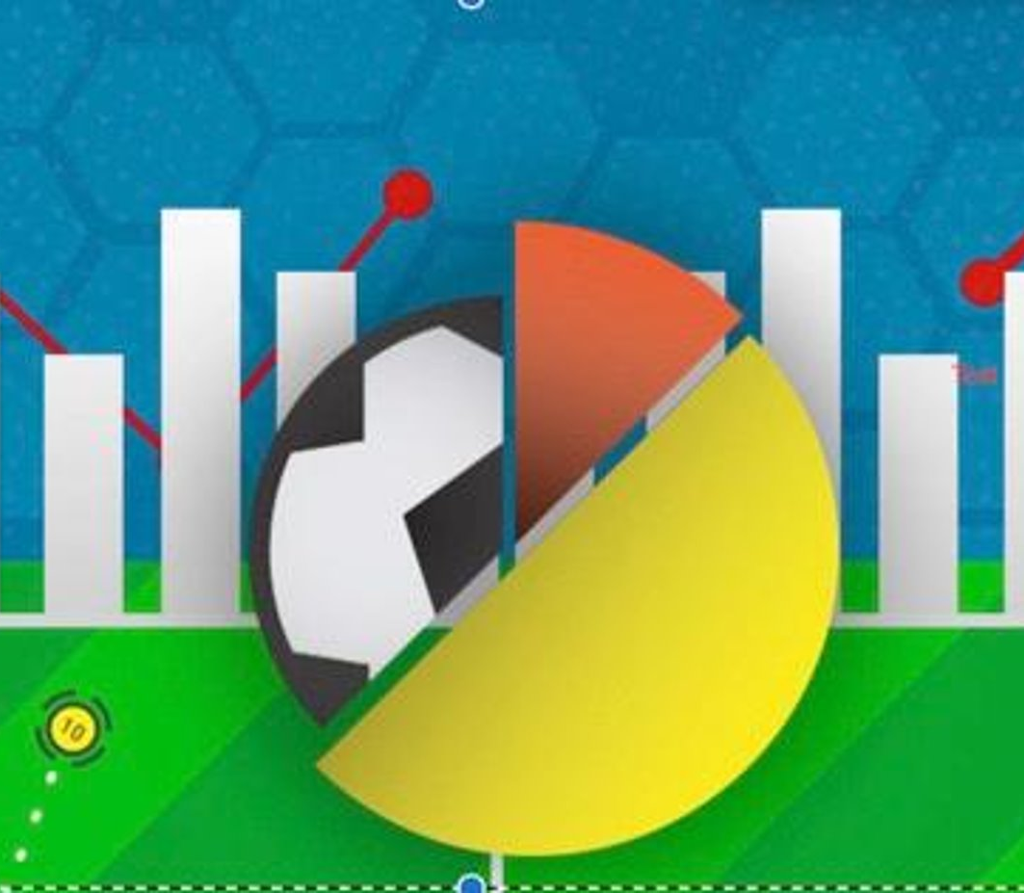
GOALYTICS
Meet the team:
Devdutt Sharma
Keerthana Adavelli
Shefali Gupta
Sravani Kotha
Urvaj Shah

Slide 2
Agenda
Business Objective
Methodology
Analysis
Expected vs achieved outcomes
Learnings
Roadmap Ahead

Slide 3
About Goalytics
Goalytics, a Chicago-based Sports Analytics firm focused on soccer.
We specialize in analyzing player performances to provide recruitment solutions to various soccer clubs.
Our tool adapts to the needs and resources of each club with the aim of optimizing their recruitment decisions.

Slide 4
Problem Statement
Arsenal FC's performance has been inconsistent for the past 5 years and they are looking to recruit some new players to rejuvenate their squad.
The new Director of Soccer at Arsenal FC, Edu Gasper, has identified specific positions for which he needs new players. He has reached out to us to help him with suggestions for the recruitment of these players.

Slide 5
Solution/ Objective
We want to build a self-service dashboard , analyzing each players performance based on key metrics like Goals scored, Assists and attributes like their position on the field, expertise.
The client then based on his requirements would be able to apply the relevant filters and be able to see all the players and their performances.
Based on our visualizations , he can select a player which best fit requirements.

Slide 6
Methodology
Project/ Data selection
Business Problem Identification
Data Cleaning and Preparation
Normalization of the dataset, upto 3NF.
Data Modelling
Extract Transform Load
Dashboard Creation on Tableau -Visualizations

Slide 7
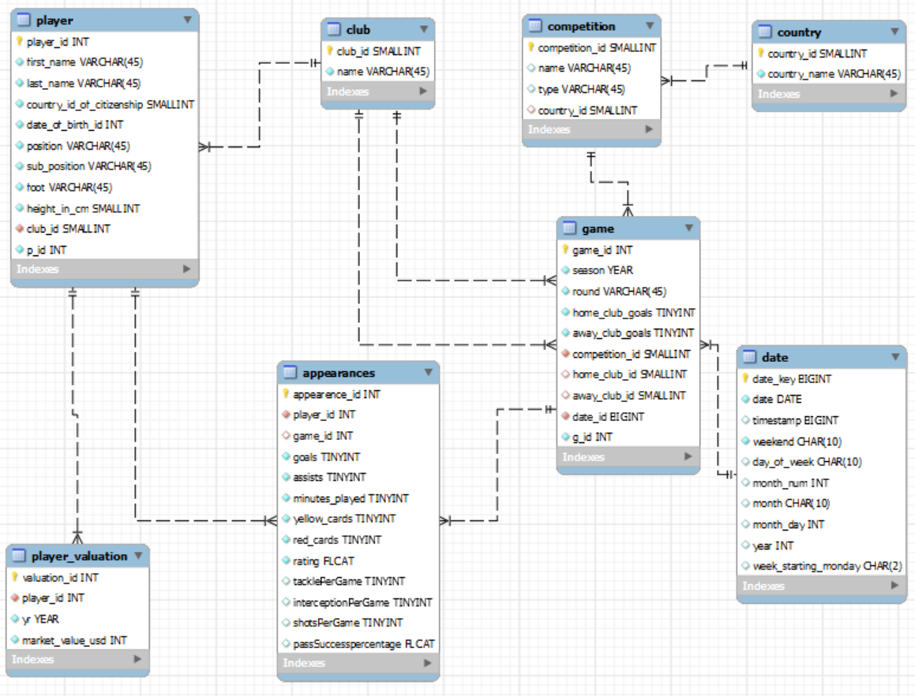
Methodology​

Slide 8
Dashboard

Slide 9

Expected vs Achieved Outcomes
Select the best player(s) according to the client requirement
A self-service tool
Able to visualize player performance
Search through players according to their field positions, nationalities etc.
Track players' market value across years.
Recommendation of players based on the team profile, player strength, position and budget.

Slide 10
Learnings:
Building Data pipelines
Data cleaning steps
Data Transformation and Normalization
Different Visualizations
Teamwork

Slide 11
Roadmap Ahead
Development of the Dashboard as a Recommendation Engine:
Based on the performance of each team and its players, the dashboard would proactively send recommendations to the registered team managers about recruiting certain players

Slide 12
Thank You

