Slide 2
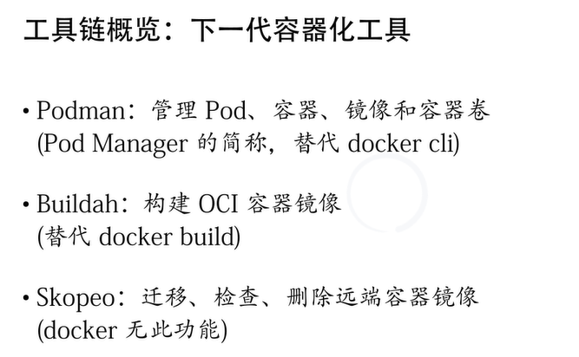
https://sasasu.github.io/diary/replacing_docker_with_podman/

Slide 3
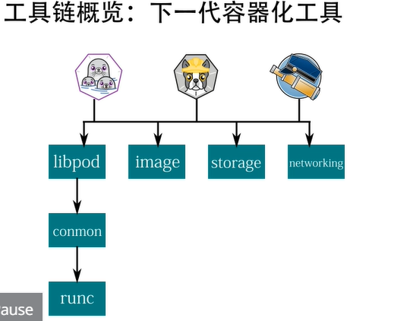
Podman

Slide 4
https://github.com/containers/libpod/blob/master/docs/tutorials/podman_tutorial.md
可利用criu 实现容器在两个host之间的热migration , 原理是
1.在源host上checkpoint
2. 把 checkpoint文件迁移到target host上去
3. 在target host上restore

