Slide 1
Clustering Stability in Healthcare Data: The Impact of Distance Metrics on Computational Phenotyping
Notes:
Hi, my name is Todd Adams, and I’m a PhD candidate in nursing and a practicing psychiatric mental health nurse practitioner.
This presentation focuses on clustering stability in healthcare data, specifically how the choice of distance metric affects computational phenotyping.
Clustering is widely used to identify patient subgroups, but one key issue is that methodological decisions—like how similarity is defined—are often not carefully evaluated.
The goal of this study is to systematically examine how different distance metrics influence the stability and reproducibility of clustering results.

Slide 2
Clustering Stability in Healthcare Data
Personal Introduction
Todd Adams
Ph.D. in Nursing student
Current Psychiatric Mental Health Nurse Practitioner
Background in critical care and emergency medicine
Research Interests
Computational phenotyping in healthcare
Identifying subgroups related to readmission risk
Integrating AI into nursing education
NIH AIM-AHEAD machine learning training.
Notes:
My clinical background includes critical care and emergency medicine, which exposed me early on to complex, high-risk patient populations and variability in outcomes.
My research focuses on computational phenotyping in healthcare essentially using data-driven methods to identify meaningful subgroups within patient populations.
In particular, I’m interested in identifying subgroups related to readmission risk, especially in Medicaid populations.
I’m also interested in integrating AI into nursing education, and I’ve had formal training through the NIH AIM-AHEAD machine learning program.
This project sits at the intersection of those interests specifically, understanding how methodological choices, like distance metrics, affect our ability to identify stable and meaningful patient subgroups.

Slide 3
Introduction
Current State
In healthcare research, computational phenotyping methods (clustering) are widely used
Research is focused on outcomes and particular demographics
PI and Researchers are typically clinicians, not data scientist or statisticians
Examples
Over 400 phenotyping studies have been registered in 2025 and 2026. (Prospero)
Over 99 studies have been published (PubMed).
Methods are given short shrift: metric choices for clustering and stability not explored.
Notes:
To frame the problem, computational phenotyping—especially clustering—is now widely used in healthcare research.
Most studies focus on outcomes and specific patient populations, such as readmission risk or chronic disease groups.
However, these studies are typically led by clinicians rather than data scientists, so methodological decisions are often not the primary focus.
This is also a rapidly growing area. There are now hundreds of phenotyping studies being registered and many already published.
Despite that growth, there’s a clear gap. Key methodological choices—particularly distance metrics and clustering stability—are often not deeply examined.
So while we are generating clusters, we are not always evaluating how reliable or reproducible those clusters actually are.
That gap is what this study aims to address.

Slide 4
Research Gap
Research Limitations
No systematic evaluation of distance metrics
Limited focus on phenotyping stability
No efforts on phenotyping taxonomies
Research Opportunities
Systematically compare distance metrics
Evaluate clustering stability using bootstrap methods
Apply to real-world healthcare data (BRFSS)
Establish guidance for metric selection in phenotyping
Notes:
This slide outlines the core research gap that motivated this study.
On the left are the key limitations in the current literature.
First, there is no systematic evaluation of distance metrics in clustering, even though this is a fundamental modeling choice.
Second, there is limited focus on clustering stability. Most studies report clusters, but don’t assess how reproducible those clusters are under different samples or perturbations.
Third, there has been very little work on building true phenotypic taxonomies—structured, reliable subgroup definitions that can be reused or validated.
On the right is how this study addresses those gaps.
We systematically compare multiple distance metrics rather than assuming one is appropriate.
We evaluate clustering stability using bootstrap methods, which allows us to assess reproducibility across resampled datasets.
We apply this framework to real-world healthcare data using the BRFSS dataset.
And ultimately, the goal is to establish practical guidance for selecting distance metrics in computational phenotyping.

Slide 5
Methods
Study Objective
The objective of this study is to evaluate how distance metric selection influences clustering stability in EHR-derived datasets using a bootstrap-framework and the Adjusted Rand Index (ARI).
Hypotheses
H0: There is no difference in clustering stability (as measured by ARI) across distance metrics
H1: Clustering stability differs significantly across distance metrics
Study Design
K-medoids clustering algorithm (k=3, 4, 5)
Distance Metrics:
Euclidean, Manhattan,
Cosine, Jaccard
Evaluation
Bootstrap resampling (n=100 per condition)
Stability quantified using ARI
Statistical Testing
Kruskal-Wallis (primary test)
One-way ANOVA (confirmation)
Mann-Whitney U with Holm correction (pairwise)
Notes:
The objective of this study is to evaluate how the choice of distance metric influences clustering stability in healthcare data.
We specifically assess stability using a bootstrap framework and quantify it with the Adjusted Rand Index, or ARI.
In terms of hypotheses, the null hypothesis is that there is no difference in clustering stability across distance metrics.
The alternative hypothesis is that clustering stability does differ significantly depending on the metric used.
For the study design, we used k-medoids clustering, which is more robust to outliers than k-means.
We evaluated models across three cluster solutions: k equals 3, 4, and 5.
We compared four distance metrics: Euclidean, Manhattan, cosine, and Jaccard.
For evaluation, we used bootstrap resampling with 100 iterations per condition.
This allows us to assess how reproducible the clustering solutions are across different samples.
Stability is quantified using ARI, which measures agreement between cluster assignments.
For statistical testing, we used the Kruskal–Wallis test as the primary method to detect overall differences across metrics.
We confirmed those findings using a one-way ANOVA.
Then, we conducted pairwise comparisons using the Mann–Whitney U test with Holm correction to control for multiple comparisons.
Overall, this framework allows us to rigorously compare how different distance metrics affect the stability of clustering results.

Slide 6
Data Source: Behavioral Risk Factor Surveillance System (BRFSS)
Dataset
2024 Behavioral Risk Factor Surveillance System (BRFSS)
National survey conducted across all U.S. states and territories, coordinated by the CDC
~450,000 + U.S. adults (2024)
Content:
Health status
Chronic conditions
Health behaviors
Healthcare access
Sampling Design
Stratified random sampling
Landline + mobile respondents
Population weights available
Analytic Design
Analyses conducted on unweighted data
Focus on methodological evaluation, not population inference
Rationale
Weighting may distort distance relationships between observations
Unweighted data preserves intrinsic feature space structure.
Notes:
This study uses data from the Behavioral Risk Factor Surveillance System, or BRFSS.
Specifically, we used the 2024 dataset, which is a large national survey coordinated by the CDC and conducted across all U.S. states and territories.
It includes roughly 450,000 adult respondents, making it well-suited for population-level health analysis.
In terms of content, the dataset captures a broad range of variables, including overall health status, chronic conditions, health behaviors, and access to care.
This makes it particularly useful for computational phenotyping because it reflects real-world, multidimensional health profiles.
The sampling design is based on stratified random sampling and includes both landline and mobile respondents.
Population weights are provided to support national estimates.
However, for this study, the analytic focus is methodological rather than inferential.
So all analyses were conducted on unweighted data.
The rationale for this decision is that weighting can distort distance relationships between observations, which are critical for clustering.
By using unweighted data, we preserve the intrinsic structure of the feature space, allowing for a more valid comparison of distance metrics.
So overall, this dataset provides a large, diverse, and realistic foundation for evaluating clustering stability in healthcare data.

Slide 7
Data Processing & Sample Reduction
Data Processing Pipeline
Raw dataset: N=457,670 observations, 301 variables
Variable selection: reduced to 21 relevant features
Complete-case dataset: n=62,367
Encoding and scaling applied for clustering
Final analytic dataset: n=3,000 (random subsample)
Jaccard dataset constructed from binary features
Reduction Rationale
Focus on complete-case data to ensure valid distance calculations
Feature selection improves signal-to-noise ratio
Scaling ensures comparability across variables
Subsampling (n=3000):
Maintains distributional structure
Enables computational feasibility
Supports bootstrap stability analysis (n=100)
Binary encoding required for Jaccard distance.
Notes:
This slide outlines the data processing pipeline and how we reduced the dataset for analysis.
We started with the full BRFSS dataset, which included about 457,000 observations and 301 variables.
We then performed variable selection, reducing the dataset to 21 features that were most relevant for clustering.
Next, we removed cases with missing data, resulting in a complete-case dataset of about 62,000 observations.
This step ensures that distance calculations are valid and not biased by missingness.
We then applied encoding and scaling to prepare the data for clustering.
This is especially important because many distance metrics are sensitive to differences in scale across variables.
From this processed dataset, we created a final analytic sample of 3,000 observations using random subsampling.
This allows us to maintain computational feasibility while still preserving the overall structure of the data.
In addition, we constructed a separate dataset for Jaccard distance using binary encoding, since Jaccard requires binary features.
On the right is the rationale behind these decisions.
We focus on complete-case data to ensure valid distance calculations.
Feature selection improves the signal-to-noise ratio.
Scaling ensures comparability across variables.
Subsampling allows us to run bootstrap analyses efficiently while maintaining the underlying distribution of the data.
And finally, binary encoding is necessary for applying the Jaccard distance metric.
Overall, this pipeline balances methodological rigor with computational feasibility.

Slide 8
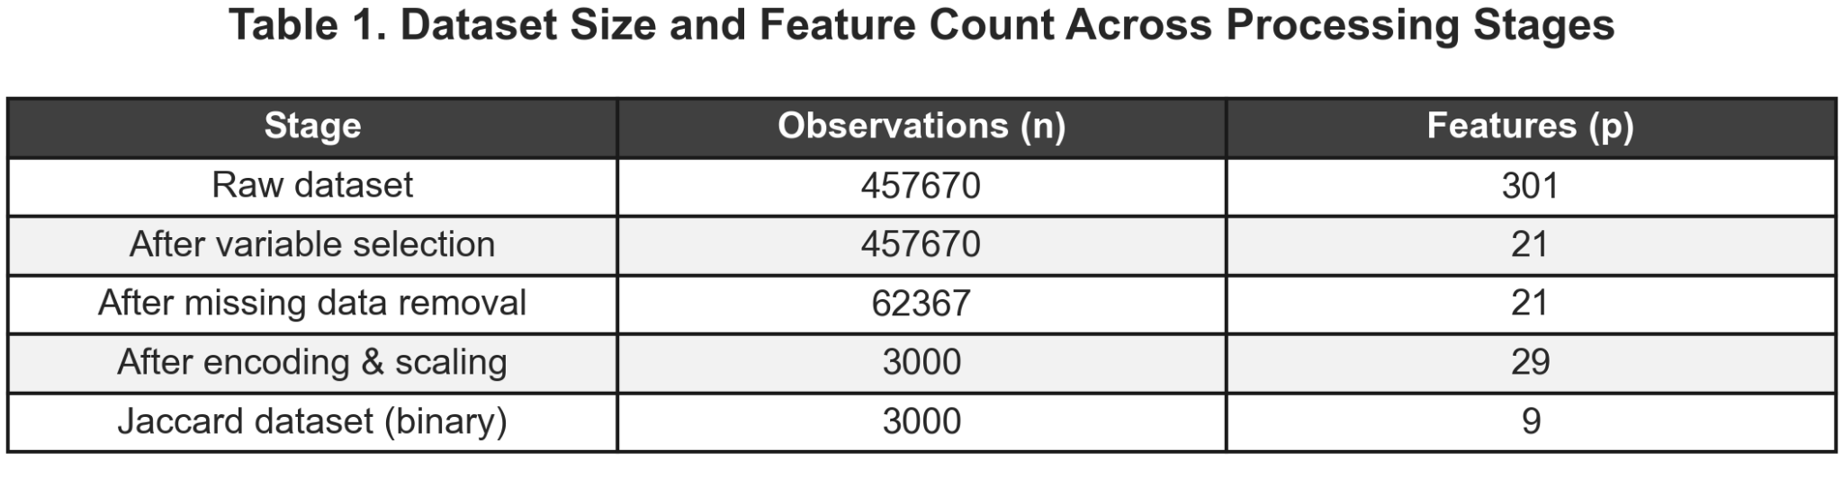
Dataset Processing Summary
Substantial data reduction occurred during complete-case filtering, followed by intentional subsampling for clustering analysis
Notes:
This slide summarizes how the dataset changes across each stage of processing.
We begin with the full dataset of about 457,000 observations and 301 variables.
After variable selection, the number of features is reduced substantially to 21, while the number of observations remains the same.
This step focuses the analysis on the most relevant variables.
The largest reduction in sample size occurs after removing missing data.
At this stage, the dataset drops to about 62,000 complete cases.
This is an important step to ensure valid distance calculations for clustering.
Next, after encoding and scaling, we take a random subsample of 3,000 observations for the final analytic dataset.
The number of features increases slightly here due to encoding, which expands some variables into multiple dimensions.
For the Jaccard analysis, we construct a separate binary dataset with 9 features, since Jaccard requires binary inputs.
The key takeaway is that the most substantial data reduction happens during complete-case filtering, followed by intentional subsampling to support computational feasibility and bootstrap analysis.

Slide 9
Clustering Setup
k-Medoids clustering
Partitions data into k clusters using representative observations (medoids)
Clusters are defined by minimizing distance to a representative medoid
More robust to outliers than k-means or k-modes
Applied with k=3, 4, 5
Evaluated across multiple distance metrics
Distance Metrics
Euclidean
Straight-line distance (sensitive to scale)
Manhattan
Sum of absolute differences (grid-like distance)
Cosine
Measures angle similarity, not magnitude
Jaccard
Measures similarity of binary features only.
Choice of metric defines “similarity” in clustering
Notes:
This slide outlines the clustering approach and the distance metrics evaluated.
We use k-medoids clustering, which partitions the data into k clusters using representative observations called medoids.
Unlike k-means, which uses centroids, k-medoids selects actual data points as cluster centers.
Clusters are formed by minimizing the distance between observations and their assigned medoid.
One advantage of k-medoids is that it is more robust to outliers, which is important in healthcare data where extreme values are common.
We evaluate clustering solutions across k equals 3, 4, and 5 to assess how stability changes with different levels of granularity.
We also evaluate each clustering solution across multiple distance metrics, which is the central focus of this study.
On the right are the four distance metrics we compare.
Euclidean distance measures straight-line distance and is sensitive to scale.
Manhattan distance measures the sum of absolute differences, similar to moving along a grid.
Cosine distance measures similarity based on the angle between vectors, focusing on direction rather than magnitude.
Jaccard distance measures similarity between binary features and is based on shared presence rather than overall magnitude.
The key idea is that the choice of distance metric fundamentally defines what we mean by similarity in clustering.
And that choice can significantly influence the resulting cluster structure and its stability.

Slide 10
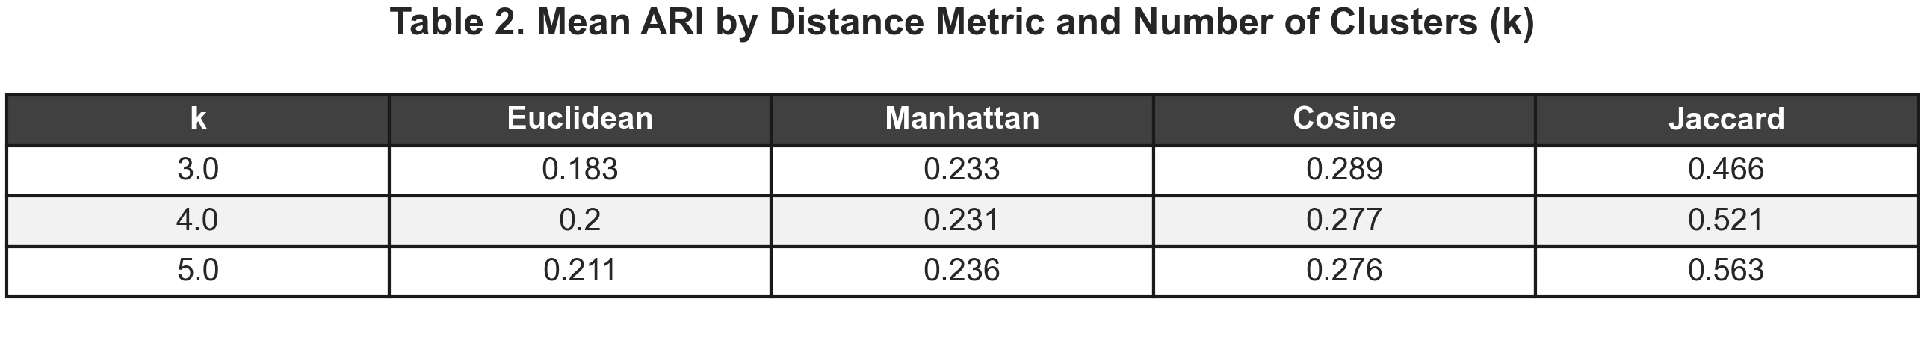
Results I
Clustering Stability (ARI)
Stability varied significantly across distance metrics
Jaccard highest (0.47-0.56, k=3-5)
Cosine showed moderate stability
Manhattan and Euclidean showed lowest stability
Statistical Results & Interpretation
Kruskal-Wallis: (p<.001)
Anova: Confirmed differences
Consistent ranking: Jaccard > Cosine> Manhattan> Euclidean
Notes:
This slide presents the primary results on clustering stability, measured using the Adjusted Rand Index.
Overall, stability varied significantly across the distance metrics.
Jaccard consistently produced the highest stability across all values of k, with ARI values ranging from about 0.47 to 0.56.
This represents a substantial improvement compared to the other metrics.
Cosine distance showed moderate stability, generally in the range of about 0.27 to 0.29.
Manhattan and Euclidean performed the worst, with lower ARI values overall.
On the right, the statistical testing confirms these differences.
The Kruskal–Wallis test showed a highly significant difference across metrics.
This was confirmed with ANOVA.
We also observed a consistent ranking across all clustering configurations.
Jaccard performed best, followed by cosine, then Manhattan, and finally Euclidean.
At the bottom, Table 2 provides the exact mean ARI values for each metric and each value of k.
You can see that Jaccard improves as k increases, while the other metrics remain relatively flat.
The key takeaway is that the choice of distance metric has a large and consistent impact on clustering stability.

Slide 11
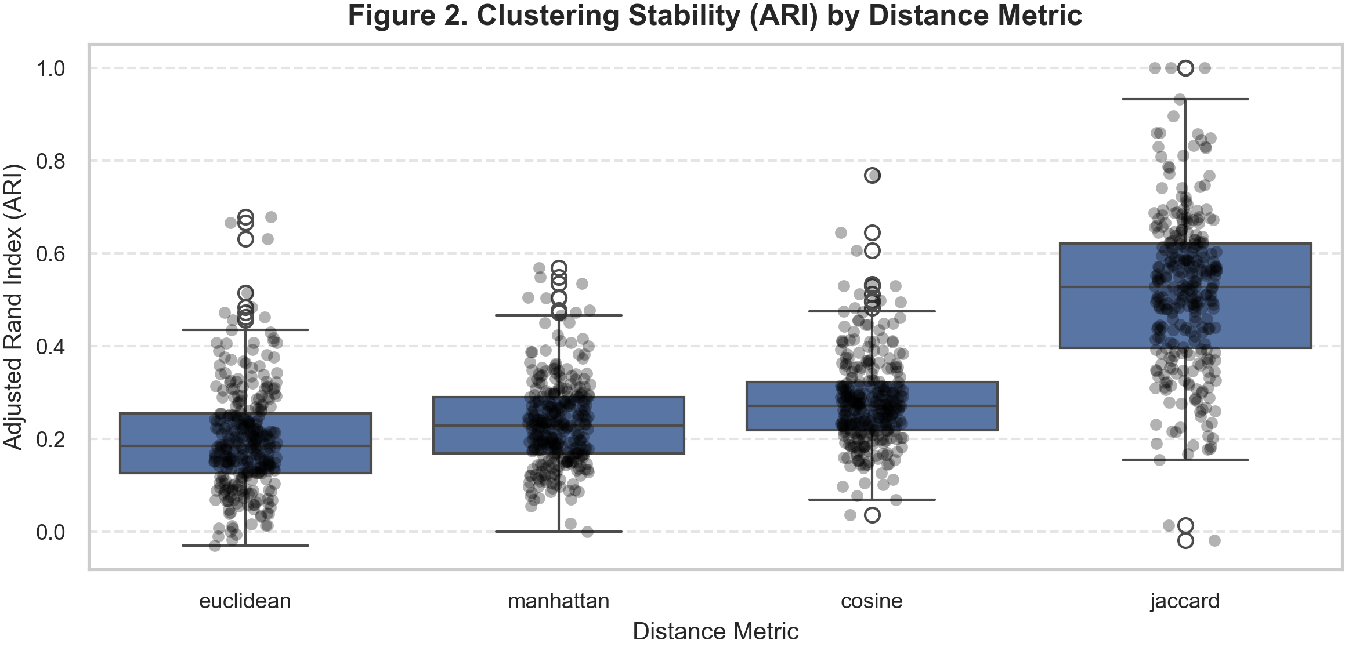
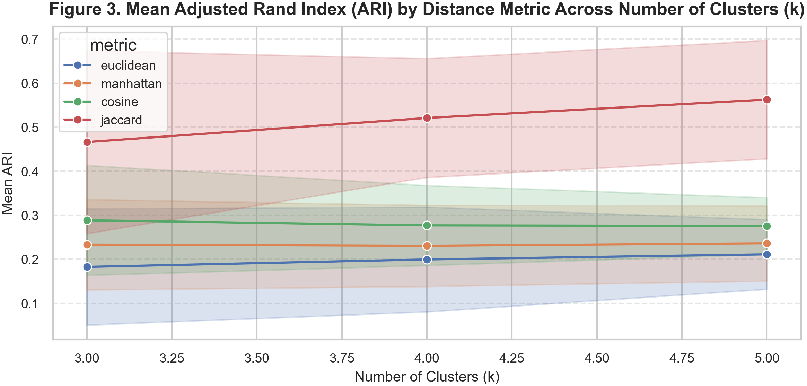
Results II
Notes:
This slide builds on the previous results by showing the full distribution of clustering stability across distance metrics.
At the top, Figure 2 shows boxplots of ARI values across bootstrap samples.
The key takeaway here is how clearly separated Jaccard is from the other metrics.
Its entire distribution is shifted upward, meaning higher stability across almost all resamples.
You can also see that Jaccard has a higher median and a wider spread.
That wider spread isn’t a weakness—it reflects the ability to achieve very high stability in many cases.
In contrast, Euclidean, Manhattan, and cosine all cluster much lower.
They also overlap heavily with each other, suggesting limited differentiation in performance.
Importantly, while those metrics occasionally reach higher ARI values, those cases are inconsistent and not reliable.
At the bottom, Figure 3 shows how stability changes as we increase the number of clusters.
Jaccard improves steadily as k increases, indicating better resolution of subgroup structure.
The other metrics are relatively flat, and cosine even declines slightly with increasing k.
So overall, these figures reinforce two key points:
Jaccard not only improves average stability, but fundamentally shifts the entire distribution toward more reproducible clustering outcomes.
And that advantage becomes even stronger as we move to more granular clustering.

Slide 12
Discussion
Interpretation
Distance metric drives clustering outcomes
Jaccard captures meaningful similarity in binary data
Higher ARI = more reproducible phenotypes
Improvement with increasing k suggests better resolution of subgroup structure in sparse data
Implications
Distance metric = primary modeling choice.
Binary similarity may be better for phenotyping
Jaccard performs best in high-dimensional, mixed clinical data
More reliable subgroup identification
Notes:
This slide moves from results into interpretation and what those findings actually mean.
Starting on the left, the key takeaway is that distance metric choice is not a minor detail—it fundamentally drives clustering outcomes.
Different metrics are effectively defining “similarity” in different ways, which leads to very different subgroup structures.
Jaccard stands out because it captures similarity based on shared presence of features, which seems to align better with this type of data.
Especially in binary or sparse clinical data, that definition of similarity appears more meaningful.
We also see that higher ARI corresponds to more reproducible phenotypes.
So this isn’t just a statistical improvement—it translates into more reliable subgroup identification.
The improvement with increasing k is also important.
It suggests that with the right metric, we can identify more granular subgroups without sacrificing stability.
On the right side, these findings have some clear implications.
First, distance metric selection should be treated as a primary modeling decision, not an afterthought.
Second, binary similarity approaches—like Jaccard—may be better suited for phenotyping tasks, especially in high-dimensional clinical datasets.
Third, Jaccard’s consistent performance suggests it may be a strong default choice in these contexts.
And ultimately, the impact is practical: more reliable subgroup identification and better reproducibility, which are critical for clinical and research applications.

Slide 13
Limitations & Future Directions
Limitations
Subsampling (n=3,000) may limit generalizability
Results dependent on feature selection and preprocessing choices
Jaccard requires binary encoding which creates potential information loss
Analysis based on unweighted data (limits population inference).
Future Research
Evaluate additional distance metrics (e.g. Gower, Hamming)
Test across different datasets and EHR systems
Explore impact of alternative clustering algorithms
Develop standardized guidelines for metric selection in phenotyping
Notes:
This slide highlights the key limitations of the study and where future work should go.
First, the analysis was conducted on a subsample of 3,000 observations. While this was necessary for computational feasibility and bootstrap analysis, it may limit generalizability to the full population.
Second, the results are influenced by feature selection and preprocessing decisions. Different variable choices or encoding strategies could affect the relative performance of distance metrics.
Third, Jaccard distance requires binary encoding, which can lead to some loss of information compared to continuous representations.
Finally, the analysis was conducted on unweighted data, since the goal was methodological evaluation rather than population-level inference. This means the results may not directly generalize to weighted survey estimates.
In terms of future research, one important direction is to evaluate additional distance metrics, such as Gower or Hamming distance, especially for mixed data types.
It would also be valuable to test these findings across different datasets, including EHR systems, to assess generalizability.
Another direction is to explore how different clustering algorithms interact with distance metrics in terms of stability.
And ultimately, the goal is to move toward developing standardized guidance for distance metric selection in computational phenotyping.

Slide 14
Conclusion
Key Findings
Distance metric significantly affects clustering stability
Jaccard outperforms other metrics
Stability improved with increasing k only for Jaccard
Results were robust across bootstrap samples
Takeaways & Impact
Distance metric is a primary modeling decision
Binary similarity measures better for phenotyping
Jaccard supports more reproducible phenotyping
Improves reliability of computational phenotyping.
Notes:
To wrap up, I’ll highlight the key findings and what they mean.
First, distance metric selection has a significant impact on clustering stability. This is not a minor tuning parameter. It fundamentally changes the results.
Second, Jaccard clearly outperformed the other metrics across all conditions, consistently producing higher and more stable ARI values.
Third, increasing the number of clusters only improved stability when using Jaccard, while the other metrics did not meaningfully benefit from increased granularity. Importantly, these results were robust across bootstrap samples, which supports their reliability.
In terms of takeaways, distance metric choice should be treated as a primary modeling decision. Binary similarity approaches appear to be better suited for phenotyping, especially in high-dimensional or sparse clinical data. Jaccard, in particular, supports more reproducible and stable subgroup identification, ultimately improving the reliability of computational phenotyping for both research and clinical applications.
To conclude, this study shows that distance metric selection has a substantial and measurable impact on clustering stability.
Jaccard distance consistently produced more stable and reproducible clustering solutions compared to the other metrics, suggesting that how we define similarity may matter more than the clustering algorithm itself.
Moving forward, treating distance metric selection as a primary modeling decision can improve the reliability of computational phenotyping in healthcare.

