Slide 1
1998년 수입조사
이주국별 근로자의 수입은 얼마나 되나?

Slide 2
workclass | education | marital-status | occupation | relationship | race | sex | native-country | predclass
count | 46043 | 48842 | 48842 | 46033 | 48842 | 48842 | 48842 | 47985 | 48842
unique | 8 | 16 | 7 | 14 | 6 | 5 | 2 | 41 | 4
top | Private | HS-grad | Married-civ-spouse | Prof-specialty | Husband | White | Male | United-States | <=50K
freq | 33906 | 15784 | 22379 | 6172 | 19716 | 41762 | 32650 | 43832 | 24720

Slide 3
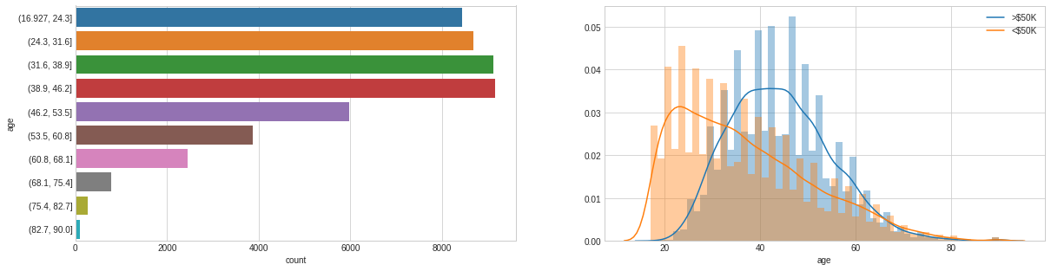

Slide 4
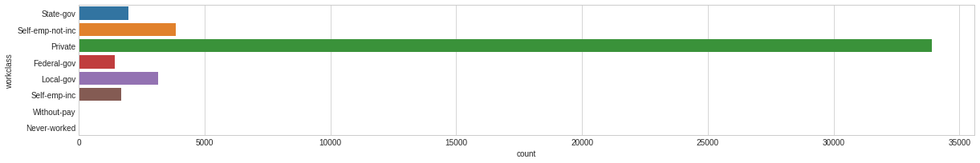

Slide 5
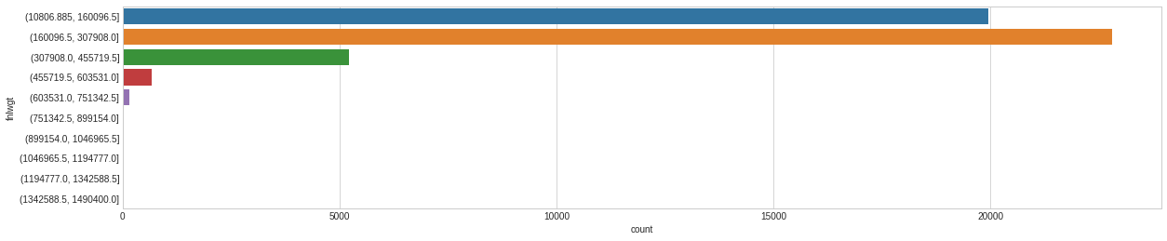

Slide 6
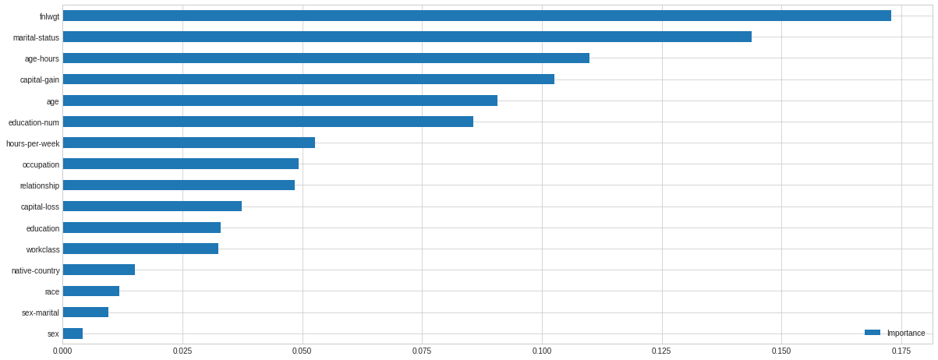

Slide 7
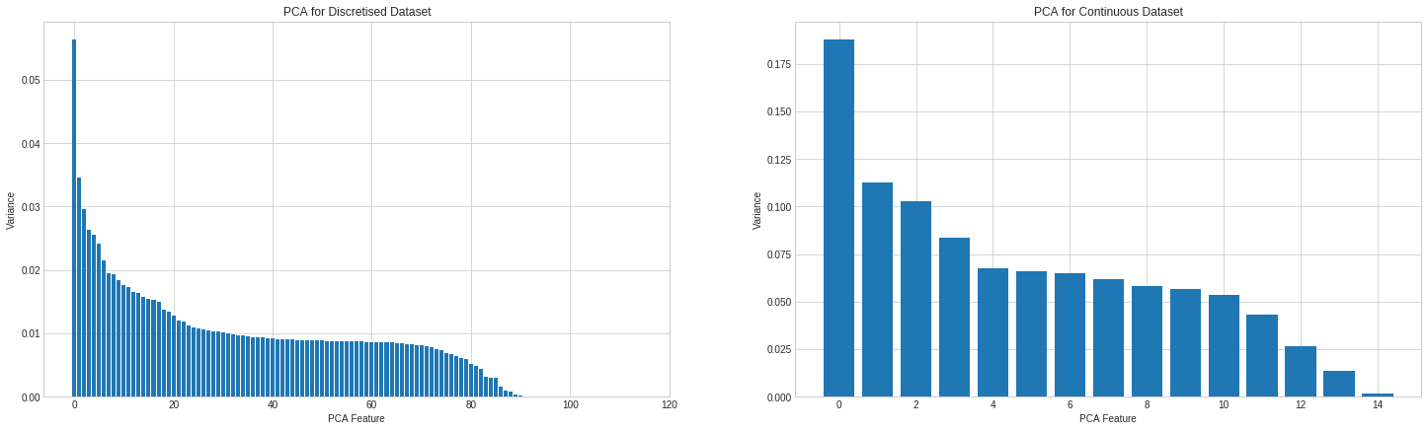

Slide 8
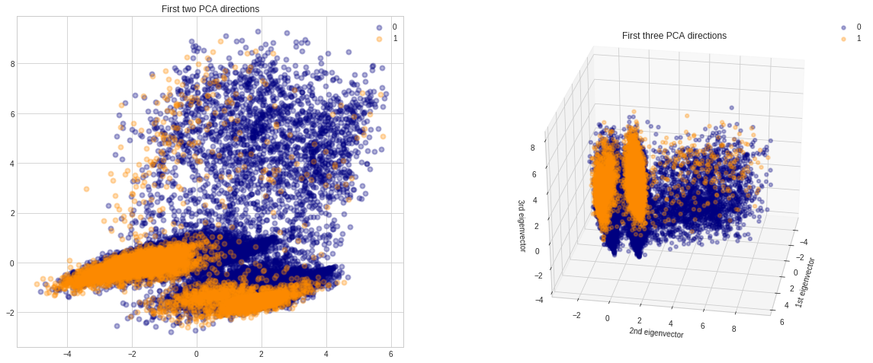

Slide 9
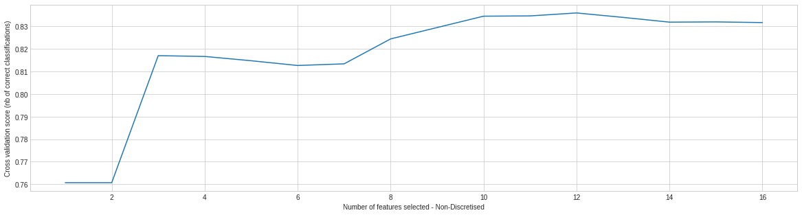

Slide 10
