Slide 1
중간 발표 – 어플리케이션-

Slide 2
OBJECTIVE

Slide 3
Objective
To Provide Intuitive, Interactive UI
depending on Home Environment

Slide 4
Goal of Application

Slide 5
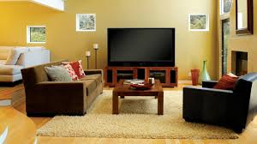
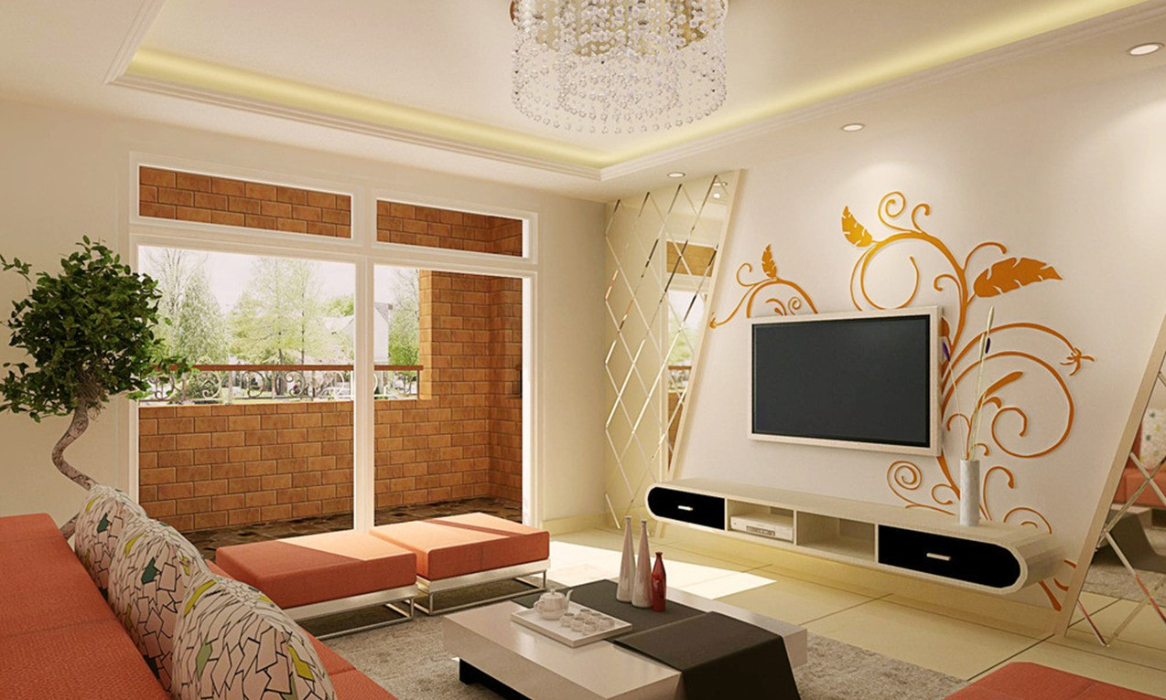
Goal
Environment 1
Environment 2
Two different home environment
빨간부분이 우리가 고려해야 할 구역 말로 언급

Slide 6





Goal
Environment 1
Environment 2
The area we are considering
2개의 공간 배치가 확연히 다름을 언급.

Slide 7

Goal
CH
^
V
CH
VOL
VOL
+
-
^
+
V
-
Environment 1
Environment 2
How UI will be shown in
two different environment

Slide 8
Implementation

Slide 9
Implementation
Two Big Part of Application
Defining Environment
Auto Resizing, Repositioning UI

Slide 10
Defining Environment
Environment 1
Given Environment

Slide 11
Defining Environment
Obstacle
Obstacle
Obstacle
Interactable Object
Environment 1
Define Space into
Obstacle, Interactable Object, Free Space
이 부분에 키넥트를 이용한 공간 파악 내용 넣어주면 될듯

Slide 12
Defining Environment
Free
Free
Obstacle
Obstacle
Interactable Object
Free
Obstacle
Environment 1
Define Spaces into
Obstacle, Interactable Object, Free Space

Slide 13

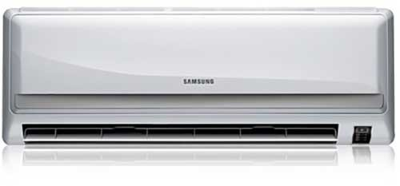
Expressing UI
When input is detected figure out object
and load predefined buttons
CH
^
V
VOL
+
-
TV
Predefined Buttons for TV
Temp
^
V
Airconditioner
Predefined Buttons for Aircon

Slide 14
Expressing UI
CH
^
V
where to put?
Free
Free
VOL
+
-
Obstacle
Obstacle
Interactable Object
Free
Obstacle
Environment 1
Resize, repose defined buttons into free space

