Slide 1











“
”
The People Behind the Places

Slide 2

Grails Grown Up: How do we get sub 500m/sec response?
Goal: Share our lessons learned in Groovy/Grails to do parallel service calls to reach sub 500m/sec response of HTML.
6/20/2012

Slide 3
Introduction Todd Ellermann
B.S. Computer Engineering University of Arizona
MBA Arizona State University (Certificate in Software Engineering Management)
V.P. of Engineering for VirtualTourist.com Subsidiary of TripAdvisor.com LLC (NASDAQ:TRIP)
Java Certified 1998
Taught SOA/e-Commerce in 30+ countries for IBM
http://www.betterwebapp.com
Wrote the same web application in 8 languages (screencast, source code, measured silly things like screen cast time and lines of code etc…)
toddecus (aim, twitter, yahoo, skype etc…)
todd@virtualtourist.com
Experienced game developer: http://www.ellermann.net/~todd/java/index.html
Speaker at SpringOne2GX and UberConf

Slide 4
What we are going to cover
Who is VT
Service Architecture
VT Today 2013
Server sizing
Groovy – VS – Java
Compile Static & Invoke Dynamic
Pagespeed
Simple Parallelization
GPARS Limitations
Goals of VT Framework
VT Solution
Modules
Results
Multiple-data sources
GORM and Master Slave

Slide 5

Who is VT?
VirtualTourist.com Stats 2012:
8.4 Million Unique Visitors
30 Million PV / Month
All Free traffic

Slide 6
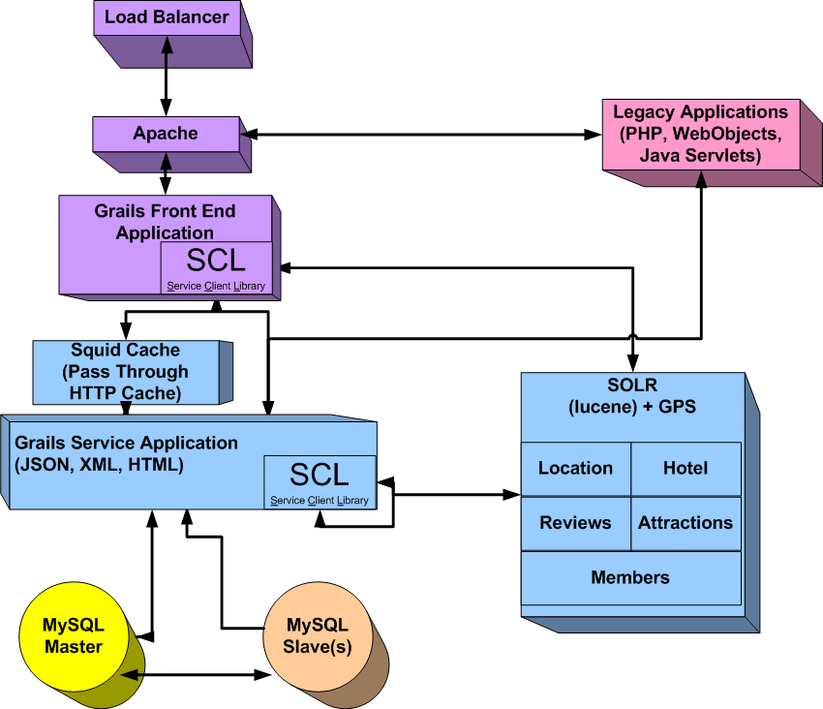
Service Architecture Overview

Slide 7
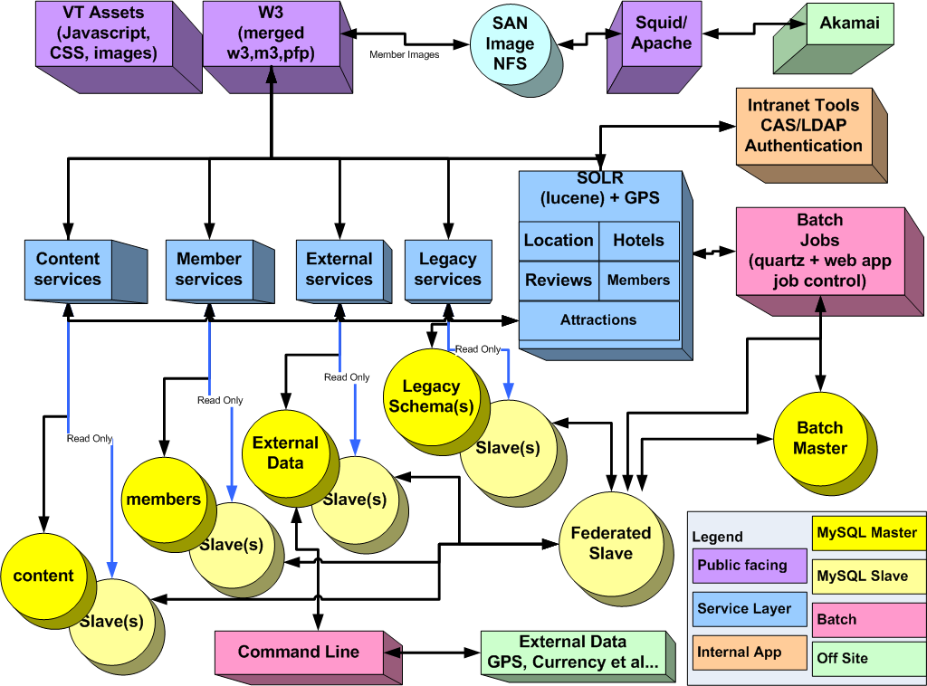
VT Architecture Today 2011
Notes:
More Detailed but simpler to develop in.

Slide 8
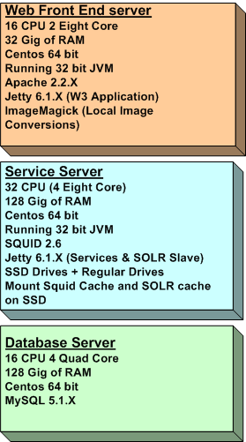
Server Sizing: A Bit Orthogonal
Currently Serving 100 Page Requests/Second at Peak Load
Pool of Web-Apps 6 new →
+ 6 old( 2 dual core 6 gig of RAM)
Pool of Service Servers
3 front facing (SOLR Slaves)
1 support batch (SOLR Master)
3 Database pairs (legacy, newDBs,Batch/Reporting)
Recent Improvements:
SSD Impact on SOLR/SQUID
New Image Processing Impact on Front End Servers
Future Improvements
Federate SQUID Caches

Slide 9

Waitomo Caves New Zealand
http://www.virtualtourist.com/travel/Australia_and_Oceania/New_Zealand/North_Island/Waikato/Waitomo_Caves-1881165/Things_To_Do-Waitomo_Caves-TG-C-1.html

Slide 10
Pagespeed
Old Technology Web Objects + Jboss CMP EJB:
2.5 seconds for 7.7KB HTML
6-7 seconds for onLoad()
Grails With Parallelization
225msec to deliver 16KB HTML
2.7 seconds for onLoad()

Slide 11
Simple Parallelization (GPARS Code)
class HotelController {
HotelService hotelService ExecutorService executorService
def GeoHotels= {
HotelParameters hotelParams = hotelService.constructHotelParams(params)
GParsExecutorsPool.withExistingPool(executorService) {
Future callHeader = {
pageElementServiceClient.fetchHeader(true, memberId, memberInfo.memberName)
}.callAsync()
Future callFooter = {
pageElementServiceClient.fetchFooter(true, memberId, false, false)
}.callAsync()
Future callRightNav = {
pageElementServiceClient.fetchRightNav(true, commerceParams.vtLocation.id,
commerceParams.vtLocation.name, commerceParams.pageType)
}.callAsync()
header = callHeader.get()
footer = callFooter.get()
rightNav = callRightNav.get(); }
[header:header, hotelParams:hotelParams, rightNav:rightNav, commerceParams:commerceParams, footer:footer]
}
}

Slide 12
Limitations of GPARS approach
Great for a single page or two
LOTS of code in controller 1000+ lines
No shared data among Futures
GeoHotels.gsp is COMPLICATED
No modularity or use of templates
Cut-N-paste for next Controller ☹
No ability to measure “long pole”
No ability to identify module on screen

Slide 13
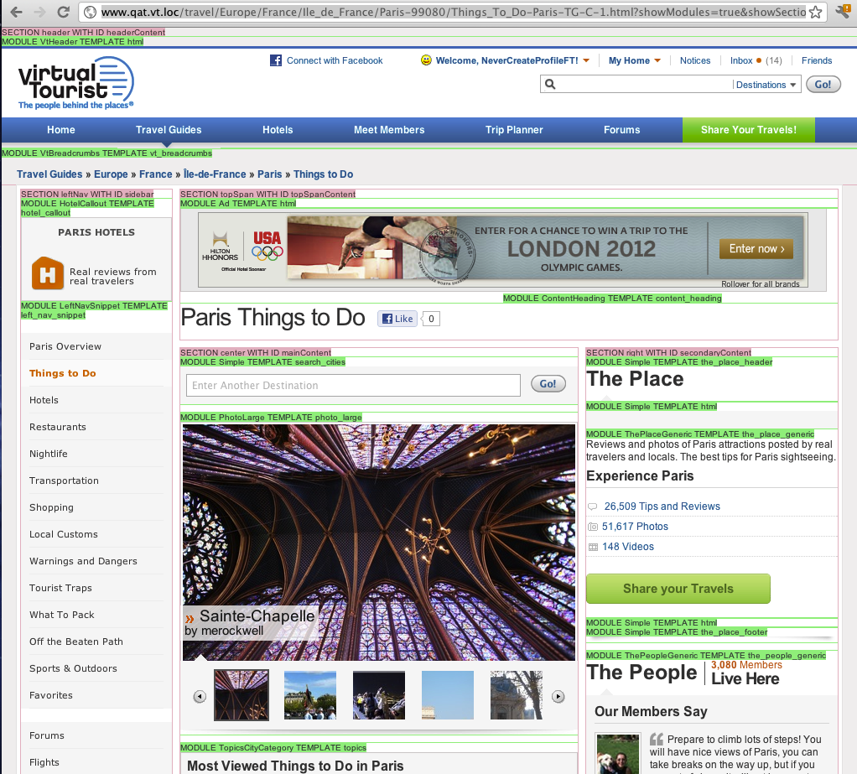

Slide 14
Framework Requirements
Declarative Display (DRY)
Hide the parallelization details
Modularize display elements
Ability to measure “long pole”
Debugging Features (turn module on and off)
Reuse data fetched for another module
Ability to Test Declaratively
Graceful Degradation
Travel Guides has 11 page types and serves more than 6 million unique pages. On average a given module is reused across 6 different page types.

Slide 15
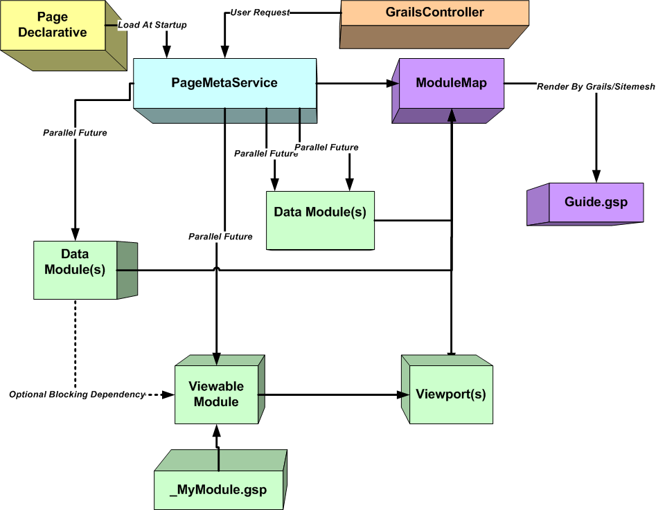
VT Solution

Slide 16
Phases of PageMetaService
Four Processing Phases to build a web page
PASS 1: collect Data Modules and View Modules for the Page
PASS 2: Module Prepare Futures & Blocking
PASS 3: Fire off Futures
PASS 4: Make results available to view
Note: Rendering view from module only has access to module’s data. (No namespace collision issues)

Slide 17
PageMeta
public List<PageMeta> createPageGroupMeta() {
[
new PageMeta( pageName: 'ROOT_PROTOTYPE',
sectionsLayout: [
new Snippet(html: '<div id="content_container" class="content">'),
new Section(layoutKey: 'top', domId: 'topSpanContent'),
new Section(layoutKey: 'center', domId: 'mainContent'),
new Section(layoutKey: 'right', domId: 'rightSectionProfile'),
new Snippet(html: '</div><!--content_container-->’) ], ),
new PageMeta( pageName: 'Member Profile Page',
layout: [
'center' : [
new Viewport(moduleClass: MemberContentIntroModule, moduleParams: [:]),
new Viewport(ajaxId: 'travelogues', moduleClass: TraveloguesModule, moduleParams: [:]),
],
'right' : [
new Viewport( moduleClass: MembersMeetingsModule, moduleParams: [:]),
new Viewport( moduleClass: MemberGroupsModule, moduleParams: [:]),
new Viewport( moduleClass: MemberVideosModule, moduleParams: [:]),
],
'top' : [
new Viewport(moduleClass: MemberProfilePageHeadingModule, moduleParams: [:]),
]
],
testCases: []
),
Notes:
Sections, PageLayouts, Viewports and modules, data fetches, and test cases.

Slide 18
@Parallel Annotation in a Module
@Parallel ONLY applies to methods of a Module class.
It takes a list of strings advising of all member variables that will be updated during the fetch method's run.
The list of member variables advises the parallelization system which member variables must have a future blocked on prior to returning its value.

Slide 19
@Parallel Annotation in a Module
Note: In the block, when getPageViews() or getReviewCount() is called fetchStats() will block. If getMemberDetails() is called, fetchMemberDetails() will block
class MyModule extends Module {
def memberDetails
def pageViews
def reviewCount
@Parallel("memberDetails")
fetchMemberDetails() {
memberDetails = scl.fetchMemberDetails()
}
@Parallel(["pageViews", "reviewCount"])
fetchStats() {
pageViews = scl.fetchPageViews()
reviewCount = scl.fetchReviewCount()
}}

Slide 20
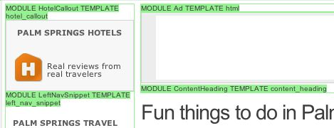
Debugging Feature
Ability to turn on and off module indicators to show debugging info, html problems etc…
It is easy to find where to make a change
using ?showModules=true
Environment specific code can’t be done in production without JNDI change

Slide 21
Page and Module Timing
Able to raise a Logging WARN or ERROR when page or module time exceeds a threshold e.g. >1 seconds to WARN and 5 seconds to ERROR
[2011-05-10 14:27:04,976] ERROR VTTimer - VtFooterModuleService: For method getFooter(): took 21045 ms
[2012-06-03 14:01:36,692] WARN VTTimer - TopicsCityCategoryModuleService: For future call 0: took 3007 ms
[2012-06-03 00:26:08,532] ERROR VTTimer - com.vtourist.app.modularization.modules.ExploreTheWorldModule.fetch: took 10187 ms

Slide 22
Future Parallelization Improvements
Parallelize HTML rendering inside the threads? (muck with grails render engine)
Cyclical Module dependency checking
A->B->C->A == Deadlock!
Modules as Special Grails Services?
Extract into Grails plug-in?
Look at Grails 2.0 and Servlet 3 for any optimization

Slide 23
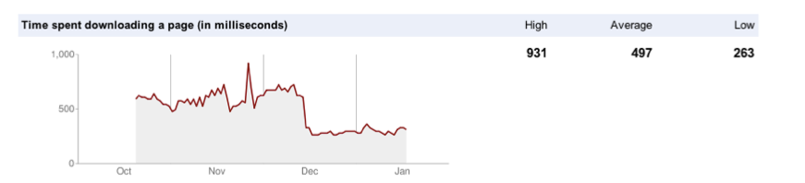
Parallelization Results
Google Analytics
Generally Subsecond for html responses
Running at 3.7 seconds according to Google Webmasters Labs Siteperformance
In some cases we dropped a full second or two from the HTML download portion of a page. Of course business unit added a ton of functionality, images and JS.

Slide 24
How do we accelerate the services?
5 types of service calls: Which one?
External 3rd party services (e.g. Google Ads)
Structural Data up 24hrs/old
e.g. Travel Guide Location << SOLR
Grails Services that are Reads and Dirty is OK
e.g. header, left nav, footer << SQUID
Grails Services: Reads and up to date NOW!
e.g. Notices << Master Db Only Solution
Calls to Grails Services that are Reads and can’t be Dirty, but don’t have to be instant
e.g. member viewing own content. << Slave Db is great.

Slide 25
Database Master/Slave
5th Call is a problem in Grails.
1 Domain object 1 datasource
Still a problem in Grails 2.0
In a “Uber App” hibernate caching might be enough, but not when
Legacy tables won’t work with GORM
Cross schema joins
SOA servers Load balanced
Distributed Cache (ehCache in Java) is bulky
Reddis maybe? (more technology)
What I really want is a traffic cop to direct my read traffic to slave database

Slide 26
Datasources Plug-in 2010 Slide
Datasources
How do I bind GORM objects to 2 or more datasources?
Note the binding of domain objects to different domain.
Not shown. The damn tables have to also exist in our original VT schema!
Note the lack of bound domains for 3rd datasource, now we can use that for “GSQL”
Future: How do I have some objects bound Read/Write and some bound Read Only to a slave?

Slide 27
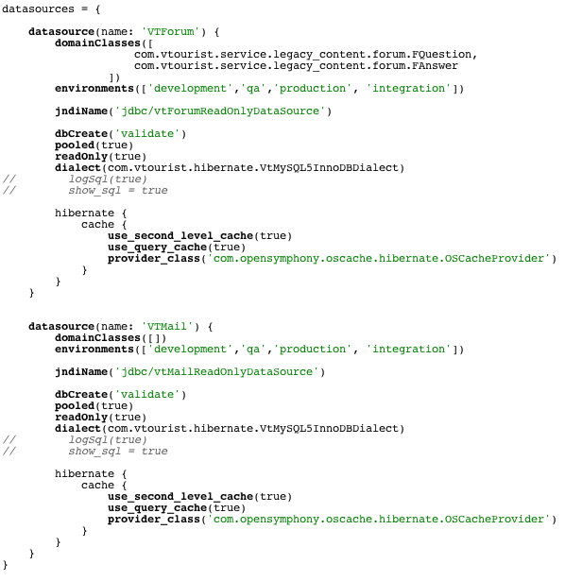
Datasources Plug-in 2010 Slide
Now in Grails 2.0!
Still have Master/Slave problem!

Slide 28
Spring the answer to Master/Slave!
GORM + Spring
org.springframework.jdbc.datasource.lookup
package com.vtourist.db;
public enum DatabaseType {
MASTER,
SLAVE
}

Slide 29
Spring the answer to Master/Slave!
package com.virtualtourist.db;
import org.springframework.jdbc.
datasource.lookup.AbstractRoutingDataSource;
public class MasterSlaveRoutingDataSource extends AbstractRoutingDataSource {
@Override
protected Object determineCurrentLookupKey() {
return MasterSlaveContextHolder.getDatabaseType();
}
}

Slide 30
AbstractRoutingDataSource
package com.vtourist.db;
import org.springframework.util.Assert;
public class MasterSlaveContextHolder {
private static final ThreadLocal<DatabaseType> contextHolder = new ThreadLocal<DatabaseType>();
public static void setDatabaseType(DatabaseType DatabaseType) {
Assert.notNull(DatabaseType, "DatabaseType cannot be null");
contextHolder.set(DatabaseType); }
public static DatabaseType getDatabaseType() {
return (DatabaseType) contextHolder.get(); }
public static void clearDatabaseType() {
contextHolder.remove(); }
}

Slide 31
AbstractRoutingDataSource
/conf/spring.groovy << Spring DSL can be environment specific
dataSource(com.vtourist.db.MasterSlaveRoutingDataSource) {
targetDataSources = [
(com.vtourist.db.DatabaseType.MASTER): ref('vtReadWriteDataSource'), (com.vtourist.db.DatabaseType.SLAVE): ref('vtReadOnlyDataSource')]
defaultTargetDataSource = ref('vtReadWriteDataSource')
}
Suddenly GORM is wired to support either Master or slave

Slide 32
Filter to set Context
import com.vtourist.common.service.ServiceRequestHelper
import com.vtourist.db.DatabaseType
import com.vtourist.db.MasterSlaveContextHolder
class Filters {
def filters = {
all(controller:'*', action:'*') {
before = {
boolean useMasterDb = Boolean.parseBoolean(params.(ServiceRequestHelper.USE_MASTER_DB_PARAM))
MasterSlaveContextHolder.setDatabaseType (useMasterDb ? DatabaseType.MASTER : DatabaseType.SLAVE); }
after = {
MasterSlaveContextHolder.clearDatabaseType() }
afterView = {}
}
}
}
GET /lms/Head/10547?update=Notice,Email,Friends&useMasterDb=true

Slide 33
Filter to set Context
This is a service server remember so we let the front end decide which type of connectivity it wants. Out front we might show non-logged-in people “Researcher” (80%+ of the traffic) the read only and our logged-in “Members” hot off the grill content.
Could easily map any not get/list/fetch method to use the Master
Standard MySQL Master/Slave lag can be an issue under heavy database load
Could be SLA driven rather than Master Slave
Clever person could combine with Multi-tenant grails plugin
Client side application might use security filter et al… to choose which service to call

Slide 34
VT Architecture Today 2011
Notes:
More Detailed but simpler to develop in.

Slide 35
Lessons Learned: 5 years of Grails
Rapid Development Harness (Shift F5 to execute)
No early optimizations! Less is more etc…
Spring Batch for batch processing, and run job control quartz plug-in in app server with web interface
Coding conventions: e.g.
Don’t catch and bury generic exceptions, catch what you can do something useful with
If you have a method that returns a collection, never return null, empty collection is better.
Fewer applications is better

Slide 36
Grails based Services
Java not groovy for service client library that is shared (android et al…)
XStream not grails native marshall/unmarshall
Don’t use: return foo as JSON/XML
Services control cache time not client or cache itself (squid,varnish)
Services return valid HTTP responses, not found 404, failure 500 etc…
Don’t return 200 and an error code or error object!

Slide 37
Strongly Type When Possible
Variables. It is preferable to be as explicit as possible with variable types and names. Be explicit even if doing so requires you to make a new "transferring" class.
Some examples:
List<Map<String, UserDefinedType>> memberIdDbList // Preferred
List<Integer> memberIdList // Preferred
List<Map<String, Object>> memberIdDbList // Sometimes acceptable
List memberIdList // Rarely acceptable
def memberIdList // Not acceptable
The exception to this rule is when a controller is passing data to a GSP view. When passing data to GSPs, generic maps are ok.

Slide 38
The use of “it”
When using a one line closure, it is acceptable to use the closure inline, and also the must be static rule is relaxed. For example, the following code is ok:
List<SomeDefinedClass> someDefinedItems = items.findAll { it > 12 }
However, in general, when using a closure it should not be used, and instead be defined with a more meaningful variable name and typed as well.
List<SomeDefinedClass> someDefinedItems = items.findAll {
Integer id ->
if (myAmazingMethod(id)) {
myAmazingCodeThing(id)
}
}

Slide 39
GString “ ” vs String ‘’
When there are is no need for variable replacements in Groovy strings, single quote should be used. For example:
String x = "This needs double quotes: ${e}"
String z = 'This one doesn\'t'
Reminder GString shouldn’t be a hash key for a map. Use single quote/String for keys!

Slide 40
Note about REST and Service Granularity
REST actually means something, and as a design principle is stupidly overly granular.
GET==Read
POST==Create
PUT ==Update
DELETE==Delete
The real trick is granularity of composite services.
Never expose services directly to Internet
Write smoke tests
Have composite services return documentation when request with bad form comes in
Use Grails filters to set timers and log.warn/log.error to achieve SLA’s

Slide 41
Q & A Discussion
@toddecus
todd@virtualtourist.com
http://www.linkedin.com/in/toddecus
http://www.virtualtourist.com
http://sbjug.org

Slide 42
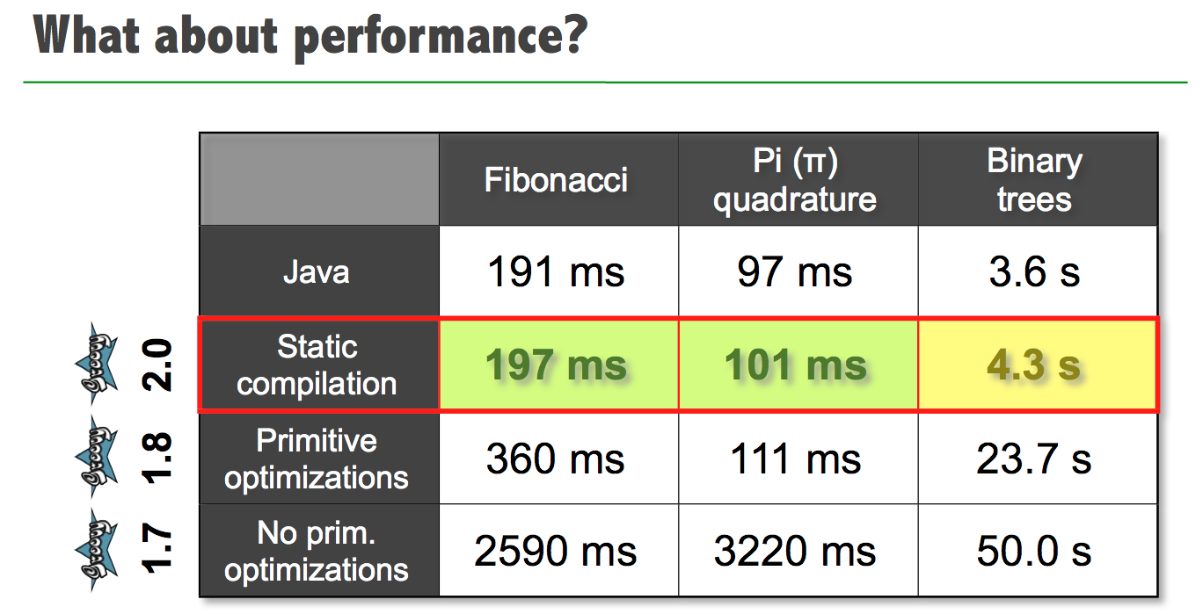
Groovy – VS – Java
Guillame Laforge SpringOne2GX 2012

