Slide 1
Reacting To Change A Deep Dive into RxJS
How to Manage State in a Complex World
Todd Snyder
Software Architect/Consultant
Anexinet
https://github.com/toddfsnyder/RxSample

Slide 2
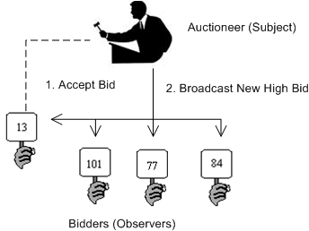
Observer Design Pattern
Define a one-to-many dependency between objects so that when one object changes state, all its dependents are notified and updated automatically.
Core GOF Pattern
(V – VM) in MVC/MVVM

Slide 3
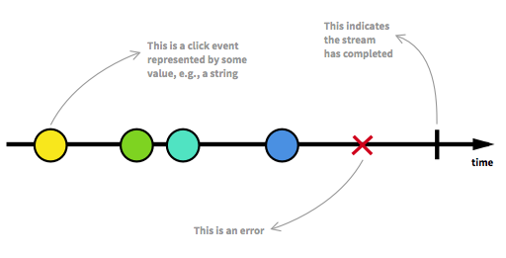
Reactive programming - Overview
Rx is programming with asynchronous data streams
Not a new concept: Events, Event Buses
Reactive is that idea on steroids! Turned anything into a stream.
The real magic
Operators
Subjects
Notes:
https://www.learnrxjs.io/

Slide 4
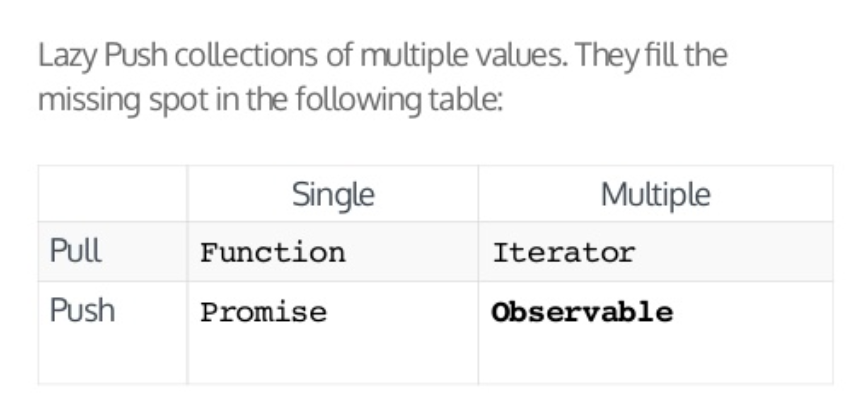
Reactive programming - Observables
There are three types of values an Observable Execution can deliver:
"Next" – Sends a value such as a Number, a String, an Object
"Error" – Sends a JS Error or exception
"Complete" – Does not send a value.
Notes:
https://www.learnrxjs.io/

Slide 5
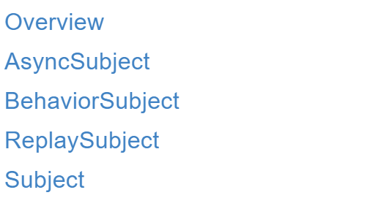
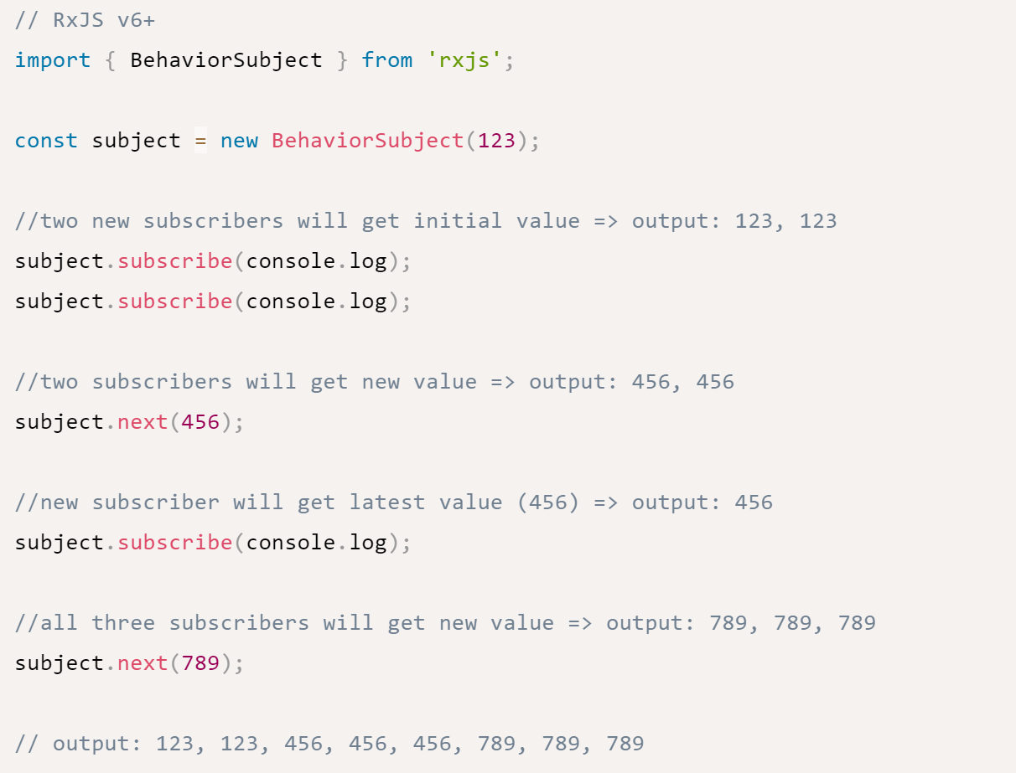
Reactive programming – Subjects
A Subject is a special type of Observable which shares a single execution path among observers.

Slide 6
Reactive programming – Subject Types
AsyncSubject: Emits latest value to observers upon completion.
Behavior Subject: which has a notion of "the current value". It stores the latest value emitted to its consumers, and whenever a new Observer subscribes, it will immediately receive the "current value" from the BehaviorSubject.
Relay Subject: is similar to a BehaviorSubject in that it can send old values to new subscribers, but it can also record a part of the Observable execution.

Slide 7
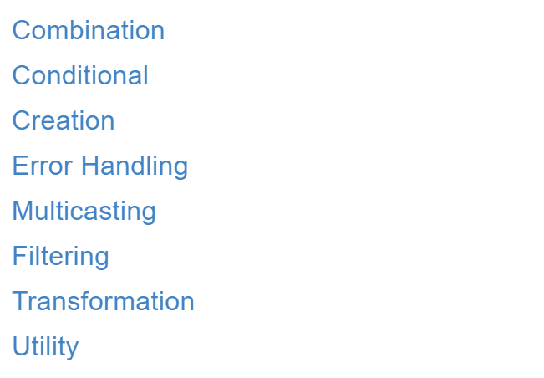
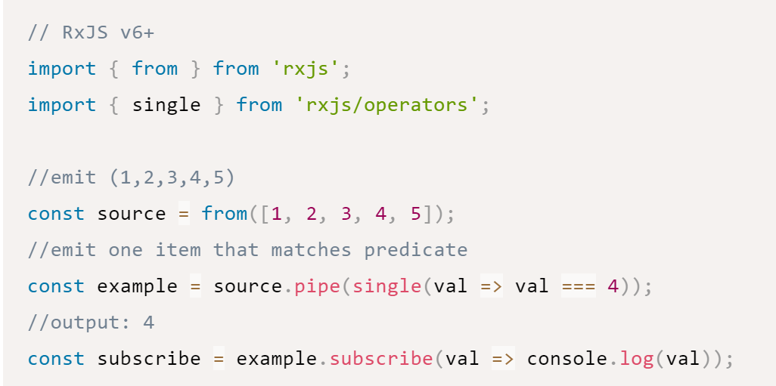
Reactive programming – Operators
Operators are the horse-power behind observables, providing an elegant, declarative solution to complex asynchronous tasks.

Slide 8
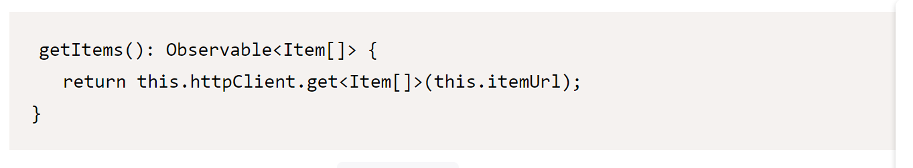
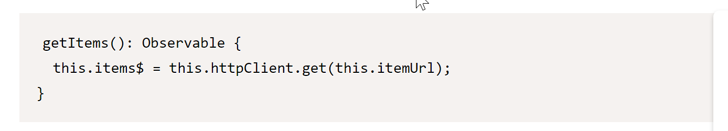
Reactive programming – NG: HttpClient
Angular HttpClient works with Observables by default. Methods such as get(), post(), put() and delete() return an instance of the Observable
HTTP requests are only sent when we subscribe to the Observable
Notes:
Because Angular applications are mostly written in TypeScript, you will typically know when a variable is an observable. Although the Angular framework does not enforce a naming convention for observables, you will often see observables named with a trailing “$” sign.
This can be useful when scanning through code and looking for observable values. Also, if you want a property to store the most recent value from an observable, it can be convenient to simply use the same name with or without the “$”.
https://angular.io/guide/rx-library

Slide 9
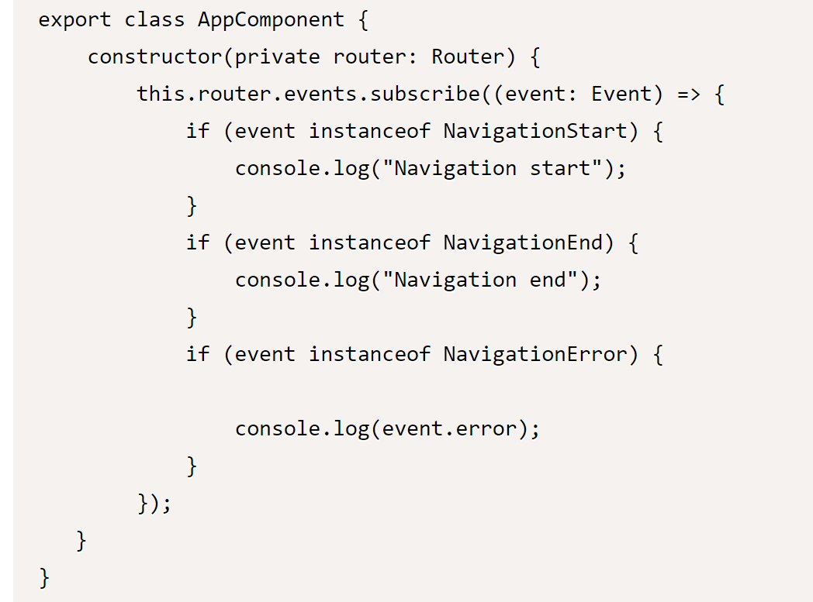
Reactive programming – NG: Routing
Notes:
Because Angular applications are mostly written in TypeScript, you will typically know when a variable is an observable. Although the Angular framework does not enforce a naming convention for observables, you will often see observables named with a trailing “$” sign.
This can be useful when scanning through code and looking for observable values. Also, if you want a property to store the most recent value from an observable, it can be convenient to simply use the same name with or without the “$”.
https://angular.io/guide/rx-library

Slide 10
Rx programming – Flux Pattern
There are many options to consider when building SPA Applications. State management can be problematic and one size does not fit all!
ngrx/store: Reactive style application using a centralized store pattern
Redux: Redux is a predictable state container for JavaScript apps
Implement Redux “lite” using RxJS
Observable Data Service
https://blog.angular-university.io/how-to-build-angular2-apps-using-rxjs-observable-data-services-pitfalls-to-avoid/

Slide 11
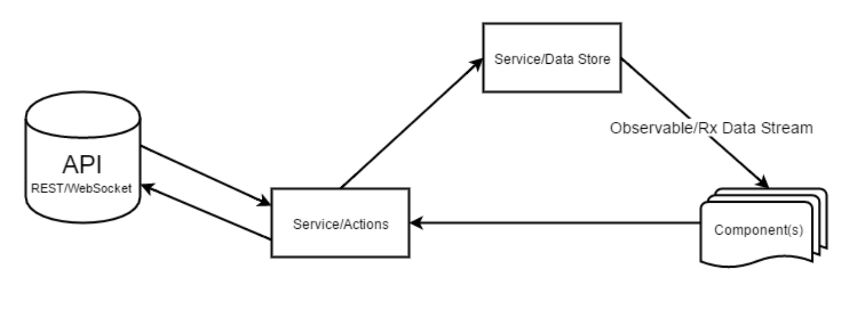
Rx programming – Observable Data Services

Slide 12

Next Steps – Never Step Learning
Links:
https://www.learnrxjs.io/
https://blog.angular-university.
https://redux.js.org
Design Patterns and Principles:
Uncle Bob
Martin Fowler
Eric Evans
Gang of Four

