Slide 1

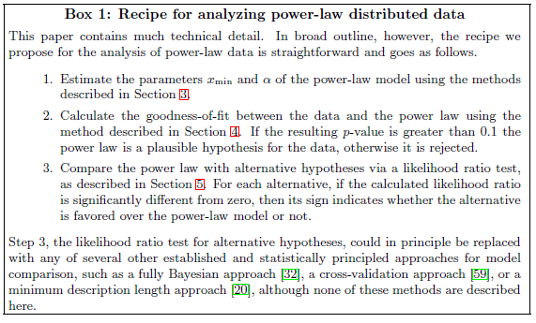
Background
[1]
Clauset et. al. [1] demonstrated statistical inference and hypothesis testing of power law distributions
Inference:
Fit α (via maximum likelihood) and x_{min} (using Kolmogrov-Smirnov test)
(Box 1 step 1)
Hypothesis testing:
Test whether fitted model follows power law distribution.
(Box 1 step 2)

