Slide 1

Microsoft Azure SQL Database
by
Todd J. Knoblock
USN CPO Retired

Slide 2
What is Azure SQL Database?
Microsoft’s fully managed, relational Database-As-A-Service (DBaaS) hosted within the Microsoft Cloud
Supports:
Relational Data
JSON (Javascript Object Notation)
Spatial
XML

Slide 3
Advantages
Scalable: Usage/Storage size can be scaled up or down to meet the consumer’s needs
Elasticity: Applications written for multiple databases can be scaled out by adding instances as needed
Upkeep: Maintenance/updates performed by Microsoft, consumers need not to worry
Physicality: No additional hardware required at consumer’s location

Slide 4
Disadvantages
Omissions: Certain features / functionality not supported that can be found in other SQL databases (i.e. T-SQL)
Bandwidth: Syncing data vs. Bandwidth limitations
MS Hardkill: Microsoft includes “hard kill” thresholds if the DB meets the criteria
Costs: Everything costs money… the more data/space required, the it will cost

Slide 5
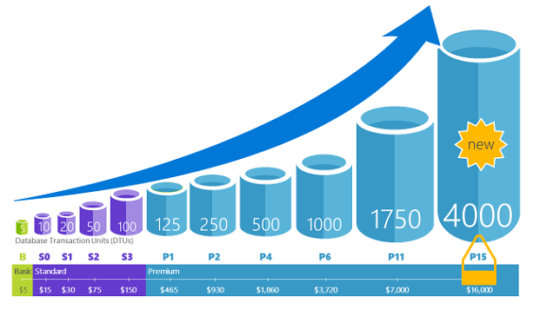
Tiered Pricing
Source: https://docs.microsoft.com/en-us/azure/sql-database/sql-database-technical-overview

Slide 6
Access
Azure Portal: https://portal.azure.com (Login credentials required)
Navigate to Azure SQL Database
Create new SQL Database
Connect via SQL Server Management System
Populate Database as needed

Slide 7
Capabilities
Automatic backups
Point in time restores
Active geo-replication
Failover groups

Slide 8
Security & Compliance
Auditing
Data encryption at rest & in motion
Dynamic data masking
Row-level security
Directory integration and multi-factor authentication
Compliance certification

Slide 9
Resources
https://docs.microsoft.com/en-us/azure/sql-database/sql-database-technical-overview
https://skillpipe.com/en-GB/Read/cb557b13-9cb4-471a-a419-e95835a0d59c

