Slide 1
OData::REST as SOAP::POX
Todd Meinershagen
Senior Software Architect
MedAssets, Plano, TX
October 19, 2012

Slide 2
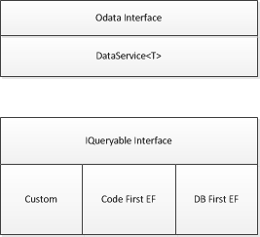
Logical Architecture of WCF Data Services

