Slide 1
OData and WCF Data Services
Todd Meinershagen
Senior Software Architect
MedAssets, Plano, TX
November 02, 2012

Slide 2
What is OData?
Open Data Protocol
Extends data access to the web
Protocol on top of RESTful architecture
URI-based Endpoints
Supports the Http Verbs that Map to CRUD Operations
GET-READ/SELECT, PUT-UPDATE, POST-CREATE/INSERT, DELETE-DELETE
Supports two content types: AtomPub and JSON
Has been proposed as an OASIS standard and currently under Microsoft Open Specification Promise
Backed by Microsoft, IBM, SAP, Progress, Citrix
Consumers and Producers for every major platform (.NET, Java, Ruby, Objective-C, JavaScript)
Find more info at http://www.odata.org
Controversial Statement - OData::REST as SOAP::POX

Slide 3

What is WCF Data Services
Formerly known as ADO.NET Data Services
A part of the WCF Data Services team, although, it may be moved to the ASP.NET team in the future.
Currently at version 5.02.
Acquire through NuGet

Slide 4
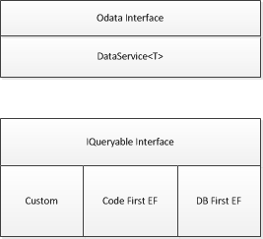
Logical Architecture of WCF Data Services

