Slide 1
NSubstitute: Mocking With Ease
September 7, 2012
Todd Meinershagen, Sr. Software Architect
MedAssets
Notes:
Stewart asked me to talk to you about a framework we are using for mocking for the Usage Events Collector that the Claims Validation team is leveraging.

Slide 2



Who Am I?

Slide 3

Assumptions
“Most of our assumptions have outlived their uselessness.”
― Marshall McLuhan

Slide 4
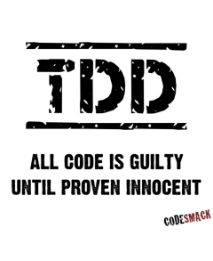
1. You Believe Testing is Important and Practice It

Slide 5

2. You Understand the Difference Between Unit and Integration Tests
Notes:
Unit testing means testing the smallest, testable part of an application and checking some assumptions about outcomes afterward.
Integration testing means testing two or more dependent software modules as a group and checking some assumptions about outcomes afterward.
Qualities of A Good Unit Test
Automatic - should run at the push of a button
Repeatable – should be able to run endless times successfully and remain for future use
Easy to write - creating a basic test in a few minutes
Durable - once written, should remain for future use
Environment Independent - anyone should be able to run it
Fast - should run quickly (all tests under a few minutes)

Slide 6
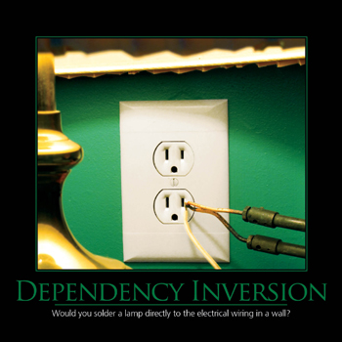
3. You Understand Dependency Inversion Principle
Notes:
HIGH LEVEL MODULES SHOULD NOT DEPEND UPON LOW LEVEL MODULES. BOTH SHOULD DEPEND UPON ABSTRACTIONS.
B. ABSTRACTIONS SHOULD NOT DEPEND UPON DETAILS. DETAILS SHOULD DEPEND UPON ABSTRACTIONS.

Slide 7






4. You’ve Used a Mocking Framework and Understand the Benefits

Slide 8

NSubstitute
Project Began in 2009
Hosted on Github (http://nsubstitute.github.com)
Available via NuGet Gallery (client id: nsubstitute)
More terse syntax than the previous mocking libraries (no string properties, no record/playback, no lambdas)
Still provides strongly typed, compiler safe syntax
Supports both State-Based (stubs) and Behavior-Based (mocks) Verification

Slide 9
Let’s Get to the Code!

Slide 10
Mocking Terminology
Fakes / Test Doubles
Stubs
Mocks
Black Box Testing
State-Based Verification
White Box Testing
Interaction-Based Verification

