Slide 1
PAS - Coding Dojo
October 1, 2015

Slide 2

How do you know you can’t trust doctors and lawyers?

Slide 3
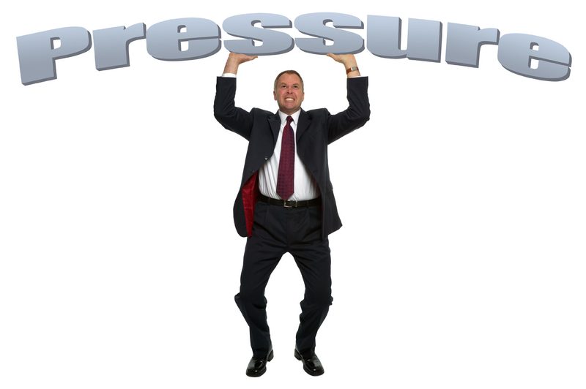
Why?
We need to practice our craft
Daily pressures make it hard to practice
Delivering new features under tight deadlines
Supporting software in production

Slide 4

What?
A coding dojo is a periodic meeting where developers practice the craft of coding together with the object of learning how to do it better.
Originated in 2004 with Emmanuel Gaillot and Laurent Bossavit out of the eXtreme Programming Meet Up in Paris

Slide 5
How?
Deliberate practice – focus on the things you don’t know
Test-Driven / Show Work
First Rule of Dojo
“One can’t discuss a form without code, and one can’t show code without tests.”
Safe Environment
Experiment
Ask Questions
No managers
Retrospective / Reflection

Slide 6

When?
Frequency / Length
Every 2 weeks, 2 hours (11 – 1 pm)
Every week, 1 hour (12 – 1pm)
Which one say you?

