Slide 1
21-1
If I had one thing to ask the professor out of the Week 1 – 6, it's a question: what's a common way that RTOS handles Mutex variables, being that Mutex variables are global variables themselves and thus subject to race conditions?

Slide 2
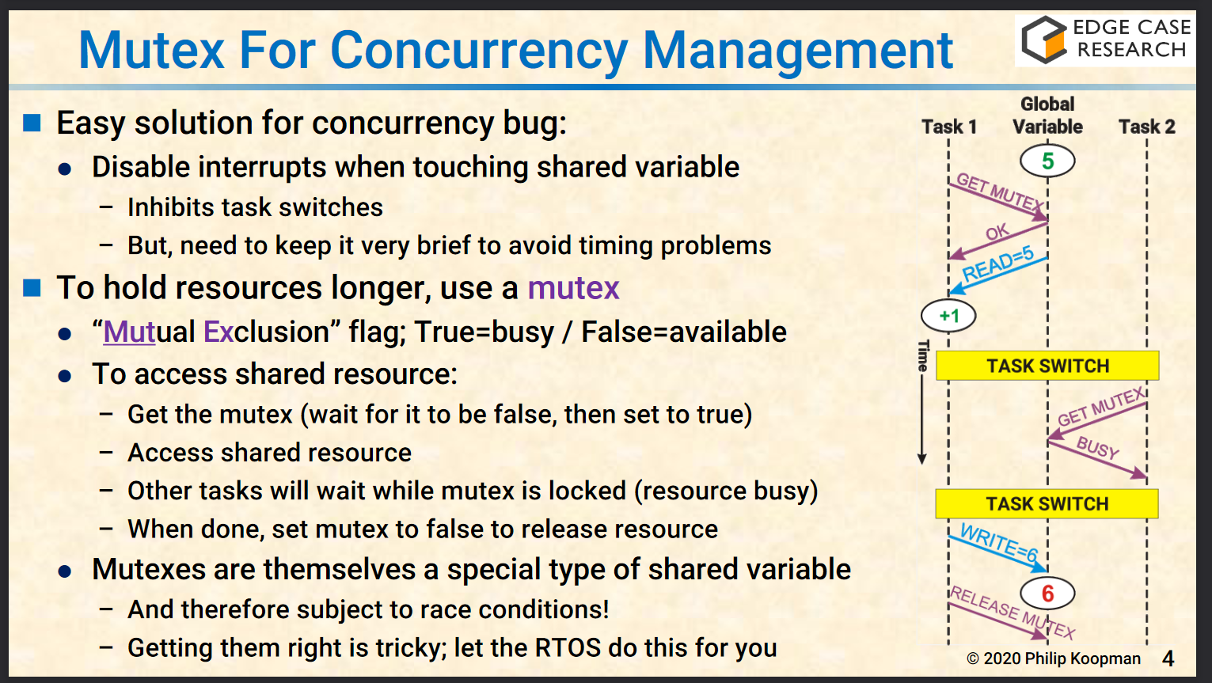
21-1

Slide 3
21-2
Unfortunately, guest speakers were not recorded, so I could not watch them online. Thus, I have no questions for the non-existent guest speakers.

Slide 4
21-3. Lect. 1 – Course Topics Overview
Software is a core competency
Product-level testing is not a fix; rather, we need good practices, development process, development skills
It only takes one bad line of code
Customers will regularly experience bugs that you will not see during testing
Good process enables good software
Good process can be the "V" system or Agile

Slide 5
21-3. Lect. 3 – SW Process
Coding is essentially 0% of creating software
Requirements change! Iterated approach is suggested
Dividing into subsystems is important
V Development Cycle
Put things on paper as you go through the Vee

Slide 6
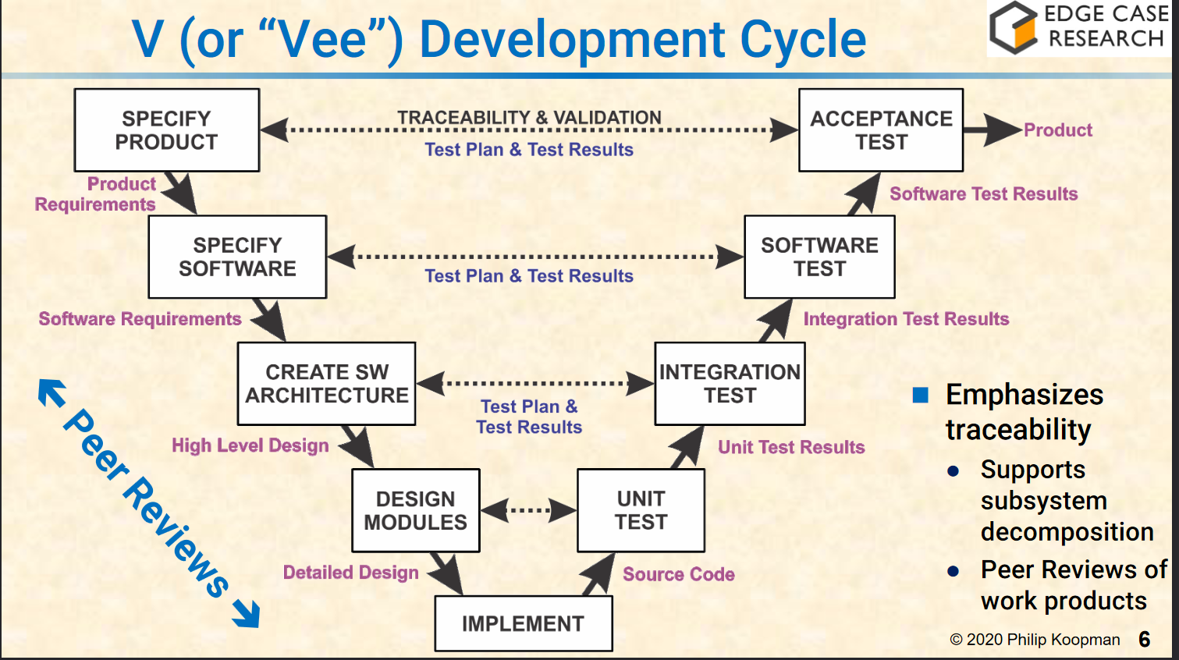
21-3. Lect. 3 – SW Process

Slide 7
21-3. Lect. 4 – Code Style for Humans
Other people MUST understand your code. Code for readability!
If it's not obviously correct, then it's wrong
Make code easy to read with consistent formatting, descriptive names, avoid magic numbers, etc.
Modularity is good!
Do not optimize unless you have performance data

Slide 8
21-3. Lect. 5 – Code Style for Compilers
A warning might mean you're doing something that's likely a bug
Do not override features designed for safe language use
Let the language help you!
Undefined or unspecified language is dangerous!
Use guidelines and tools to write secure code. Examples of guidelines and tools are MISRA, CERT Secure, static analysis tools, and dynamic analysis tools
Deviate from the language rules with CARE!

Slide 9
21-3. Lect. 6 – Peer Reviews
If peer reviews find < 50% of all bugs, then it is an anti-pattern!
FORMAL peer reviews find more bugs than testing
Fagan Style Inspections are the gold standard
methodical, in-person review meetings
Do not get defensive over your code. Nobody writes perfect code.
Limit meetings to two hours
Perspective-based review are more effective!
each participant focuses on one section
Review requirements / design as well, not just the code!

Slide 10
21-3. Lect. 7 – Requirements
Requirements need to be written in a precise, testable language
Requirements are supported within the context of the system
any conflicting requirements need to be resolved or prioritized
Requirements need to have a measurable tolerance
Requirements do NOT describe implementation; rather, requirements need to describe what the product does
Requirements must follow design constraints
Try to follow EARS: Easy Approach to Requirements Syntax
[While/Where <precondition] [when/if <trigger> then] <system> shall <response>

Slide 11
21-3. Lect. 8 – Global Variables
Global variables are evil! Only have a few read/write globals
Use of globals indicate poor modularity
Globals increase complexity
File static can only be seen inside .c file; similar to "private"
Arrange .c files based on access to data
Use accessor functions (getters / functions that increments the variable) instead of allowing access to variables directly

Slide 12
21-3. Lect. 9 – Spaghetti
Unstructured code leads to bugs, as unstructured code is generally hard to understand, test, and review
We need to limit complexity within each unit / subroutine / method
McCabe Cyclomatic Complexity (MCC) can measure each module
Maximum MCC should be in the range of 10 - 15
Strict Cyclomatic Complexity (SCC) counts complexity using their control flow (if statements / conditionals
Spaghetti Factor: SF = SCC + (Globals * 5) + (SLOC / 20)
want to be between 5-10, and don't go above 15
The purpose of the complexity measurements is to split up complex code into smaller pieces
Don't have nested if statements / don't excessively use `break`, `continue`, or multiple `returns`

