Slide 1
21-1
If I had one thing to ask the professor out of the Week 1 – 6, it's a question: what's a common way that RTOS handles Mutex variables, being that Mutex variables are global variables themselves and thus subject to race conditions?

Slide 2
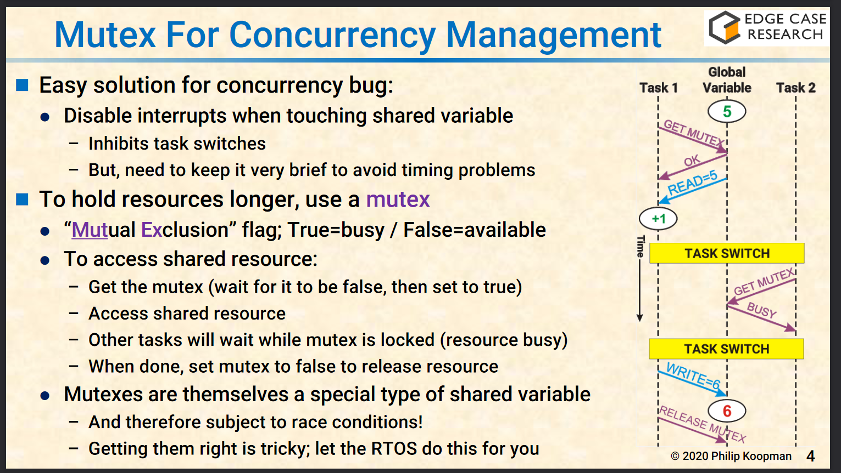
21-1

Slide 3
21-2
Unfortunately, guest speakers were not recorded, so I could not watch them online. Thus, I have no questions for the non-existent guest speakers.

Slide 4
21-3. Lect. 1 – Course Topics Overview
Software is a core competency
Product-level testing is not a fix; rather, we need good practices, development process, development skills
It only takes one bad line of code
Customers will regularly experience bugs that you will not see during testing
Good process enables good software
Good process can be the "V" system or Agile

Slide 5
21-3. Lect. 3 – SW Process
Coding is essentially 0% of creating software
Requirements change! Iterated approach is suggested
Dividing into subsystems is important
V Development Cycle
Put things on paper as you go through the Vee

Slide 6
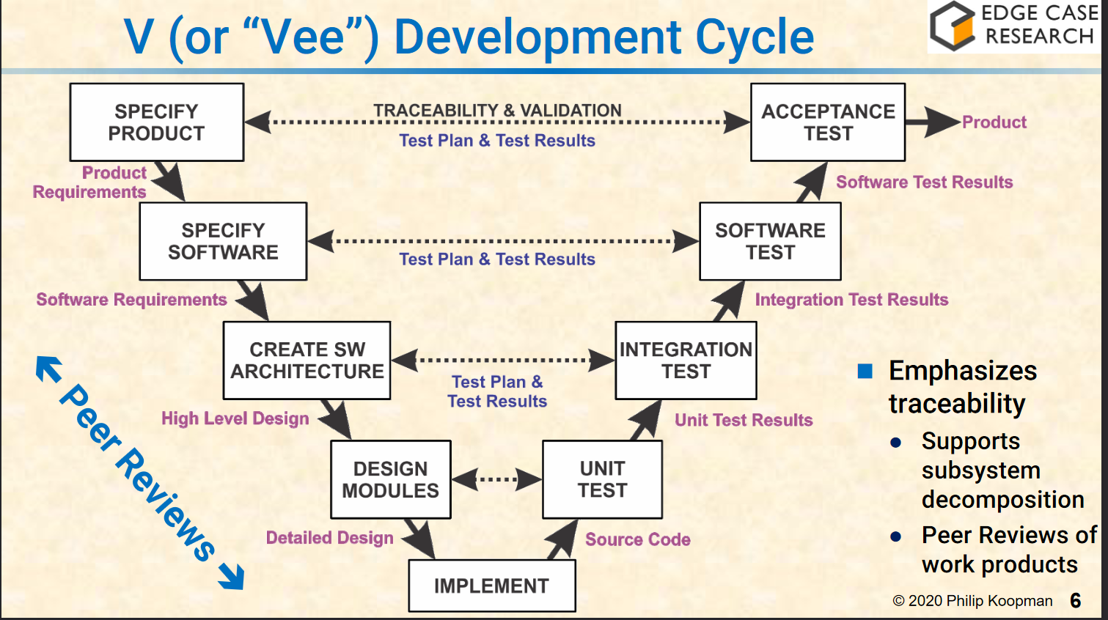
21-3. Lect. 3 – SW Process

Slide 7
21-3. Lect. 4 – Code Style for Humans
Other people MUST understand your code. Code for readability!
If it's not obviously correct, then it's wrong
Make code easy to read with consistent formatting, descriptive names, avoid magic numbers, etc.
Modularity is good!
Do not optimize unless you have performance data

Slide 8
21-3. Lect. 5 – Code Style for Compilers
A warning might mean you're doing something that's likely a bug
Do not override features designed for safe language use
Let the language help you!
Undefined or unspecified language is dangerous!
Use guidelines and tools to write secure code. Examples of guidelines and tools are MISRA, CERT Secure, static analysis tools, and dynamic analysis tools
Deviate from the language rules with CARE!

Slide 9
21-3. Lect. 6 – Peer Reviews
If peer reviews find < 50% of all bugs, then it is an anti-pattern!
FORMAL peer reviews find more bugs than testing
Fagan Style Inspections are the gold standard
methodical, in-person review meetings
Do not get defensive over your code. Nobody writes perfect code.
Limit meetings to two hours
Perspective-based review are more effective!
each participant focuses on one section
Review requirements / design as well, not just the code!

Slide 10
21-3. Lect. 7 – Requirements
Requirements need to be written in a precise, testable language
Requirements are supported within the context of the system
any conflicting requirements need to be resolved or prioritized
Requirements need to have a measurable tolerance
Requirements do NOT describe implementation; rather, requirements need to describe what the product does
Requirements must follow design constraints
Try to follow EARS: Easy Approach to Requirements Syntax
[While/Where <precondition] [when/if <trigger> then] <system> shall <response>

Slide 11
21-3. Lect. 8 – Global Variables
Global variables are evil! Only have a few read/write globals
Use of globals indicate poor modularity
Globals increase complexity
File static can only be seen inside .c file; similar to "private"
Arrange .c files based on access to data
Use accessor functions (getters / functions that increments the variable) instead of allowing access to variables directly

Slide 12
21-3. Lect. 9 – Spaghetti
Unstructured code leads to bugs, as unstructured code is generally hard to understand, test, and review
We need to limit complexity within each unit / subroutine / method
McCabe Cyclomatic Complexity (MCC) can measure each module
Maximum MCC should be in the range of 10 - 15
Strict Cyclomatic Complexity (SCC) counts complexity using their control flow (if statements / conditionals
Spaghetti Factor: SF = SCC + (Globals * 5) + (SLOC / 20)
want to be between 5-10, and don't go above 15
The purpose of the complexity measurements is to split up complex code into smaller pieces
Don't have nested if statements / don't excessively use `break`, `continue`, or multiple `returns`

Slide 13
21-3. Lect. 10 – Toyota UA Case
In the late 2000s, Toyota has many 89 unattended acceleration cases
NASA found no "smoking gun"
Impractical to test everything at the vehicle level
US Car manufacturers do not have a standard / certification requirement for software
No MISRA!
Looks like static analysis was not used during development
Watchdog does not detect death of major tasks, including “Task X”
Task X includes throttle angle calculation & most failsafes

Slide 14
21-3. Lect. 11 – Stack Overflow
Recursion is an anti-pattern for stack overflow
We need to handle worst-case stack size
Stack Overflow: if stack gets too big, it stomps on other memory
Static analysis tools can figure out maximum stack depth
Use "Stack Sentinels" to check at runtime
Use Memory Management Unit (MMU) hardware protection if you have it

Slide 15
21-3. Lect. 12 – Software Architecture and High Level Design
Going from requirements to code is an anti-pattern
Elements of high level design includes architecture (boxes, arrows, interfaces)
HLD = <architecture (nouns)> + <requirements (verbs)>
Software architecture shows the big picture
Each Sequence Diagram (SD) shows a scenario
SD is a partial behavioral description for objects
Use Case → Sequence Diagram: use case is a type of interaction, SD is a specific scenario / interaction design
Statecharts is a design that incorporates ALL scenarios

Slide 16
21-3. Lect. 13 – System & Statecharts
An anti-pattern is no detailed design, just code
Statecharts describe the software finite state machine
A statechart has:
set of states with side effects
set of guards that cause transitions (no side effects on transitions!)
need an initial state
Statecharts for stateful code makes it easier to map to switch statement
Move complex behaviors to per-state subroutine helper functions

Slide 17
21-3. Lect. 14 – Traceability
Tests need to map to requirements
Verification: Requirement ↔ Design; you did something the way you said you would do it
Validation: Requirement ↔ Test; the thing you created behaves the way it should
Ensure nothing is added that should not be there
Trace everything in design package
everything in design has an ID tag for traceability
Use the correct tool
Spreadsheets are good for smaller projects, but they do not scale to big projects

Slide 18
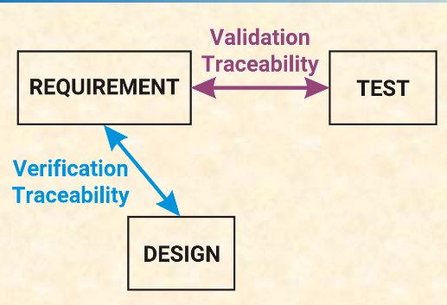
21-3. Lect. 14 – Traceability

Slide 19
21-3. Lect. 15 – Software Testing Overview
A workload is applied to SW under test. This result then gets compared to an oracle and check if SW matches oracle
We need to have a defined notion of testing coverage
Do not use unstructured testing approaches, such as "smoke tests" or "exploratory" testing
Need to use methodical testing approaches: a combined approach of white box + black box testing
Black box = use requirements to guide test design; exercise all code functions.
White box = use structure of code to guide test design; exercise all paths through code.
Testing all data is impractical; 100% passing test is not 100% bug free

Slide 20
21-3. Lect. 16 – Unit Testing
For unit testing, need to test all paths (not just "happy" paths)
Unit testing tests a single subroutine / procedure /method
unit = "code module"
Best way to catch boundary-based bugs
Use both white & black box testing
Coverage is a metric for how thorough testing is
Unit Test Coverage strategies: boundary tests & exceptional values, (NULL, NaN, etc)

Slide 21
21-3. Lect. 17 – Integration Testing
Need traceability from integration test to High Level Design (HLD)
Testing component integration: exercise all component interfaces
We also need to observe intermediate, output arcs, and documented side effects
Concentrate on component interactions (let unit test tests each component); observe module interactions
Exercise all interfaces. Use SDs and HLD info to drive testing
Interaction test coverage: are all arcs on SDs exercised?
Integration test "passed" is also based on output, if all arcs appear, and if the timing is appropriate
Integration testing should exercise "message" structure
HLD will have the message dictionary

Slide 22
21-3. Lect. 18 – System Level Test
Excessive defect should not "escape" to field testing
System-level "acceptance test" emphasizes customer-type usage
System test plan covers ALL requirements
For an embedded system I/O, we can use a HAL and swap in simulator
Bugs found in system test is a PROCESS failure
System requirement defects should be most of what you find
Testing fault management is hard if you haven't planned for it

Slide 23
21-3. Lect. 19 – Race Conditions
Shared variables need protected access, and they need to be declared volatile.
Race condition: multiple threads compete for the same resources
Concurrency bugs can happen due to shared resources
or what if CPU switches at the wrong time?
Disable interrupts for short tasks, use Mutexes so that you can hold resources longer
Blocking Time: high priority tasks can miss deadlines
Priority Inversion: Low priority task blocks high priority task
Unbounded priority inversion: medium priority task blocks high task without ever touching the mutex
Priority Inheritance: task priority elevated when locking mutex; restored when freeing mutex

Slide 24
21-3. Lect. 20 – SQA Isn't Testing
5-6% of effort should be spent on Software Quality Assurance (SQA)
SQA define & maintain software process definition
Audit to ensure process is being followed
Coach / intervene to fix process failures
Every process step produces lightweight artifacts
If it is not written down, it did not happen
SQA keeps records & metrics to ensure process is on track
SQA must have a broad view of quality

