Slide 1
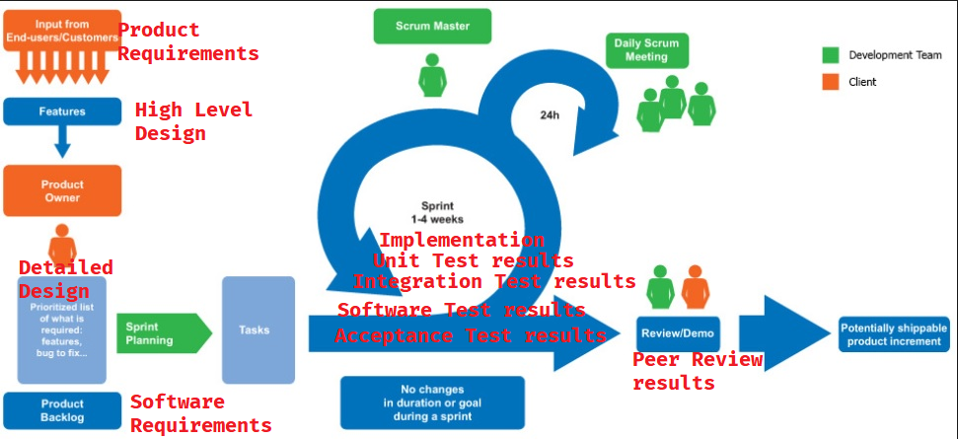
Agile technique: Scrum
Link:
http://www.softwaretestingstudio.com/wp-content/uploads/2016/10/Agile-Scrum-process.jpg

Slide 2
Scrum Sprint ends; get any new requirements
Peer Review Results
Product Requirements
High Level Design
Implementation
Acceptance Test Results
Software Requirements
Detailed Design
Unit Test Results
Software Test Results
Integration Test Results

