Slide 1
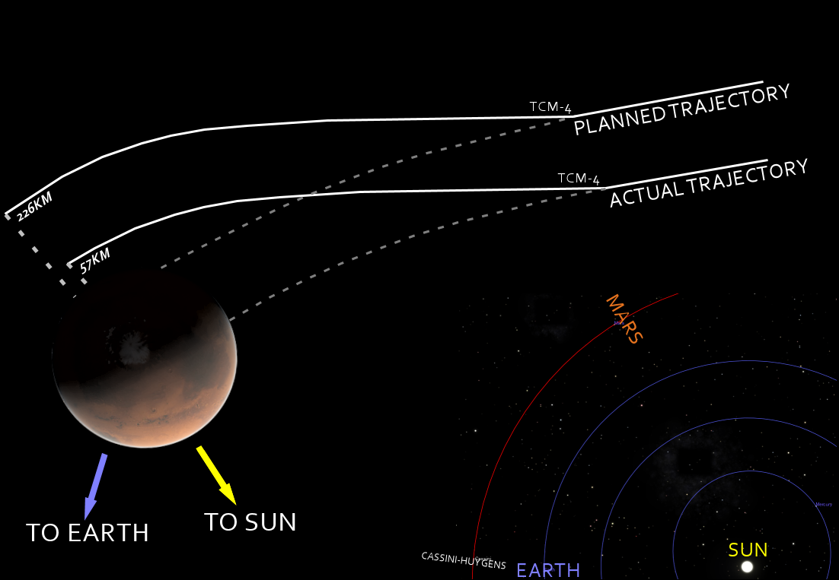
7: Mars Climate Orbiter (1998). Contact with the spacecraft was never re-established 10 minutes after the spacecraft passed behind Mars. Findings of the failure review board indicate that a navigation error resulted from some spacecraft commands being sent in English units instead of being converted to metric.
Loss: $327.6 million total: $193.1 million for spacecraft development, $91.7 million for launch, and $42.8 million for mission operations
Technical cause: Spacecraft commands being sent in English units (feet, inches, etc.) instead of being converted to metric.
In my opinion, if they used proper typedef or proper enum classes then the failure would be avoided
Link: https://upload.wikimedia.org/wikipedia/commons/8/83/Mars_Climate_Orbiter_-_mishap_diagram.png

