Slide 1
13-1a
I used https://app.diagrams.net/

Slide 2
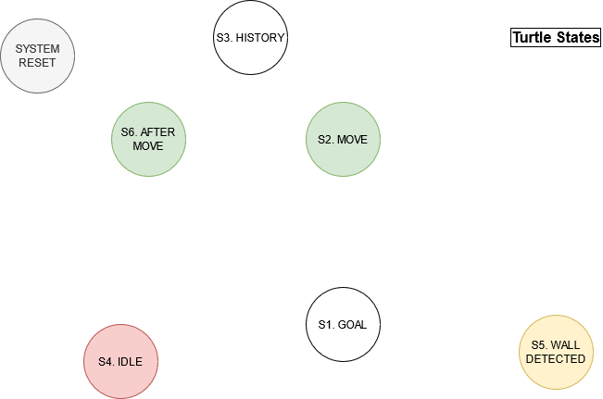
13-1b. States

Slide 3
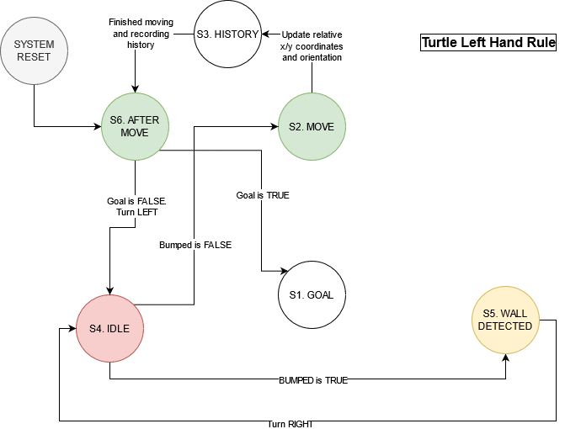
13-1c. Left Hand Rule

Slide 4

13-1d. Right Hand Rule

Slide 5
13-1e
I only had to change 2 arcs for the right-hand rule behavior. The only thing that's different is the direction the turtle turns from the S6. AFTER MOVE state to S4. IDLE state, and the direction from S5. WALL DETECTED state to the S4. IDLE state.
The experience will make changing the code significantly easier, as the only code that will have to be changed is the orientation, and not the actual algorithm itself.

