Slide 1


Degrees of Climate Change Project Summary
5 June 2018
Todd Schultz, Rahul Birmiwal, Abhishek Anand

Slide 2
Outline
Background
User persona/Research Questions
Data Sources
Demo
Design
Project Structure. Show the structure of your github repository.
Lessons learned and future work

Slide 3
Background
Climate change, fundamentally, is defined by
Historical changes in statistical properties of a climate system(s)
Often measured by sample mean/sample variance (spread) of historical global temperatures
Does climate change equal global warming and what caused it?
Ramifications reach to the ability of planet to support life
Corrections cost enormous sums of money
Corrections threaten entire industries and nations
What’s the true in the data?
Factbook database, such as the World Bank, is "centrist"; perhaps that from
NOAA (National Oceanic and Atmospheric Administration), or Berkeley Earth given their sources of funding as bastions of progressive change, are biased towards data evincing global warming
China, Russia, the Middle East, whose economies wholly depend on the prolonged sustenance of oil, tend towards conservative climate estimates

Slide 4
Background
So who watches the watchers?

Slide 5
Sally the Scientist, Activist
Concerned about climate change
Professional scientist, engineer, or mathematician
Self exploration
Novice with computer languages
Novice with web service technology

Slide 6
Research Questions
What is the average global temperature from a certain agency?
How does the estimates from various agencies compare?
How do I add another agency’s estimate?
What other quantities correlate to the average global temperature?

Slide 7
Data Sources
NOAA (https://www.ncdc.noaa.gov/cag/global/time-series)
Berkeley Earth (http://berkeleyearth.org)
The World Bank (http://data.worldbank.org)

Slide 8
National Oceanic and Atmospheric Administration (NOAA)
Scientific agency within the National Oceanic and Atmospheric Administration
Historic record goes back to 1850
Provided calculated global average temperature anomalies
Earth divided into blocks
Computed average temperature for each block
Normalized to the 20th century average
Calculated estimates provided monthly
Zhang, H.-M., B. Huang, J. Lawrimore, M. Menne, Thomas M. Smith, NOAA Global Surface Temperature Dataset (NOAAGlobalTemp), Version 4.0 NOAA Global Surface Temperature Data. NOAA National Centers for Environmental Information. doi:10.7289/V5FN144H.

Slide 9
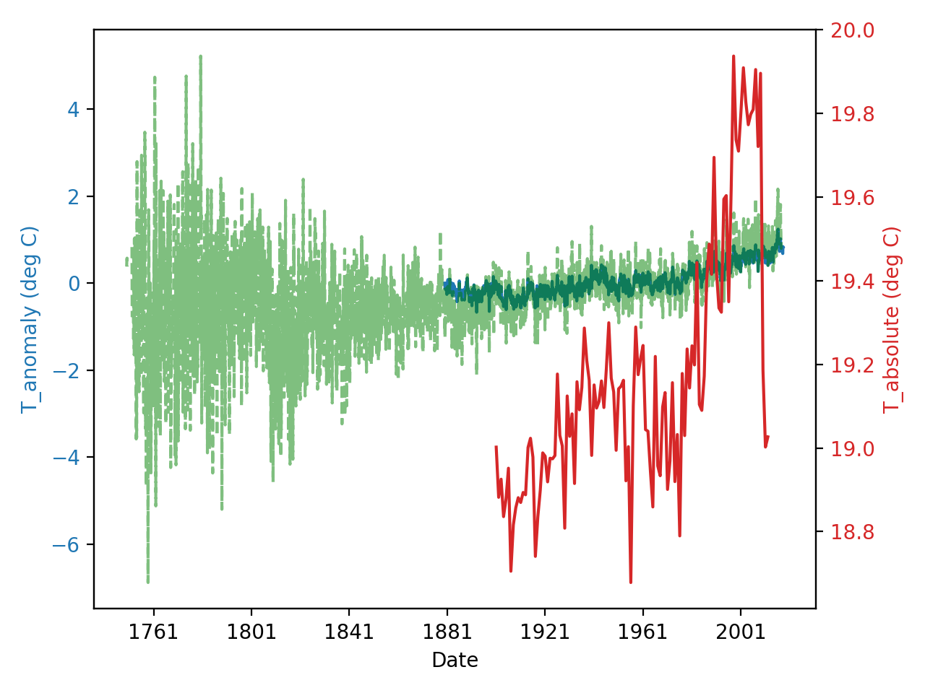
Demo

Slide 10
Design

Slide 11
Project Structure

Slide 12
Lessons Learned
Setting up imports to work with modules in different folders can be challenging
Setting up imports to work with Travis CI can be challenging

Slide 13
Future Work
Additional data sources
Increase geopolitical diversity of data source origins
Add potential causal data sources
CO2 emissions
Solar activity
Improve data handling and visiualizatons

