Slide 1
Rahul's slides

Slide 2
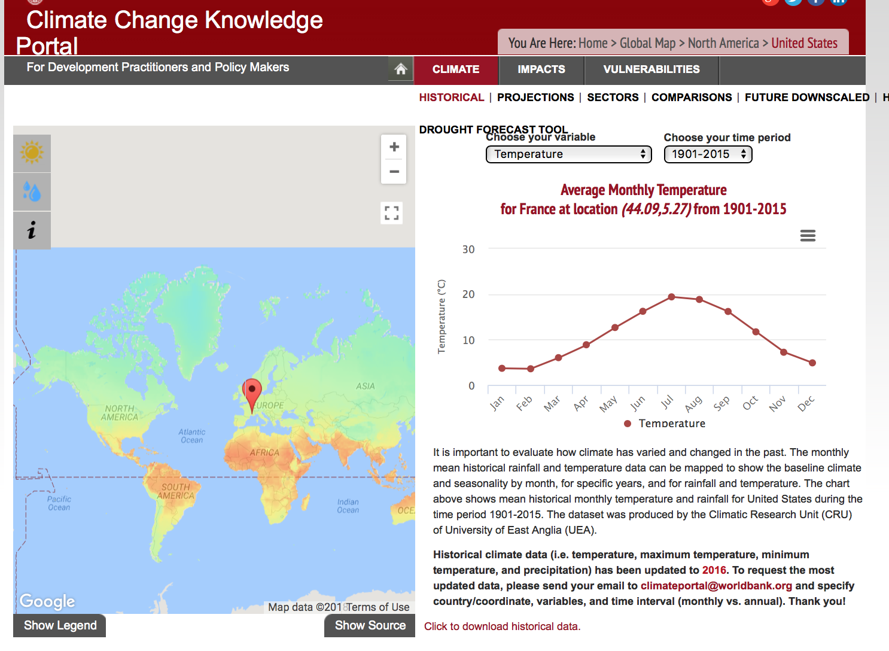
WorldBank Data
Multinational partnership amongst 170 countries worldwide
Seeking to improve improve global welfare.
Akin to the famous CIA World Factbook, the Worldbank provides data repositories for various things:
Population
Health
Social demographics
Economics
Education
Climate data!!

Slide 3
Interfacing via 'wbpy' library
'wbpy' --> class wrapper to access datasets of the Worldbank
Defines multiple .get(foo) functions, where foo is a query on a/many indicator(s) from the World Bank dataset
·population_indicators = api.get_indicators(search="population")
Pros
Single method calls to do the equivalent of multiple API requests, makes for much more readable and repeatable code
Supports both ISO 1366 alpha-2 and alpha-3 country codes. Most standard API wrapper libraries only support alpha-3 ISO codes. i.e. wbpy supports 'legacy format' regarding the ISO-3166 standard
This support of arbitrary inputs would be helpful if say, Sally is elderly and used to the ancient format!
Automatically fills in missing dates within a queried time interval (if necessary)

Slide 4
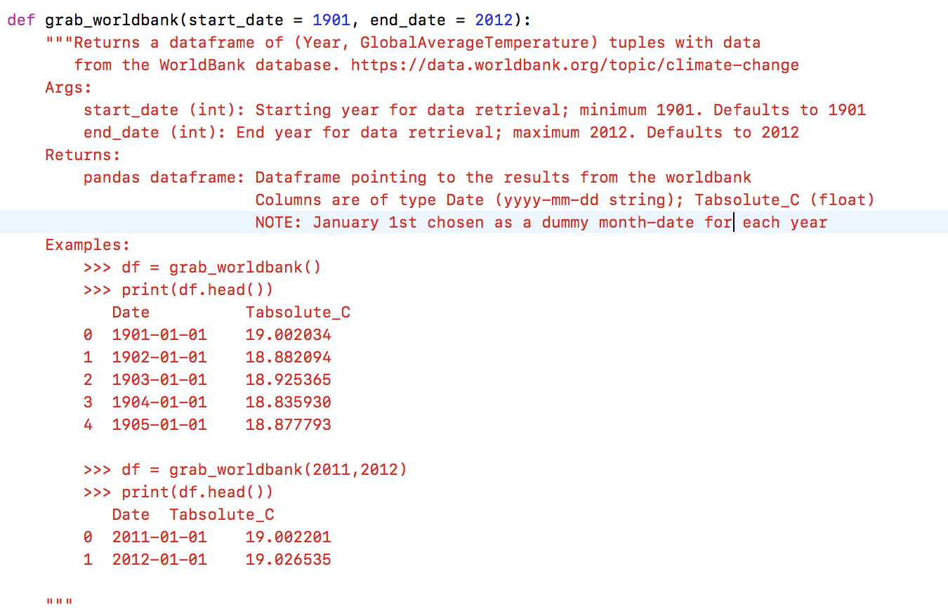

Slide 5
Climate Data: Scripps Institute
Original project design: incorporate auxiliary climate data
Latest climate buzzwords:
Global warming
CO2 emissions
Not assuming any bias or political slant here, but...still...
Exploratory data analysis

Slide 6
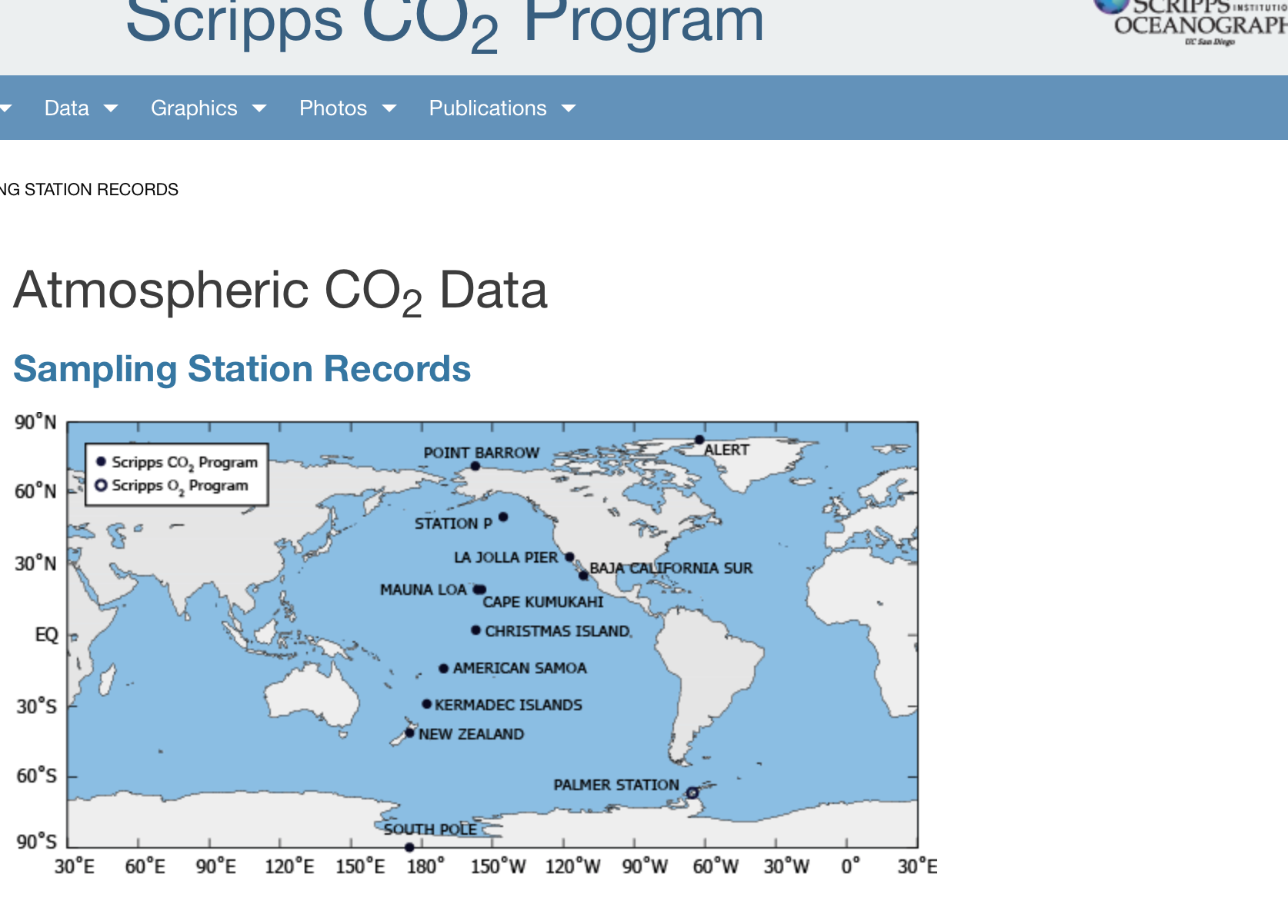
Climate Data: Scripps Institute
The Scripps Institute for Oceanography is a heralded forum for carbon dioxide research.
Founder, Charles Keeling, is considered by many to first have alerted the world to the potential risks of greenhouse gas emissions.
Scripps has several sampling stations in the western hemisphere to gather CO2 data in parts per million

Slide 7
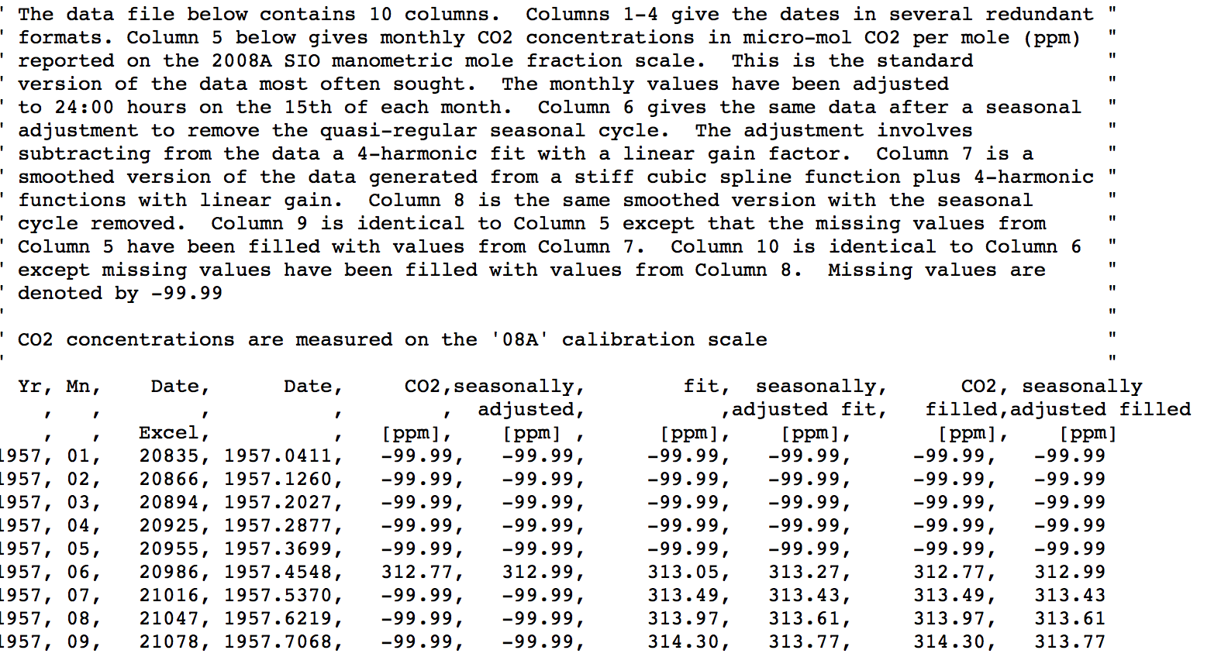
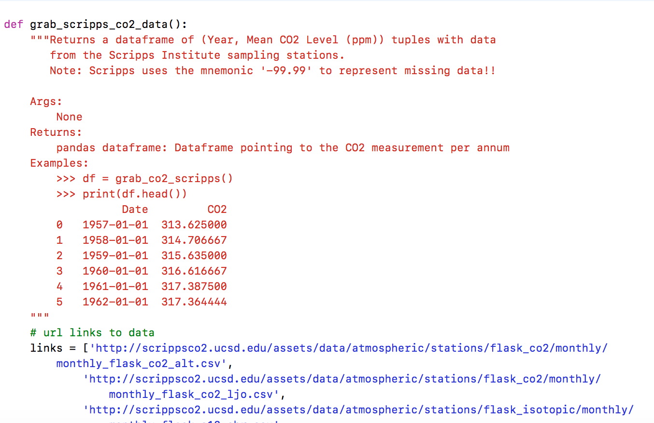

Slide 8
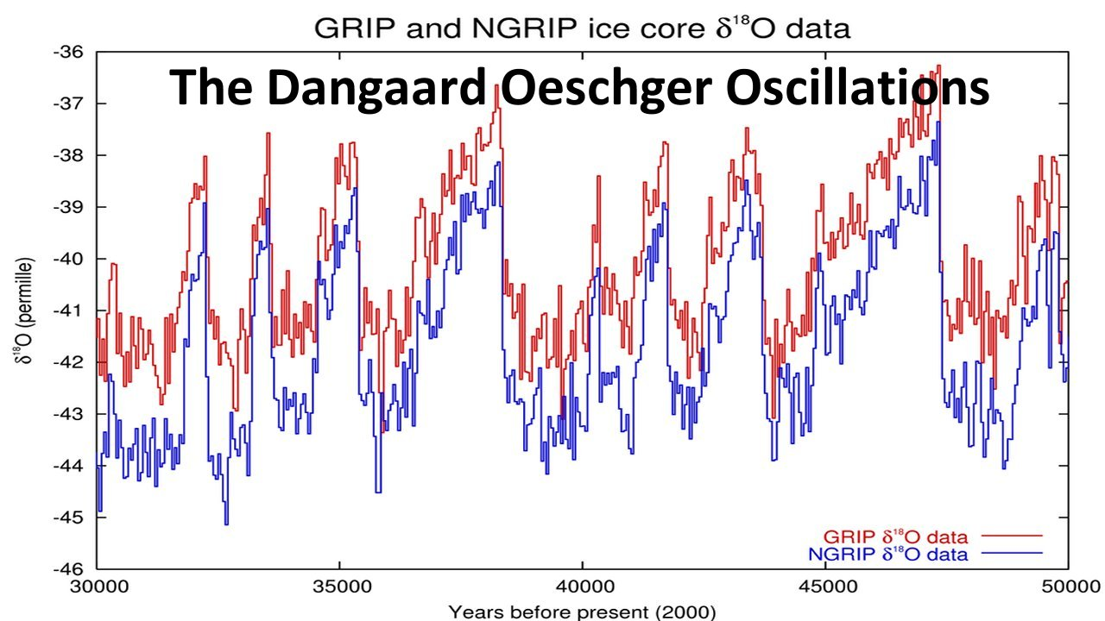
Future Work: Need Longer-Dated Climate & Temperature Data
Temperature Proxy
http://ice-age-ahead-iaa.ca/scrp-awake/laba027.htm

Slide 9
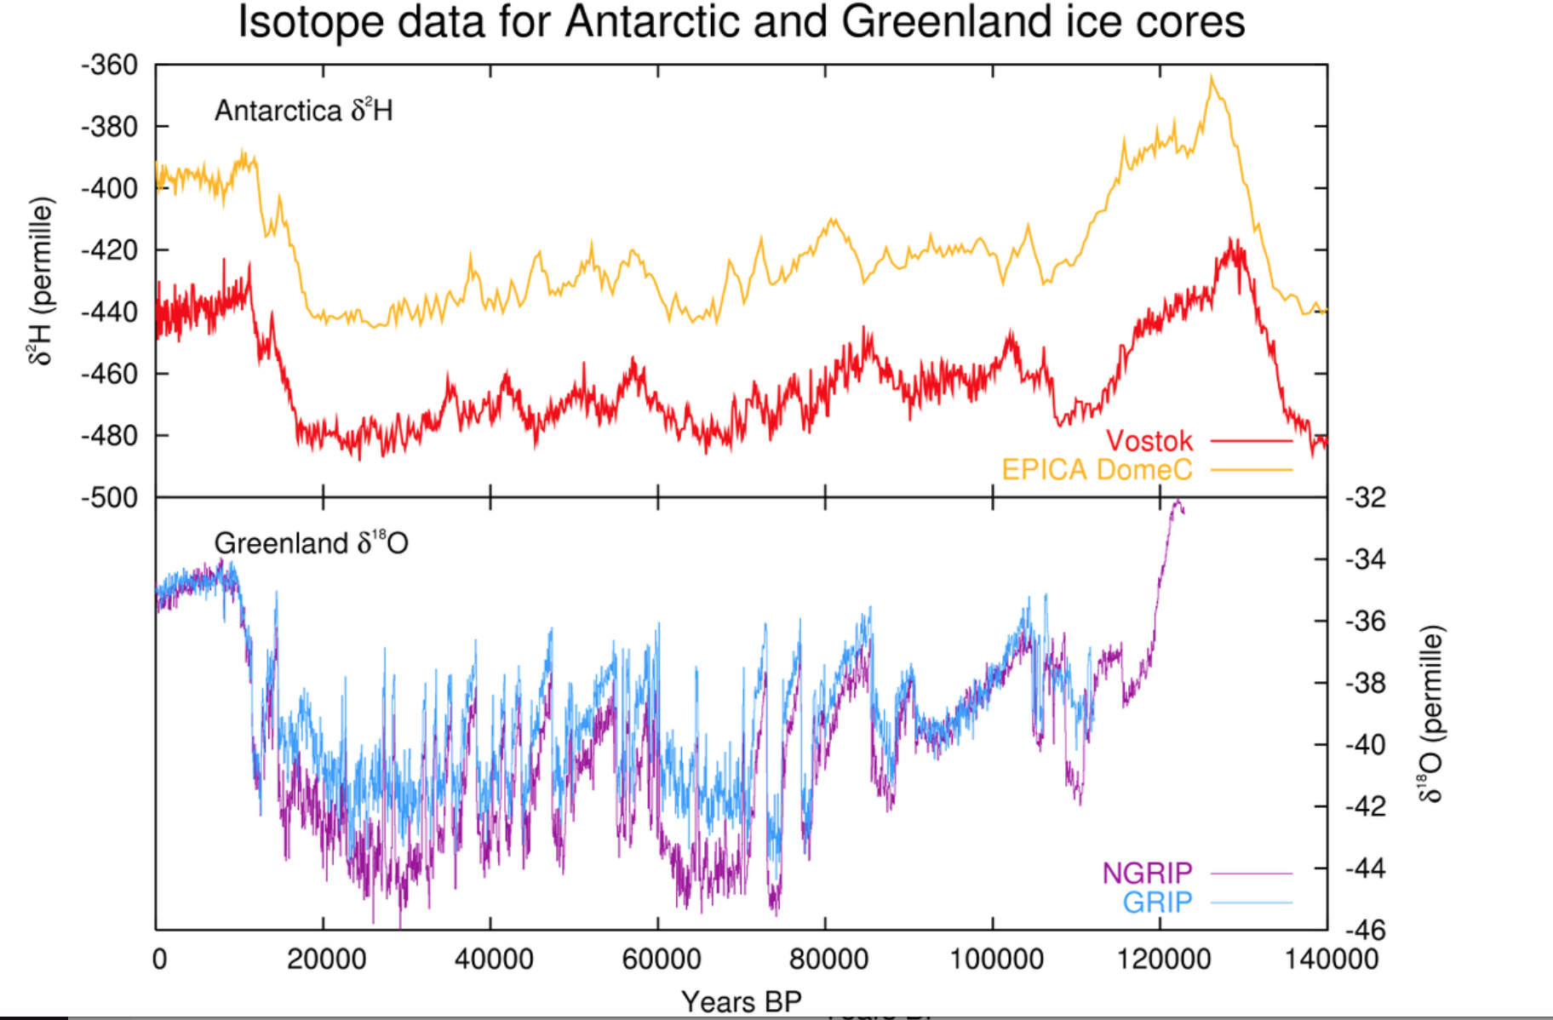
Data does not go back far enough!!
What if......our current data is biased I.e. we are only sampling in an "upswing"
Temperature Proxy
https://en.wikipedia.org/wiki/Dansgaard–Oeschger_event
Present
Prehistoric Age

