Slide 1
Environmental Noise Contamination Detection
Todd Schultz, Rahul Birmiwal, Sean Miller
20 Feb 2019
Notes:
Plan for only 20 minutes of content

Slide 2
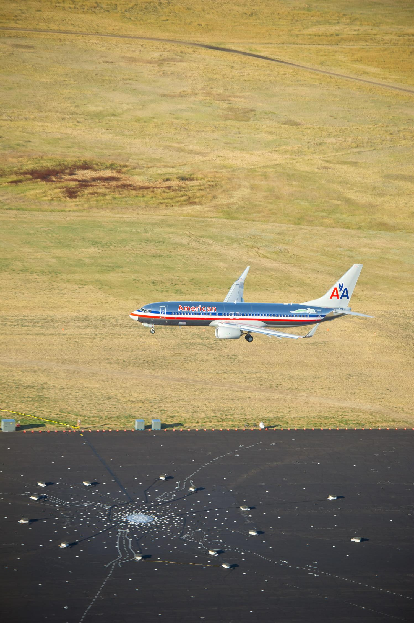
Project Motivation
Noise reduction is being targeted by regulatory agencies around the world
Community noise testing is expensive
Noise certification testing done at remote locations
Noise contamination still possible from birds, insects, livestock, wildlife, and road traffic
Noise contamination can increase recorded noise levels
Personnel used to monitor recordings for contamination

Slide 3
Project Goal
Research the feasibility of automating the detection of environmental noise contamination contained in acoustic measurements for aircraft community noise testing
Investigate wide range of feature and model types
Document performance and recommendations to proceed
Bird 01
Plane 08

Slide 4
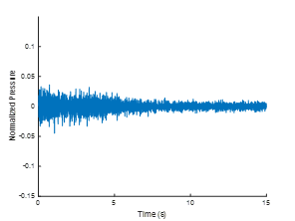
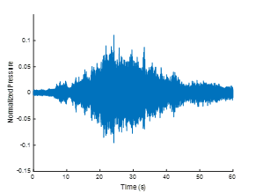
Data Example-Time Series
Bird 01
Plane 08

Slide 5
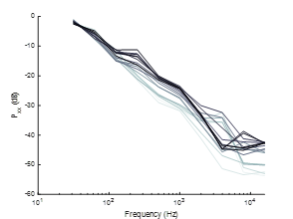
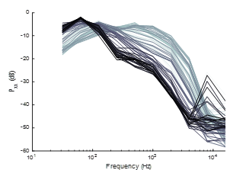
Data Example-Octave Spectrum
Bird 01
Plane 08

Slide 6
Data

Slide 7
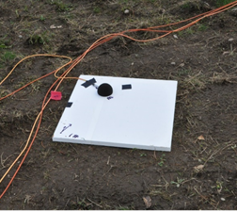
Data
66 audio files from Boeing Test & Evaluation
Wave file recordings
Anonymized by an unknown normalization factor
49 aircraft (737, A350, Q400 turboprop, etc)
10 ambient
7 contamination
6 audio file from US National Parks Service
Public domain data
Non-consistent sampling rate and uncalibrated levels
Crickets, bison, common raven, sparrow, Steller’s jay, and yellow-rumped warbler
Total of 233 MB of audio

Slide 8
Project Challenges
How to turn audio recordings into features?
Separate into blocks
Process each block for features
Accumulate feature sets as function of time
Does this make streaming processing difficult later?
How to quantify contamination levels?
Only use audio recordings that are of only a single noise source
Combine aircraft or ambient with contamination examples to create contaminated audio
Allows for control of signal-to-noise ratio

Slide 9
Data Preprocessing

Slide 10
Working With Audio Files
For each audio signal
t

Slide 11
Working With Audio Files
Separate into (overlapping) blocks

Slide 12
Working With Audio Files
Stack the blocks
t

Slide 13
Working With Audio Files
Add contamination (adjust levels of each block to achieve SNR)
a₁
a₂
+
=
a_{n}

Slide 14
Working With Audio Files
Generate features
f(x)

Slide 15
Working With Audio Files
Train the model
g(x)
model

Slide 16
Feature Set and Model Exploration

Slide 17
Initial Broad Investigation-Features
Octave Spectrum
Full octave with 10 features
⅓ octave with 29 features
Mel-frequency Cepstral Coefficients
13 features
Modified Mel-frequency Cepstral Coefficients
Extended frequency range up to 20 kHz
13 features
26 features
FFT
∆f = 25 Hz with 799 features
∆f = 100 Hz with 200 features
Continuous Wavelet Transform
Scalograms
Scalograms bag-of-features with 500 features
Discrete Wavelet Transform
Wavelet Variance (Percival UW)
Shannon entropy
Mean/SD of subband coefficients
Coiflet, Haar, Daubechies
2-5 levels of transform
7, 13, 17, 49 features

Slide 18
Initial Broad Investigation-Models
Logistic Regression
Trees
Fine
Medium
Coarse
SVM
Linear
Quadratic
Cubic
Gaussian (Fine, Medium, Coarse)
Ensembles / Forests
Boosted
Bagged
Subspace KNN
Neural Nets
Shallow
Convolutional
Long Short Term Memory

Slide 19
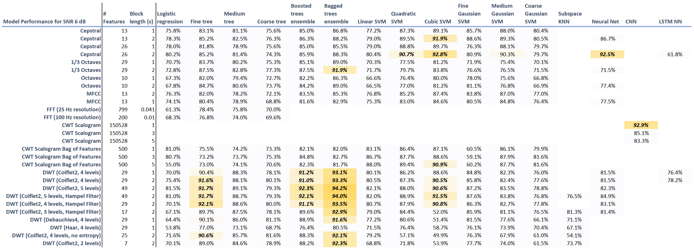
Broad Investigation Results

Slide 20
Observations/Comments
If accuracy is low, confusion matrix tends to be skewed with high false negative rate
Conventional models and shallow neural networks achieve >90% accuracy
Long short term memory network not performing as expected
Likely requires creating unique, varying input sequences for training
GPUs only necessary for training convolutional neural network

Slide 21
Remaining Project Work

Slide 22
Remaining Work
Down select to only 3 feature/model combinations
Optimization of model hyperparameters
Increase performance metric to include
Accuracy
F1 score
False positive rate
False negative rate
Detailed study of performance for:
Varying SNR
Percent of signal block contaminated
Randomization of blocks contaminated
Monte Carlo simulation of randomized parameters
To simulate real-world scenario

Slide 23
Select Feature/Models
Wavelets (Coiflet2, 5 level, T=2s)/bagged trees
Best overall with accuracy of 94.2% (best overall)
Wavelets (Coiflet2, 4 level, T=2s)/bagged trees
Accuracy of 93.3% (4rd best overall)
Cepstral (26 feature T=2 s)/cubic SVM
Best non-NN, non-wavelet performer with accuracy of 92.8% (7th best overall)
Coiflet2: Coiflet wavelet with 2 vanishing moments
T = 2s: block length

Slide 24

Work Tracking
Using Trello to track our work
Agile Tools
5 Story Points = ~ 1 Week of Work
~60 points of work remaining after 2/6
Workflow
Stories are added to separate backlog lists
Stories are moved to In Progress
Stories are closed or removed

Slide 25
Remaining Work
Epic | Story Points
In Progress - Feature Set | 1 points
In Progress - Documentation | 7 points
In Progress - Course Assignments | 3 points
In Progress - Machine Learning | 5 points
Poster Session | 6 points
Machine Learning | 25 points
Literature Review | 2 points
Documentation | 6 points
Course Assignments | 3 points
Notes:
The bulk of our remaining work will be deeply exploring the three feature set-model combinations that performed the best in our broad exploration
After that, the paper as well as our poster comprise most of our work.

Slide 26
Q&A

